Slide 1
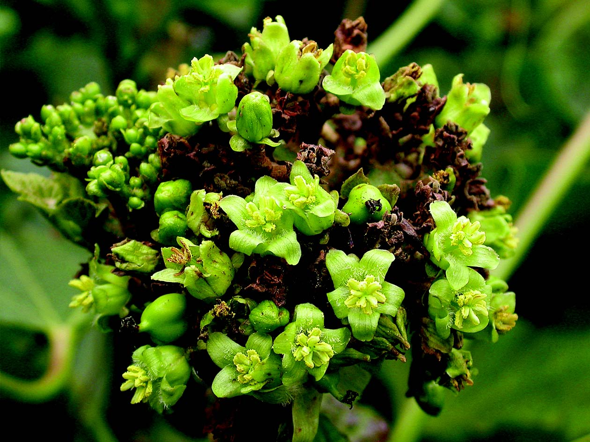
BIO DIESEL
Dr. A. MAAJITHA BEGAM
ASSISTANT PROFESSOR OF BOTANY
HAJEE KARUTHA ROWTHER HOWDIA COLLEGE
UTHAMAPALAYAM
THENI DISTRICT
TAMILNADU

Slide 2
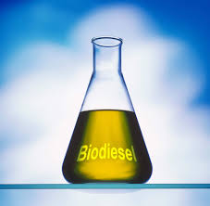
Biodiesel - Introduction
Biodiesel is a clean burning oil manufactured from fat or vegetable oils by transesterification process.
It is not petroleum origin
It is biodegradable
Non-toxic
Free from sulphur and aromatics
Used with no or little modification

Slide 3
Fuel engines designed till 1993 could not use 100 % biodiesel because they had rubber seals
Modern engines does not have the rubber seal so that 100% biodiesel can be used
It is used to run vehicles, generators, boats and so on.
Biodiesel can be produces from algae and many plants

Slide 4
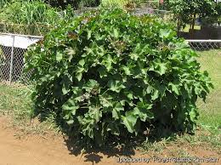
Jatropha
Bio fuel is prepared from plant oils. It is known as biodiesel.
Jatropha curcus
Euphorbiaceae
3 to 5cm in height
Lobed leaves with spiral phyllotaxy
Fruits produced after a year of plantation
Plant can grow anywhere.

Slide 5
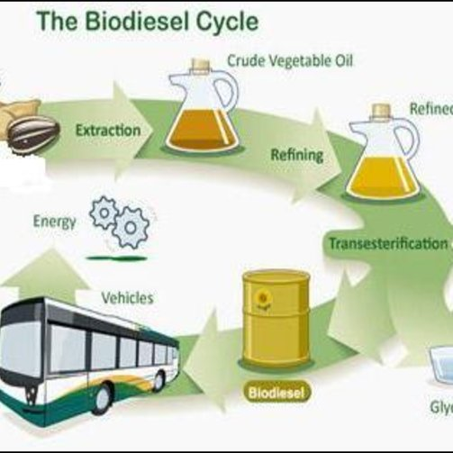
Production of Bio diesel involves the following steps
Preparation of Jatropha Seeds
Extraction of Oils
Purification of Oils
Transesterification

Slide 6
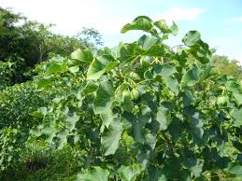
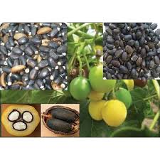
jatropha CURCUS

Slide 7
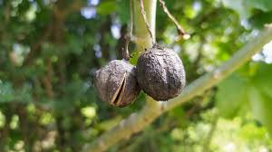
Preparation of seeds and extraction
Plucking of ripened fruits
Decorticated
sundried

Slide 8
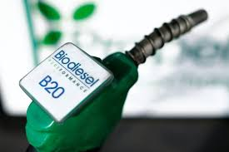
Mechanical Extraction by screw press / Solvent extraction/ Sox-let extraction
Removal of suspended particles by filtration
Boiled with 20% of water
Decantation
Boiling
Decantation

Slide 9
transesterification
NaOH/KOH mixed with methanol
Dissolve hydroxide
Sodium methoxide/Potassium methoxide
Sodium methoxide mixture is added to hot Jatropha Oil
Mixed well for 10 mins

Slide 10
Transesterfication
Methanol reacts with the fatty acids of the jatropha oil to produce mono alkyl ester (biodiesel) and glycerol.
Transesterification - One alcohol is displaced from an ester by another alcohol
Allowed to sediment for 8 -24 hrs
Glycerol settled at bottom and it is drained off
NaOH & KOH acted as Catalyst

Slide 11
Overall process
Sodium hydroxide + Methanol Sodium methoxide
Sodium methoxide + Jatropha Oil Mono alkyl ester (Biodiesel) + Glycerol
Jatropha Oil + Methanol + NaOH Glycerol + BIodiesel

Slide 14
THANKS

