Slide 1
Formulas, Ranges, and Functions
STAFF NAME : R.ABIRAMAKRISHNAN..
ASSISTANT PROFESSOR
PG DEPARTMENT OF COMMERCE CA,
HKRH COLLEGE,UTHAMAPALAYAM

Slide 2
Formulas
Formulas perform operations such as addition, multiplication, and comparison on worksheet values.
Formulas can refer to other cells on the same worksheet, cells on other worksheets in the same workbook, or even cells on worksheets in other workbooks.
Formulas may make use of built-in functions.

Slide 3
Excel knows you are entering a formula in a cell because every formula starts with an = sign.
If you forget the = sign, what you enter will be treated as text (unless it can be interpreted as a number in some format).

Slide 4
The following example adds the value of cell B4 to 25 and then divides the result by the sum of cells D5, E5, and F5.
= (B4+25)/SUM(D5:F5)

Slide 5
This example illustrates the use of
The cell reference B4
The numerical constant 25
Arithmetic operators + and /
The use of parentheses to specify order of calculation
The built-in SUM function
A range reference D5:F5

Slide 6
About formula syntax
Formulas calculate values in an order based on usual mathematical conventions.
You can always add parentheses to control the order of calculation.
For example, 4+3*2 is interpreted as 4+(3*2), which is 10.
If you want the addition done first, use (4+3)*2, which is 14.

Slide 7
Calculation operators in formulas
Operators specify the type of calculation that you want to perform on the elements of a formula.
Microsoft Excel includes four different types of calculation operators: arithmetic, comparison, text, and reference.
Reference operators are used in range references, and we examine them later.

Slide 8
Arithmetic operators perform basic mathematical operations such as addition, subtraction, or multiplication; combine numbers; and produce numeric results.

Slide 9
Arithmetic operator
+ (plus sign)
– (minus sign)
* (asterisk)
/ (forward slash)
% (percent sign)
^ (caret)
Meaning and Example
Addition 3+3
Subtraction 3-1 or Negation -1
Multiplication 3*3
Division 3/3
Percent 20%
Exponentiation 3^2

Slide 10
Comparison operators compare two values and then produce the logical value TRUE or FALSE.
Comparison operator
= (equal sign)
> (greater than sign)
< (less than sign)
>= (greater than or equal to sign)
<= (less than or equal to sign)
<> (not equal to sign)
Meaning & Example
Equal to A1=B1
Greater than A1>B1
Less than A1<B1
Greater than or equal to A1>=B1
Less than or equal to A1<=B1
Not equal to A1<>B1

Slide 11
The comparison operators are often used with certain built-in functions like IF to produce a numeric result.
For example,
IF(A1>B1,5,0)
would yield 5 if the value in cell A1 is greater than the value in cell B1 and 0 otherwise.

Slide 12
Range References
Formulas can refer to individual cells or ranges of cells, or to names or labels that represent cells or ranges.
Ranges of cells are most often used as arguments to functions that can be applied to a variable number of cells, and they are also used when specifying what values are to be plotted in a chart.

Slide 13
Some range reference examples
SUM(B5:E10) adds up the values in all the cells in the rectangular area of the chart from column B through column E and from row 5 through row 10.
B5:B10 is the range reference, referring to a total of 24 cells:

Slide 14
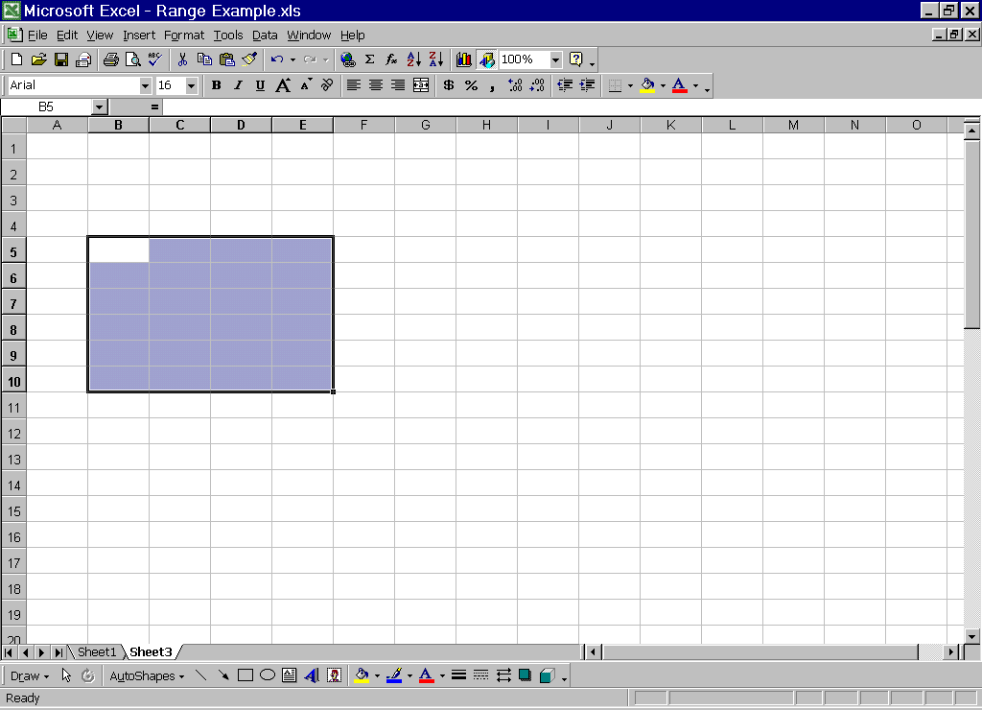

Slide 15
This is what is called a contiguous range, which represents a rectangular set of cells within the worksheet.
Other examples of contiguous ranges are D7:H7 (all within one row) and C14:C25 (all within one column).

Slide 16
Consider SUM(B5:E10,G1:G7)
Here, a total of 24+7=31 numbers are to be summed.
B5:E10,G1:G7 is considered a range reference as well, but this is called a non-contiguous range:

Slide 17
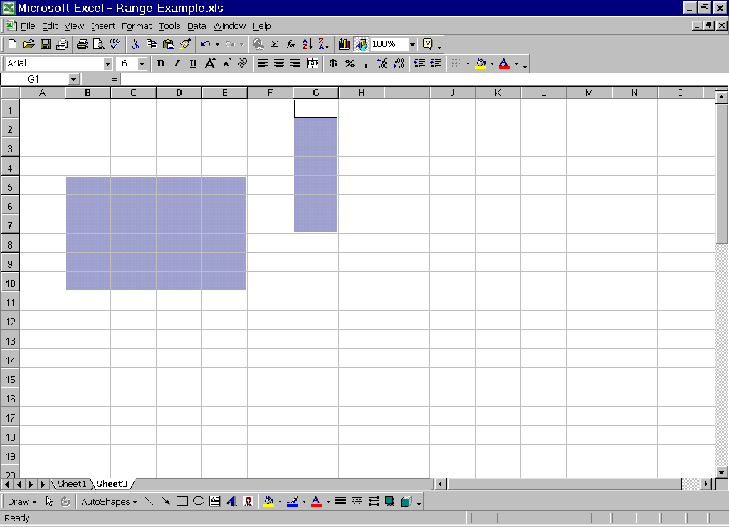

Slide 18
The main reference operators are then
: (colon) – used to specify a contiguous range of cells
, (comma) – used to represent the union of two or more contiguous ranges

Slide 19
Another reference operator is the single space, used to represent the intersection of two ranges.
This is most often used when rows and columns are given names.
E.g., in our earlier grade book example, Adams Final would specify the cell at the intersection of the Adams row and the Final column.

Slide 20
Tip on entering cell and range references in formulas
When you’re entering a formula, instead of typing a cell reference like B4 in the formula, click in cell B4 and the reference will be created for you automatically.
To get a contiguous range reference, click and drag from one corner of the range to the opposite corner.

Slide 21
To get a non-contiguous range reference, click and drag to select the first contiguous sub-range, then hold the shift key down while clicking and dragging to select all the remaining contiguous sub-ranges.

Slide 22
Functions
Microsoft Excel contains many predefined functions that can be used in formulas.
Functions can be used to perform simple or complex calculations.
To enter a function, you can either type it in directly, or select it from the dialog box that appears when you click the Paste Function button on the standard toolbar:

Slide 23
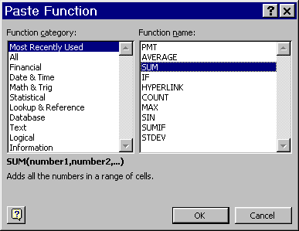

Slide 24
The most common function in worksheets is the SUM function, which is used to add ranges of cells.
In fact, it is so commonly used that it has its own button, the AutoSum button, on the standard toolbar.

Slide 25
Although SUM(B3:B5) yields the same value as B3+B4+B5, it is generally much better to use the SUM function because the range reference B3:B5 adapts automatically to changes like inserting additional rows within the range.

Slide 26
Using functions to calculate values
Functions are predefined formulas that perform calculations by using specific values, called arguments, in a particular order, called the syntax.
For example, the SUM function adds values or ranges of cells, and the PMT function calculates the loan payments based on an interest rate, the length of the loan, and the principal amount of the loan.

Slide 27
Syntax of a function
The syntax of a function begins with the function name, followed by an opening parenthesis, the arguments for the function separated by commas, and a closing parenthesis.
If the function starts a formula, don’t forget to type an equal sign (=) before the function name.

Slide 28
As you create a formula that contains a function, the Formula Palette can help you.
This is a dialog box that comes up after you select a function from the Paste Function dialog box and click OK.

Slide 29
Arguments to functions can be
numbers,
text,
logical values such as TRUE or FALSE,
arrays,
error values such as #N/A,
cell references,
constants,
formulas, or
other functions

Slide 30
Functions within functions, or nesting
Functions can be used as arguments for other functions.
When a function is used as an argument, or nested, it must return the same type of value that the argument uses.
If a nested function does not return the correct type of value, Microsoft Excel will display a #VALUE! error value.

Slide 31
A formula can contain up to seven levels of nested functions.
When Function B is used as an argument in Function A, Function B is a second-level function.
If Function B contains Function C as an argument, Function C would be a third-level function.

Slide 32
There are over 400 built-in functions in Excel

Slide 33
Categories of functions
Financial
Date and time
Math and trig
Statistical
Lookup and reference
Database
Text
Logical
Information

Slide 34
Examples of financial functions
IPMT--returns the interest payment for a given period for an investment based on periodic, constant payments and a constant interest rate.
PMT--calculates the payment on a loan based on constant payments and a constant interest rate.

Slide 35
Some Date and Time Functions
NOW--returns the serial number of the current date and time.
TODAY--returns a number that represents the current date in MS Excel date-time code.
Neither one takes an argument; so they look like NOW() and TODAY().
The result of NOW() might be 10/9/00 10:30.
The result of TODAY() could be 10/9/00.
These will always be updated each time the workbook is opened or closed.

Slide 36
Sample Math and Trig functions
COS(num)--returns the cosine of an angle.
FLOOR(number, significance)--rounds a number down, toward zero, to the nearest multiple of significance.
SUM(num 1, num 2,…)--adds all the numbers in a range of cells.

Slide 37
Some Statistical Functions
AVERAGE(num1, num2,…)--returns the average (arithmetic mean) of its arguments.
COUNT(value1, value2,…)--counts how many cell contain numbers among all the cells in the list of arguments.
MAX(num1, num2,…)--returns the largest value in a set of values.

Slide 38
Some Lookup and Reference Functions
LOOKUP(…)--returns a value either from a one-row or a one-column range.
TRANSPOSE(array)--returns a vertical range of cells as a horizontal range, or vice versa.

Slide 39
Sample Database Functions
DCOUNT(database,field,criteria)--counts the cells containing numbers in the field (column) of records in the database that match the specified criteria.

Slide 40
Some Logical Functions
AND(logical1,logical2,...)--returns TRUE if all its arguments are TRUE; returns FALSE if any argument is FALSE.
NOT(logical)--reverses the logic of its argument; returns TRUE for a FALSE argument and FALSE for a TRUE argument.

