Slide 1
VISUAL BASIC Class : II B.COM CA PG DEPARTMENT OF COMMERCE CA Staff Name: R.ABIRAMAKRISHNAN

Slide 2
List of Appendices
A. Visual Basic Reserved Words
B. Object-Naming Conventions for Visual Basic
C. The Toolbox, Toolbars, and Controls
D. Standard Menus for Windows Applications
E. PH/CBT Systems CD-ROM Tutorial
F. What’s New with Visual Basic 6.0

Slide 3
Visual Basic Reserved Words
A
Keywords...
are words and symbols recognized by Visual Basic as part of the programming language
are reserved by Visual Basic and should not be used as a variable or constant names in your code

Slide 4
Object-Naming Conventions for Visual Basic...
B
Object - combination of code and data that is treated as a unit
Class - formal definition of an object that defines the properties and methods of an object
Method - a procedure that acts on an object
Instance - one of a set of object that belong to the same class

Slide 5
Naming Objects
B
Follow these rules when naming objects:
Name must begin with a letter
Name must contain only letters, numbers, and the underscore character
Neither punctuation marks nor spaces are allowed
Name can be a maximum of 40 characters

Slide 6
Naming Objects
B
See Table B.1 (page 416) for suggested prefixes for intrinsic controls and primary objects
See Table B.2 (page 417) for suggested prefixes for ActiveX controls
See Table B.3 (page 418) for menu-naming conventions
See Table B.4 (page 418) for variable-naming conventions

Slide 7
The Toolbox, Toolbars, and Controls
C
Visual Basic Integrated Development Environment includes:
Standard toolbar
Form Editor toolbar (optional)
Edit toolbar (optional)
Debug toolbar (optional)
Toolbox

Slide 8
Displaying the Toolbars
C
Standard Toolbar
Debug Toolbar
Edit Toolbar
Form Editor Toolbar

Slide 9
Standard Toolbar’s Measurement Indicators
C
Measurement Indicators
located at the right end of the standard toolbar
twip is the unit of measurement
uses x,y coordinate system
Twip - screen independent unit, 1440 twips to a logical inch
Pixel - picture element, number of pixels per inch varies with the screen

Slide 10
Intrinsic Controls
C
Pointer tool
Picture box
Label
Text box
Frame
Command button
Check box
Option button
Combo box
List box
Horizontal scroll bar
Vertical scroll bar
Timer
Drive list
Directory list box
File list box
Shape
Image
Line
OLE container
Data

Slide 11
Intrinsic Controls...
C
Pointer - use to move or change the size of a control
Picture box - use to display graphics
Image - use to display a graphic, uses fewer resources than a picture box
Label - use for text that the user cannot change
Text box - use for text that the user can enter or change
Frame - use to group controls together
Command button - use to create a clickable button

Slide 12
Intrinsic Controls...
C
Check box - use for choices where more than one choice can be selected
Option button - use for choices where choices are mutually exclusive
Combo box - user can either select an item from the list or enter a value
List box - use to display a list of items where only one choice is allowed
Horizontal or Vertical Scroll bars - use to quickly navigated through a long list of items or a large amount of information

Slide 13
Intrinsic Controls...
C
Timer - use like a stopwatch to trigger events
Drive list box - displays list of disk drives
Directory list box - displays list of folders
File List box - displays a list of files
Shape - use to draw a rectangle, square, oval or circle
Line - use to draw a variety of lines
OLE Container - use to link or embed OLE objects
Data - use to create applications from many types of databases

Slide 14
ActiveX Controls
C
ActiveX Controls...
controls that are stored in individual files
have a file extension of .ocx
include controls such as the data-bound list box, toolbars, and the tabbed dialog
called Custom Controls in older versions of Visual Basic (.vbx extension)

Slide 15
Insertable Objects
C
Insertable Objects...
objects from another application that can be embedded or linked to your application
can be added to the toolbox

Slide 16
Standard Menus for Windows Applications
D
Standard Menu Titles for Office applications
File, Edit, View, Format, Tools, App-Specific, Window, Help
See Table D.2 (page 427) for Standard menu items for Office applications

Slide 17
PH/CBT Systems CD-ROM Tutorial
E
CBT Systems - leading developer of computer-based interactive tutorials
Partnership between CBT Systems and Prentice Hall
Visual Basic tutorial CD-ROM may be ordered with this textbook
See Table E.1, E.2, & E.3 (pages 430 - 436) for tutorial topics

Slide 18
What’s New with Visual Basic 6.0
F
MSDN Library
New and Improved Wizards
File System Object (FSO) Model
Data and Database Enhancements

Slide 19
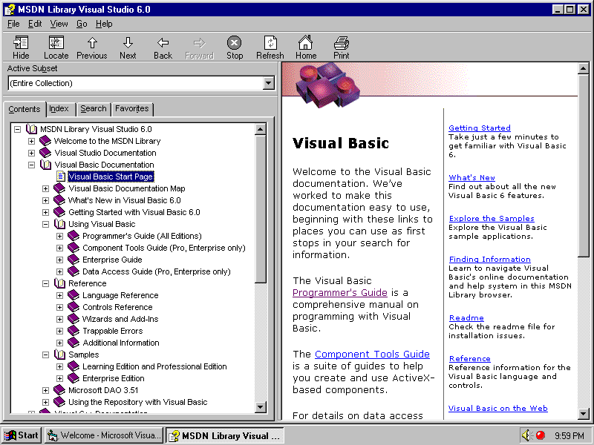
MSDN Library
F

Slide 20
New and Improved Wizards
F
Package and Deployment Wizard - replaces Setup Wizard in VB 5.0
Application Wizard - improved wizard can save profiles for later use
Toolbar Wizard - automatically starts when you add a toolbar to a form with the Application Wizard

Slide 21
File System Object (FSO) Model
F
Provides an object-based tool for working with drives, folders, and files
Easier to process sequential access of text files
Drive object
Folder object
File object
FileSystem object
TextStream object

Slide 22
Data and Database Enhancement
F
New version of existing controls
Data Grid control
Data List control
Data Combo control
Microsoft FlexGrid
Hierarchical FlexGrid
Data Environment Designer
Visual Database Tools
New Data View button (not available in Learning Edition)

Slide 23
The End Thank you...

