Slide 1
Hajee Karutha Rowther Howdia College
(Autonomous)
Uthamapalayam
WELCOME

Slide 2
Hajee. Dr. M. Kamal Nasar
Associate Professor of Chemistry
HKRH College, Uthamapalayam

Slide 3
Hydrogen and Oxides
Hydrogen: Isotopes of hydrogen – preparation, properties and uses of heavy hydrogen – hydrides – definition – classification – examples - Oxides – Definition – classification – examples.

Slide 4
HYDROGEN
An atom with its symbol, atomic number and mass number are represented as follows,
Isotopes
Atoms which have the same atomic number but different mass number are called isotopes. Hydrogen has three isotopes. They are,

Slide 5
No. | Name | Symbol | Number of protons | Number of neutrons | Number of electrons | Mass number | % availability
1 | Hydrogen (or) protium | ₁H¹ | 1 | 0 | 1 | 1 | 99.984
2 | Heavy hydrogen (or) Deuterium | ₁H² or ₁D² | 1 | 1 | 1 | 2 | 0.016
3 | Tritium | ₁H³ or ₁T³ | 1 | 2 | 1 | 3 | 10⁻¹⁵

Slide 6
Nucleus containing
one proton
Nucleus containing
one proton + one neutron
Nucleus containing
one proton + two neutrons
One electron
One electron
One electron
Heavy hydrogen
(or) Deuterium
Tritium
Hydrogen
(or) protium
In nature, roughly 1 atom of deuterium present in 6000 atoms of hydrogen.
Preparation of heavy hydrogen
6000 parts of ordinary water contains about 1 part of heavy water. Ordinary water on continuous electrolysis yields heavy water. Heavy hydrogen is prepared from heavy water.
The electrolysis is carried out with a 0.5 N NaOH solution using nickel anode and steel cathode electrodes. During electrolysis hydrogen is liberated more readily than deuterium. Thus the proportion of heavy water increases and pure heavy water obtained after about seven stages of electrolysis.

Slide 7
Nickel anode (+)
Steel cathode (-)
Gases
Steel cell
0.5 N NaOH
The heavy water thus obtained is decomposed by the action of sodium to liberate heavy hydrogen.

Slide 8
1 proton mass = 1836 electron mass
1 neutron mass = 1838.5 electron mass
Properties:
Physical properties:
The boiling point, melting point, density, etc., are high for heavy hydrogen than ordinary hydrogen. This is due to the high mass of heavy hydrogen than ordinary hydrogen.
Chemical properties:
Heavy hydrogen resembles ordinary hydrogen in chemical properties. But heavy hydrogen reacts slowly than ordinary hydrogen. This is also due to the high mass of heavy hydrogen than ordinary hydrogen.

Slide 9
Examples:
1. Reaction with oxygen:
Heavy hydrogen burns with oxygen at 560 ̊ C to form heavy water (D₂O).
Reaction with nitrogen:
Heavy hydrogen reacts with nitrogen to form deutero ammonia (ND₃).
Reaction with halogen:
Heavy hydrogen reacts with chloride to form deuterium chloride (DCℓ).

Slide 10
4. Exchange reaction:
Heavy hydrogen atom exchanges ordinary hydrogen atoms in H₂O, C₆H₆, NH₃, etc., molecules to gives corresponding deuterated product.
Uses of Deuterium:
i). Deuterium is used in the production of hydrogen bomb.
ii). Deuterium is used in the preparation of heavy water which is used as a moderator in nuclear reactor.
iii). Deuterium is used as a tracer in the determination of reaction mechanism.
iv). Deuterium is used as a projectiles in several nuclear transformations.

Slide 11
Ortho and Para hydrogen
Hydrogen molecule is composed of two hydrogen atoms. The spins of the nucleus in the hydrogen atoms may be either in the same direction or in the opposite direction as shown below. This gives rise to two types of hydrogen molecules. They are,
i). Spinning of nucleus in the same direction is called Ortho hydrogen (parallel spin).
ii). Spinning of nucleus in the opposite direction is called para hydrogen (antiparallel spin).
In ordinary hydrogen, the ortho and para hydrogens are in the ratio,
Ortho hydrogen : Para hydrogen = 3 : 1

Slide 12
Preparation of ortho hydrogen
Method 1:
Ordinary hydrogen gas is heated to 700 to 800 ̊ C for a long time, ortho hydrogen is formed.
Method 2:
When ordinary hydrogen gas is brought in contact with materials containing unpaired electrons like iron, cobalt, nickel, etc., pure ortho hydrogen is formed.
Preparation of para hydrogen
Method 1:
Keeping ordinary hydrogen gas at high pressure and liquid air temperature (low temperature) para hydrogen is formed.
Method 2:
Hydrogen gas is allowed to adsorb on activated charcoal in a quartz vessel and slowly lowering the temperature to -253 ̊ C. After some time when the gas is pumped off, 99.8% of para hydrogen is obtained.

Slide 13
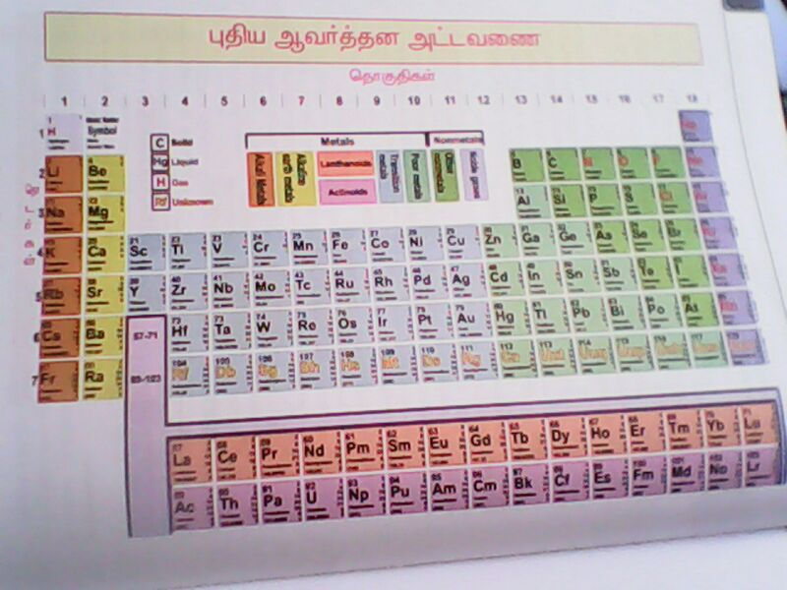
S-block elements
p-block elements
d-block elements
f-block elements

Slide 14
Hydrides
The binary compounds formed between hydrogen and another elements are called hydrides.
Classification of hydrides:
On the basis of type of bonds present in the hydrides, they are classified into 4 types. They are,
1. Ionic hydride (or) Salt like hydride
This type of hydride is formed between hydrogen and s-block elements. In these hydrides strong ionic bond is present.
Example: LiH, NaH, CaH₂, BaH₂, etc.,
2. Covalent hydride (or) Molecular hydride
This type of hydride is formed between hydrogen and p-block elements. In these hydrides covalent bond is present.
Example: CH₄,, SiH₄, GeH₄, AℓH₃ etc.,

Slide 15
3. Metallic hydride (or) Interstitial hydride
This type of hydride is formed between hydrogen and d-block elements. In these hydrides hydrogen occupy the interstitial position between metal atoms.
Example:
FeH₂, CoH₂, NiH₂, etc.,
4. Complex hydride
Two or more metal atoms are linked by hydrogen atom are called complex hydride.
Example:
Lithium aluminium hydride - LiAℓH₄,
Lithium boro hydride - LiBH₄,
Sodium boro hydride - NaBH₄, etc.,
interstitial position
Metal atom

Slide 16
OXIDES
The binary compound formed between oxygen and another element is called as an oxide.
Classification of oxides
Oxides are classified on the basis of two. They are,
i). Based on the their chemical behavior
ii). Based on their oxygen content.
Classification of oxides based on their chemical behavior:
Based on the chemical behavior, oxides are classified into 4 types. They are,
1. Acidic oxides:
Oxides which dissolved in water to give acids are called Acidic oxides. These oxides react with bases to form salt and water.
CO₂ + H₂O → H₂CO₃ (carbonic acid)
SO₃ + H₂O → H₂SO₄ (sulphuric acid)
C rO₃ + H₂O → H₂CrO₄ (chromic acid)
E.g. CO₂, SO₃, CrO₃, etc.,

Slide 17
2. Basic oxides:
Oxides which dissolved in water to give bases are called Basic oxides. These oxides are reacts with acids to form salt and water.
Na₂O + H₂O → 2 NaOH
K₂O + H₂O → 2 KOH
CaO + H₂O → Ca(OH)₂
3. Amphoteric oxides: E.g. ZnO, Aℓ₂O₃, etc.,
Oxides which react with acids or bases to form salt and water are called amphoteric oxides.
ZnO + 2HCℓ → ZnCℓ₂ + H₂O
ZnO + 2NaOH → Na₂ ZnO₂ + H₂O
E.g. Na₂O, K₂O, CaO, etc.,
4. Neutral oxides:
The oxides which is not react with acids or bases are called Neutral oxides. E.g. CO, H₂O, etc.,
CO + 2HCℓ → No reaction
CO + 2NaOH → No reaction.

Slide 18
Classification of oxides based on their oxygen content
Based on the oxygen content, oxides are classified into 4 types. They are,
1. Normal oxides
Normal oxides contain oxygen allowed by normal valency consideration. These oxides contain only M – O bonds where M - is the metal.
E.g. PbO, ZnO, MnO, CO₂, H₂O, etc.,
2. Poly oxides:
Poly oxides contain more oxygen than normal valency considerations. These oxides contain M – O bonds as well as O – O bonds.
E.g. H₂O₂, Na₂O₂, MnO₂, etc.,

Slide 19
3. Suboxides:
Suboxides contain lesser oxygen than normal valency considerations. These oxides contain only M – M bonds as well as M – O bonds.
E.g. Pb₂O, N₂O, etc.,
4. Compound oxides:
Those oxides which behave as a mixture of two oxides are called Compound oxides.
E.g. Fe₃O₄, Pb₃O₄, etc.,
(Fe₃O₄ is a mixture of FeO and Fe₂O₃).

