Slide 1
Polysaccharides
Course code: 17UCHS51
Course title: Organic and Pharmaceutical Chemistry
Class: III B.Sc., Chemistry
Unit: II - Carbohydrates
Dr. M. Jannathul Firdhouse
Assistant Professor
Department of Chemistry
Hajee Karutha Rowther Howdia College
Uthamapalayam

Slide 2
Unit – II
Polysaccharides: structure of starch and cellulose- uses of cellulose.

Slide 3
Polysaccharides
These carbohydrates give a large number of monosaccharide units on hydrolysis.
These monosaccharide units are joined together by linkages are called glycosidic linkages.
The common and widely distributed polysaccharides - general formula (C₆H₁₀O₅)n.
Polysaccharides are not sweet in taste, so they are called non-sugars.
Examples are starch, cellulose, glycogen, etc

Slide 4
Starch
Starch is the major form of stored carbohydrate in plants.
general formula - (C₆H₁₀O₅)n
It is the most important source of carbohydrates in human diet.
Commercial sources of starch are wheat, rice, maize, potatoes, barley and arrowroot.
The grains are soaked in water to soften the material and crushed to break the cell walls.
The pulp thus obtained is carried by a stream of water to a fine sieve.
The form of milky suspension is allowed to settle down and decanted.
It is finally dried in the air or in oven.

Slide 5
Structure of Starch
Starch is not a pure compound.
It is composed of a mixture of two polysaccharides: amylose, an essentially linear polysaccharide, and amylopectin, a highly branched polysaccharide.
Both forms of starch are polymers of α-D-Glucose.
Amylose forms a colloidal dispersion in hot water and gives blue colour with iodine.
Amylopectin is completely insoluble in water and gives no colour.
Natural starches contain 10-20% amylose and 80- 90% amylopectin.

Slide 6
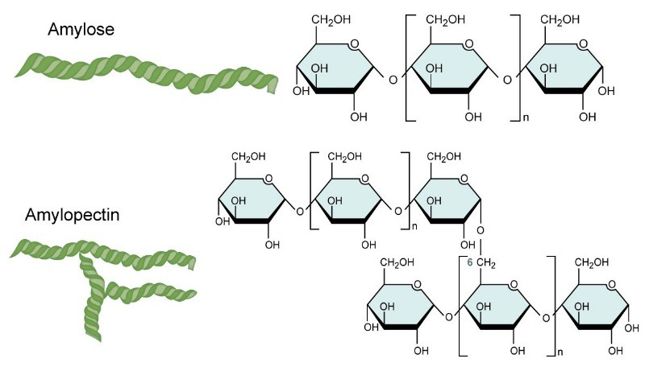

Slide 7
Amylose
Amylose molecules consist typically of 200 to 20,000 glucose units which form a helix as a result of the bond angles between the glucose units.
α-1,4– glycosidic linkages

Slide 8
Amylopectin
Amylopectin differs from amylose in being highly branched.
Short side chains of about 30 glucose units are attached with 1α→6 linkages approximately every twenty to thirty glucose units along the chain.
Amylopectin molecules may contain up to two million glucose units.
The side branching chains are clustered together within the amylopectin Molecule.

Slide 9
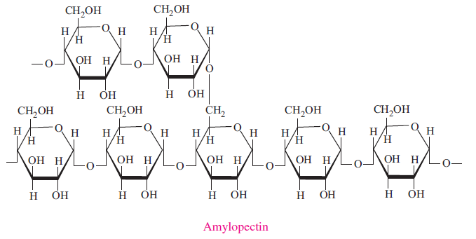

Slide 10
Cellulose
Cellulose is a polymer of β-D-Glucose, which in contrast to starch, is oriented with –CH2OH groups alternating above and below the plane of the cellulose molecule thus producing long, unbranched chains.
The absence of side chains allows cellulose molecules to lie close together and form rigid structures.
Cellulose is the major structural material of plants.
Wood is largely cellulose, and cotton is almost pure cellulose.
Cellulose can be hydrolyzed to its constituent glucose units by microorganisms that inhabit the digestive tract of termites and ruminants.

Slide 11
Cellulose Nitrate
First prepared over 150 years ago by treating cellulose with nitric acid, is the earliest synthetic polymer.
The fully nitrated compound, --[C₆H₇O(ONO₂)₃]_{n}--, called guncotton, is explosively flammable and is a component of smokeless powder.
Partially nitrated cellulose is called pyroxylin.
Pyroxylin is soluble in ether and at one time was used for photographic film, nail polish and lacquers.
The high flammability of pyroxylin caused many tragic cinema fires during its period of use.
Furthermore, slow hydrolysis of pyroxylin yields nitric acid, a process that contributes to the deterioration of early motion picture films in storage.

Slide 12
Cellulose Acetate
C₆H₇O(OAc)₃]_{n}--, is less flammable than pyroxylin, and has replaced it in most applications.
It is prepared by reaction of cellulose with acetic anhydride and an acid catalyst.
The properties of the product vary with the degree of acetylation.
An acetone solution of cellulose acetate may be forced through a spinneret to generate filaments, called acetate rayon, that can be woven into fabrics.
Viscose Rayon, is prepared by formation of an alkali soluble xanthate derivative that can be spun into a fiber that reforms the cellulose polymer by acid quenching.
The product fiber is called viscose rayon.

Slide 13
Thank you

