Slide 1
The Agrarian Revolution
NASREEN BANU S
ASSISTANT PROFESSOR
DEPT OF ENGLISH

Slide 2
System Before
Before the Agrarian revolution food was produced using ‘the Open Field System’
Crops were grown on strips of land in large open fields
Tenant farmers rented strips of land from local landowner
Significant sections of land were designated as ‘common land’ on which tenants and agricultural labourers had rights to graze their livestock
Crops were rotated using 3 Field system – one year of wheat, one year of barley (oats), one year of fallow (left to meadow to recover)
The Open field system was very inefficient but had served Britain’s needs for hundreds of years
Village life was reasonably secure and predictable

Slide 4
Pressure for Change
Population Growth: Between 1750-1820 British population trebled from 7 million to 21 million – the old system could not feed that many people
French Wars – war with France from 1793 reduced the amount of important food to near to zero, shortages got worse and prices rose
‘An Age of innovations’– ideas from the industrialising areas began to have an influence e.g. Mechanisation, economies of scale
Greed and opportunity – landowners saw a unique opportunity to enrich themselves by adopting new practises

Slide 5
Enclosure
The main feature of the Agrarian Revolution was the Enclosure of the land – joining the strips together into large, hedged off fields to take advantage of technology and innovation
Enclosure began as a voluntary process as large to medium sized landowners saw the mutual advantages of banding together to make money.
Eventually Enclosure had to be regulated by Parliament as conflicts between larger landowners and small landowners and tenant farmers increased
The largest landowner in an area would push an Enclosure act through Parliament joining up all the local strips with small amounts of compensation for those who lost out
Between 1760-1820 there were 4,000 separate Enclosure Acts illustrating the landed nature of Parliament

Slide 6
Consequences
Much larger farms – grow more food, able to innovate, wealthier so can invest, better disease control and weed control. Massive increase in food production – birth of modern farming
All common land disappeared and agricultural labourers lost their rights and their livelihoods, increase in rural poverty – many joined the rural urban drift to seek their fortunes in the new towns
Agricultural land more and more concentrated into the hands of the wealthiest landowners. Small farmers forced by Act of Parliament to sell to large landowners at low prices and inadequate compensation

Slide 7
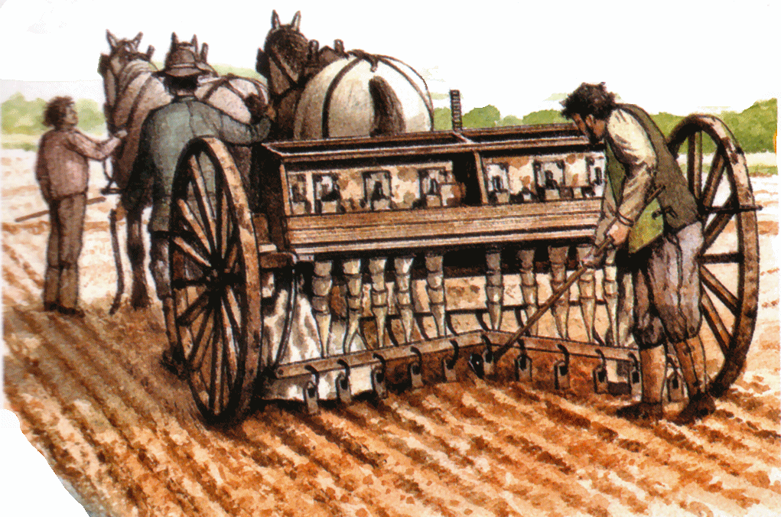
Other Innovations: Jethro Tull
In 1701 Tull invented a seed drill which was a horse drawn machine that planted seed in straight rows and at a uniform depth.
In 1714 Tull developed a horse drawn hoe that made it much easier to get rid of the weeds between crop rows. This replaced hand hoeing.

Slide 8
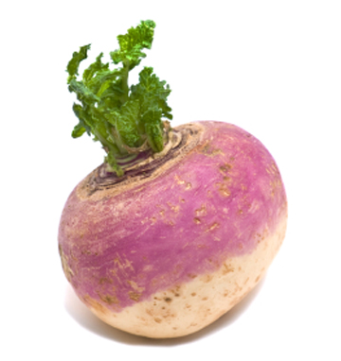
Turnip Townshend
Devised a way of improving on the old wheat-barley-fallow rotation by getting rid of the fallow year
Townshend introduced a new 4 year sequence – wheat-turnips- barley-clover. Turnips as a root crop use different nutrients in the soil and both turnips and clover actually introduced nutrients helpful for wheat and barley.
Turnips and clover provided valuable winter cattle food, cutting the need for grazing and making it possible for farmers to keep larger and larger herds

Slide 9
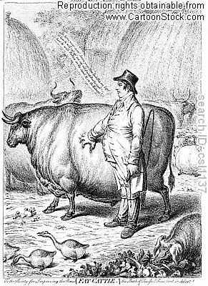
Robert Bakewell
Robert Bakewell of Leicester was the first farmer to introduce selective breeding of cattle.. Using selected types of cattle and breeding them with others to maximise their advantages e.g. Milk yield and meat yield
Thanks to his influence cattle weighed up to 3X what they had 100 years earlier and specialist breeds started to emerge for particular products
His ideas were developed further by the Colling brothers

Slide 10
Arthur Young
In the 1770s and 1780s Young travelled many thousands of miles observing the process of change and encouraging it.
He edited the journal 'The Annals of Agriculture'.
In 1793 Young was appointed to be the Secretary to the newly formed Board of Agriculture and made a big contribution to spreading the innovative ideas of the Agrarian Revolution far and wide.

Slide 11
Effects of Agrarian Revolution
The increase in agricultural production and technological advancements during the Agricultural Revolution contributed to unprecedented population growth and new agricultural practices, triggering such phenomena as rural-to-urban migration, development of a coherent and loosely regulated agricultural market, and emergence of capitalist farmers.

Slide 12
Significance of Agrarian Revolution
The Agricultural Revolution in Britain proved to be a major turning point, allowing population to far exceed earlier peaks and sustain the country’s rise to industrial pre-eminence.
Although evidence-based advice on farming began to appear in England in the mid-17th century, the overall agricultural productivity of Britain grew significantly only later.
Towards the end of the 19th century, the substantial gains in British agricultural productivity were rapidly offset by competition from cheaper imports, made possible by the exploitation of colonies and advances in transportation, refrigeration, and other technologies.

Slide 13
Social Impact
The increase in the food supply contributed to the rapid growth of population in England and Wales.
The rise in productivity accelerated the decline of the agricultural share of the labour force, adding to the urban workforce on which industrialization depended.
The Agricultural Revolution has therefore been cited as a cause of the Industrial Revolution.
As enclosure deprived many of access to land or left farmers with plots too small and of poor quality, increasing numbers of workers had no choice but migrate to the city.

Slide 14
THANK YOU

