Slide 1
S.ANEES FATHIMA
Assistant Professor
H.K.R.H College
Noun

Slide 5
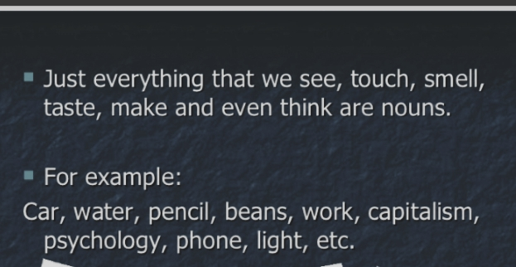

Slide 8
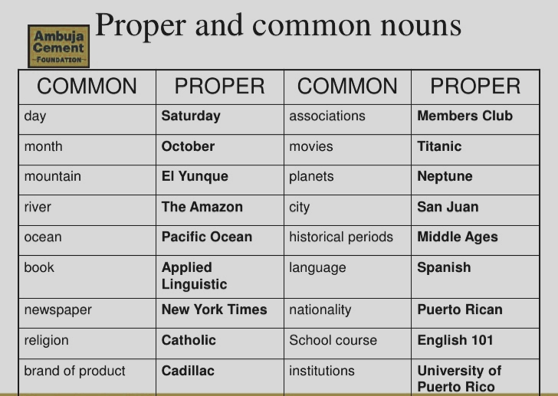

Slide 9
