Slide 1
S.ANEES FATHIMA
Assistant Professor
H.K.R.H College
Preposition

Slide 13
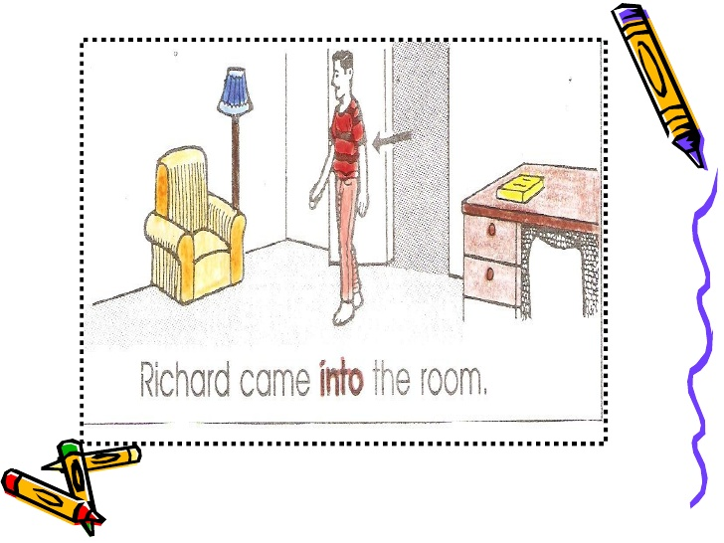

Slide 26
Thank you

