Slide 1
POEM
MY GRANDMOTHER’S HOUSE

Slide 2
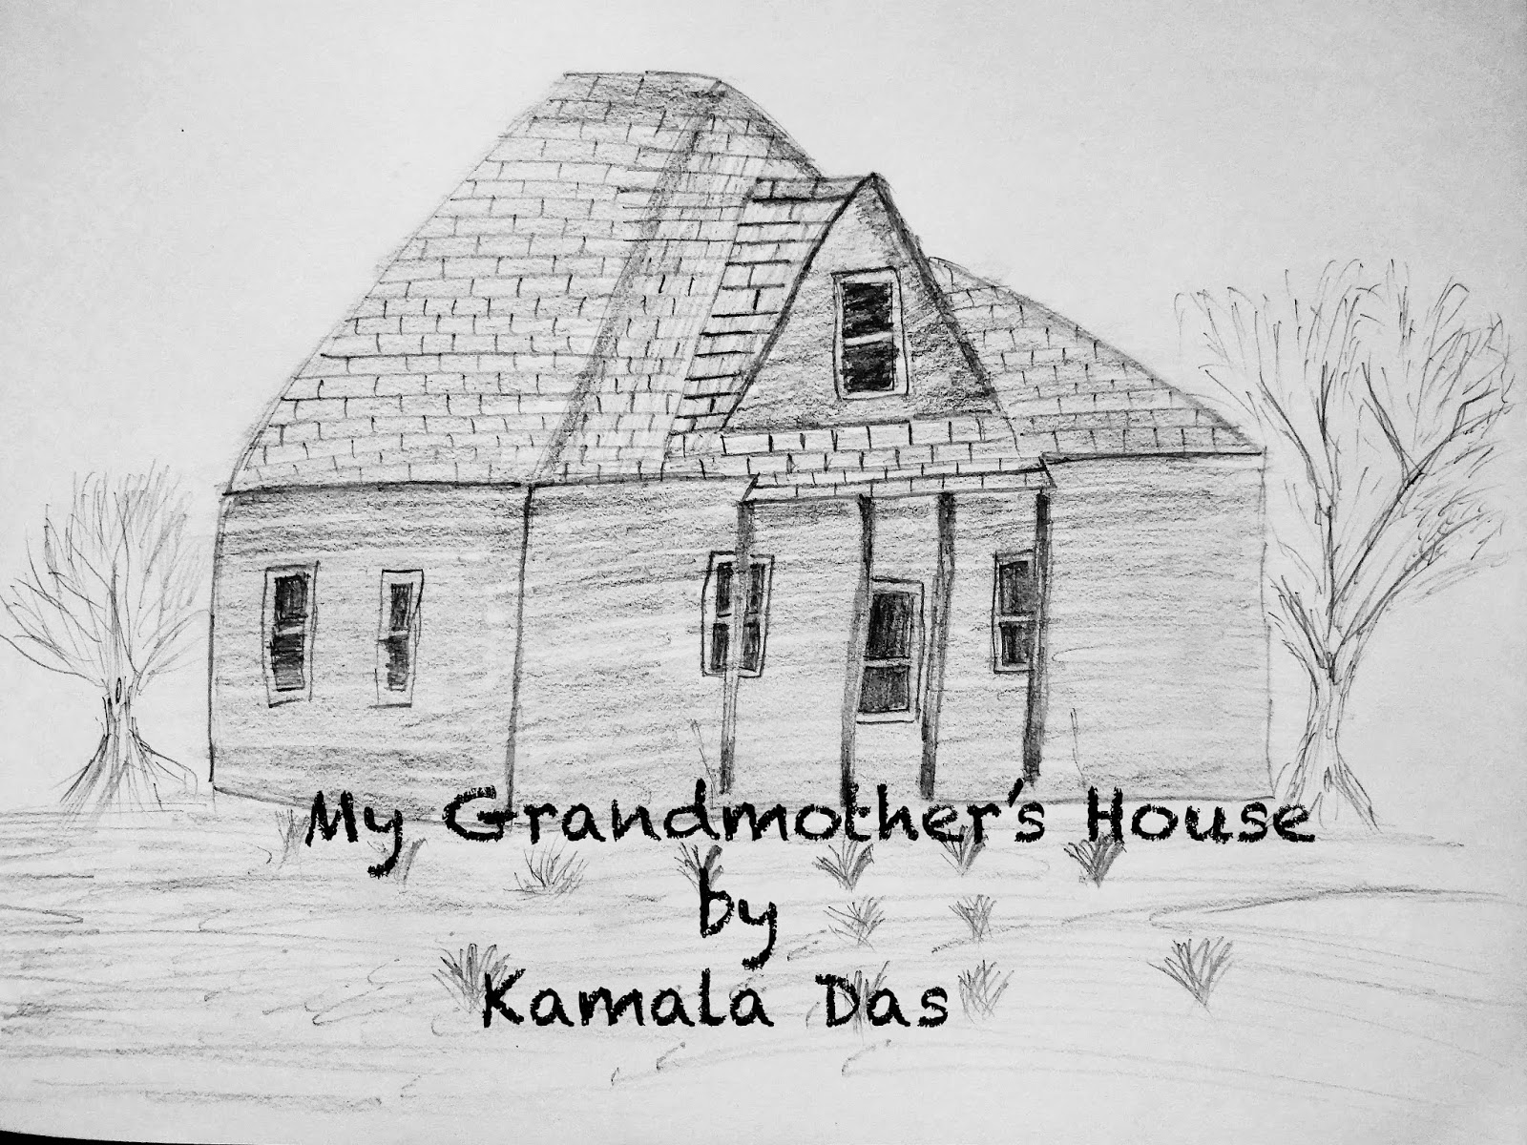

Slide 4
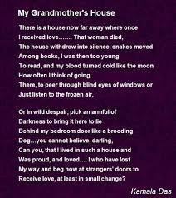

Slide 8
