Slide 1
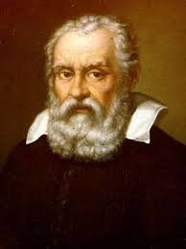
GALILEO GALILEi
DR.S VARGHESE JEYERAJ
ASSOCIATE PROFESSOR
Programme: BA
Course Title: History of Science and Technology
Course Code: 17UHIC 43/17UHVC43
H.K.R.H COLLEGE, UTHAMAPALAYAM

Slide 2
GALILEO GALILIE 1564-1642

Slide 3
GALILEO GALILEI
Galileo was born at Pisa in Italy on February 15,1564
In 1581, he entered the university of Pisa to study medicine
At the age of 17,he discovered the isochronisms of the pendulum.
At his 25, Galileo began to lecture on mathematics at the University of Pisa.

Slide 4
GALILEO GALILIE
He was an Italian astronomer, Physicist, Mathematician
He initiated the scientific revolution of the seventeenth century Italy.
He was the first man to see the true face of the moon and the first to observe the infinite multitude of stars beyond he sight of the naked eye .

Slide 5
Galileo’s Observations
Galileo was one among the first scientist who questioned the ancient ideas and disproved them.
The discovery of Isochronism
Two objects with different weight fall down at the same speed.

Slide 6
Galileo’s Inventions
1593- Thermometer
1597- Compass
1609- Telescope
1641- Pendulum Clock

Slide 7
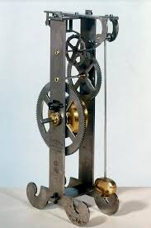
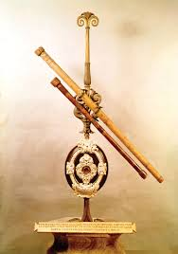
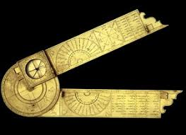
Galileo’s Inventions

Slide 8
Astronomy
Gallileo invented a telescope that had 3x the magnification then Hans Lippersney invented in 1608
With this telescope he could see magnified, upright images of earth
First to report lunar mountains and craters made the conclusion that the moon is rough and uneven just like earth
Also observed Venus, Milky Way, and Saturn.

Slide 9
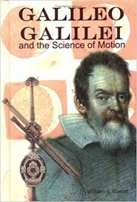
Books by Galileo Galilei

