Slide 1
CIVIL DISOBEDIENCE MOVEMENT
L.PANDIAMMAL
Asst. Professor of history
Programme: MA History
COURSE: HISTORY OF FREEDOM STRUGGLE IN INDIA 1800-1947 AD
COURSE CODE:17PHIC13

Slide 2
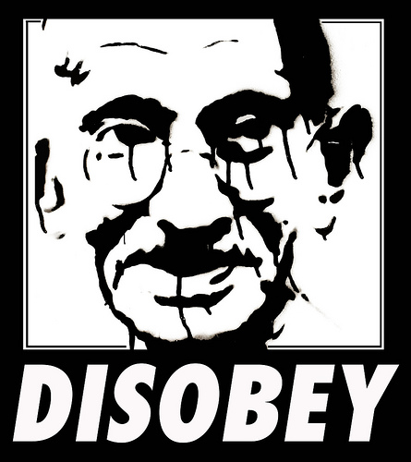
Civil Disobedience

Slide 3
Civil Disobedience
Throughout history native peoples have tried armed resistance against imperialist forces and time and again the native peoples were defeated.
Civil Disobedience: People demonstrate their unhappiness with authority by challenging the authority in a civilized manner without resisting officers of the law.

Slide 4
Rules for Civil Disobedience
1) You must be sure that your position is morally superior to that which you oppose.
2) You must be certain that your opponent, despite their actions, supports the same morality that you do.
3) You must be 100% committed to your action.
4) You must be willing to suffer for your convictions.
5) You must be ready to accept the consequences of your actions.

Slide 5
Forms of Passive Resistance
Letter Writing, Campaigns and Petitions
Hunger Strikes
Economic Boycotts
Marches and Rallies
Civil Disobedience tries to defeat the morality of your opponent by appealing to his or her conscience.

Slide 6
Passive Resistance
The British force Indians to buy only British clothing. Gandhi leads a movement of Indians who spin their own cloth at home circumventing the British law. Gandhi is arrested and only released after a lengthy hunger strike.
RESULT: Britain changes the law.

Slide 7
Passive Resistance
The British passes making all Indian industry illegal. Ex. All Indians must buy Salt manufactured in England. Gandhi leads a march to the sea where Indians make sea salt. Gandhi is arrested and only released after a lengthy hunger strike.
RESULT: Britain changes the law.

Slide 8
SALT SATYAGHAHA
THE CONGRESS WORKING COMMITTEE THAT MET AT SABARAMATHI FROM 14TH TO 16TH FEBRUARY 1930 VESTED GANDHI WITH FULL POWERS TO START THE CIVIL DISOBEDIENCE MOVEMENTS.
GANDHI FOUND THE TIME WAS RIPES AND THE IRON WAS HOT.
HE ANNOUNCED HIS DECISION TO OPEN HIS CAMPAIGN BY OPPOSING THE SALT ACT.

Slide 9
DANDI MARCH
IN 1930 GANDHI AND HIS 78 CHOSEN DISIPLES COMMENCED THEIR HISTORIC DANDI MARCH
WITH A SOLEMN VOW TO BREAK THE SALT LAW. DANDI WAS 385 K.M AWAY FROM SABARMATI
IT LAST OF 24 DAYS

Slide 10
BOYCOTT OF FOREIGN CLOTHS
IN BOMBAY , THE BOYCOTT OF FORGIN CLOTHS FOUND STRONG SUPPORTS . IN TAMILNADU THE AGITATIONS SPREAD TO THE INTERIOR DISTICTS

Slide 11
FIRST ROUND TABLE CONFERENCE 1930-31
IN THE MIDST OF THE CIVIL DISOBEDIENCES MOVEMENT OF THE FIRST ROUND TABLE CONFERENCE WAS IN JAIL AND LONDON FROM 12TH NOVEMBER 1930 TO 19TH JANUARY 1931
GANDHI-IRWIN PACT,1931

Slide 12
SECOND ROUND TABLE CONFRENCE 1931
THE SECOUND ROUND TABLE CONFRENECE OPENED ON 7TH SEPTEMBER 1931.
GANDHI REACHED LONDON ON THE 12TH SEPTEMBER ,FIVE DAYS BEGINDS THE SCHEDULE.
IN ALL, 107 DELEGATES ATTENED THE CONFERENCE.

Slide 13
COMMUNAL AWARDS 1932
AS THE DISOBEDIENCE MOVEMENTS WAS IN THE PROGRESS THE BRITISH PRIME MINISTER RAMSAY MAC DONALD ANNONCED HIS COMMUNAL AWARD ON 17TH AUGUST 1932
POONA PACT,1932

Slide 14
THIRED ROUND TABLE CONFERENCE 1932
AS INDIAN WERE PREOCCUPIED WITH FINDING OUT AN AGREED SOLUTION TO THE COMMUNAL COMPLICATION , THE BRITISH GOVERNMENT CALLED FOR THE THIRED ROUND TABLE CONFERENCE.
IT LASTED FROM 17TH NOVEMBER TO 24TH DECEMBER 1932.

Slide 15
CONCLUSION
GANDHI ATARTED THE CIVIL DISOBEDIENCE MOVEMENT AS A FIGHT TO THE FINISH BUT IT ENDED UNFINISHED .
TRUE THE SALT SATYAGRAHA DEVELOPED INTO A MASS MOVEMENT AND ENVELOPED THE ENTIRE COUNTRY THOUGH ITS SUCCESS WAS QULIFIED

