Slide 1
English East India Company
CP.Muhammed Kabeer
Assistant Professor of History
Programme : B.A. Economics
Course: History of India-II
Course Code : 17UHSA21

Slide 2
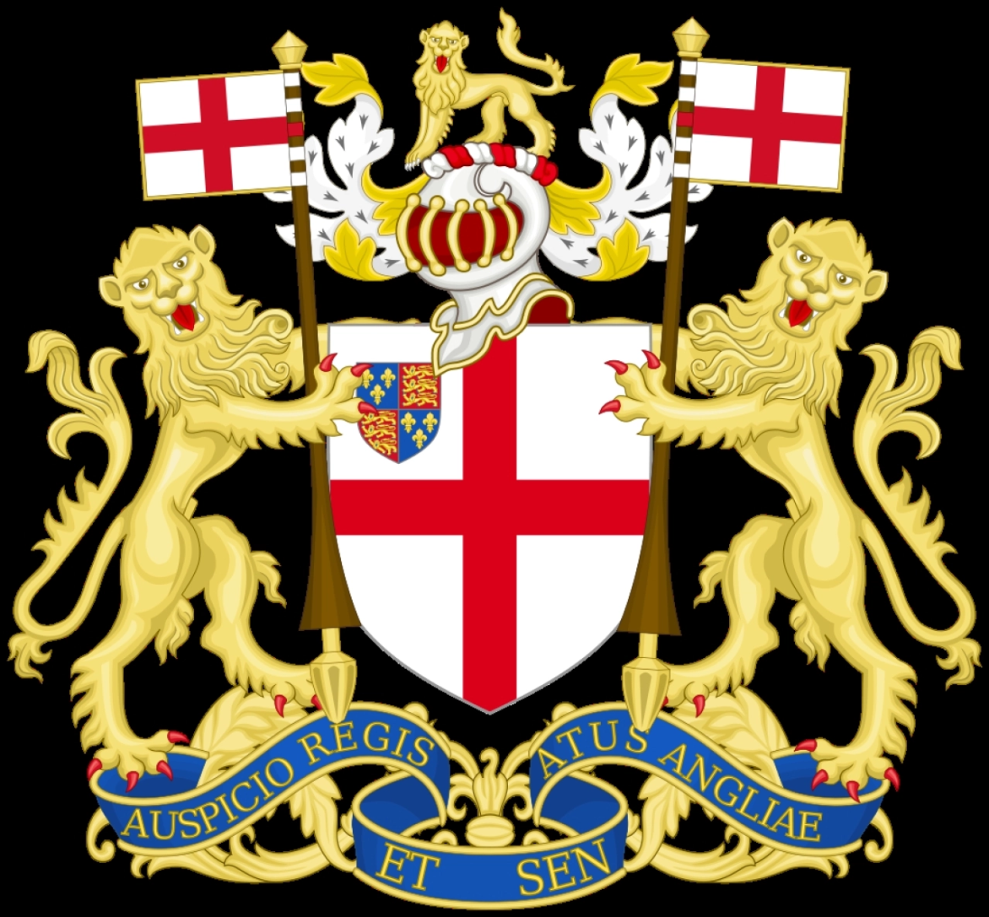
LOGO

Slide 3
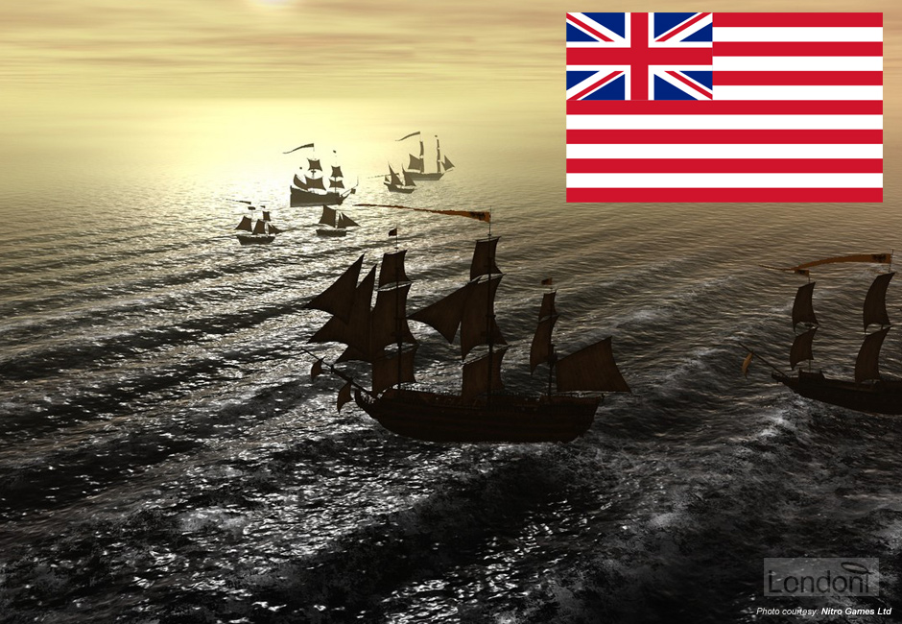

Slide 4
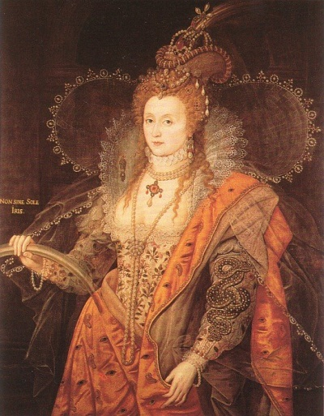
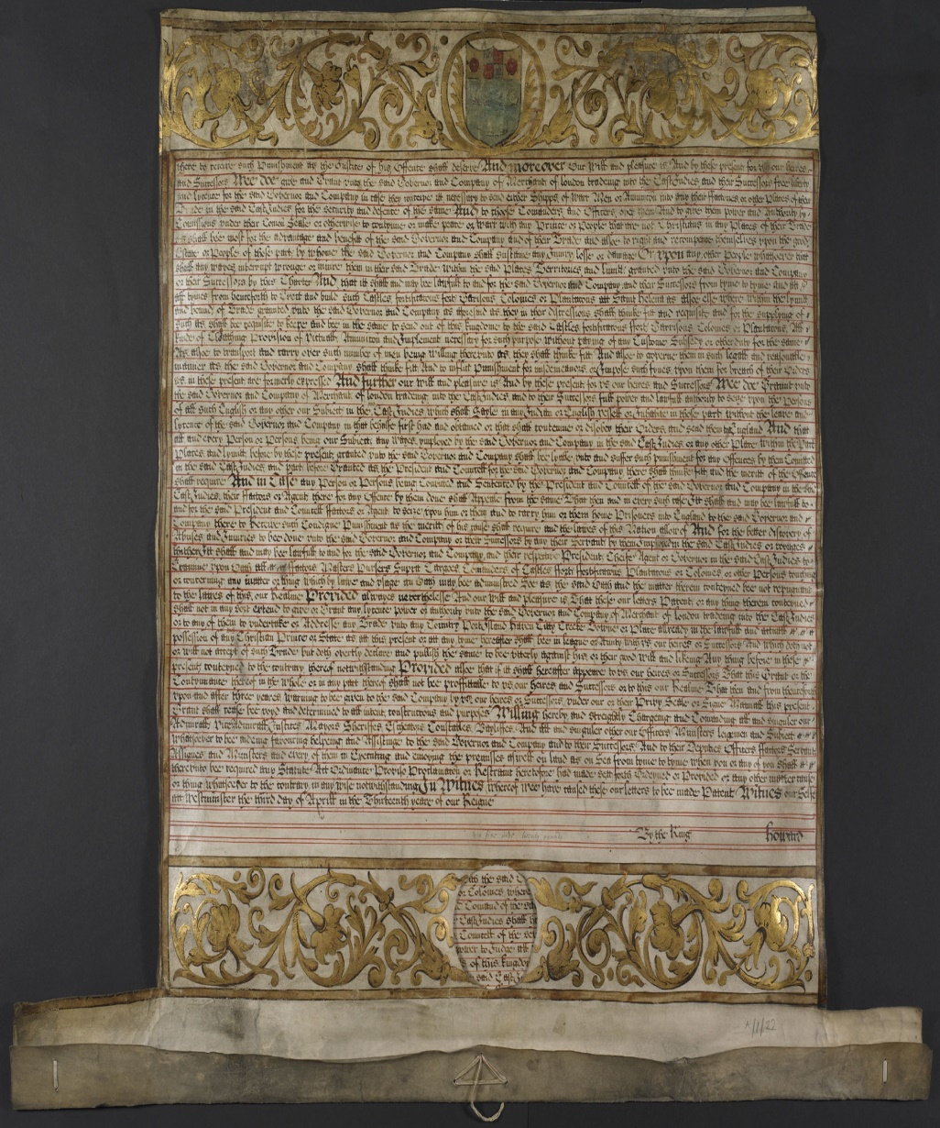
Queen Elizabeth - I
Royal Charter

Slide 5
English East India Company
Honourable East India Company or John Company
On 31 Dec 1600 a Royal Charter issued by British Queen Elizabeth-I
A joint stock company established
15 years monopoly for trade with East of “Cape of Good Hope” and west of “Straits of Magellan”

Slide 6
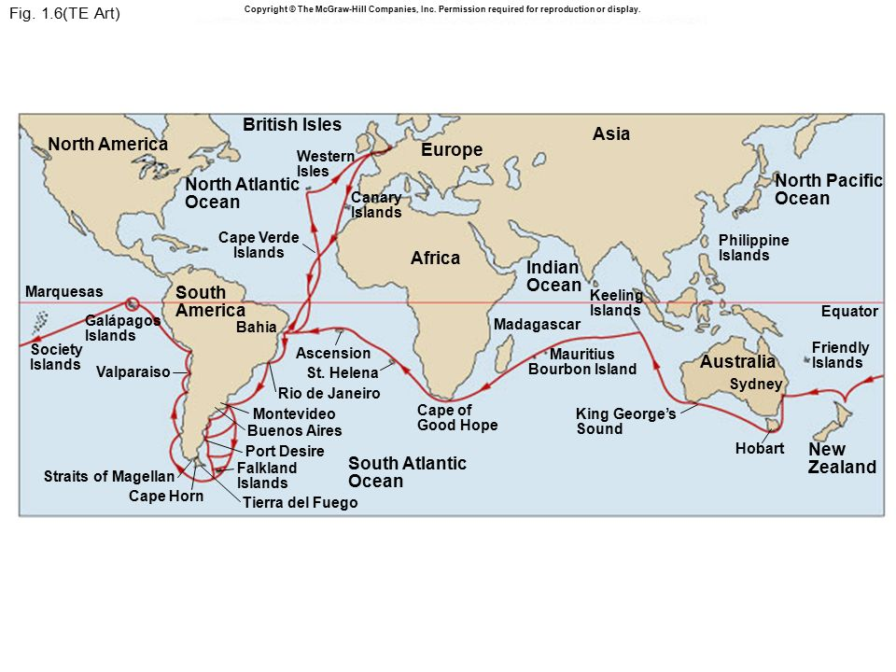

Slide 7

Spices

Slide 8


Saltpetre
Opium

Slide 9


Indigo dye
Cotton

Slide 10
Factories (Trading Centres)
1608- Captain Sir William Hawkins– Surat
1612- Sir Thomas Roe – King James –I
1612, the Battle of Swally and decline of Portuguese monopoly.
Jahangir (1605-1627)- Mughal Emperor (Agra)
Trade Permission
1.Machilipattinam-1611 (Andhrapradesh)
2.Surat – 1612(Gujrat)
3.Balasore -1633(Odisha)
4.Madras – 1639
5.Hoogly –1652(West Bengal)
6.Bombay - 1668 (gifted by Portugal to England)

Slide 11
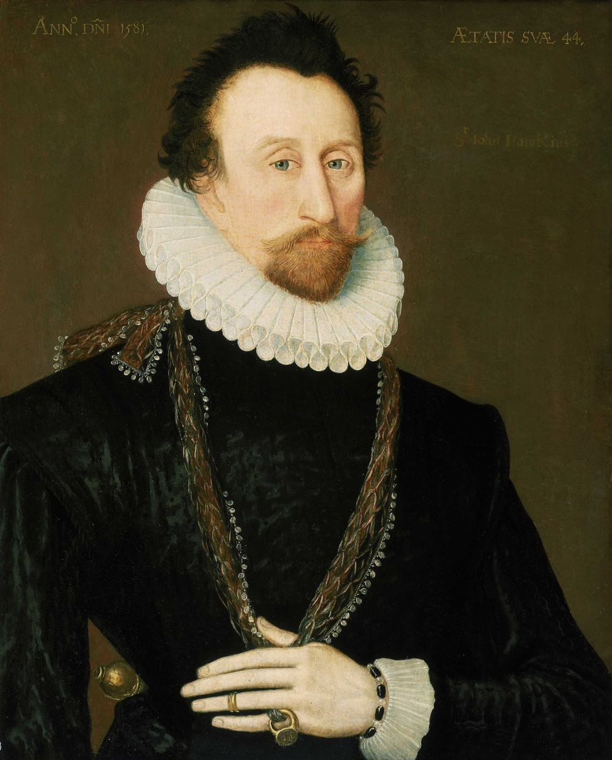
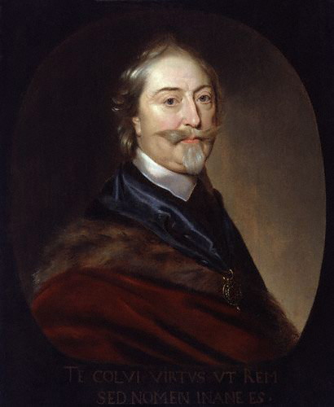
Captain William Hawkins (1608)
Sir Thomas Roe (1615)

Slide 12
Francis Day – Madras city (1639)
Job Charnok - Founder of Calcutta city (1698)(sutanati, kalikata & Govindpur ) three villages
1.Culcutta
2.Madras Set up organisation of the EEIC
3. Bombay
Fort St. George in Madras, Fort William in Bengal and the manor house Bombay Castle.
Each of these had a Governor Deputy Governor Trader Factors Writer

Slide 13
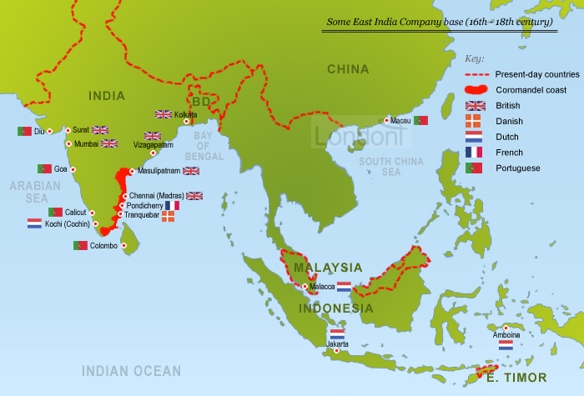

Slide 14
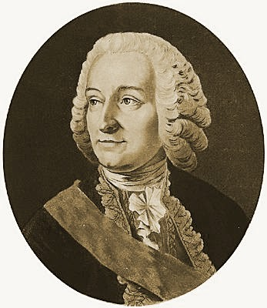
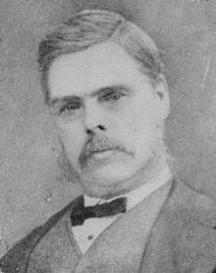
Calcutta and Madras
Job Charnok
Francis Day

Slide 15
Rise and fall of East India company
In Bengal, the Mughal Emperor completely waived off customs duties for trade for the company in 1717.
The Battle of Plassey in 1757
The Battle of Buxar in 1764
The Regulating Act of 1773
Several other acts were passed throughout the years till 1853 in order to regulate and administer the company’s possessions in India.
The Revolt of 1857
Government of India Act 1858
The company’s possessions, military and administrative powers were all transferred to the government.

