Slide 1
Tourism Marketing Systems
M. JAMAL MOHAMIDEEN
ASSISTENT PROFESSOR
DEPARTMENT OF HISTORY
HAJEE KARUTHA ROWTHER HOWDIA COLLEGE

Slide 2
Definition
the organized, combined efforts of the national tourist bodies and/or the businesses in the tourism sector of an international, national or local area to achieve growth in tourism by maximizing the satisfaction of tourists. In doing so, the tourist bodies and businesses expect to receive profits
Product
climate, history, culture,
amenities,
The tourism product is the sum of all the factors in an area that can result in consumer satisfaction.
A tourist or his travel agent combines the different components to get his own tourist product.
CCDD – Create, Communicate, Deliver & feedback
Marketing means achieving the firm's goals by identifying the needs and desires of consumers, and then satisfying them better than competitors.
Tourism marketing is the application of marketing concepts in the travel and tourism industry.
Tourism marketing could be complex due to the product being an amalgam of many different industries such as accommodation and transportation.
The markets also vary widely, and determining the consumers' preferences could be difficult.
2

Slide 3
Characteristics
Features
intangible
Consumption happens at
once
consumer relies on pre- purchase information to make his decisions because he has no option to see
different producers are involved to create and market the product
Demand is seasonal
motivations of consumers vary widely
Intermediaries such as travel agents have a strong control over product design, distribution, promotion and pricing
High fixed costs are often involved, resulting in the use of short-run marketing
involves several steps
Market research seeks to understand the
consumer
product development aims to meet his needs
Analysis and selection of target markets, also known as segmentation, means studying potential customer groups and selecting only certain groups whose needs and wants can be best met with a certain producer's product
Marketing strategy seeks to reach the target markets using promotion, advertising, pricing and distribution.
Communication
occur in three ways: external, internal and word-
of-mouth
External marketing uses formal communication channels to promote the tourism product to the traveler, boasting of its benefits and making promises
Internal marketing communication occurs when the tourism service provider makes contact with the tourist and delivers the promised benefits.
Word-of-mouth communication occurs informally when visitors or employees discuss their experiences of the tourism product to others.
3

Slide 4
SWOT analysis of Tourism
Strengths
Vast geography with
forests, deserts, mountains & beaches.
Varied culture.
Many historical monuments.
Knowledge of English by majority of local people.
Efficient transport facilities.
Weakness
Lack of adequate infrastructure.
Safety and security of foreign tourists.
Misconception about India by
foreigners
Lack of maintenance of monuments, forts etc.
Many languages and dialects.
Opportunities
Increased privatization.
CWG 2010, Grandprix2011
Medical tourism.
Go-green initiative.
World-class hotels and airports
Threats
Terrorism.
Tensions with Pakistan.
Better promotion by other countries.
Economic slowdown.

Slide 5
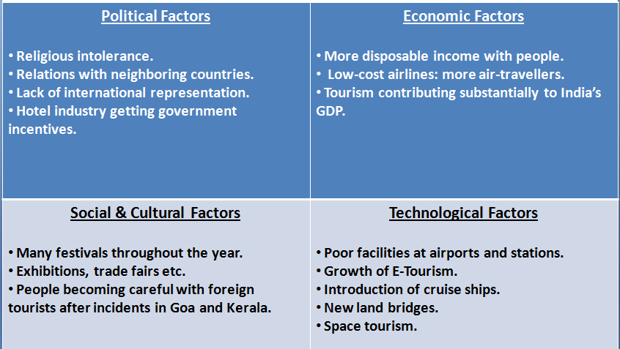
PEST analysis of Tourism

Slide 6
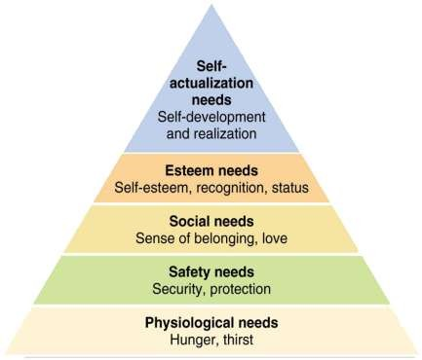
Core concepts in Marketing
Needs
– state of felt deprivation including physical, social, and individual needs.
Wants
Needs become wants when they are directed to specific objects that might satisfy the need.
Demands
Wants + buying power
Needs and Wants Fulfilled through a Marketing Offer :
Some combination of products, services, informatio n, or experiences offered to a market to satisfy a need or want.

Slide 7
Target markets & segmentation
Differences in
needs, behavior, demogra phics or psychographics are used to identify segments.
The segment served by the firm is called the target market.
The market offering is customized to the needs of the target market.
Market
The Marketplace is physical, as when one goes for shopping in a store.
Marketspace is digital, as when one goes shopping on the internet.
Metamarket is described as a cluster of complementary products and services that are closely related in the minds of consumers but are spread across a diverse set of industries.

Slide 8
Marketing Management Philosophies
The Production Concept
The production concept holds that customers will favor products that are available and highly affordable and that management should therefore focus on improving production and distribution efficiency.
The production concept is useful when:
1) Demand for a product
exceeds the supply.
2) The product's cost is too high and improved productivity is needed to bring it down.
The risk with this concept is in focusing too narrowly on company operations. Do not ignore the desires of the market.
The Product Concept
The product concept states that consumers will favor products that offer the most
quality, performance, and features, and that the organization should therefore devote its energy to making continuous product improvements.
1. Some manufacturers
mistakenly believe that if they
``build a better mousetrap'' consumers will beat a path to their door just for their product.
2. The product concept can also lead to “marketing myopia” the failure to see the challenges being presented by other products.

Slide 9
The selling Concept
– Many organizations follow the selling concept. The selling concept is the idea that consumers will not buy enough of the organization's products unless the organization undertakes a large-scale selling and promotion effort.
The Marketing Concept
The marketing concept holds that achieving organizational goals depends on determining the needs and wants of target markets and delivering the desired satisfactions more effectively and efficiently than competitors do.
The marketing and selling concepts are often confused. The primary differences are:
1. This concept is typically practiced with unsought goods (those that buyers do not normally think of buying).
2. To be successful with this concept, the organization must be good at tracking down the interested buyer.
1) The selling concept takes an 'inside-out'' perspective (focuses or existing products and uses heavy promotion and selling efforts).
3. Industries that use this concept usually have overcapacity. Their aim is to sell what they make rather than make what will sell in the market.
2) The marketing concept takes
an ``outside-in'' perspective
(focuses on customer
needs, values, and satisfactions).
– Many companies claim to adopt the marketing concept but really do not unless they commit to market-focused and customer- driven philosophies.
4. There are not only high risks with this approach but low satisfaction by customers.

Slide 10
The Societal Marketing Concept
– The societal marketing
concept holds that the organization should determine the needs, wants, and interests of target markets. It should then deliver the desired satisfactions more effectively and efficiently than competitors in a way that maintains or improves the consumer's and the society's well- being.
4) The societal concept
calls upon marketers to balance three considerations in setting their marketing policies:
a) Company profits.
b) Customer wants.
c) Society's
interests.
5) It has became good
1) The societal marketing concept is the newest of the marketing philosophies.
business to consider and think of society's interests when the organization makes marketing decisions.
2) It questions whether the
pure marketing concept is
adequate given the wide variety of societal problems and ills.
3) According to the societal marketing concept, the pure marketing concept overlooks possible conflicts between short-run consumer wants and long-run consumer welfare.

Slide 11
Economic importance of Marketing
Generation of revenue •
Large scale production
profit generation and marketing is the only source to meet its expenses and earn profits.
survival and growth of the business enterprise depends on the effectiveness and efficiency of marketing.
– marketing makes mass selling possible and thereby facilitates large scale production. Economies of large scale production help to reduce the cost of production per unit.
Economic Development
Customer satisfaction
– Marketing gives a boost to
transportation, banking, insurance, wareho using and other economics activities. It makes the economy strong and stable by balancing production with consumption. In fact, marketing is the kingpin that keeps the economy moving ahead.
Marketing helps to identify and satisfy the needs and wants of consumers.
Customer satisfaction has a important role in marketing without which a business can’t be successful.
Employment Generation
Foreign exchange earner
– marketing offers challenging and rewarding jobs to a large number of persons. It also generates employment in production by enlarging the scale of distribution and production.
– marketing helps in exploring foreign markets and in exporting goods and services. It is through marketing that a country earns valuable foreign exchange.
Higher standards of living
Creation of utilities
– Marketing is helpful in improving the standard of living of people by offering a wide variety of goods and services with freedom of choice. It has modernized the living standards of people through the supply of quality products at reasonable price.
– Marketing includes all activities involved in the creation of place utility, time utility and possession utility. Place utility is created by making goods available at the places where they are needed. Time utility is created by making goods available at the right time. Possession utility is created when goods are transferred to those who need them.

Slide 12
Tourism marketing
Tourism Demand
Highly unstable
Seasonal
Economical
political
Facilitators
Motivators
resistance factors
characteristics
Price elasticity – responsiveness of demand to change in price
Income elasticity – increase in individual’s income will not necessarily mean an increase in travel demand.
May result in an increase in quality product or destination.
Service Characteristics
Curiosity and desire to travel
Tourism marketing creates desire in tourists
Multifaceted activities
produces tourism product
Various sub sectors, that are in themselves complete industries
Tourism promotion in various forms in different socio economic structures
Marketing strategy is must

Slide 13
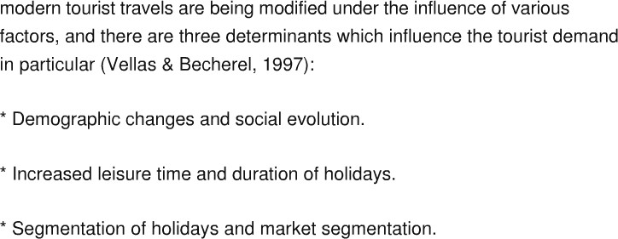
Tourism Product
Intangible, irreversible, perishable, lack of ownership,
Heterogeneity, Non-material, consumed where produced,
multiplicity of producers, highly unstable demand, dominant role of intermediaries, motivations.
Tourism Demand Determinants

Slide 14
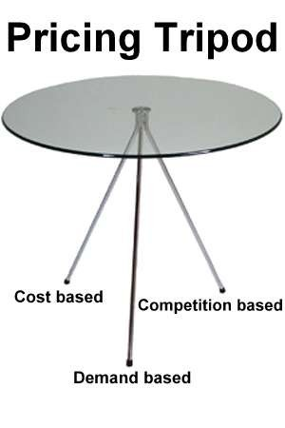
Tourism Marketing mix
2. Pricing
Cost
Demand
Competition
Duration
Mode of transport
Peak/Non-peak season
Destination
8 P’s in Tourism
Product
Place
Price
Promotion
People
Process
Productivity & Quality
Physical Evidence
1.Product
Accommodation
Attraction
Transportation
Recreation
Shopping
Restaurant

Slide 15
3. Promotion
– Different states highlighting about
their features.
E.g.
4. Place
The ‘destination’ is the important aspect in
place.
Travel agents, tour operators etc. are distribution points.
Proper infrastructure, transport and communication.
1. Kerala- ‘God’s own country’Highlighting about
backwaters, ayurveda, elephants, h ouseboats, beaches etc.
Incredible India’ and ‘Atithi Devo Bhava’ are taglines of Indian Tourism
‘Our guest is blessed’ and ‘Our visitor is god’
Aamir Khan as brand ambassador for ‘Atithi Devo Bhava’ for Indian tourism.
Use of websites to sell tourism.
Brochures, pamphlets, ads in
newspapers.
E.g. Raj, Kesari and Thomas Cook.
5. People
Role of people is very important in any
service.
In tourism, people involved are travel agents, guides, airline crew members, receptionist in hotel etc.
Contacts with people may be high, medium or low.
Examples:
1. In case of airlines:
The passenger will have high or medium contact with the air-hostess, ground- staff where as low or no contact with the pilot.
-
2. In case of railways:
- The passenger will have high or medium contact with travel agents or ticket issuer but low or no contact with the loco pilot.

Slide 16
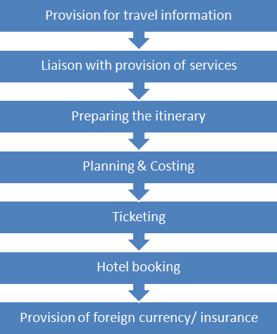
Travel agents should provide best deals to customers after understanding their requirements.
Guides should have in- depth knowledge about the locations, monuments, forts, history etc.
Employees should deliver what the company promises to the customer.
Physical appearance of guides also matters a lot.
6. Process

Slide 17
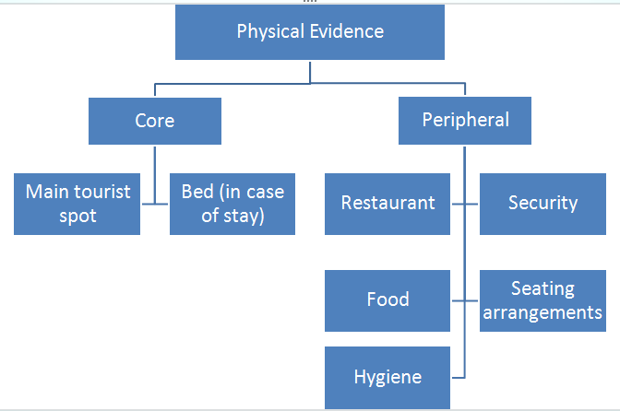
7. Physical Evidence
8. Productivity & Quality
It involves positioning the process, the overall destination, the intangibles etc.
It also involves positioning of tourism as National priority.

Slide 18
Tourism Demand Modeling and Forecasting
the explanatory variables for tourism demand include origin country
income, destination country tourism prices, substitute destination country tourism prices, tastes, etc. Empirical studies usually use living costs for tourists in the destination as the tourism price. Various demand models can be used to estimate and forecast tourism demand.
modeling tourism demand in a vector autoregressive (VAR) framework, to forecast the number of holidays spent by non residents
Tourism demand modeling and forecasting are very important for tourism-related business decision making
Stock effect,
market response effect
Analysis
Tourism demand can be measured in terms of
number of tourist visits from an origin country to a destination country
tourist expenditure by visitors from the origin country in the destination country
tourist nights spent by visitors in the destination country

