Slide 1
Algorithm Analysis
-- Dr.J.Thasleen Fathima
1

Slide 2
Algorithm
• An algorithm is a set of instructions to be followed to
solve a problem.
– There can be more than one solution (more than one
algorithm) to solve a given problem.
– An algorithm can be implemented using different
programming languages on different platforms.
• An algorithm must be correct. It should correctly solve
the problem.
– e.g. For sorting, this means even if (1) the input is already
sorted, or (2) it contains repeated elements.
• Once we have a correct algorithm for a problem, we
have to determine the efficiency of that algorithm.
2

Slide 3
Algorithmic Performance
There are two aspects of algorithmic performance:
• Time
• Instructions take time.
• How fast does the algorithm perform?
• What affects its runtime?
• Space
• Data structures take space
• What kind of data structures can be used?
• How does choice of data structure affect the runtime?
➢ We will focus on time:
– How to estimate the time required for an algorithm
– How to reduce the time required
3

Slide 4
Analysis of Algorithms
• Analysis of Algorithms is the area of computer science that
provides tools to analyze the efficiency of different methods of
solutions.
• How do we compare the time efficiency of two algorithms that
solve the same problem?
Naïve Approach: implement these algorithms in a programming
language (C++), and run them to compare their time
requirements. Comparing the programs (instead of algorithms)
has difficulties.
– How are the algorithms coded?
• Comparing running times means comparing the implementations.
• We should not compare implementations, because they are sensitive to programming
style that may cloud the issue of which algorithm is inherently more efficient.
– What computer should we use?
• We should compare the efficiency of the algorithms independently of a particular
computer.
– What data should the program use?
• Any analysis must be independent of specific data.
4

Slide 5
Analysis of Algorithms
• When we analyze algorithms, we should employ
mathematical techniques that analyze algorithms
independently of specific
implementations, computers, or data.
• To analyze algorithms:
– First, we start to count the number of significant
operations in a particular solution to assess its
efficiency.
– Then, we will express the efficiency of algorithms
using growth functions.
5

Slide 6
The Execution Time of Algorithms
• Each operation in an algorithm (or a program) has a cost.
➔ Each operation takes a certain of time.
count = count + 1;➔ take a certain amount of time, but it is constant
A sequence of operations:
count = count + 1;
sum = sum + count;
Cost: c₁
Cost: c₂
➔ Total Cost = c₁ + c₂
6

Slide 7
The Execution Time of Algorithms (cont.)
Example: Simple If-Statement
Cost
c1
Times
if (n < 0)
absval = -n
else
absval = n;
1
1
c2
c3
1
Total Cost <= c1 + max(c2,c3)
7

Slide 8
The Execution Time of Algorithms (cont.)
Example: Simple Loop
Cost
c1
Times
i = 1;
1
sum = 0;
c2
1
while (i <= n) {
i = i + 1;
sum = sum + i;
}
c3
n+1
n
c4
c5
n
Total Cost = c1 + c2 + (n+1)*c3 + n*c4 + n*c5
➔ The time required for this algorithm is proportional to n
8

Slide 9
The Execution Time of Algorithms (cont.)
Example: Nested Loop
Cost
c1
Times
i=1;
1
sum = 0;
c2
1
while (i <= n) {
j=1;
c3
c4
n+1
n
while (j <= n) {
c5
n*(n+1)
sum = sum + i; c6
n*n
n*n
j = j + 1;
c7
}
i = i +1;
c8
n
}
Total Cost = c1 + c2 + (n+1)*c3 + n*c4 + n*(n+1)*c5+n*n*c6+n*n*c7+n*c8
➔ The time required for this algorithm is proportional to n²
9

Slide 10
General Rules for Estimation
• Loops: The running time of a loop is at most the running time
of the statements inside of that loop times the number of
iterations.
• Nested Loops: Running time of a nested loop containing a
statement in the inner most loop is the running time of statement
multiplied by the product of the sized of all loops.
• Consecutive Statements: Just add the running times of those
consecutive statements.
• If/Else: Never more than the running time of the test plus the
larger of running times of S1 and S2.
10

Slide 11
Algorithm Growth Rates
• We measure an algorithm’s time requirement as a function of the
problem size.
– Problem size depends on the application: e.g. number of elements in a list for a
sorting algorithm, the number disks for towers of hanoi.
• So, for instance, we say that (if the problem size is n)
– Algorithm A requires 5*n² time units to solve a problem of size n.
– Algorithm B requires 7*n time units to solve a problem of size n.
• The most important thing to learn is how quickly the algorithm’s
time requirement grows as a function of the problem size.
– Algorithm A requires time proportional to n².
– Algorithm B requires time proportional to n.
• An algorithm’s proportional time requirement is known as
growth rate.
• We can compare the efficiency of two algorithms by comparing
their growth rates.
11

Slide 12
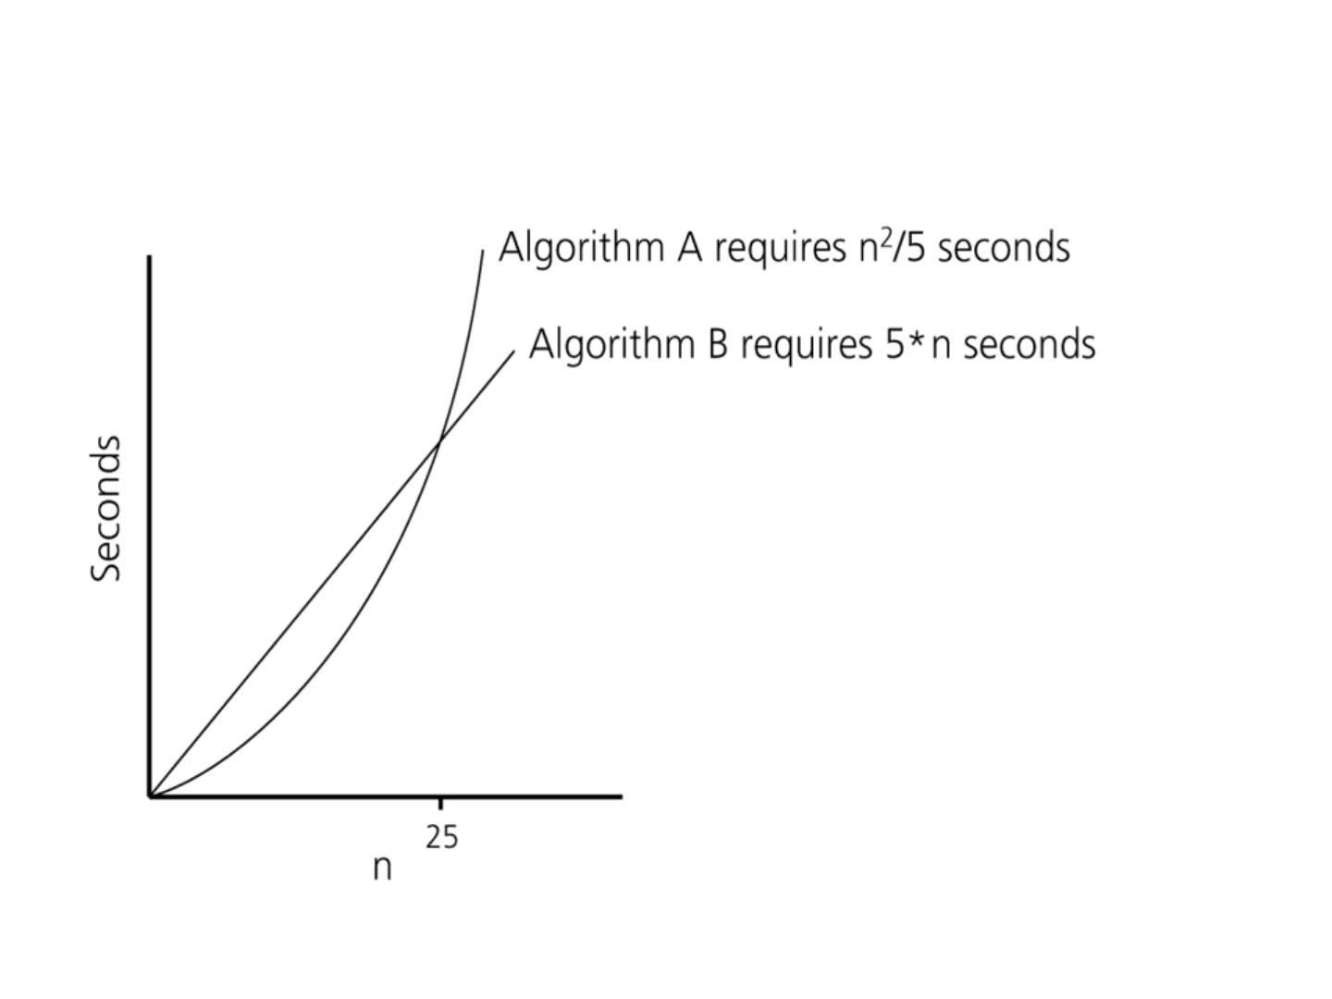
Algorithm Growth Rates (cont.)
Time requirements as a function
of the problem size n
12

Slide 13
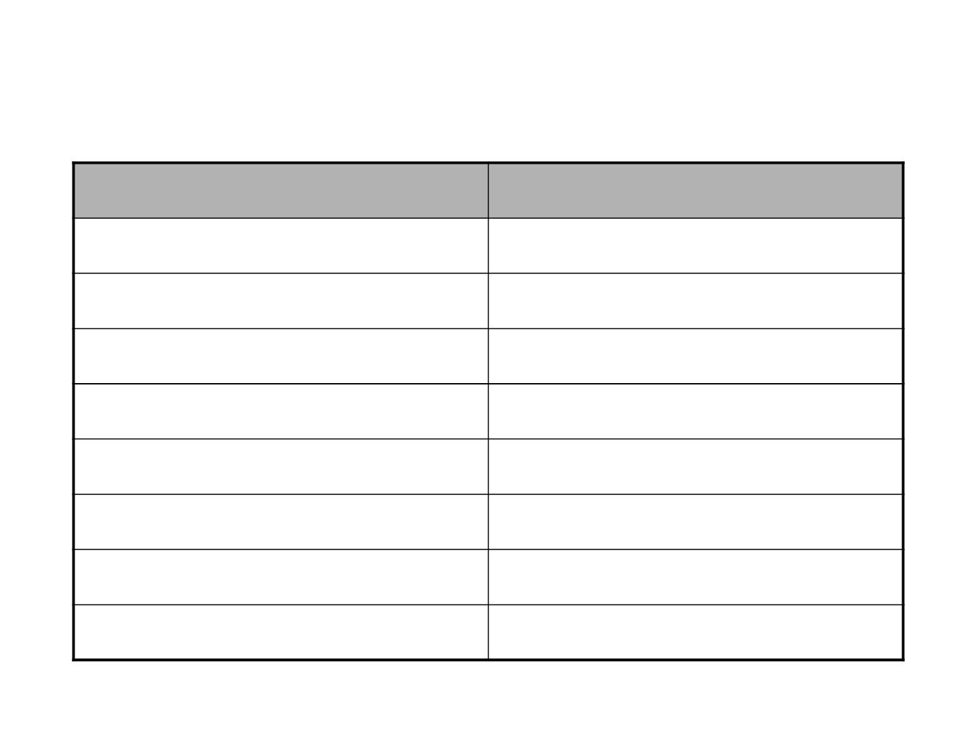
Common Growth Rates
Function
c
Growth Rate Name
Constant
log N
log²N
N
Logarithmic
Log-squared
Linear
N log N
N²
Quadratic
Cubic
N³
2^{N}
Exponential
13

Slide 14
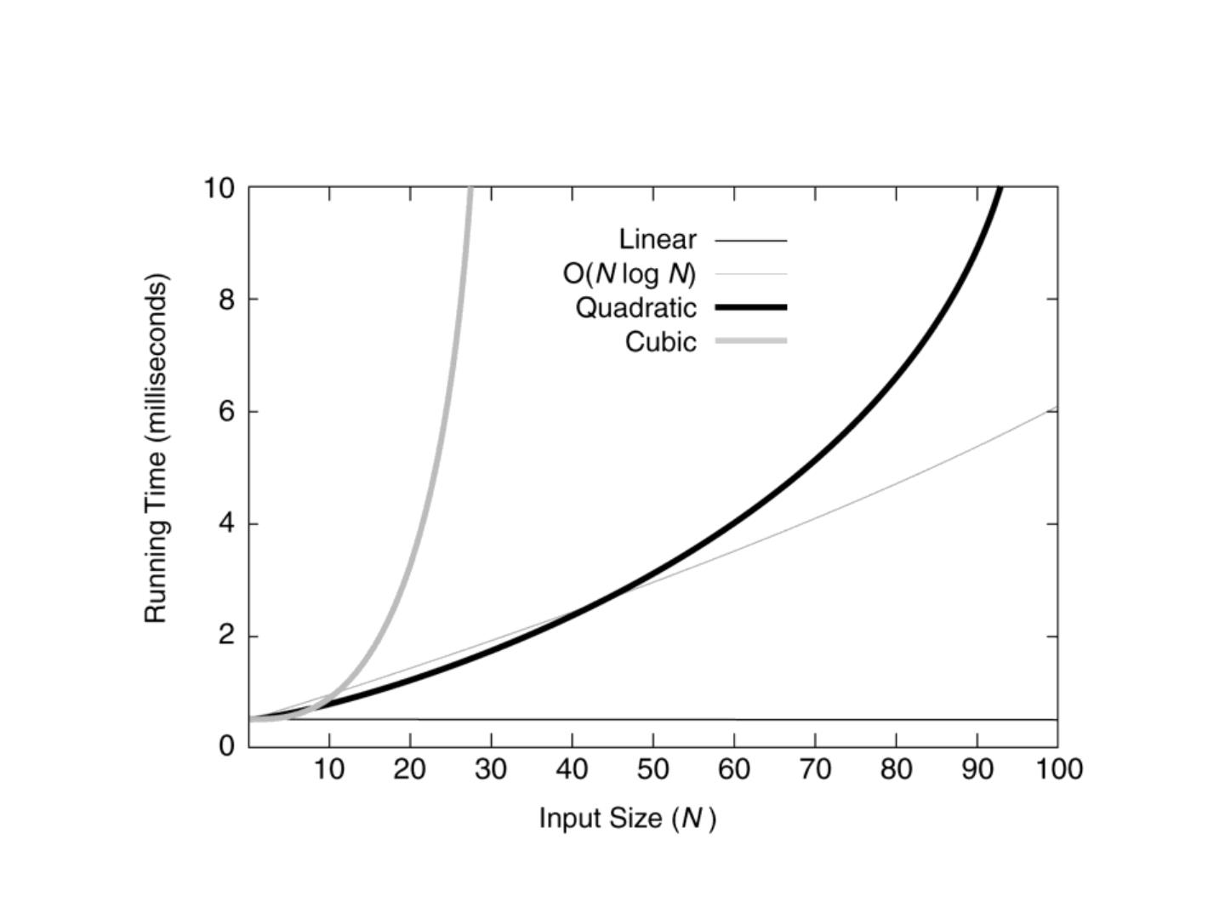
Figure 6.1
Running times for small inputs
14

Slide 15
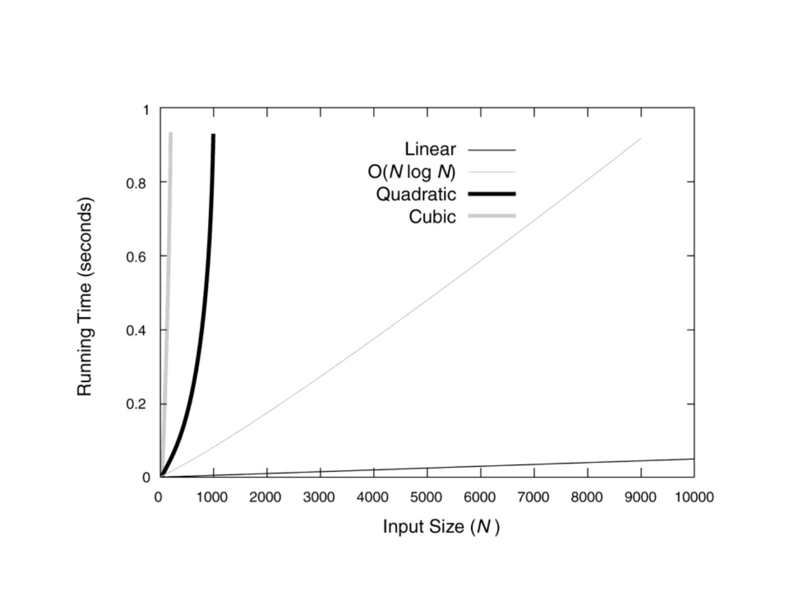
Figure 6.2
Running times for moderate inputs
15

Slide 16
Order-of-Magnitude Analysis and Big O
Notation
• If Algorithm A requires time proportional to f(n), Algorithm A is
said to be order f(n), and it is denoted as O(f(n)).
• The function f(n) is called the algorithm’s growth-rate
function.
• Since the capital O is used in the notation, this notation is called
the Big O notation.
• If Algorithm A requires time proportional to n², it is O(n²).
• If Algorithm A requires time proportional to n, it is O(n).
16

Slide 17
Definition of the Order of an Algorithm
Definition:
Algorithm A is order f(n) – denoted as O(f(n)) –
if constants k and n₀ exist such that A requires
no more than k*f(n) time units to solve a problem
of size n  n₀.
• The requirement of n  n₀ in the definition of O(f(n)) formalizes
the notion of sufficiently large problems.
– In general, many values of k and n can satisfy this definition.
17

Slide 18
Order of an Algorithm
• If an algorithm requires n²–3*n+10 seconds to solve a problem
size n. If constants k and n₀ exist such that
k*n² > n²–3*n+10 for all n  n₀ .
the algorithm is order n² (In fact, k is 3 and n₀ is 2)
3*n² > n²–3*n+10 for all n  2 .
Thus, the algorithm requires no more than k*n² time units for n 
n ,
0
So it is O(n²)
18

Slide 19
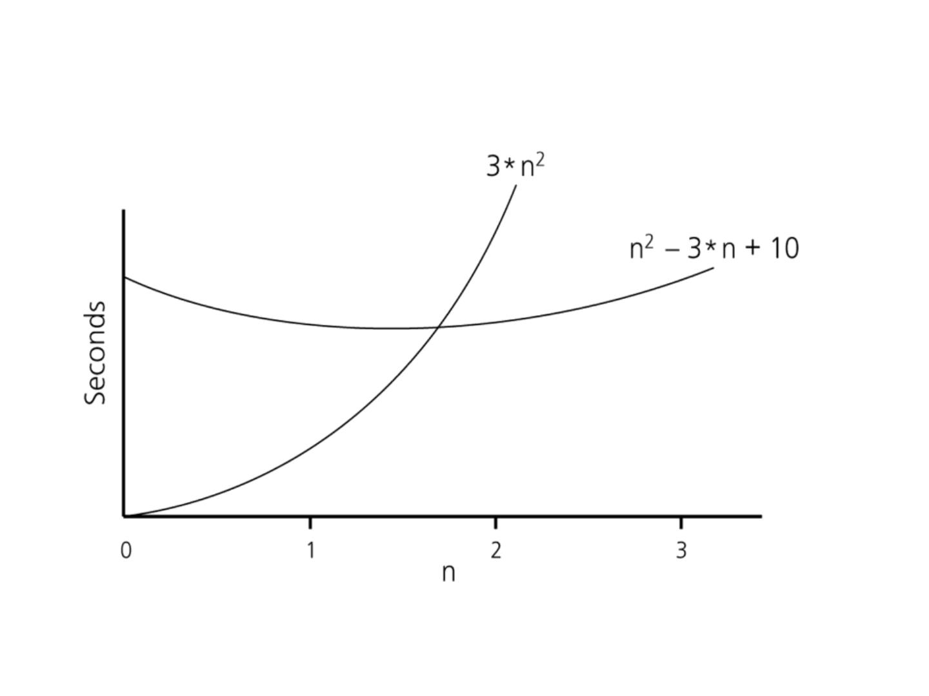
Order of an Algorithm (cont.)
19

Slide 20
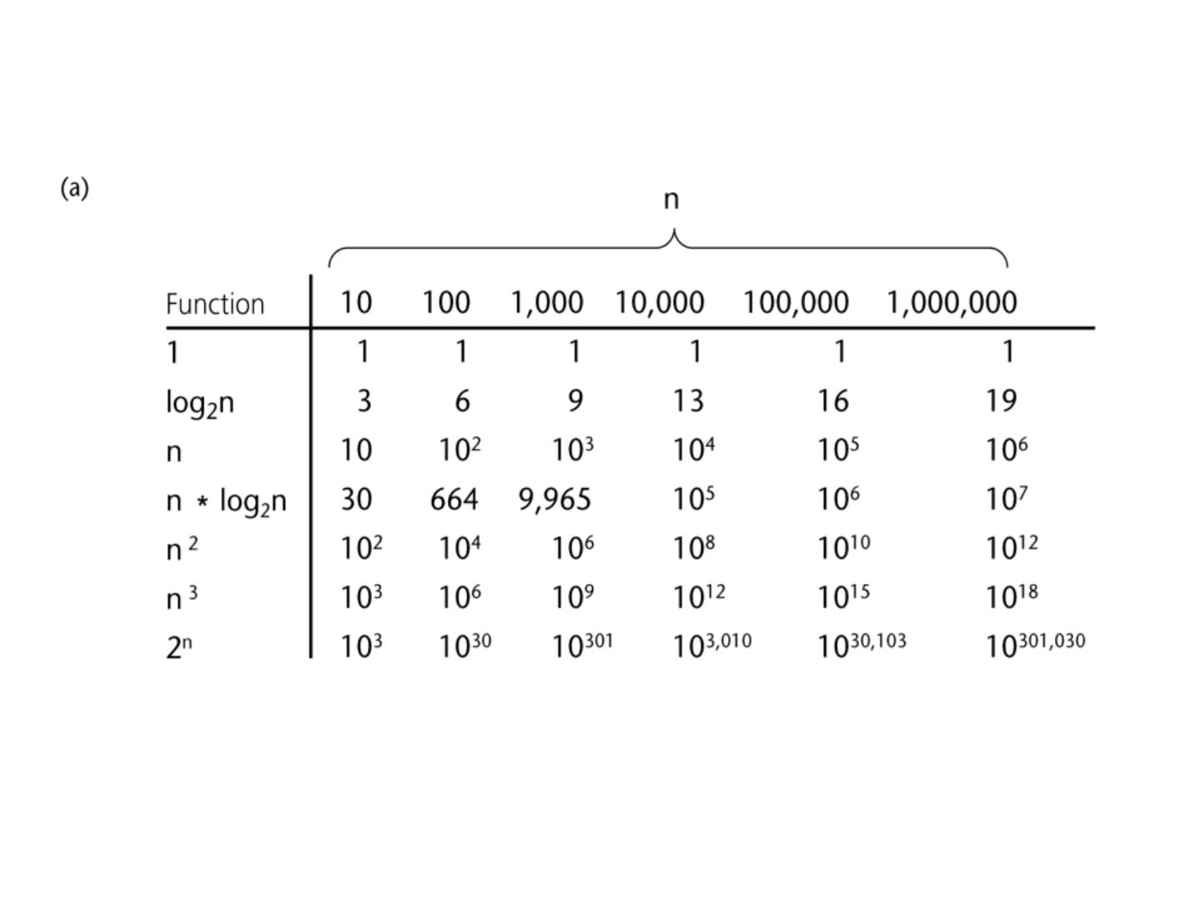
A Comparison of Growth-Rate Functions
20

Slide 21
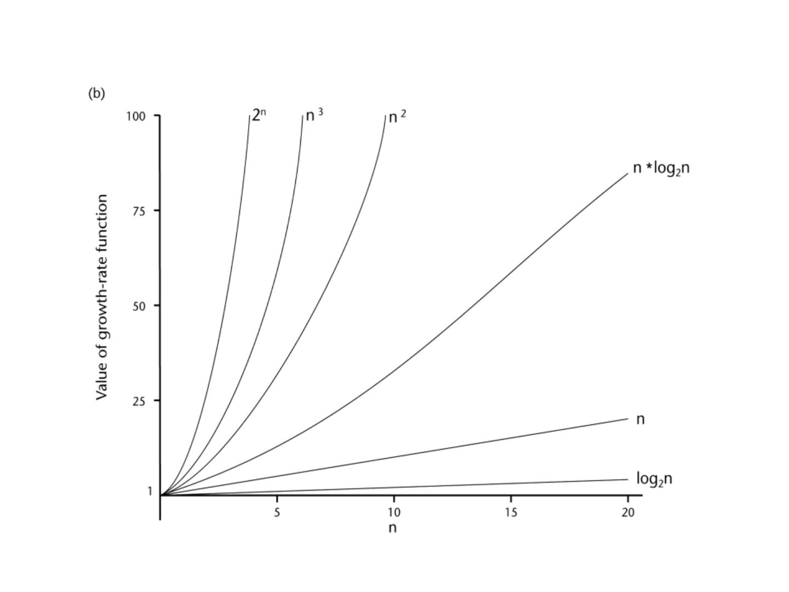
A Comparison of Growth-Rate Functions (cont.)
21

Slide 22
Growth-Rate Functions
O(1)
Time requirement is constant, and it is independent of the problem’s size.
Time requirement for a logarithmic algorithm increases increases slowly
as the problem size increases.
O(log₂n)
O(n)
Time requirement for a linear algorithm increases directly with the size
of the problem.
O(n*log n) Time requirement for a n*log n algorithm increases more rapidly than
2
2
a linear algorithm.
O(n²)
O(n³)
O(2^{n})
Time requirement for a quadratic algorithm increases rapidly with the
size of the problem.
Time requirement for a cubic algorithm increases more rapidly with the
size of the problem than the time requirement for a quadratic algorithm.
As the size of the problem increases, the time requirement for an
exponential algorithm increases too rapidly to be practical.
22

Slide 23
Growth-Rate Functions
• If an algorithm takes 1 second to run with the problem size
8, what is the time requirement (approximately) for that algorithm
with the problem size 16?
• If its order is:
O(1)
➔ T(n) = 1 second
O(log n) ➔ T(n) = (1*log 16) / log 8 = 4/3 seconds
2
2
2
O(n)
➔ T(n) = (1*16) / 8 = 2 seconds
O(n*log n) ➔ T(n) = (1*16*log 16) / 8*log 8 = 8/3 seconds
2
2
2
O(n²)
O(n³)
O(2^{n})
➔ T(n) = (1*16²) / 8² = 4 seconds
➔ T(n) = (1*16³) / 8³ = 8 seconds
➔ T(n) = (1*2¹⁶) / 2⁸ = 2⁸ seconds = 256 seconds
23

Slide 24
Properties of Growth-Rate Functions
1. We can ignore low-order terms in an algorithm’s growth-rate
function.
– If an algorithm is O(n³+4n²+3n), it is also O(n³).
– We only use the higher-order term as algorithm’s growth-rate function.
2. We can ignore a multiplicative constant in the higher-order term
of an algorithm’s growth-rate function.
– If an algorithm is O(5n³), it is also O(n³).
3. O(f(n)) + O(g(n)) = O(f(n)+g(n))
– We can combine growth-rate functions.
– If an algorithm is O(n³) + O(4n), it is also O(n³ +4n²)  So, it is O(n³).
– Similar rules hold for multiplication.
24

Slide 25
Some Mathematical Facts
• Some mathematical equalities are:
n

2

n * (n 1) n
i  1  2  ...  n 

i1
2
2
n


3

n * (n 1) * (2n 1) n
2
   
i 1 4 ... n
2


i1
6
3
n 1

i
n 
¹  
    
2 0 1 2 ... 2
n
2 1
i0
25

Slide 26
Growth-Rate Functions – Example1
Cost
c1
Times
i = 1;
1
sum = 0;
c2
1
while (i <= n) {
i = i + 1;
sum = sum + i;
}
c3
c4
c5
n+1
n
n
T(n) = c1 + c2 + (n+1)*c3 + n*c4 + n*c5
= (c3+c4+c5)*n + (c1+c2+c3)
= a*n + b
➔ So, the growth-rate function for this algorithm is O(n)
26

Slide 27
Growth-Rate Functions – Example2
Cost
c1
Times
i=1;
1
sum = 0;
c2
1
while (i <= n) {
j=1;
c3
c4
n+1
n
while (j <= n) {
c5
n*(n+1)
n*n
n*n
sum = sum + i; c6
j = j + 1;
i = i +1;
c7
c8
}
n
}
T(n)
= c1 + c2 + (n+1)*c3 + n*c4 + n*(n+1)*c5+n*n*c6+n*n*c7+n*c8
= (c5+c6+c7)*n² + (c3+c4+c5+c8)*n + (c1+c2+c3)
= a*n² + b*n + c
 So, the growth-rate function for this algorithm is O(n²)
27

Slide 28
Growth-Rate Functions – Example3
Cost
Times
for (i=1; i<=n; i++)
c1
n+1
n

j 1
n
( j  1)
for (j=1; j<=i; j++) c2
for (k=1; k<=j; k++) c3
j
 
(k  1)
j 1 k 1
n
j
x=x+1;
c4
 
k
j 1 k 1
n
n
j
n
j
T(n)
= c1*(n+1) + c2*(

( j  1)
) + c3* (
 
(k  1)
) + c4*(
 
k
)
j 1

1
j 1 k 1
j
1 k
= a*n³ + b*n² + c*n + d
 So, the growth-rate function for this algorithm is O(n³)
28

Slide 29
Growth-Rate Functions – Recursive Algorithms
void hanoi(int n, char source, char dest, char spare) {
if (n > 0) {
Cost
c1
hanoi(n-1, source, spare, dest);
cout << "Move top disk from pole " << source
<< " to pole " << dest << endl;
hanoi(n-1, spare, dest, source);
} }
c2
c3
c4
• The time-complexity function T(n) of a recursive algorithm is
defined in terms of itself, and this is known as recurrence equation
for T(n).
• To find the growth-rate function for a recursive algorithm, we have
to solve its recurrence relation.
29

Slide 30
Growth-Rate Functions – Hanoi Towers
• What is the cost of hanoi(n,’A’,’B’,’C’)?
when n=0
T(0) = c1
when n>0
T(n) = c1 + c2 + T(n-1) + c3 + c4 + T(n-1)
= 2*T(n-1) + (c1+c2+c3+c4)
= 2*T(n-1) + c ⬅ recurrence equation for the growth-rate
function of hanoi-towers algorithm
• Now, we have to solve this recurrence equation to find the growth-rate
function of hanoi-towers algorithm
30

Slide 31
Growth-Rate Functions – Hanoi Towers (cont.)
• There are many methods to solve recurrence equations, but we will use a simple
method known as repeated substitutions.
T(n) = 2*T(n-1) + c
= 2 * (2*T(n-2)+c) + c
= 2 * (2* (2*T(n-3)+c) + c) + c
= 2³ * T(n-3) + (2²+2¹+2⁰)*c
when substitution repeated i-1th times
= 2^{i} * T(n-i) + (2^{i-1}+ ... +2¹+2⁰)*c
when i=n
(assuming n>2)
= 2^{n} * T(0) + (2^{n-1}+ ... +2¹+2⁰)*c
n 1
= 2^{n} * c1 + (  )*c
i
2
i  0
= 2^{n} * c1 + ( 2^{n}-1 )*c = 2^{n}*(c1+c) – c  So, the growth rate function is O(2^{n})
31

Slide 32
What to Analyze
• An algorithm can require different times to solve different
problems of the same size.
– Eg. Searching an item in a list of n elements using sequential search. ➔ Cost:
1,2,...,n
• Worst-Case Analysis –The maximum amount of time that an
algorithm require to solve a problem of size n.
– This gives an upper bound for the time complexity of an algorithm.
– Normally, we try to find worst-case behavior of an algorithm.
• Best-Case Analysis –The minimum amount of time that an
algorithm require to solve a problem of size n.
– The best case behavior of an algorithm is NOT so useful.
• Average-Case Analysis –The average amount of time that an
algorithm require to solve a problem of size n.
– Sometimes, it is difficult to find the average-case behavior of an algorithm.
– We have to look at all possible data organizations of a given size n, and their
distribution probabilities of these organizations.
– Worst-case analysis is more common than average-case analysis.
32

Slide 33
What is Important?
• An array-based list retrieveoperation is O(1), a linked-list-
based list retrieveoperation is O(n).
• But insert and delete operations are much easier on a linked-list-
based list implementation.
➔ When selecting the implementation of an Abstract Data Type
(ADT), we have to consider how frequently particular ADT
operations occur in a given application.
• If the problem size is always small, we can probably ignore the
algorithm’s efficiency.
– In this case, we should choose the simplest algorithm.
33

Slide 34
What is Important? (cont.)
• We have to weigh the trade-offs between an algorithm’s time
requirement and its memory requirements.
• We have to compare algorithms for both style and efficiency.
– The analysis should focus on gross differences in efficiency and not reward coding
tricks that save small amount of time.
– That is, there is no need for coding tricks if the gain is not too much.
– Easily understandable program is also important.
• Order-of-magnitude analysis focuses on large problems.
34

Slide 35
Sequential Search
int sequentialSearch(const int a[], int item, int n){
for (int i = 0; i < n && a[i]!= item; i++);
if (i == n)
return –1;
return i;
}
Unsuccessful Search:
➔ O(n)
Successful Search:
Best-Case: item is in the first location of the array O(1)
Worst-Case: item is in the last location of the array O(n)
Average-Case: The number of key comparisons 1, 2, ..., n
n

i
2

n) / 2
i1

(n
 O(n)
n
n
35

Slide 36
Binary Search
int binarySearch(int a[], int size, int x) {
int low =0;
int high = size –1;
int mid;
// mid will be the index of
// target when it’s found.
while (low <= high) {
mid = (low + high)/2;
if (a[mid] < x)
low = mid + 1;
else if (a[mid] > x)
high = mid – 1;
else
return mid;
}
return –1;
}
36

Slide 37
Binary Search – Analysis
• For an unsuccessful search:
– The number of iterations in the loop is log₂n✗ + 1
➔ O(log₂n)
• For a successful search:
– Best-Case: The number of iterations is 1.
➔ O(1)
– Worst-Case: The number of iterations is log n✗ +1 ➔ O(log n)
2
2
– Average-Case:
The avg. # of iterations < log₂n
➔ O(log₂n)
0 1 2 3 4 5 6 7 ← an array with size 8
3 2 3 1 3 2 3 4 ← # of iterations
The average # of iterations = 21/8 < log₂8
37

Slide 38
How much better is O(log₂n)?
n
O(log₂n)
16
4
64
6
256
8
1024 (1KB)
16,384
131,072
262,144
524,288
10
14
17
18
19
1,048,576 (1MB)
20
30
1,073,741,824 (1GB)
38

