Slide 1

STACK
Dr.J.Thasleen Fathima

Slide 2
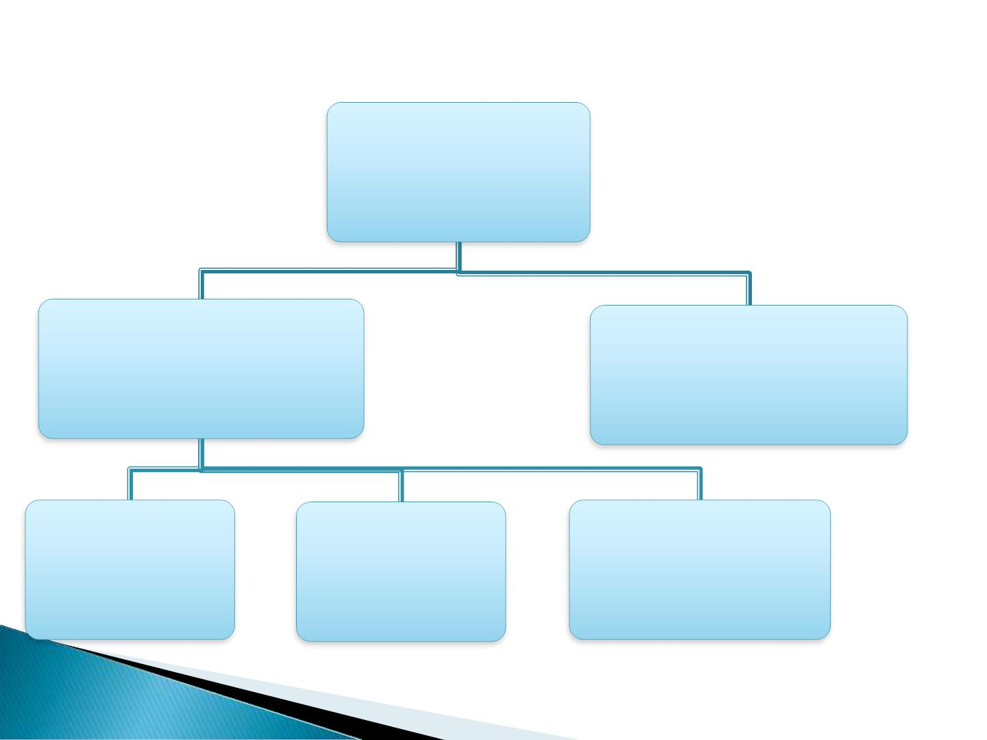
DATA
STRUCTURE
NON LINEAR
DATA
STRUCTURE
LINEAR DATA
STRUCTURE
QUEUE
STACK
ARRAY

Slide 3

What is Linear Data Structure
➢In linear data structure, data is arranged
in linear sequence.
➢ Data items can be traversed in a single
run.
➢ In linear data structure elements are
accessed or placed in contiguous(together
in sequence) memory location.

Slide 4

WHAT Is
➢ A stack is called a last-in-first-out (LIFO)
collection. This means that the last thing
we added (pushed) is the first thing that
gets pulled (popped) off.
 A stack is a sequence of items that are
accessible at only one end of the sequence.

Slide 5

EXAMPLES OF STACK:

Slide 6
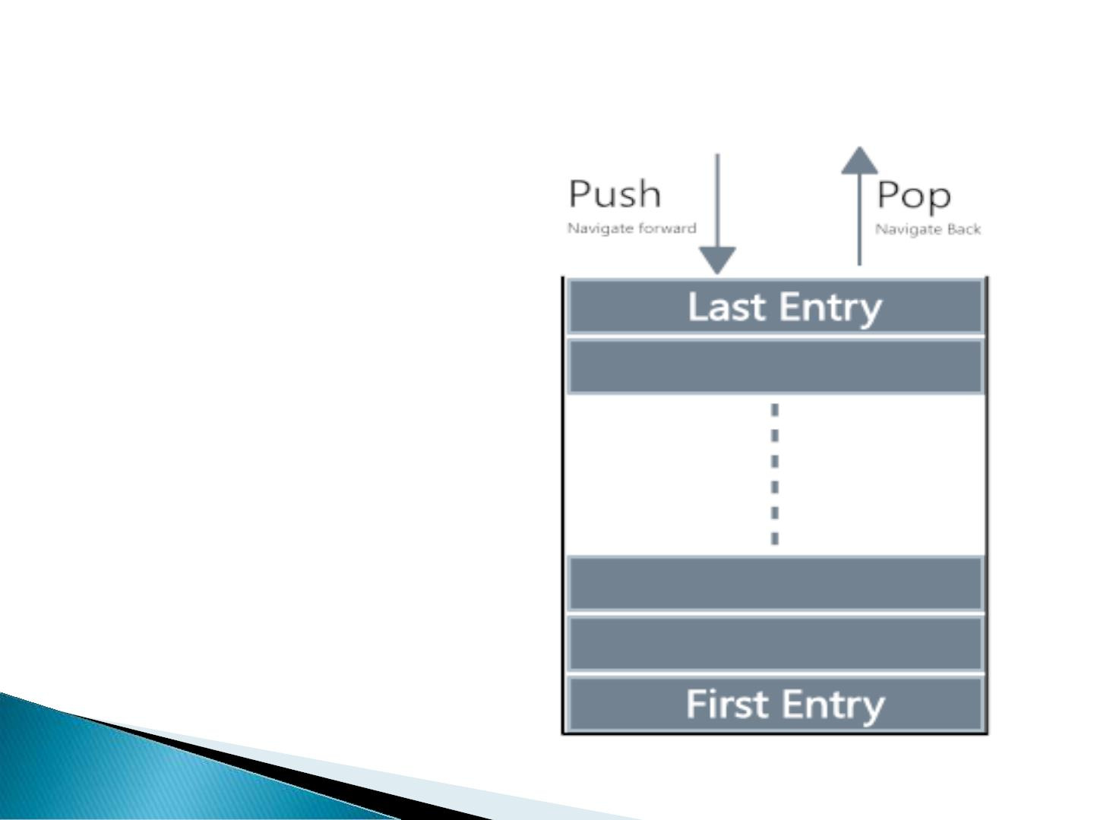
Operations that can be performed
on STACK:
PUSH.
➢
➢ POP.

Slide 7
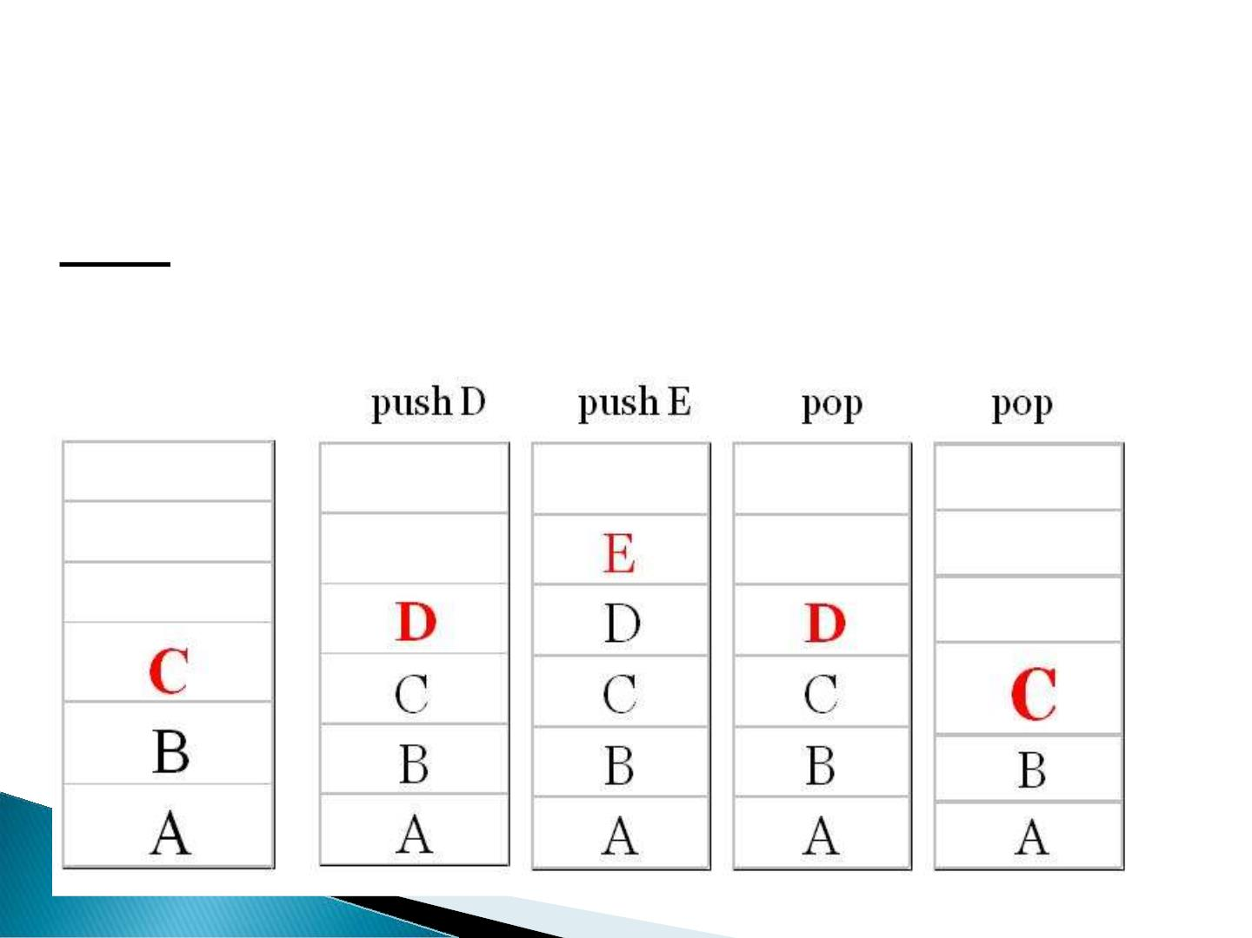
PUSH : It is used to insert items into the stack.
POP: It is used to delete items from stack.
TOP: It represents the current location of data
in stack.

Slide 8
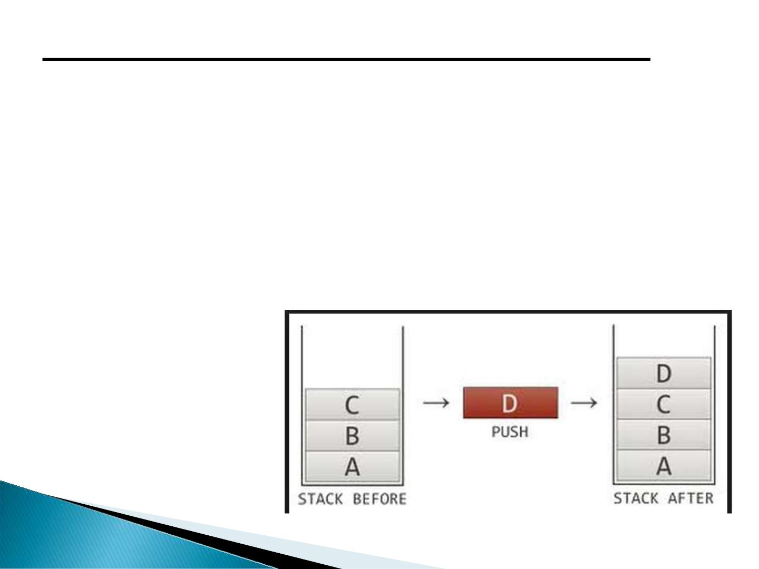
ALGORITHM OF INSERTION IN
STACK: (PUSH)
1. Insertion(a,top,item,max)
2. If top=max then
print ‘STACK OVERFLOW’
exit
else
3. top=top+1
end if
4. a[top]=item
5. Exit

Slide 9
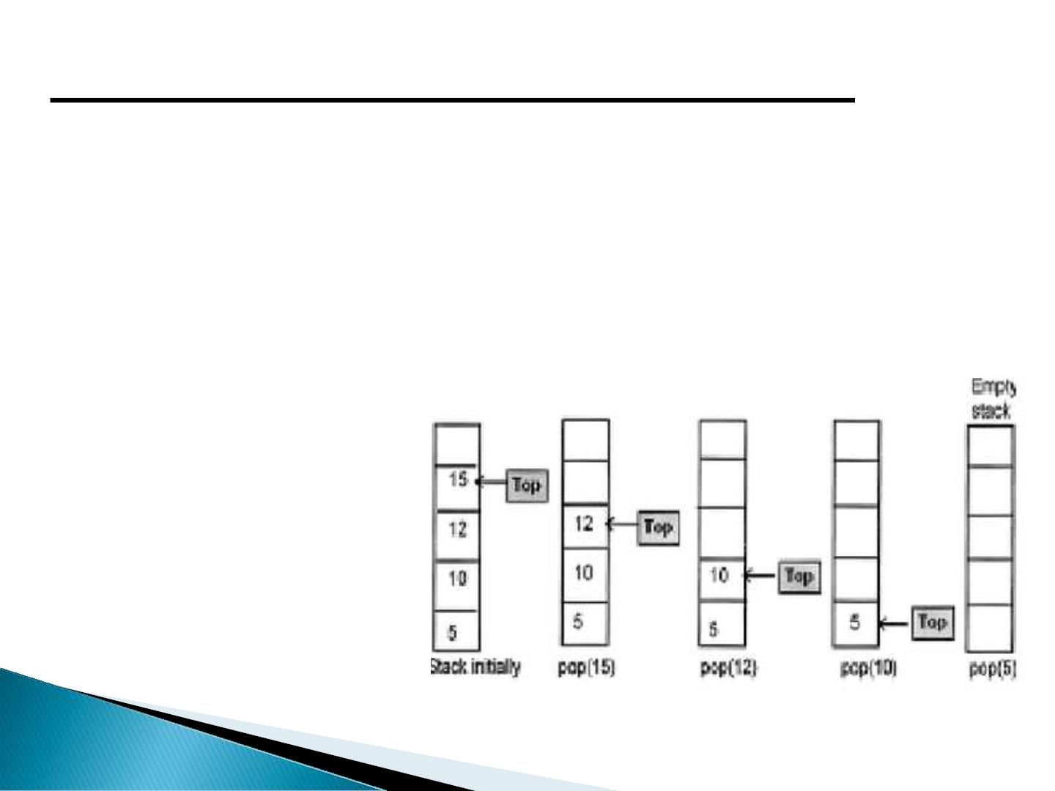
ALGORITHM OF DELETION IN
STACK: (POP)
1. Deletion(a,top,item)
2. If top=0 then
print ‘STACK UNDERFLOW’
exit
else
3. item=a[top]
end if
4. top=top-1
5. Exit

Slide 10
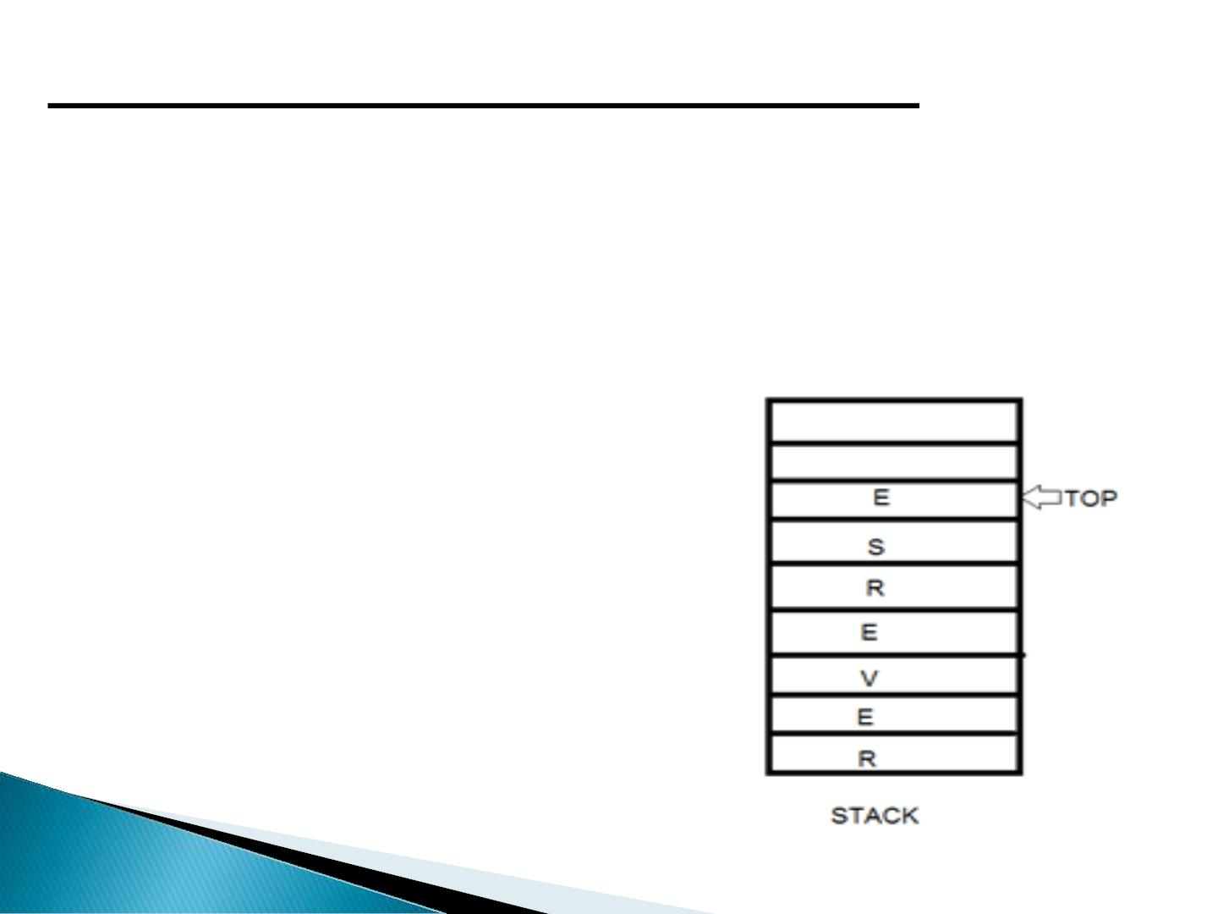
ALGORITHM OF DISPLAY IN
STACK:
1.Display(top,i,a[i])
2.If top=0 then
Print ‘STACK EMPTY’
Exit
Else
3.For i=top to 0
Print a[i]
End for
4.exit

Slide 11
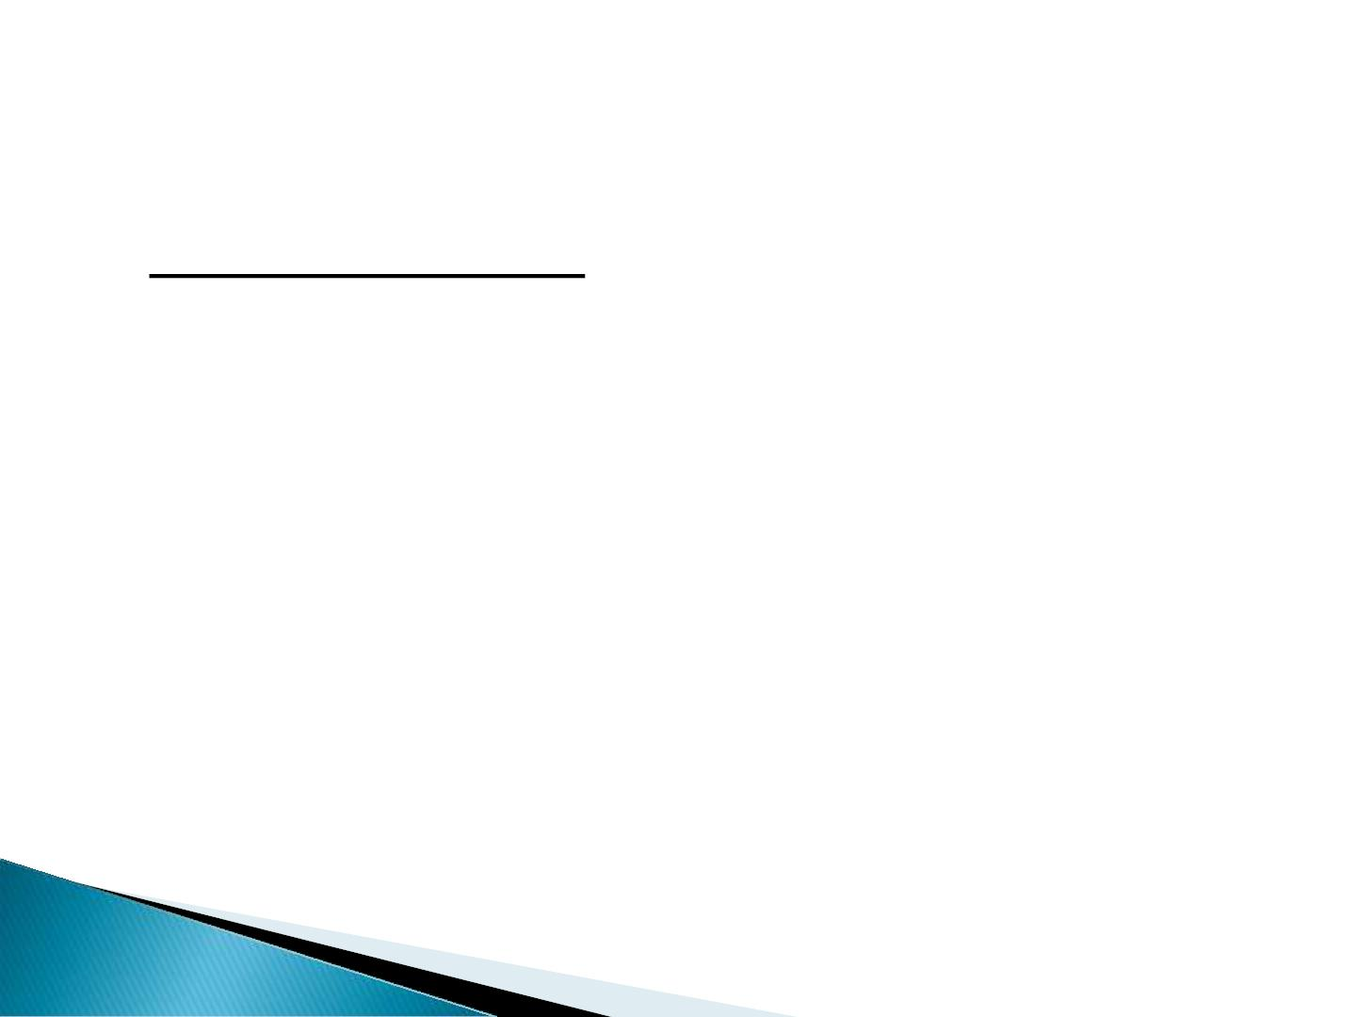
APPLICATIONS OF STACKS ARE:
I. Reversing Strings:
• A simple application of stack is reversing strings.
To reverse a string , the characters of string are
pushed onto the stack one by one as the string
is read from left to right.
• Once all the characters
of string are pushed onto stack, they are
popped one by one. Since the character last
pushed in comes out first, subsequent pop
operation results in the reversal of the string.

Slide 12
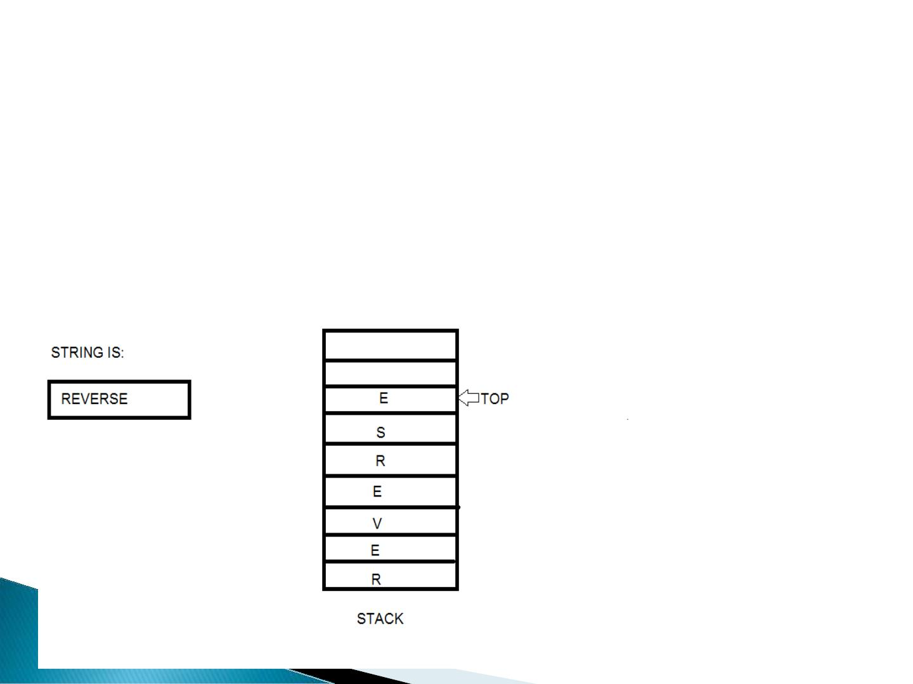
For example:
To reverse the string ‘REVERSE’ the string is
read from left to right and its characters are
pushed . LIKE:

Slide 13

II. Checking the validity of an expression
containing nested parenthesis:
• Stacks are also used to check whether a given
arithmetic expressions containing nested
parenthesis is properly parenthesized.
• The program for checking the validity of an
expression verifies that for each left parenthesis
braces or bracket ,there is a corresponding
closing symbol and symbols are appropriately
nested.

Slide 14

For example:
VALID INPUTS INVALID INPUTS
{ }
{ ( }
( { [ ] } ) ( [ ( ( ) ] )
{ [ ] ( ) } { } [ ] )
[ { ( { } [ ] ( { [ { ) } ( ] } ]
})}]

Slide 15
III. Evaluating arithmetic expressions:
INFIX notation:
The general way of writing arithmetic
expressions is known as infix notation.
e.g, (a+b)
PREFIX notation:
e.g, +AB
POSTFIX notation:
e.g: AB+

Slide 16
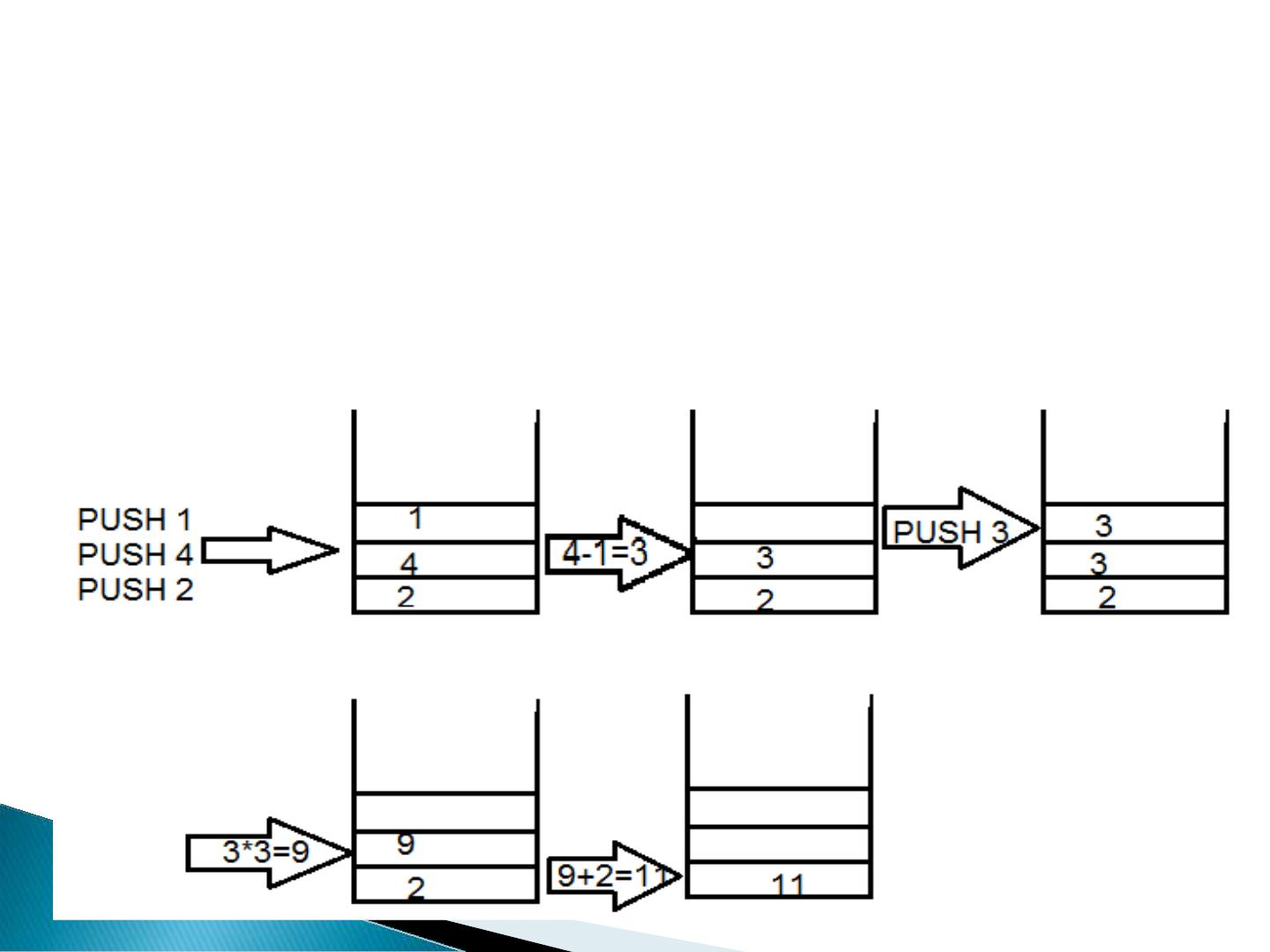
Conversion of INFIX to POSTFIX conversion:
Example: 2+(4-1)*3
2+41-*3
step1
step2
step3
step4
2+41-3*
241-3*+

Slide 17
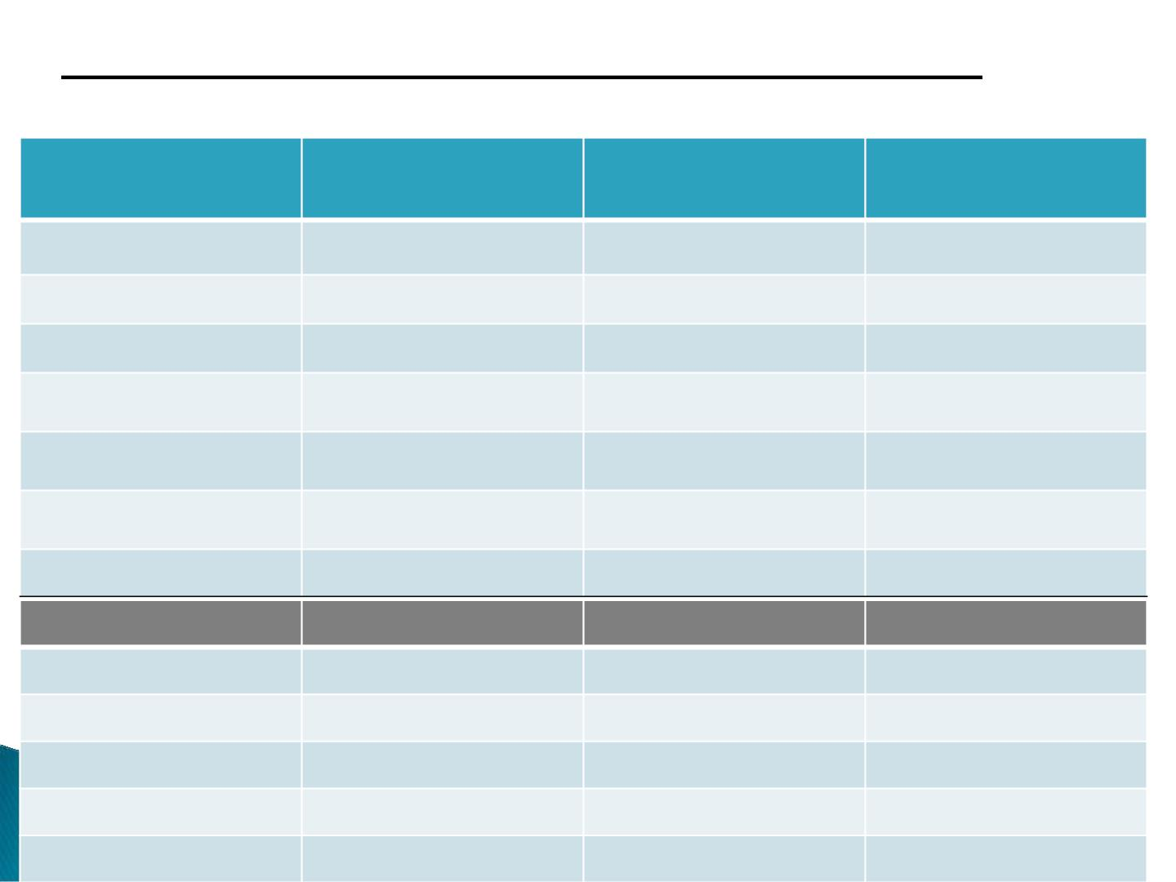
CONVERSION OF INFIX INTO POSTFIX
2+(4-1)*3 into 241-3*+
CURRENT
ACTION
STACK STATUS
POSTFIX
SYMBOL
PERFORMED
EXPRESSION
(
PUSH C
C
2
2
+
(
2
2
24
PUSH +
PUSH (
(+
(+(
4
-
24
PUSH -
POP
(+(-
241
1
)
241-
241-
(+
*
3
PUSH *
(+*
241-
241-3
241-3*
241-3*+
POP *
POP +
)

