Slide 1
Glycolysis
(oR)
Embden Meyerhof Pathway
Prepared by
Dr. P. Sivamanikandan
Assistant Professor of Microbiology
Hajee Karutha Rowther Howdia College(Autonomous),
Uthamapalayam-625533

Slide 3
INTRODUCTION
Glycolysis is a process. The oxidation of glucose to pyruvate and lactate is called glycolysis. The term glycolysis means splitting of sugar.
It is also named as the Embden Meyerhof-Parnas pathway. It is discovery in the 1930s.
Glucose 6 phosphate is a principal compound in the metabolism of glucose.
Glycolysis is an anaerobic phase of carbohydrate metabolism.
All the enzyme of glycolysis are found in the extra mitochondrial soluble part of the cell and hence glycolysis occurs in the cytoplasm of the cells outside the mitochondria.

Slide 4
Reaction of Glycolysis
Step 1 – Phosphorylation
Glucose is converted to glucose 6 -phosphate.
This reaction is catalyzed by the enzyme hexokinase.
This reaction is irreversible.
ATP acts as a phosphate donor.
The presence of magnesium ions is necessary. The reaction occurs mainly in liver and muscle.
Step 2 – Isomerization
Glucose 6- phosphate is converted to fructose 6- phosphate.
This reaction is catalyzed by the enzyme phospho hexose isomerase.

Slide 5
Step 3 – Phosphorylation
Fructose 6 -phosphate is converted to Fructose 1,6- diphosphate
ATP acts as a phosphate donor.
This reaction is catalyzed by the enzyme phospho fructo kinase.
Step 4 – Cleavage of Fructose 1,6-diphosphate
This reaction is involves the splitting of fructose 1,6- diphosphate molecule.
The splitting is Glyceraldehyde 3-phosphate and dihydroxy acetone phosphate.
This reaction is catalyzed by the enzyme aldolase and inter conversion is catalysed by the enzyme triose phosphate isomerase.

Slide 6
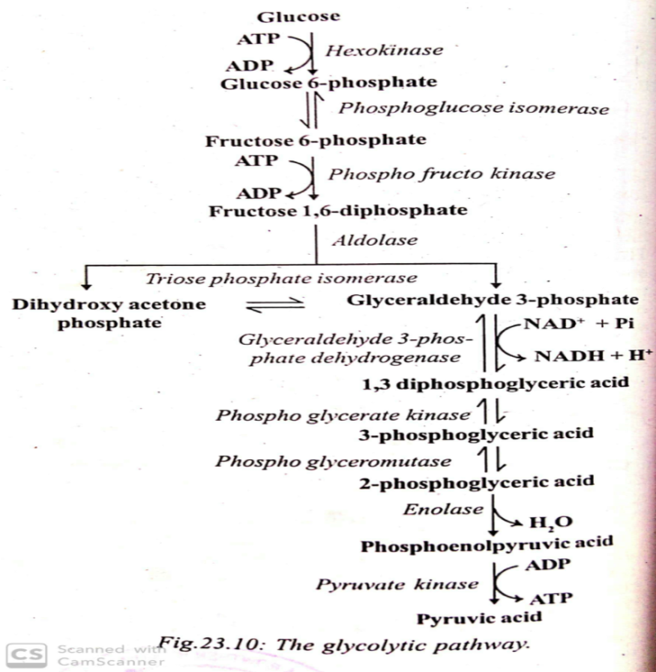
NAD⁺ is reduced to NADH and one proton (H⁺) is released.
This reaction is energy transfer as the re oxidation of NADH to NAD⁺ by the electron transfer system can to the synthesis of ATP molecules.
Step 5- Isomerization
Glyceraldehyde 3-phosphate is a direct pathway of glycolysis.
Glyceraldehyde 3-phosphate is an aldose and dihydroxy acetone phosphate is a ketose.
This Isomerization is catalysed by the enzyme triose phosphate isomerase.
Step 6 – oxidation of Phosphorylation
Glyceraldehyde 3-phosphate is oxidized and phosphorylated to 1,3-diphosphoglyceric acid.
This reaction is catalyzed by the enzyme Glyceraldehyde 3-phosphate dehydrogenase.
This reaction requires the coenzyme NAD. NAD is a oxidized form NAD^{+.} When Glyceraldehyde 3-phosphate is oxidized.

Slide 7
Step 7- Substrate level Phosphorylation
1,3-diphosphoglyceric acid is transferred to ADP resulting in the formation of 3-phosphoglyceric acid and ATP.
This reaction is catalyzed by the enzyme phospho glycerate kinase.
Step 8- Isomerization
3-phosphoglyceric acid is move to form 2-phosphoglyceric acid.
This reaction is catalyzed by the enzyme phospho glycerate mutase.
Step 9 – Dehydration
2-phosphoglyceric acid is dehydrated and to yield phosphoenol pyruvic acid.
This reaction is catalyzed by the enzyme enolase.

Slide 8
Step 10- Substrate level Phosphorylation
In this final step, there is a transfer of phosphate from phosphoenol pyruvic acid to ADP. thus a molecule of ATP is directly synthesized and pyruvic acid is also formed. This reaction is catalyzed by the enzyme pyruvate kinase
Overall balanced equation for glycolysis
C₆H₁₂O₆ + 2ADP + 2NAD⁺ +2Pi --------→ 2C₃H₄O₃ + 2ATP + 2NADH + 2H⁺ + 2H₂O
Glucose Pyruvic acid

Slide 9
Thank you
Dr. P. Sivamanikandan
Assistant Professor of Microbiology
Hajee Karutha Rowther Howdia College(Autonomous),
Uthamapalayam-625533

