Slide 1
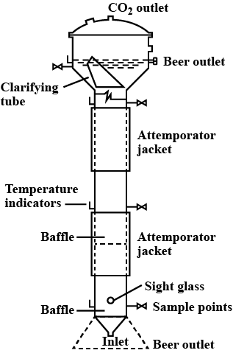
Tower Fermenter
Prepared by
Dr. P. Sivamanikandan
Assistant Professor of Microbiology
Hajee Karutha Rowther Howdia College(Autonomous),
Uthamapalayam-625533

Slide 3
It is a non -mechanically agitated bioreactor.
A simple tower fermentor consists of a long tube with closed ends.
In this process yeast flocs are maintained.
Sterile air is pumped into the fermenter through its base and it mixes the nutrient medium before going out through a gas outlet at the top.
The fermentor consists of a vertical cylinder and the height and diameter of the tube is in the ratio of 10:1.

Slide 4
At the top of the tower a separator is provided to induce the gas bubbles produced by the reaction to combine and escape from the liquid phase.
The separator (settle zone) works free of the rising gas, so that the yeast may settle and return to the main body of the tower and clear beer can be removed.
There is a water jacket around the vessel to regulate the temperature inside.
Tower fermenters are used in the production of citric acid, tetracycline, beer and baker’s yeast.

Slide 5
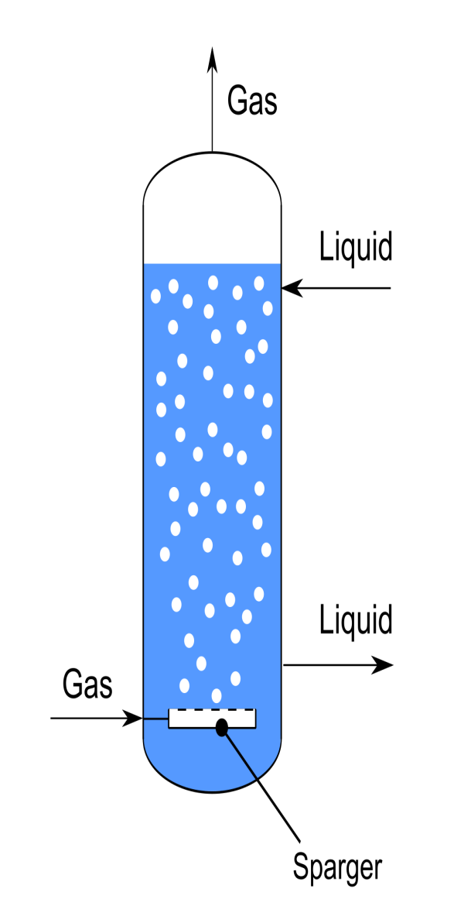
There are three different types of tower fermenters on the basis of their design:
(1) Bubble columns, (2) Vertical-tower beer fermenter and (3) Multistage fermenter systems.
1. Bubble Column Tower Fermenters:
These are the simplest type of tower fermenters; they consist of glass or metal tubes into which air is introduced at the base
These tower fermenters have been used for citric acid and tetracycline production, and for a range of other fermentations based on mycelial fungi.

Slide 6
2. Vertical-Tower Beer Fermenters:
These fermenters were designed for beer production and to maximize yeast biomass yields.
It has a settling zone free of gas; in this zone, yeast cells settle down to the bottom and return to the main body of the tower fermenter, and clear beer could be removed from the fermenter.

Slide 7
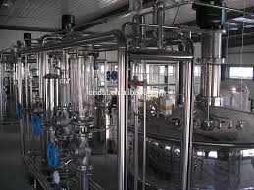
3. Multistage Tower Fermenters:
In these Fermenters, a column forms the body of vessel, which is divided into compartments by placing perforated plates across the fermenter.
About 10% of the horizontal area of plates is perforated. In a variant of this type of fermenter (down-flow tower fermenter), the substrate is fed in at the top and overflowed through down spouts to the next section, and the air is supplied from the base.
These fermenters have been used for continuous culture of E. coli, S. cerevisiae (baker’s yeast), and activated sludge.

Slide 8
Thank you
Prepared by
Dr. P. Sivamanikandan
Assistant Professor of Microbiology
Hajee Karutha Rowther Howdia College(Autonomous),
Uthamapalayam-625533

