Slide 1
MHC Major Histocompatibility Complex
Unit III
Under topic: MHC
Subject Name: Immunology
Subject Code: 17UMBC41
Dr. A Sajith Ahamed
Assistant Professor
Department of Microbiology
H.K.R.H. College

Slide 2
Introduction
It refers to a cluster of genes responsible for immune responcse, transplantation antigens and proteins of the complement system
Garer 1930 discovered it
Histocompatible molecules: set of protein produced by MHC
In cell surface of nucleated cell & in blood serum
Responsible for Allograft rejection, Immune recognition, complement levels etc.,
Histocompatible Antigen: Molecules produced by MHC gene

Slide 3
Classification
4 types
Class I molecules
Class II molecules
Class III molecules
Class VI molecules

Slide 4
Class I molecules

Slide 5
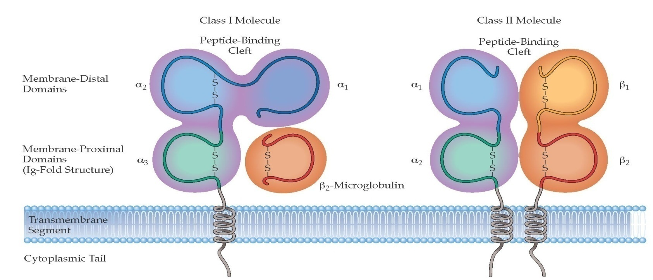
Structure of MHC molecules

Slide 6
MHC class-I
Class-I MHC gene encodes glycoprotein molecule which expressed on the surface of all nucleated cells and platelets.
MHC-I molecule contains a 45KDa α-chain associated non-covalentely with a 12KDa β2 microglobulin molecule.
Association of α-chain and β2 microglobulin is required for expression of class-I MHC molecule on cell membrane.

Slide 7
α-chain of MHC-I
The α-chain is a transmembrane glycoprotein encoded by polymorphic gene within A, B and C region of Human HLA complex
The α-chain is anchored in the plasma membrane by its hydrophobic trans-membrane segment and hydrophilic cytoplasmic tail.
α-chain is made up of 3 domains (α1,α2 and α3). Each domain containing approximately 90 aminoacids, a transmsmbrane domain of about 25 hydrophobic aminoacids followed by short stretch of charged (hydrophilic) aminoacids of cytoplasmic tails of 3o aminoacids.
α1 and α2 domains interacts to form a deep groove on the top which is a peptide binding clift. It can binds antigen of 8-10 animoacids long.
α3 and β2 are organized into β-pleated sheets, each formed by antiparallel β-strand of aminoacids, this structure is known as immunoglobulin fold. Because of this structure α-chain and β2 microglobulin are classified as member of immunoglobulin super-family receptor.

Slide 8
β2 microglobulin of MHC-I
β2 microglobulin is a protein encoded by a highly conserved gene located on different chromosome
β2 microglobulin is similar in size and organization to α3 domain.
Β2 microglobulin does not contain transmembrane region and is non-covalently linked with α-chain

Slide 9
Functions of MHC class I
Major function of MHC-I is to bind peptide antigens and present to CD8+ T cells (T helper cells)
CD8 T cells are specific for MHC-I antigen
MHC-I binds endogenous antigen and present to T helper cells.
MHC-I molecules are found on surface of all nucleated cells.

Slide 10
MHC class-II

Slide 11
MHC class-II
Class-II MHC is the glycoprotein molecule expressed primarily on antigen presenting cells such as macrophages, dendritic cells and B-cells.
MHC-II molecules contains two different polypeptide chains, 1 33 KDa α-chain and 28KDa β-chain which are associated by non-covalent interactions.

Slide 12
α-chain and β-chain of MHC-II
α-chain and β-chain of MHC-II is a membrane bound glycoprotein that contains external domains, atransmembrane segment and acytoplasmic tail.
α-chain and β-chain are made up of two domains (α1 and α2) and (β1 and β2) respectively.
The peptide biding cleft is a open ended groove formed between α-chain and β-chain at proximal end. The cleft can bind antigenic peptide of 13-18 aminoacids long.

Slide 13
Functions of MHC class II
Major function of MHC-II is to bind peptide antigen and present to CD4 T cells.
MHC-II are found on surface of Antigen presenting cells (APCs).
CD4+T-cells are specific for MHC-II
Activates B cells for antibody production
MHC-II plays a significant role in graft versus host response and in mixed lymphocyte reaction (MLR) because the immune response gene is identical to MHC-II in human.

Slide 14
MHC class-III
MHc-III are diverse group of molecules that serves a wide variety of functions in immune system.
MHC-III are not a marker on cell surface.

Slide 15
Functions of MHC class-III
Involved in complement activation
Involved in inflammation caused by cytokines, tumor necrosis factors etc

Slide 16
Class VI Molecule
Ags present in T Cells or leukemia (Tla) as well as on immature thymocytes which lose Tla during differentiation into mature T cells

Slide 17
MHC: H-2 Complex of Mouse Genes
O O O O O O
O O O O O O
K | I | S | D | L | T

Slide 18
MHC: H-2 Complex of Mouse Genes
Produce Ags located on the nucleated cell membrane and complement components
6 loci: KISDLT
Genes name: Class I gene, Class II gene, Class III gene and Class VI gene
MHCT | Gene
MHC Type Genes | I | II | III | I | VI
Moleculesx | K | I-AI-EI-J | C2C2B | DL | QuTlu
Accessions | Transplantation Ag | Immune Associated Ag | Complement Components | Transplantation Ags | Primitive Ags

Slide 19
Kuby reference of MHC: H-2 Complex of Mouse Genes
Complex | H–2
MHC class | I | II |  | III |  | I
Region | K | IA | IE | S |  | D
Gene products | H–2K | IA αβ | IE αβ | C′ proteins | TNF-α TNF-β | H–2D | H–2L
Proteins | classical MHC molecules | classical MHC molecules |  | Complement proteins | tumor necrosis factors | Classical MHC molecules

