Slide 1
UNIT 3
Subject Name – Recombinant DNA Technology
Subject Code –17UMBC61
Semester : III
Programme : B. Sc. Microbiology
METHODS OF GENE TRANSFER
Dr Sajith Ahamed. Mphil., PhD
Assistant Professor
Department of Microbiology
H.K.R.H.College

Slide 2
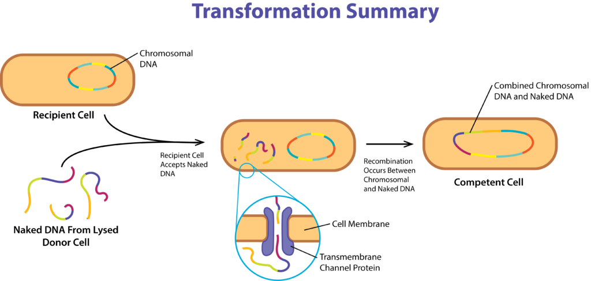
METHODS OF GENE TRANSFER - TRANSFORMATION -

Slide 3
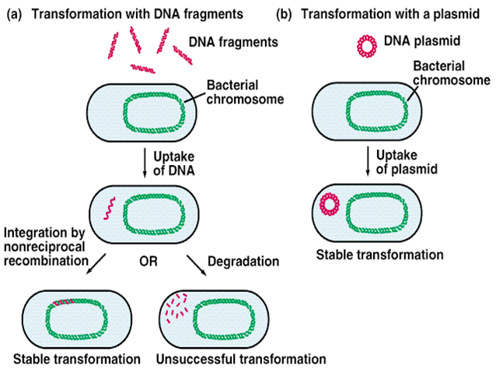
METHODS OF GENE TRANSFER - TRANSFORMATION -

Slide 4
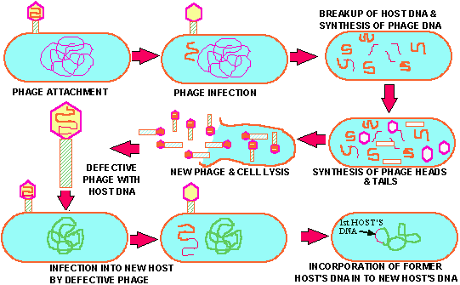
METHODS OF GENE TRANSFER - TRANSDUCTION -

Slide 5
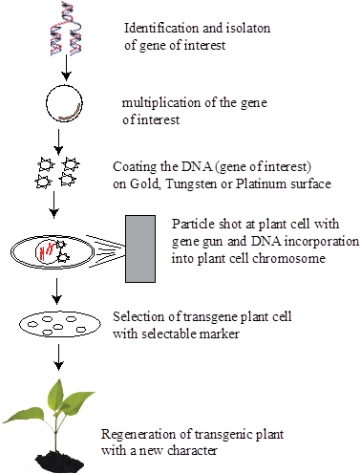
METHODS OF GENE TRANSFER MICROPROJECTILE BOMBARDMENT

Slide 6
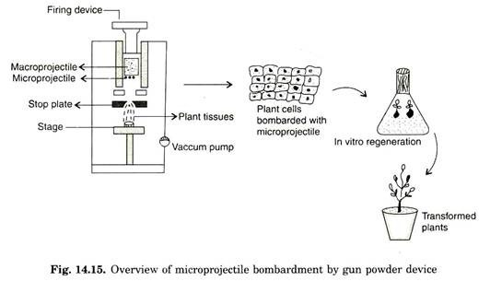
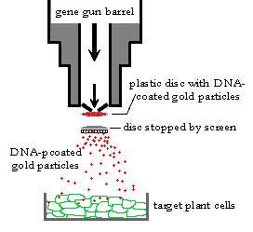
METHODS OF GENE TRANSFER - MICROPROJECTILE BOMBARDMENT-

Slide 7
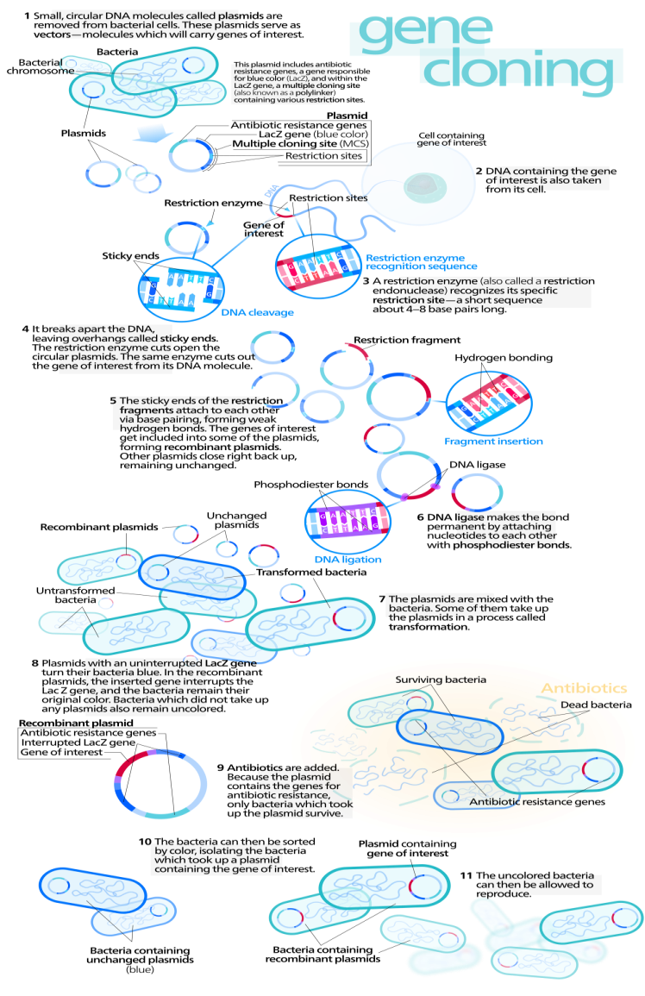
GENE CLONING METHOD

Slide 8
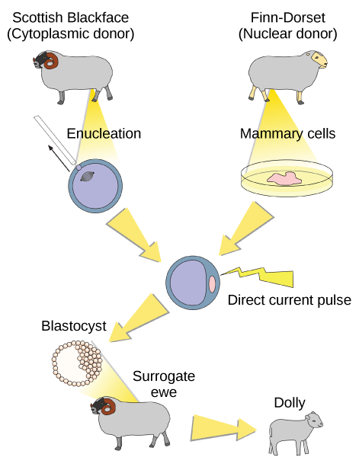
SHEEP CLONING

