Slide 1
ngah; : Kidth;.ng.KUfd;
gzpapd; ngah; : ,izg;Nguhrphpah;>
jiyth;
Jiw : jkpo;j;Jiw
Mz;L : ,uz;lhk; Mz;L
gUtk; : ehd;fhk; gUtk;
ghlk; : ,yf;fzk;
(mfg;nghUs;)

Slide 2
mfg;nghUspd; tiffs;

Slide 3
mfg;nghUspd; tif:
“kyHjiy cyfj;Jg;GyNthH Ma;e;j mUe;jkpo; mfg;nghUs; iff;fpis Ie;jpiz ngUe;jpiz vdvO ngw;wpj; jhFk;.”
gue;j ,lj;ijAila jkpo; ehl;lfj;J> rhd;Nwhuhy; Muhag;gl;l mupa jkpohf tpsq;FtJ mfg;nghUs;. ,J iff;fpis Ie;jpiz ngUe;jpiz vd VO ngw;wpj; jhFk;.

Slide 4
iff;fpis:
“mtw;Wl; iff;fpis cilaJ xUjiyf; fhkk;. Nkw;nrhy;yg;gl;l mfg;nghUs; VoDs; iff;fpis vd;gJ xU jiyf;fhkk; MFk;”.
jiytd; jiytpkhl;Lj; xUjiyaha;f; nfhs;Sk; md;G MFk;. ,J rpyNghJ jiytd; khl;Lj; jiytpaplKk; Njhd;WtJz;L. vdNt ,J Mz;ghw; iff;fpis> ngz;ghw; iff;fpis vdg;gl;lJ.

Slide 5
Ie;jpiz:
“Ie;jpiz cilaJ md;Gilf; fhkk;.”
Ie;jpiz vd;gjDila nghUs; md;Gilf; fhkk; MFk;. mJ FwpQ;rp> Ky;iy> kUjk;> nea;jy;. ghiy vd;W nrhy;yg;gLk;.

Slide 6
ngUe;jpiz:
“ngUe;jpiz vd;gJ nghUe;jhf; fhkk;.”
ngUe;jpiz vd;gJ nghUe;jhf; fhkk; vd;gjhk;. ,J xg;Gik ,y;yhj; jiykf;fs; khl;Lj; Njhd;WtJ MFk;. ,t; xOf;fk; kpFjpahfg; gpd;gw;wg;gl;likahy; ngUe;jpiz vdg;gl;lJ vd;ghH ,sk;G+uzH.

Slide 7
Ie;jpizapd; ngaH:
“FwpQ;rp ghiy Ky;iy kUjk; nea;jy; Ie;jpizfF; va;jpa ngaNu.”
epyk; tFf;fg;glhj iff;fpisAk; ngUe;jpizAk; ePq;fyhf epyk; tFf;fg;gLk; Ie;jpizf;Fk; cupa ngaH czHj;jpw;W. FwpQ;rpAk; ghiyAk; Ky;iyAk; kUjKk; nea;jYk; mt;ite;J jpizf;Fk; nghUe;jpangauhFk;. ,jidj; njhy;fhg;gpaH khNahd; Nka fhLiw AyfKk; NrNahd; Nka iktiu AyfKk; Nte;jd; Nka jPk;Gd YyfKk; tUzd; Nka ngUkz YyfKk; Ky;iy FwpQ;rp kUj nea;jnydr; nrhy;ypa Kiwahw; nrhy;yTk; gLNk" vdf; Fwpg;ghH;.

Slide 8
Ie;jpizf;Fk; cupa nghUs;:
“mitjhk;> Kjw;nghUs; fUg;nghUs; cupg;nghUs; vdKiw Ejw;nghUz; %d;wpDk; Etyg; gLNk.”
FwpQ;rp Kjyhfpa Ie;jpizjhk; Kjw;nghUSk; fUg;nghUSk; cupg;nghUSk; vd KiwahNd fUJjiyAila nghUs; %d;whYk; nrhy;yg;gLk.; ,jidj; njhy;fhg;gpaH “Kjy;fU cupg;nghUs; vd;w %d;Nw EtYq; fhiy Kiwrpwe; jdNt ghlYl; gapd;wit ehLq; fhiy” vdf; Fwpg;ghH.

Slide 9
Kjw; nghUspd; tif:
“epyKk; nghOJnkd KjypU tifj;Nj.” Kjw;nghUshtJ epyKk; nghOJk; vd ,uz;L $w;wpid cilj;jhFk;.

Slide 10
fhyk;:
“ngUk; nghOJ vd;wh rpWnghOJ vd;wh ,uz;L $w;wJ ,ak;gpa nghONj.”
Kjw;nghUs;> ngUk; nghOJ vd;Wk;rpWnghOJ vd;Wk; ,uz;L gFjpapid cilajhFk;.

Slide 11
ngUk;nghOjpd; tif:
“fhNu $jpH Kd;gdp gpd;gdp rPups Ntdpy; Ntdp nyd;whq;F ,U%d;W jpwj;jJ njup ngUk; nghONj.”
ngUk;nghOJ fhH Kjyhf Ntdpy; Gul;lhrp – fhHfhyk; Ig;grp> fhHj;jpif - $jpH fhyk; khHfop> ij – Kd;gdpf;fhyk; khrp> gq;Fdp – gpd;gdpf;fhyk; rpj;jpiu> itfhrp - ,sNtdpw;fhyk; Mdp> Mb – KJNtdpw; fhyk;

Slide 12
rpWnghOjpd; tif:
“khiy ahkk; itfiw vw;gL fhiy ntq;fjpH fhAk; ez;gfnydf; iftifr; rpWnghO ijtifj; jhFk;.”
rpWnghOJ khiy Kjyhf ez;gfy; khiyahtJ eprpapd;Kd;Dk; vw;ghl;bd; gpd;Dk; cz;lhfpa fhyk;.ahkkhtJ ,ilapuT> itfiw ahtJ tpbaw;fhyk;. vw;gLfhiyahtJ Mjpj;jd; gLfpw nghOJ. ez;gfyhtJ cr;rpg;nghOJ MFk;.

Slide 13
Ie;jpizf;Fupa ngUk;nghOJk; rpWnghOJk;:
FwpQ;rpf;Fhpa ngUk;nghOJk; rpWnghOJk;:
“mtw;Ws;> $jpH ahkk; Kd;gdp nad;wpit
Xjpa FwpQ;rpf; Fupa thFk;.”
ngUk; nghOJk; rpWnghOJkhfpa gjpndhd;wDs; $jpUk; ahkKk; Kd;gdpAkhfpa %d;WkhFk;.
ghiyf;Fupa ngUk;nghOJk; rpWnghOJk;:
“Ntdpy; ez;gfy; gpd;gdp nad;wpit
ghd;ikap Dupa ghiy jdf;Nf”
ghiyf;F NtdpYk; ez;gfYk; gpd;gdpAkhfpa %d;Wk; tpjpahd; cupathFk;

Slide 14
Ky;iyf;Fupa ngUk;nghOJk; rpWnghOJk;:
“ky;FfhH khiy Ky;iyf; Fupa.”
fhHfhyKk; khiyf;fhyKk; Mfpa ,uz;L fhyKk; Ky;iyf;Fupad.
.kUjj;Jf;Fupa rpWnghOJ:
“,Us;GyH fhiy kUjj;jpw; Fupj;Nj.”
kUjj;jpw;F Fupa rpWnghOJ tpbaw;fhyk; MFk;.
nea;jw;Fupa rpWnghOJ:
“nta;Nahd; ghL nea;jw; Fupj;Nj.”
new;jw;Fupa rpWnghOJ fjputd; gLfpd;w fhyk; MFk;.
kUjk; nea;jy; vd;Dk; ,uz;lw;Fupa ngUk;nghOJ
kUjKk; nea;jYk; vd;Dk; ,uz;lw;Fk; ngUk;nghOJ MWk; cupathk;.

Slide 15
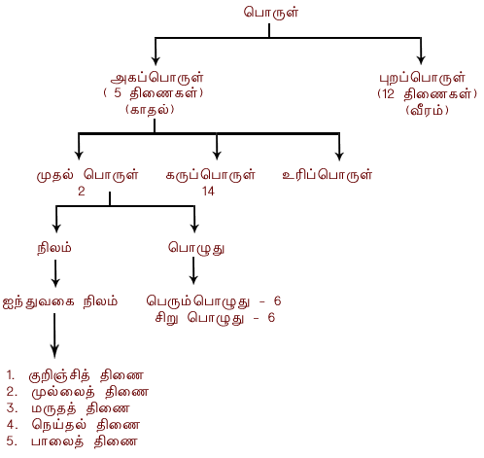
fUg;nghUs; tif – tpsf;fk;

Slide 16
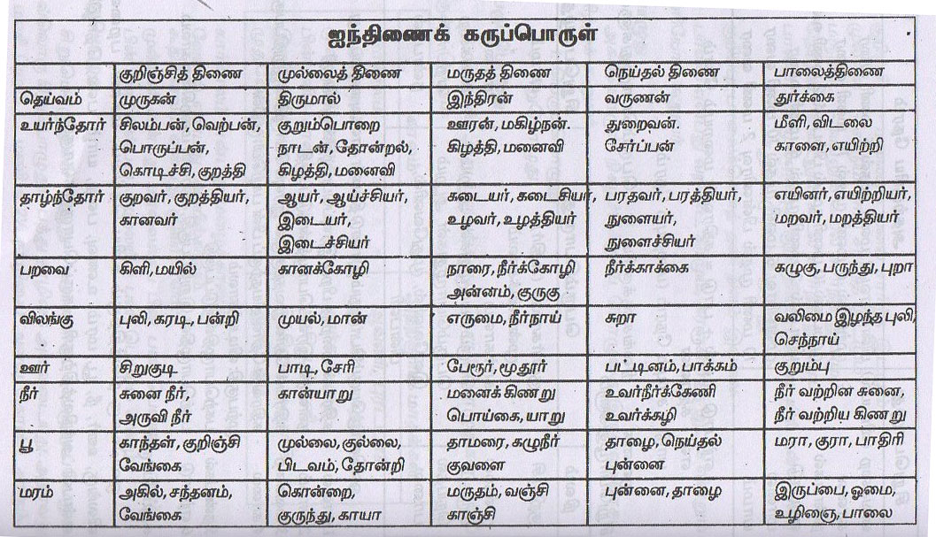

Slide 17
