Slide 1
`h[p fUj;j uhTj;jh;
n`sjpah fy;Yhhp
jkpo;j;Jiw
,ilf;fhy ,yf;fpak; kw;Wk; Gjpd ,yf;fpak; (17UTAL21)
gf;jp ,yf;fpak;
,uh. [hd;rpuhzp
(TNMK021SFT182)

Slide 2
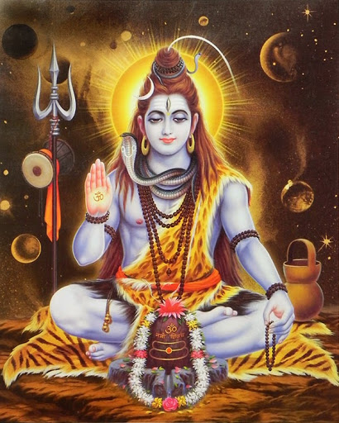

Slide 3
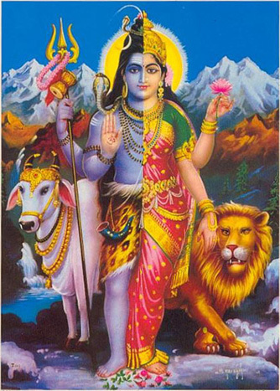

Slide 4
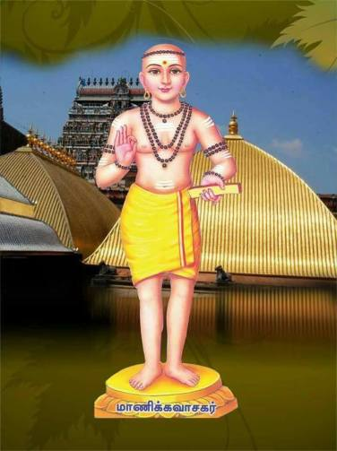

Slide 5
Ch; : jpUthjt+h;
,aw;ngah; : jpUthjT+ubfs;
rpwg;Gg; ngah;fs; : khzpf;fthrfh;> mUs;thrfh;
jpUthjt+ubfs;> njd;dtd; gpukuhad;
ngw;Nwhh; : rk;Gghjrhpjh;> rptQhdtjp
fhyk; : fp.gp. xd;gjhk; Ehw;whz;L
ghba gf;jp ghRuq;fs; : jpUthrfk;> jpUf;Nfhitahh;

Slide 6
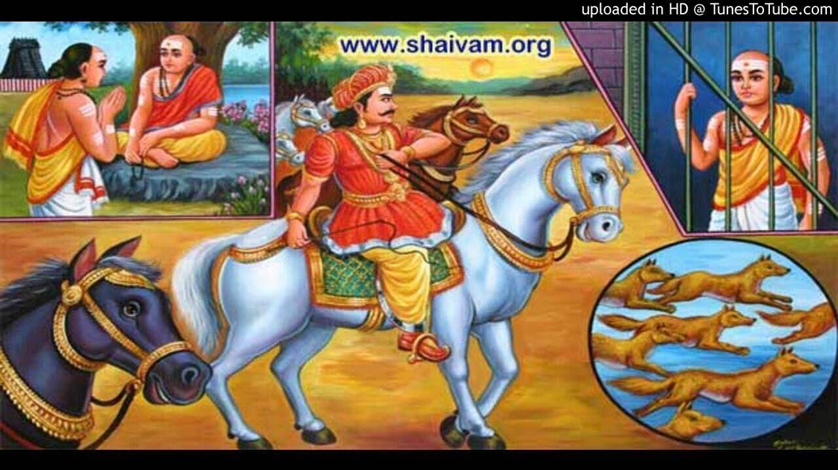

Slide 7
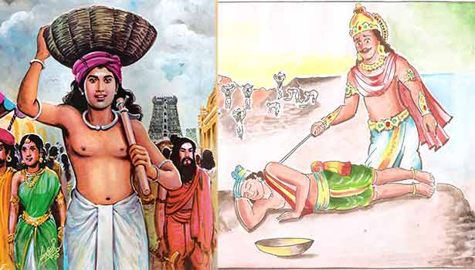

Slide 8
jpUthrfk;
gd;dpU jpUKiwfspy; vl;lhk; jpUKiwahf cs;sJ. jpUthrfj;jpd; rpwg;ig ‘jpUthrfj;jpw;F cUfhh; xU thfj;jpw;Fk; cUfhh;” vd;w thpfs; Rl;Lfpd;wd. ,e;Ehypy; 51 gjpfq;fs; 658 ghly;fs; cs;sd.

Slide 9
Gy;yhfpg; g+lha;g; GOtha; kukhfpg;
gy;kpUf khfpg; gwitaha;g; ghk;ghfpf;
fy;yha; kdpjuha;g; Ngaha;f; fzq;fsha;
ty;mRu uhfp Kdptuha;j; Njtuha;r;
nry;yhm epd;w,j; jhtu rq;fkj;Js;
vy;yhg; gpwg;Gk; gpwe;J,isj;Njd; vk;ngUkhd;
nka;Nacd; nghd;dbfs; fz;L,d;W tPLw;Nwd;

Slide 10
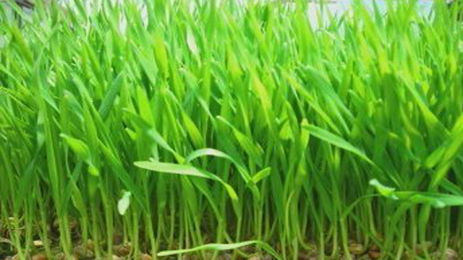

Slide 11
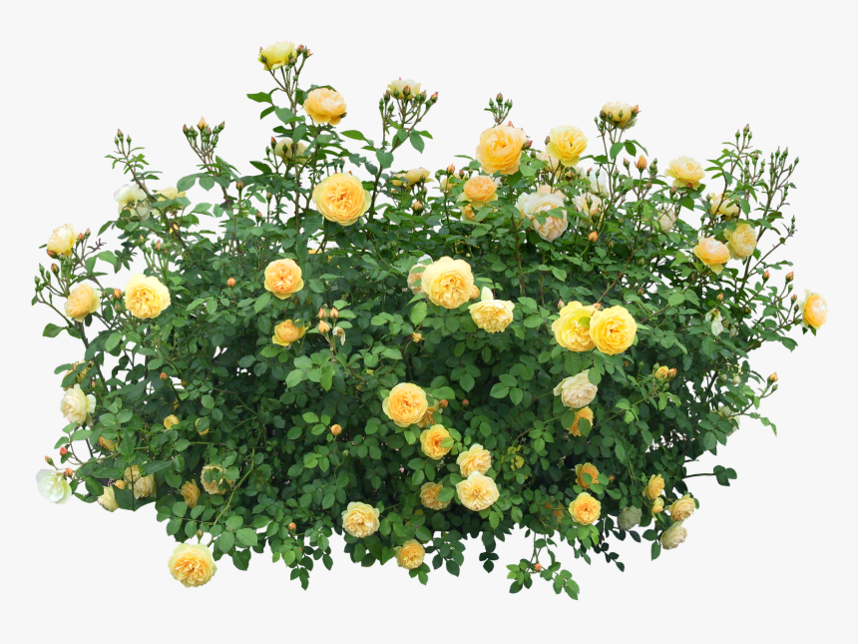

Slide 12
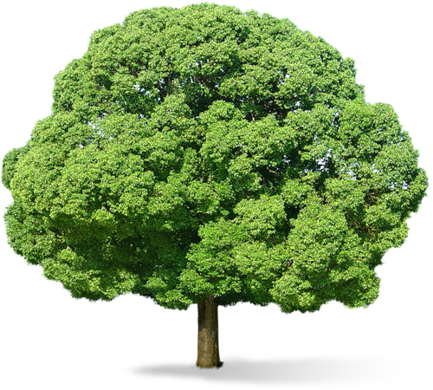

Slide 13
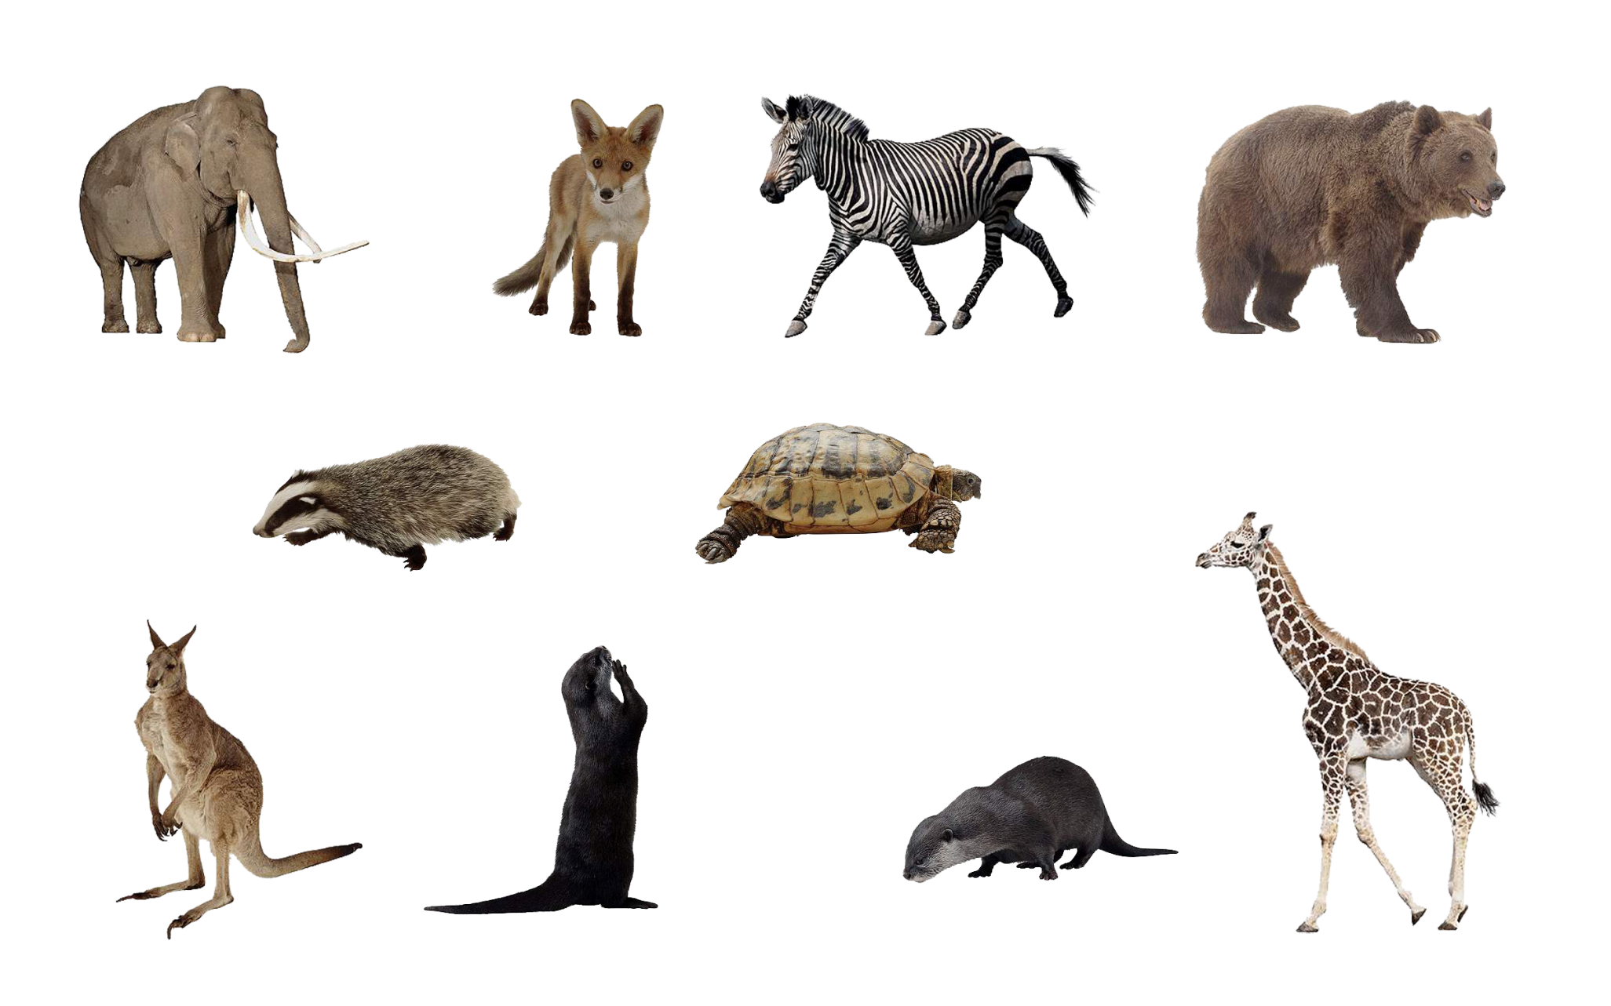

Slide 14
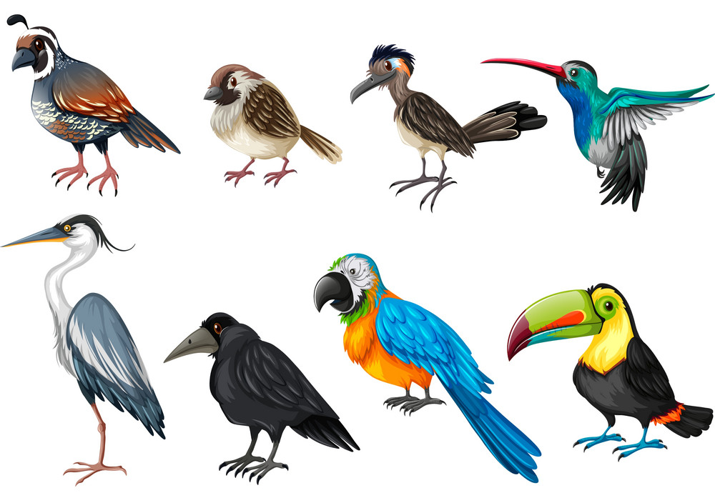

Slide 15
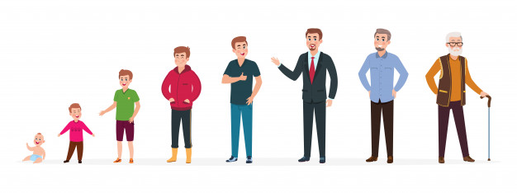

Slide 16
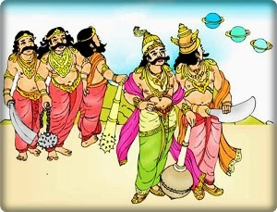

Slide 17
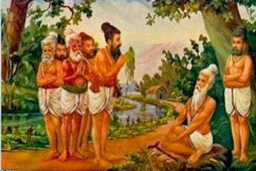

Slide 18
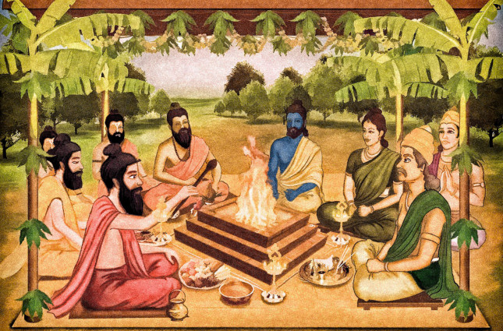

Slide 19
Gy;yhfTk;> rpW nrbfshfTk;>
GOthfTk;> kukhfTk;>
gytif kpUfq;fshfTk;>
gwitfshfTk;> ghk;ghfTk;>
fy;ypy; thOk; capuhfTk;>
kdpjuhfTk;> cly; ePq;fpa Nga;fshfTk;>
gyjug;gl;l fzf;$l;lq;fshfTk;>
typik kpFe;j mRuh;fshfTk;>
KdptuhfTk;> NjtuhfTk;
,e;j mirAk; kw;Wk;
mirahjtw;why; Md (mz;lk;) KOJk;
nrd;W
vy;yhg; gpwg;Gk; gpwe;J
fisj;Jtpl;Nld;> vk;ngUkhNd!
cd;Dila jq;fj; jpUtbfisf;
fz;L ,d;W cz;ikahfNt tPL
Ngwile;Njd;

Slide 20
ghh;it Ehy;
jpUthrfk; %yKk;> ciuAk; -
t.j. ,uhk Rg;gpukzpak;
,izajsf; fl;Liu
sivamejeyam.blogspot.com

