Slide 1
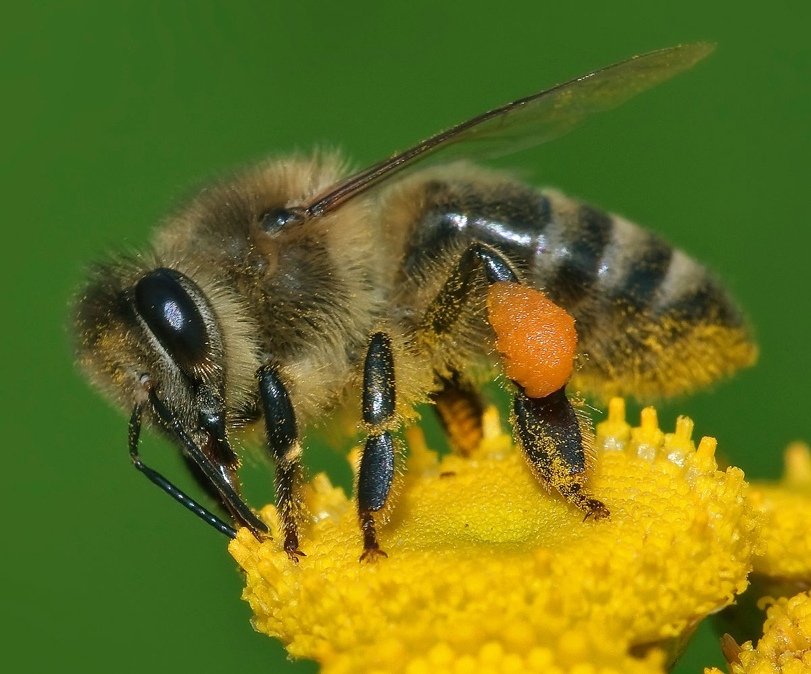
Apiculture
Dr.M.Mohamed Meeran
HOD of Zoology

Slide 2
Where is Adam’s bridge is located?

Slide 3
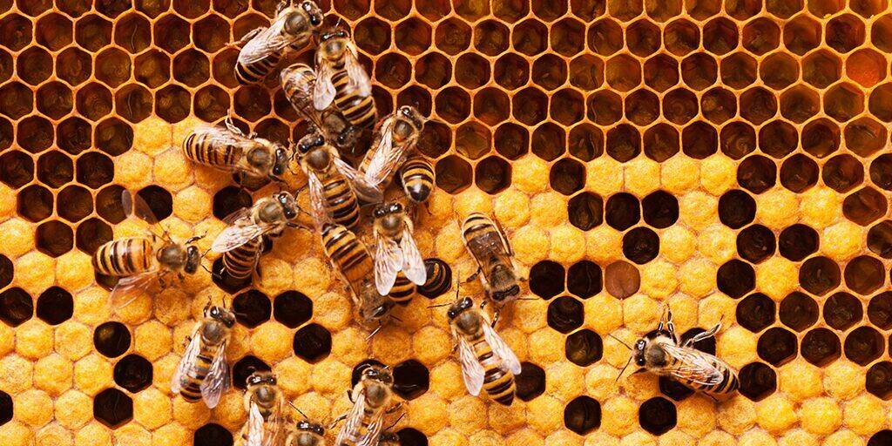
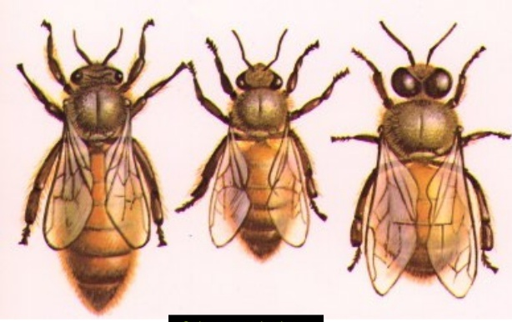
Introduction
The genus name Apis is Latin for "bee".
Hence the name Apiculture which denotes culture of honey bees for honey and other by products
Entomologist Robert Snodgrass asserts that correct usage of the word “honey bee”
Honey bees are social insects that live in colonies.
Honey bee colonies consist of a single queen, hundreds of male drones and 20,000 to 80,000 female worker bees.

Slide 4
Characteristics | Queen | Drone | Worker
Relative size | large | medium | small
Numbers in hive | 1 | ~200 or 0 | 20K-200K
lifespan | 2 years | 21-32 days | 20-40 days
sex | Female | Male | Sterile female
functions | -kill sisters and mother -mate with males -lay 1500 eggs/day = 200K eggs/year -secrete pheromone = 9-hydroxydecenoic acid HOOC=C-C-C-C-C-C-COH-C | -mate with young queen | -make comb -tend larvae -tend young drones -tend queen -clean hive -gather nectar -gather pollen -gather propolis -evaporate nectar -cap cells -defend hive -starve drones -lay drone eggs -move larvae for making new queen

Slide 5
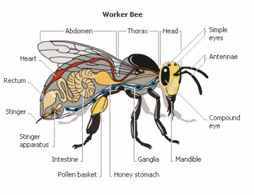
Biology of honey bee

Slide 6
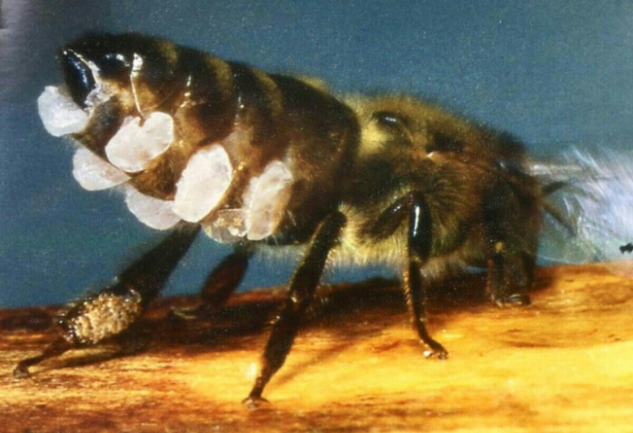
Special apparatus in worker bees
Pollen basket – It is a special apparatus in foraging bees to carry the pollen which will be gathered from flowers during the visit to a flower by the honey bees.
Honey stomach- Using its straw-like proboscis, a forager bee drinks the liquid nectar from a flower and stores it in a special organ called the honey stomach. The bee continues to forage until its honey stomach is full, visiting 50 to 100 flowers per trip from the hive.
Wax gland – Ventral abdomen
Sting gland – Worker bees

Slide 7
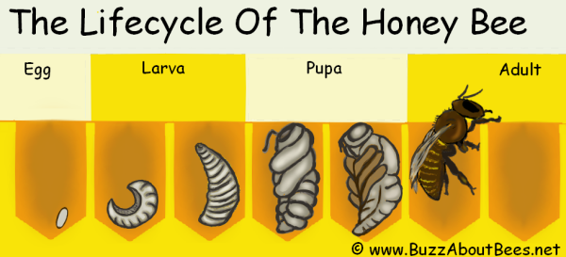
Life cycle of honey bees
Each honey bee colony also consists of developing eggs, larvae and pupae.
Honey bee colony undergoes complete metamorphosis, passing through the egg, larval and pupal stages before becoming adults.
Honey bee larvae are legless grubs that eat honey, nectar or pollen. Larvae shed their skin and molt several times before they enter the pupal stage.
After another molt, these pupae will emerge as adult honey bees and begin to perform specialized tasks for the colony.

Slide 8
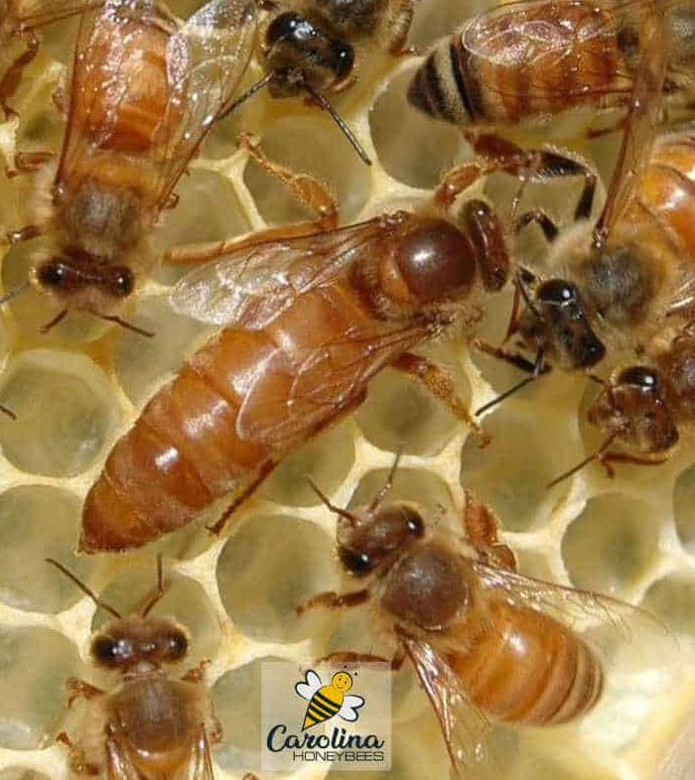
Queen bee
Queens are the only members of a colony able to lay fertilized eggs.
An egg-laying queen is important in establishing a strong honey bee colony, and is capable of producing up to 2,000 eggs within a single day.
Queens mate early in life and store up millions of sperm within their bodies.
While they are capable of living up to five years, they only often only live two to three years producing eggs.

Slide 9
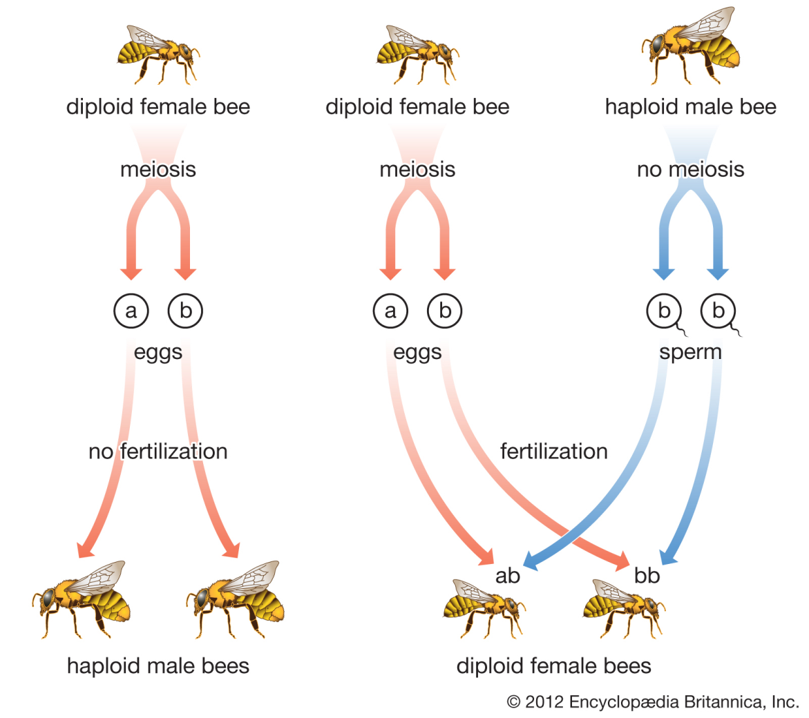
Drones
Drones, or male honey bees, have only one task: to fertilize new queens.
Develops from unfertilized egg by the process of parthenogenesis
Drones mate outdoors usually in midair and die soon after mating.
Some honey bee colonies will eject surviving drones during fall when food for the colony becomes limited.

Slide 10
Workers
Worker bees are entirely female, but they are unable to produce fertilized eggs.
Worker bees use their barbed stingers to defend the colony, but after attacking, the barbs attach to the victim's skin, tearing the stinging bee's abdomen, resulting in death.
They forage for pollen and nectar, tend to queens and drones, feed larvae, ventilate the hive, defend the nest and perform other tasks to preserve the survival of the colony.
The average life span of worker bees is approximately six weeks.

Slide 11
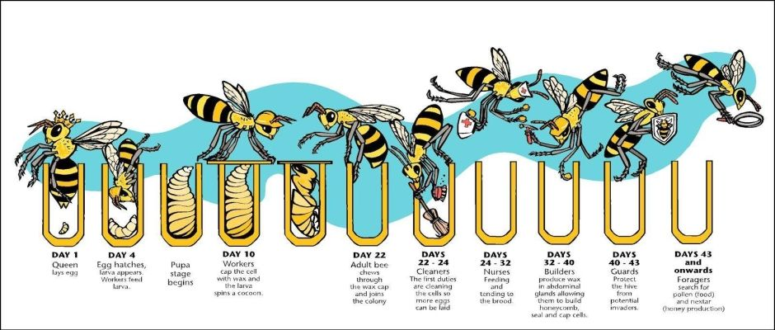

Slide 12
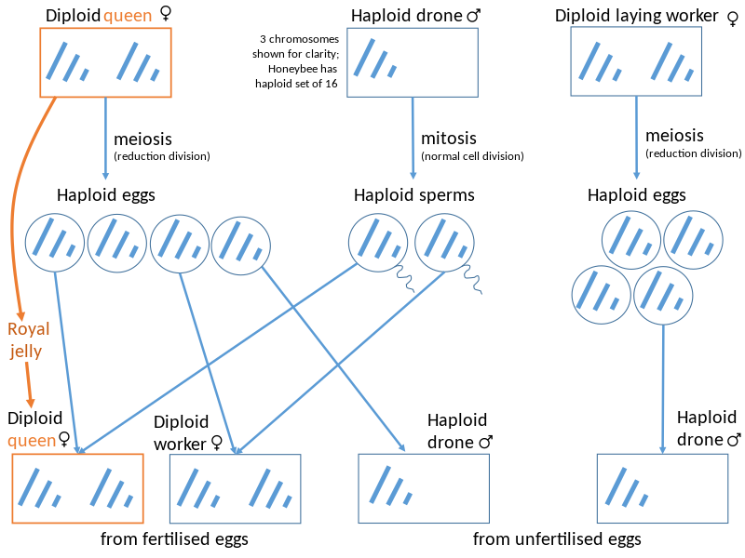
Development of colonies in bee

Slide 13
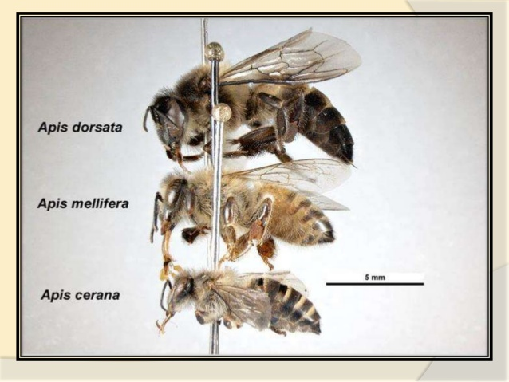
Types of Honey bees species….
Apis dorsata
Apis mellifera
Apis cerana
Apis florea

Slide 14
Apis dorsata – Rock bee
These bees are the largest among the bees described.
They are giant bees found all over India in sub-mountainous regions up to an altitude of 2700 m. They construct single comb in open about 6 feet long and 3 feet deep.
They shift the place of the colony often. Rock bees are ferocious and difficult to rear.
They produce about 36 Kg honey per comb per year.

Slide 15
Apis mellifera
They are also similar in habits to Indian bees, which build parallel combs.
They are bigger than all other honeybees except Apis dorsata.
The average production per colony is 25-40 kg. They have been imported from European countries (Italy).
They are less prone to swarming and absconding.

Slide 16
Apis cerana
Apis cerana, the eastern honey bee or the Asiatic honey bee, is a species of honey bee native to southern, southeastern, and eastern Asia.
They are the domesticated species, which construct multiple parallel combs with an average honey yield of 6-8 kg per colony per year.
These bees are larger than Apis florae but smaller than Apis mellifera.
They are more prone to swarming and absconding. They are native of India/Asia.
In comparing Apis mellifera colonies can reach sizes of up to 50,000 or more individuals, Apis cerana colonies are relatively small, with only around 6,000 to 7,000 workers.

Slide 17
Apis florea
They build single vertical combs. They also construct comb in open of the size of palm in branches of bushes, hedges, buildings, caves, empty cases.
They produce about half a kilo of honey per year per hive.
They are not rearable as they frequently change their place.
The size of the bees is smallest among four Apis species described and smaller than Indian bee.
They distribute only in plains and not in hills above 450 MSL.

Slide 18
Thank you

