Slide 1
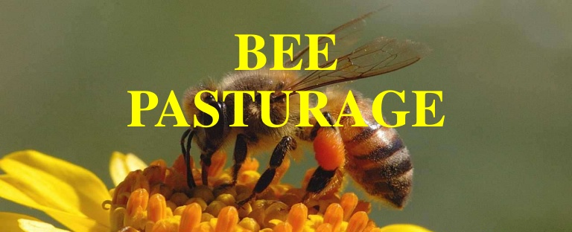
Part – III Apiary
Dr.M.Mohamed Meeran
HOD of Zoology

Slide 2
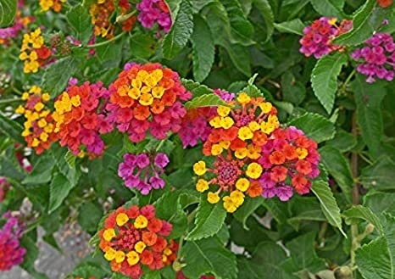
Identify the flower

Slide 3
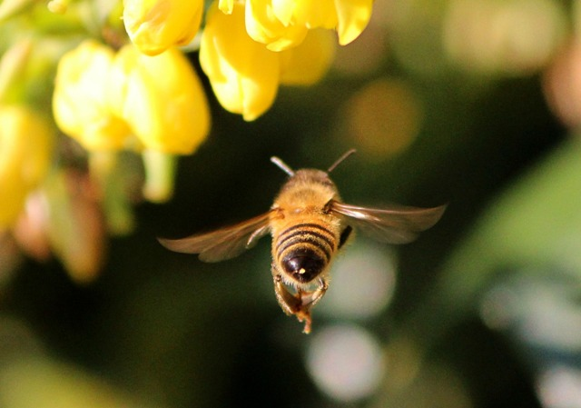
What is Pasturage?
It is defined as
The vegetation of flowers and plants that are available near to the bee hives so that the bees can feed on the nectar.
Pasturage is important in apiculture because the quality, quantity, and the taste of the honey is dependent on the pasturage. As the yield of pasturage gets better, the quality of honey improves.

Slide 4
Bee pasturage or bee forage
Plants that yield pollen and nectar are collectively called bee pasturage or bee forage.
Plants which are good source of nectar are tamarind, moringa, neem, Prosopis juliflora, Soapnut tree, Eucalyptus, Tribulus terrestris and pungam.
Plants which are good source of pollen are sorghum, sweet potato, maize, tobacco, millets like cumbu, tenai, varagu, ragi, coconut, roses, castor, pomegranate and date palm.
Plants which are good source of both pollen and nectar are banana, peach, citrus, guava, apple, Sunflower, berries, safflower, pear, mango and plum.

Slide 5
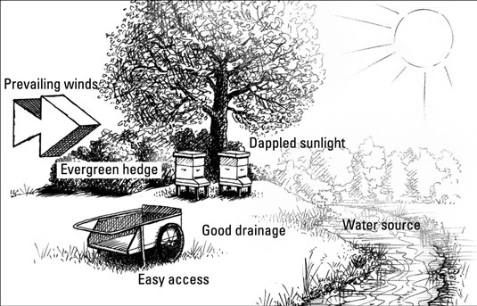
Location of Apiary
An apiary is a location where beehives of honey bees are kept. Apiaries come in many sizes and can be rural or urban depending on the honey production operation.
Food and Water - There should also be a source of water available yea arround. Bees prefer to forage within a 2-mile radius of the hive but can travel up to 5 miles if necessary.

Slide 6
Hive Orientation and Placement
The entrance of the hive ideally should face somewhere between south and east. The advantage to an east-facing entrance is earlier foraging flights, and a south facing entrance promotes longer foraging periods in the cooler months.
Safety - Avoid liability issues by placing hives away from areas of human or animal traffic whenever possible.
Some honey bees will not tolerate the presence of nearby horses or cattle and may attack grazing animals that wander too close to your hives.

Slide 7
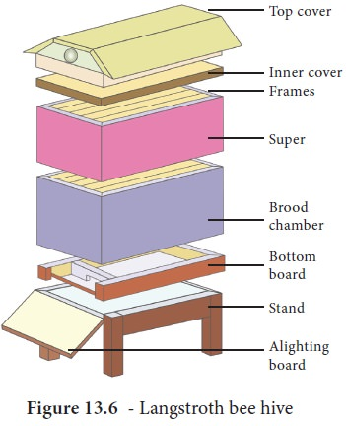
Newton’s Bee hive
Floor board/bottom board with an extension in front which serves as an alighting board.
Brood chamber is mounted over the floor board
Wooden frames are hung inside the brood chamber
Super chamber kept over the brood chamber
Top cover is kept on super or brood chamber.
Steel stand for resting the bee hive on ground

Slide 8
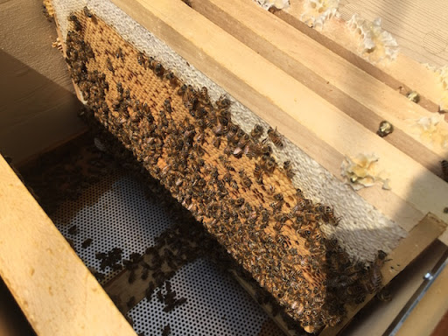
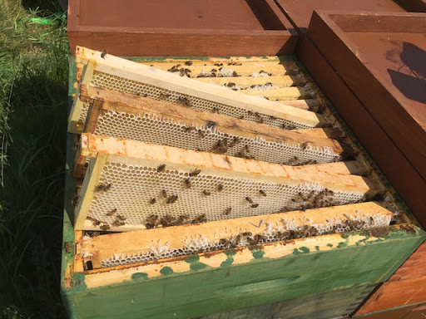
Frames inside Super and brood chamber

Slide 9
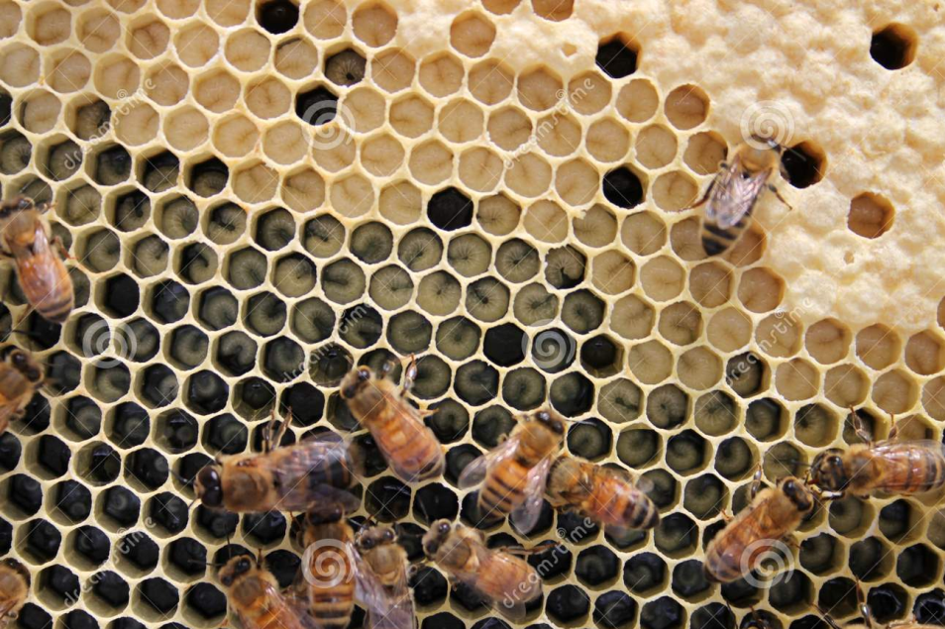
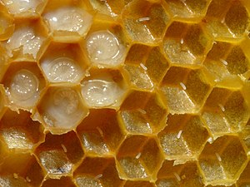
Brood chamber
Bees develop comb to rear brood in this chamber
Queen will be in the brood chamber
Queen excluder is placed between brood and super chamber to contain queen bee in brood chamber because when queen reaches the super chamber it begins to drink honey from the super chamber
During the dearth period the drone bees in the hive have been killed by the worker bee

Slide 10
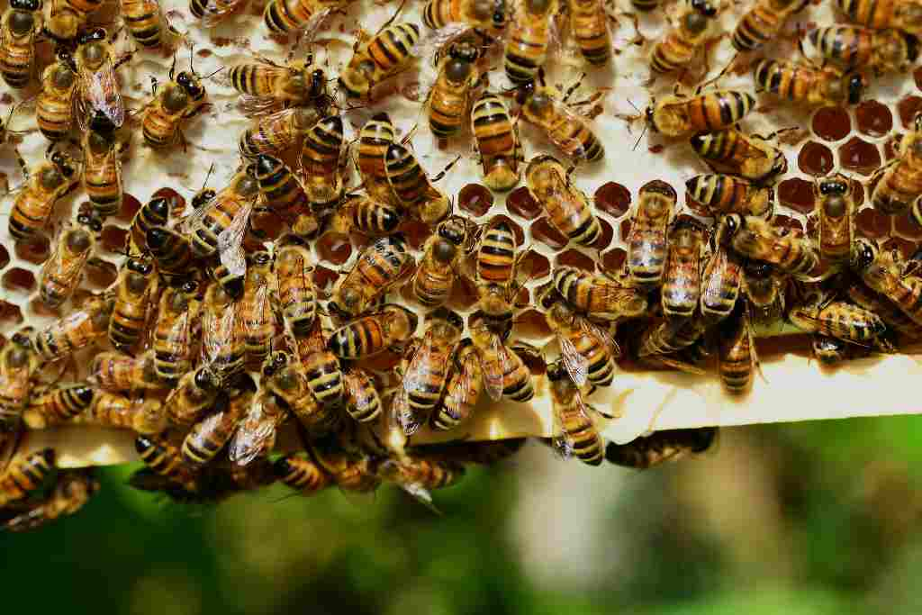
Super chamber
When comparing the size of the brood chamber the height of the super chamber is reduced
It is the place where the honey is stored in abundant and capped with wax
During the honey flow period a super chamber with frames can also added to the existing hive

Slide 11
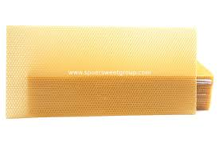
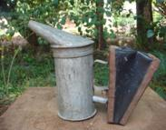
Appliances used in Beekeeping
Comb foundation sheet- Made of wax. It is artificially provided for the colonies during honey flow season pure by cutting them to a proper conical size and attaching them to super frames by means of thread or fibre
Dummy division board/Movable wall - It is placed inside the brood chamber. It prevents the bees from going beyond it. It can be used as a movable wall there by limiting the volume of brood chamber
Smoker The smoker is used to calm bees and drive away bees from super. It is a small tin with an elastic bulb at one side; rags of cloth or wood shavings can be burnt inside and the smoke expelled to any desired spot

Slide 12
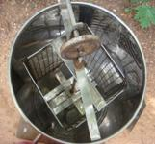
Decapping knife Single (or) double edged steel knife is used for removing wax cappings from the honey comb.
Honey extractor This equipment consists of cylindrical drum containing a rack or box inside to hold the super frames. The box is fixed to a rod at the centre and it can be rotated by a set of two gear wheels. The frames with, honey cells are decapped by a sharp knife after dipping it in hot water and fixed to the slots provided in the box which is rotated by the handle. The rotation should be very gentle and slow at first and the speed of revolution increased gradually. By the action of the centrifugal force and honey can be collected in vessels through an exit in the drum. As cells are constructed on both sides of the comb, by changing the sides of the frames and again rotating, the honey contained in the cells on the other side can also be drained off.

Slide 13
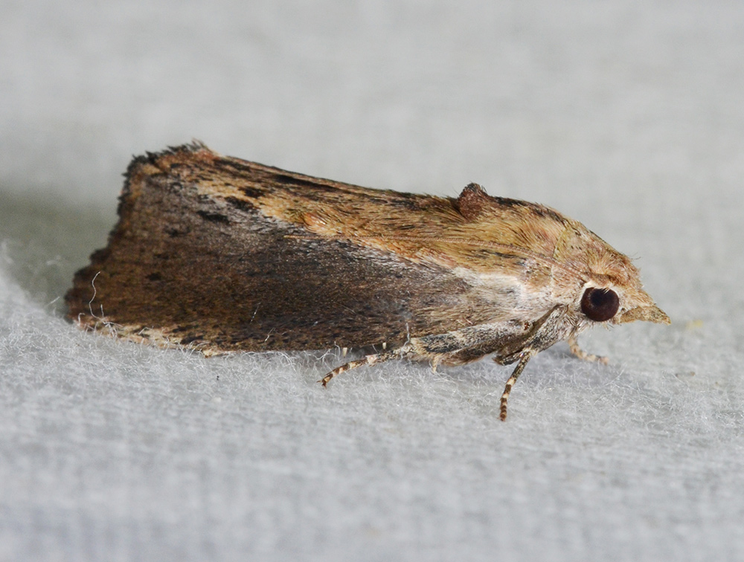
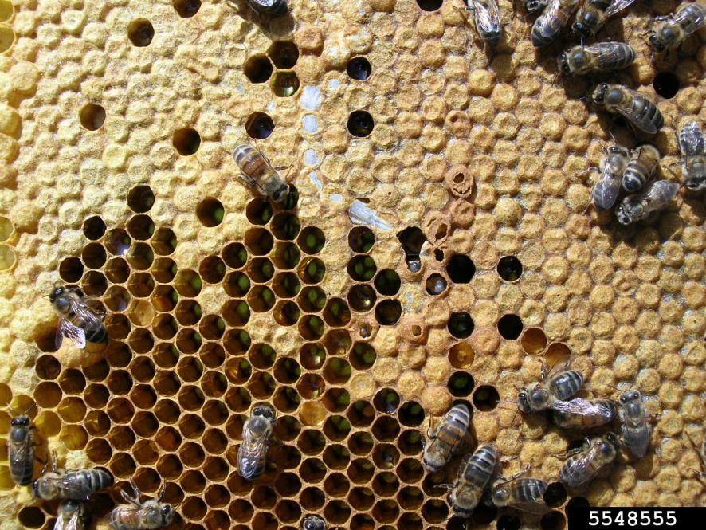
Enemies of honey bee
Wax moths - Galleria mellonella . It is one of most important enemies of the bee colony causing serious damage particularly to weak colonies where the number of bees are not sufficient enough to cover all the combs
The caterpillars live in silken tunnels made by them and feed on the propolis, pollen and wax in the combs. As they penetrate the wax layers, particles of wax are dislodged and fall into the cells and in the hive. The presence of loose dislodged particles in the hive is the first symptom of attack.
The insect can be controlled by frequent examination all the crevices of the hive and removing all debris. The excess of the hive not covered by the bees are removed and stored after fumigation with ethylene bromide.

Slide 14
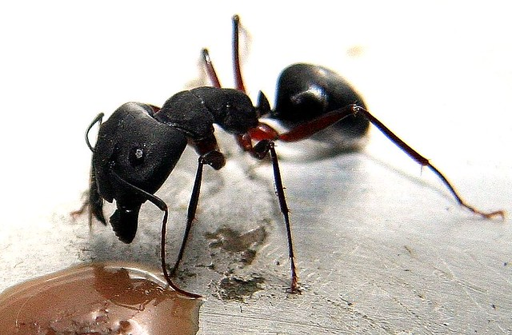
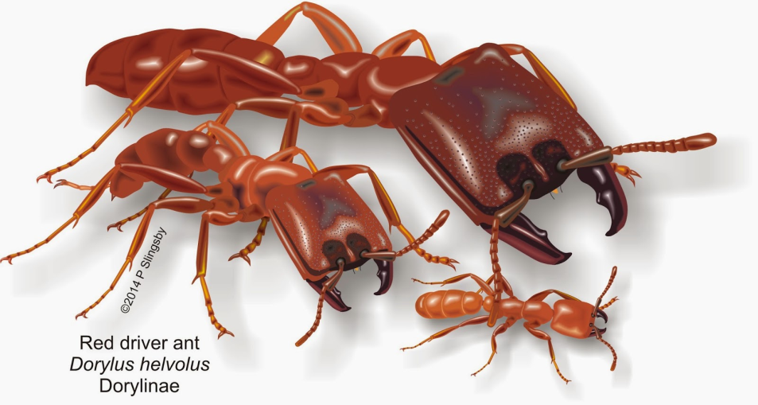
Ants The black ant, Camponotus compressus, the-household red ant, Dorylus labiams and Monomorium spp. are dangerous enemies of the bee. They attack weak colonies and carry away the honey, pollen and the brood.
By providing ant pans around the bases of the stand or oil bands over the stands ants can be kept away. Underground ant nests are eliminated by dusting of Methyl parathion or carbaryl or pouring 0.1% chlorpyriphos solution

Slide 15
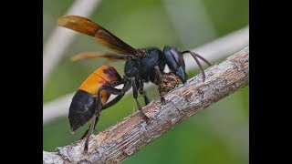
Wasps The yellow banded hornet, Vespa cincta F., is a large wasp with a broad transverse yield band on the abdomen.
It is a social insect constructing papery nests in hollow spaces.
It waits area the entrance of the hive, catches bees as they come out, macerates them for feeding the juice to its young.
It captures bee in the field also.
By reducing the width of the alighting board of the hive, the wasps can be prevented from sitting near the entrance

Slide 16
Diseases of honey bees
The Indian bee is comparatively free from many infectious diseases except Thai Sac brood virus whereas the Italian bee in other countries is known to be susceptible to diseases like foul brood, sac brood, Acarine diseases etc.

Slide 17
Nosema Disease
This disease is caused by a protozoan, Nosema apis. The Nosema infestation leads to dysentery.
The flies are unable to fly and void loose excreta on the combs, frames and ground in front of the hive.
An antibiotic known as Fumagillin is useful in controlling the infection.
The drug is administered by giving a feed of 100 mg fumagillin per colony in 250 ml of sugar syrup for 10 days continuously.

Slide 18
European foul-brood disease, Streptococcus pluton
This disease was first noticed in Mahabaleshwar and is now widespread. The disease is believed to have been introduced along with Apis mellifera imported from exotic sources. The disease is caused by non-spore-forming bacterium, Streptococcus pluton
The symptoms are: the larvae turn watery, yellow then brown and lastly dark coloured. The tracheal system becomes visible and larva dies in a coiled stage causing foul smell.
Terramycin is given dissolved in sugar syrup @ 100 mg of active terramycin in a litre of syrup. The terramycin syrup (freshly prepared) is fed every seventh day.

Slide 19
Sac-brood disease (SBV)
Sac brood is a virus disease attacking Apis mellifera. The diseased larvae appear sac like and hence the name. But so far this disease is not reported in India.
Thai sac brood virus (TSBV)
This virus attacks specifically Apis cerena indica.
The dead brood is found in propupal but sealed stage.
The pupae turn into sac-like structures filled with lemon-coloured liquid at the posterior end.

Slide 20
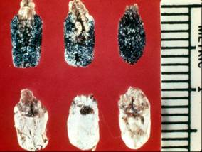
Chalk brood disease and stone brood disease
The fungus Ascosphaera apis that causes chalk brood only attacks larvae.
When the spores are ingested, they germinate and mycelia grow through the body penetrating the epidermis and covering the pre-pupa in a short time-span.
They cause mummification of the diseased larvae.

Slide 21
Thank you
Hope You all inculcated with the basic terms of Apiculture?
Erect Artificial bee hive in your home gardens/cultivable lands……… to get natural honey as well as maintaining the ecological sustainability in an area…………

