Slide 1
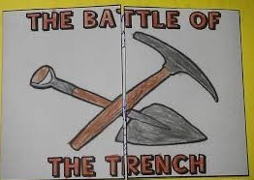
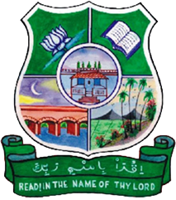
KHANDAQ WAR
Subject Name – Seerath - VI Subject Code –17UARC62
K. Bushra
Assistant Professor
H.K.R.H. College
Uthamapalayam

Slide 2
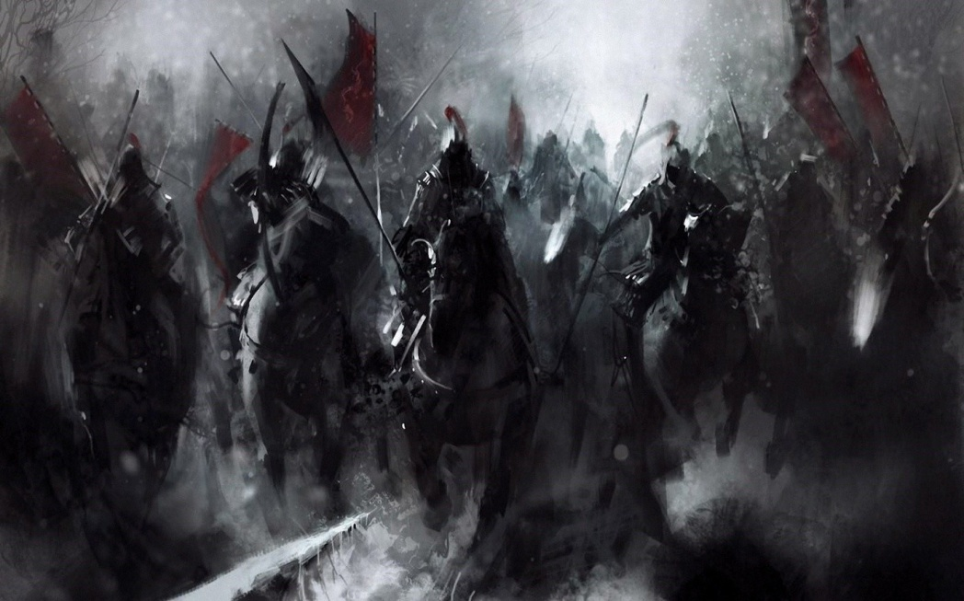
Background History
There was a treaty of mutual defense between the Muslims and the Jews nearby Madînah.
The Jews betrayed their treaty since they planned to kill the Prophet (SAWS). They met with the leaders of Quraysh. They reached an
agreement with them, and with the tribe of Ghatafân, to wage war against the Muslims.
They all united to fight the Muslims, totaling an army of 10,000 fighters, with Abu-Sufyân

Slide 3
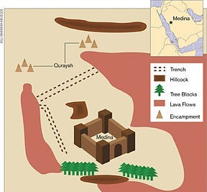
Defence of Muslims
When the Prophet (SAWS) heard about their gathering, he consulted his companions about what to do to resist them.Hazrat Salman Farsy suggested
digging a trench, which is the direction of entry into the city, so the Muslims dug it.Madinah was land locked by two sides and other two sides were open to attack and later on those sides,trench was dug.0

Slide 4
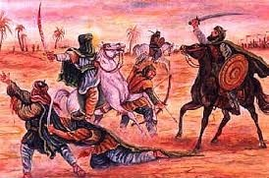
Events
When Quraysh came with the allies, they were shocked to these trench as they had never fought such type of battle before. After seeing an army of nearly 50 0 men, Muslims were also feared. On this occasion, an Ayat was revealed in Surah Ahzab

Slide 5
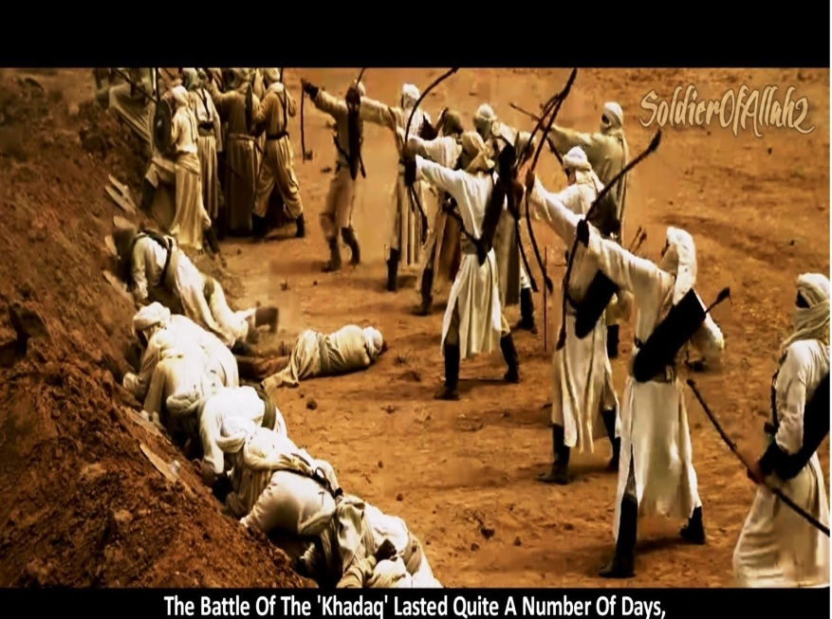
J
They camped behind the trench,facing the Muslim army of only 300 men. Ikrimah bin Abi Jahl managed to cross the trench and Ali bin Abi Talib accepted his challenge and on
first hit killed Ikrimah. Meanwhile,the confederates tried to encourage Banu Quariza to wage a war against Muslims. Banu Quraiza were already in pact with Muslims and being the neutal overall was confirmed that Muslims

Slide 6
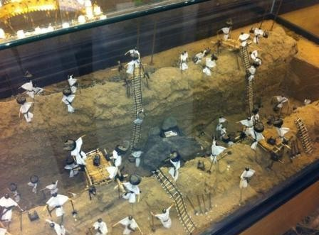
h
Some of the bravemen from pagans as well as from Muslims also accepted challenges and fought. There began to lack of food and resources in Madinah but Muslims didn’t loose hope…They stayed in this situation,meanwhile, exchanging arrow- fights.The Seige lasted for more than 20 days.

Slide 7
Outcomes
The failure of the siege marked the beginning of Muhammad's undoubted political strength in Madina.This defeat caused Makkans to lose their trade with Syria and much of their prestige with it. What Makkans at this point began to know that conversion to Islam would be the most prudent option.

