Slide 1
Classical Arabic literature
Prof. M. Seyid Abdul Kadher M.A., M.Phil. .,Net (Arabic), M.a. (English), m.b.a.
Asst. prof. & HeAD of the dept. of Arabic, HKRH College, uthamapalayam, theni dt., tamilnadu

Slide 2
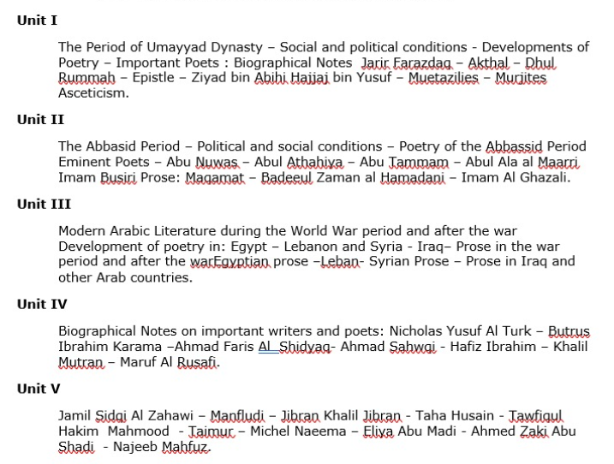
Contents

Slide 3
Unit i
Notes:
Consider talking about:
The exemplar of classical literature
Islamic scholarship

Slide 4
Umayyad period
Social & Political conditions
Developments in Poetry
Important Poets
Mutazilites
Murijites
Asceticism
Notes:
Consider talking about:
Poetry
Novels
Plays

Slide 5
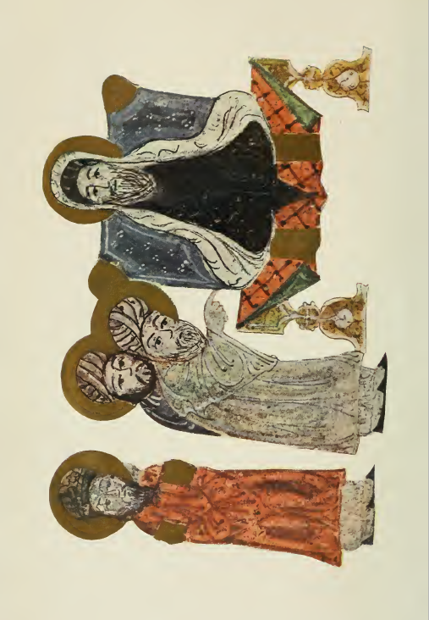
Social & political conditions
Umayyad Period

Slide 6
Umayyad dynasty (661-750)
Umayyads were Arabs first and Muslims afterwards
By 732 C.E. the Muslim conquests had reached beyond Oxus, the Pyrenes, the Caspian sea upto the Nile river valley
Meanwhile the dynasty was weakened by political and religious differences
The Shias who revolted again and again were joined by Persians who felt oppressed by the Umayyad government
The Abbasids, a family closely related to the Prophet, headed the agitations against the Umayyads and this lead to their downfall

Slide 7
Umayyad poets
The names of al-Akhtal, al-Farazdaq, and Jarir stand out pre-eminently in the list of Umayyad poets. They were men who refused to battle except on the field of love. It is noteworthy that all three were born and bred in Mesopotamia.
Farazdaq and Jarir are intimately connected by a peculiar rivalry. For many years they engaged in a public scolding matches.

Slide 8
Umayyad poets
A subject of frequent argument at the Umayyad Court was the relative merits of the three poets, Akhtal, Farazdaq, and Jarir. The princes would amuse themselves by making their courtiers pronounce an opinion, and the courtiers, who dreaded the vengeance of the two poets, would get out of the difficulty by taking refuge in generalities. “Jarir draws water from a well,“ said one; “Ferazdaq carves out of the rock ; as for Akhtal, he excels in eulogy and in heroic verse."

Slide 9
Umayyad poets
In later days, under the Abbasids, when passions had cooled, grammarians ended by preferring Akhtal, because his verses were more finished and correct, and because he had been able to produce the largest number of poems of a certain length which are irreproachable, from beginning to end, both in subject and in form. The qualities most valued in his work are fulness of divine creative inspiration and purity of expression. We are told nothing as to the loftiness of his inspiration. But one famous line, which Harun al-Rashid loved to recall, proves the nobility of the moral sentiments he enunciated.
It occurs in his ode addressed to the Caliph Abdul Malik, in which, speaking of the Umayyads, he says :”Terrible in their rage if they are withstood, they are the most clement of men when victory is won."

Slide 10
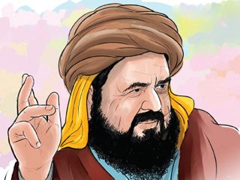
Farazdaq الـفـرزدق
Farazdaq was a pious Muslim, entirely devoted to the Prophet's family. His name was Hammam, and he belonged to the tribe of Tamim. He was born at Basra towards the end of 641. Caliph ‘Ali advised him to learn the Koran instead of running after poetry, and the young man is said to have fastened chains to his own feet until he got the sacred lines by heart. But his father’s death soon brought back all his poetic instincts. He devoted his talent largely to satire and attacked the Bani Nahshal and the Bani Fuqaim. When Ziyad, a member of the latter tribe, became governor of Basra in 669, the poet was compelled to flee, first to Kufa, and then, as he was still too near Ziyad, to Medina, where he was well received by the city’s Amir, Sa'd ibn al-'As. Here he remained about ten years, writing satires on tribes, but avoiding city politics.

Slide 11
FARAZDAQ الـفـرزدق
But he lived a prodigal life, and his amorous verses led to his expulsion by the caliph Marwan I. Just at that time, he learned of the death of Ziyad and returned to Basra, where he secured the favor of Ziyad's successor Ubayd Allah ibn Ziyad. Much of his poetry was now devoted to his matrimonial affairs. He had taken advantage of his position as guardian and married his cousin Nawar against her will. She sought help in vain from the court of Basra and from various tribes. All feared the poet's satires. At last, she fled to Mecca and appealed to the political contender to the Umayyads Abdallah ibn Zubayr, who, however, succeeded in inducing her to consent to a confirmation of the marriage.

Slide 12
Farazdaq الـفـرزدق
Quarrels soon arose again. Farazdaq took a second wife, and after her death a third, to annoy Nawar. Finally, he consented to a divorce pronounced by Hasan al-Basri. Another subject occasioned a long series of verses, namely his feud with his rival Jarir and his tribe the Bani Kulaib. These poems are published as the Naqaid which were recordings of the Public scoldings (Muhjat) of Jarir and al-Farazdaq. Al-Farazdaq became official poet to the Umayyad caliph Al-Walid I (reigned 705–715), to whom he dedicated a number of panegyrics. He is most famous for the poem that he gave in Makkah when Ali bin Hussain bin Ali bin Abu Talib (Zayn al-Abidin) entered the Haram of the Kaba. This act of his angered the Amir. The poem is extremely powerful. It is because of this poem that he was imprisoned.

Slide 13
The naqaid نـقـائـض
As neither had any scruples, they abused each other in the foulest language. However, their language kept away from vulgarity due to its literary excellence. Soon these Naqaid of Jarir and Farazdaq were recited everywhere. One day Muhallab b. Abi Sufra, the governor of Khurasan, who was marching against the Azariqa, a sect of the Kharijites, heard a great quarrel in the camp. On inquiring its cause, he found that the soldiers had been fiercely disputing as to the comparative merits of Jarir and Farazdaq, and desired to submit the question to his decision.
" Would you expose me," said Muhallab, " to be torn to pieces by these two dogs ? I will not decide between them, but I will point out to you those who don’t care for either of them. Go to the Azariqa ! They are Arabs who understand poetry and judge it right.“
Next day, when the armies faced each other, an Azraqite named Abid b, Hilal stepped forth from the ranks and offered single combat. One of Muhallab's men accepted the challenge, but before fighting he begged his adversary to inform him which was the better poet Farazdaq or Jarir ? " God confound you ! “ cried 'Abid " Do you ask me about poetry instead of studying the Quran and the Sacred Law ? " Then he quoted a verse by Jarir and gave judgment in his favour. This incident affords a striking proof that the taste for poetry, far from being confined to literary circles, was diffused throughout the whole nation, and was cultivated even amidst the fatigues and dangers of war.

Slide 14
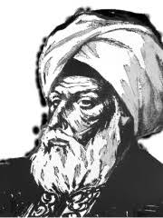
AL Akhtal الأخطل‎
Al-Akhtal al-Taghlibî was one of the great panegyrists of the Umayyad period. He became famous for his satires and panegyrics in a period when poetry was an important political instrument. Al-Akhtal was introduced to Yazid I by Ka'b ibn Ju'ayl and became a close friend of the heir apparent to Caliph Mu'awiya I (r. 661–680). Yazid, when he acceded to the throne, was generous to al-Akhtal. Despite his Christianity, he was favored by leading Umayyad caliphs. Throughout his life, al-Akhtal was a supporter of the ruling Umayyad dynasty.
He lauded in his panegyrics Yazid, Abd al-Malik ibn Marwan and al-Walid I and in his satires attacked all the opponents of the caliphs. Al-Akhtal became the official court poet of Abd al-Malik, to whom he dedicated a number of panegyrics. But he fell into disfavour under al-Walid. The pre-Islamic Bedouin tradition is always apparent in the poems of al-Akhtal and his panegyrics show the continued vitality of this tradition. The panegyrics of al-Akhtal acquired a classical status. His poetry was accepted by critics as a source of pure Arabic.
Few details are known about al-Akhtal's personal life, save that he was married and divorced, and that he spent part of his time in Damascus, part with his tribe in the Jazira (Upper Mesopotamia). In the Taghlib–Qays war he participated on the battlefield, as well as by his satires. In the literary strife between his contemporaries Jarir ibn Atiyah and al-Farazdaq, Akhtal was induced to support the latter poet. Al-Akhtal, Jarir and al-Farazdaq form a trio celebrated among the Arabs, but as to superiority there is dispute. Abu Ubayda placed him highest of the three on the ground that among his poems there were ten flawless qasidas (Arabic poetic odes), and ten more nearly so, and that this could not be said of the other two.

Slide 15
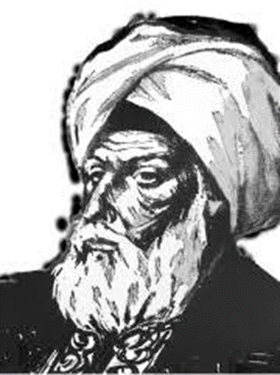
AL Akhtal الأخطل
On hearing Akhtal's ode in praise of the Umayyad dynasty, Abdu1 Malik ordered one of his clients to conduct the author through the streets of Damascus and to cry out, “Here is the poet of the Commander of the Faithful ! Here is the best poet of the Arabs ! “
The great tribe of Bakr used to invite him to act as arbitrator whenever any controversy arose among them. 3 Despite the luxury in which he lived, his wild Bedouin nature pined for freedom, and he frequently left the capital to visit his home in the desert.
We have already noticed the part which he played in the literary duel between Jarir and Farazdaq. From his deathbed he sent a final injunction to Farazdaq not to spare their common enemy. Akhtal is commended by Arabian critics for the number anexcellence of his long poems, as well as for the purity, polish and correctness of his style. The celebrated collector of Pre-islamic poetry, Abu 'Amr b. al-'Ala, declared that if Akhtal had lived a single day in the Pagan Age he would not have preferred any other poet to him. His supremacy in panegyric was acknowledged by Farazdaq, and he himself claims to have surpassed all competitors in three styles, viz., panegyric, satire, and erotic poetry.

Slide 16
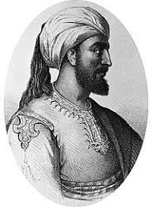
Jarir جـريـر
Jarir ibn Atiyah al-Khatfi Al-Tamimi (جرير بن عطية الخطفي التميمي‎ (c. 650 – c. 728) was an Arab poet and satirist. He was born in the reign of the caliph Othman, and was a member of the tribe Kulaib, a part of the Banu Tamim. He was a native of al-Yamamah, but also spent time in Damascus at the court of the Umayyad caliphs.
Little is known of his early life, but he succeeded in winning the favor of Al-Hajjaj bin Yousef, the governor of Iraq. Already famous for his verse, he became more widely known by his feud with rival poets Farazdaq and Akhtal. Later he went to Damascus and visited the court of the caliph Abd al-Malik and that of his successor, Al-Walid I. From neither of these did he receive a warm welcome. He was, however, more successful with Umar II, and was the only poet received by the pious caliph.
His verse, like that of his contemporaries, is largely satire and eulogy

Slide 17
jarir جـريـر
Jarīr’s special skill lay in poems insulting personal rivals or the enemies of his patrons. After sharp verbal clashes in Arabia in defense of Kulayb, his tribe, Jarīr moved to Iraq. There he won the favour of the governor, al-Ḥajjāj, and wrote a number of poems in his praise. He also met the poet al-Farazdaq, with whom he had already begun a battle of poems that is said to have lasted 40 years. The results were collected in the following century as naqāʾid (“slanging-matches on parallel themes”). The governor’s goodwill earned Jarīr entry at the Umayyad court in Damascus. Jarīr was not able, however, to dislodge the poet al-Akhṭal from the esteem of the caliph ʿAbd al-Malik, and another poetic battle ensued, also producing naqāʾid. Of the caliphs who succeeded ʿAbd al-Malik, only the pious ʿUmar II seems to have favoured Jarīr, and much of Jarīr’s life was spent away from court in his native Yamāmah.

Slide 18
Jarir جـريـر
Many of Jarīr’s poems are in the conventional qaṣīdah (“ode”) form. They typically open with an amatory prelude that is followed by invective and panegyric; the robust style of these later sections is frequently at odds with that of the prelude. Jarīr also wrote elegies, wisdom poetry, and epigrams.

Slide 19
Dhu’r Rummah Arab poet. nicknamed Ghailan ibn Ugbah. Born 696 - died 735 C.E.
In his work, Dhu’r Rummah revived pre-Islamic poetic traditions. He wrote poems that in their form did not differ from the qasida of the pre-Islamic Bedouin poets, introducing into their themes, Islamic elements. Especially popular were his rawiyat (pastorals), in which the natural beauty of the desert and the life of the herdsmen are vividly described. Imitating the Bedouin poets, he also revived the poetic form of the Urjuza, in which a single rhyme is repeated not only at the ends of the lines but also at the hemistiches (internal rhyme). The work of a gifted lyric poet, Dhu’r Rummah’s poetry is popular among readers of Arabic literature even today.

Slide 20
Ziyad bin abih
History first makes an appearance under the sway of the Umayyads. We are told that Ziyad, brother to Muawiya, and his lieutenant, wrote a book on the pretensions of the Arab families, which was intended to serve as a weapon in the hands of his own descendants in case their origin should be attacked (he was the son of Abu Sufyan, Muawiya's father, by a slave) ; but this is by no means a certainty, though the assertion is supported by the authority of Al Fihrist. He was an administrator and statesman of the successive Rashidun and Umayyad caliphates in the mid-7th century. He served as the governor of Basra in 665–670 and ultimately the first governor of Iraq and virtual viceroy of the eastern Caliphate between 670 and his death.

Slide 21
Ziyad bin abih
Ziyad was raised among the Banu Thaqif in Ta'if and arrived with his adoptive tribesmen in Basra upon its foundation in 636 as the Muslim Arabs' springboard for the conquest of the Sasanian Empire. He was initially employed by the city's first governor, Utba ibn Ghazwan al-Mazini, and was kept on as a scribe or secretary by his successors. Caliph Ali (r. 656–661) appointed Ziyad to Fars to suppress a local rebellion and he maintained his loyalty to Ali's caliphate after the latter's assassination in 661 and the subsequent rule of Ali's enemy, Mu'awiya I (r. 661–680). The latter ultimately overcame Ziyad's opposition, formally recognized him as his own paternal half-brother and appointed him governor of Basra. Ziyad's inaugural speech, in which he announced his carrot-and-stick policies to the city's turbulent population, is celebrated in Arab history for its eloquence. After the death of Kufa's governor, Ziyad's mentor al-Mughira ibn Shu'ba, Mu'awiya made Ziyad the first governor of a unified Iraqi province.

Slide 22
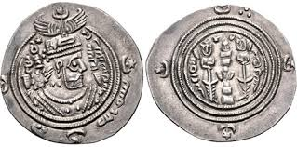
Ziyad bin abih
He administratively reorganized the garrison cities and minted Sasanian-style silver dirhams in his own name. He firmly established Arab power and recommenced conquests in the Caliphate's easternmost province of Khurasan by relocating there 50,000 Arab soldiers and their families from Iraq and dispatching expeditionary forces against Tukharistan, Balkh and Quhistan. Though the mass resettlement improved Iraq's economic and political conditions by siphoning off Arab tribal soldiers from the overcrowded garrisons and creating new opportunities for war spoils, the move had major ramifications for the Caliphate as the descendants of these Khurasani Arab troops formed the army that toppled the Umayyads in 750.
Ziyad died near Kufa in 673, but his sons Ubayd Allah, Abd al-Rahman, Salm, Abbad and Yazid went on to hold posts as governors or deputy governors of Iraq, Khurasan and Sijistan. Ziyad was the subject of early Arabic biographies and is remembered in Arab history as one of the four great wise men of his era and as a highly skilled administrator and orator. His administration in Iraq served as a model for his successors.

Slide 23
AL Hajjaj ibn yusuf (661-715 C.E.)
Abū Muhammad al-Ḥajjāj ibn Yūsuf ibn al-Ḥakam ibn ʿAqīl al-Thaqafī (أبو محمد الحجاج بن يوسف بن الحكم بن عقيل الثقفي‎) known simply as al-Hajjaj ibn Yusuf (الحجاج بن يوسف‎ ) was perhaps the most notable governor who served the Umayyad Caliphate. He began his service with the Umayyads under Caliph Abd al-Malik (r. 685–705), who successively promoted him as the head of the caliph's shurta (security forces), the governor of the Hijaz (western Arabia) in 692–694, and the practical viceroy of a unified Iraqi province and the eastern parts of the Caliphate in 694. Al-Hajjaj retained the last post under Abd al-Malik's son and successor al-Walid I (r. 705–715), whose decision-making was highly influenced by al-Hajjaj, until his death in 714.
When Hajjaj became the Governor of Iraq, he entered the Mosque at Kufa, mounted the pulpit and introduced himself to the assembled townsmen in these memorable words : "I am he who scattereth the darkness and climbeth o'er the summits. When I lift the turban from my face, ye will know me. O people of Kilfa ! I see heads that are ripe for cutting and I am the man to do it. And, I see blood between the turbans and beards.". He used no idle threats as the people soon found out. Rebellion, which had been rampant before his arrival, was rapidly extinguished. "He restored order in 'Iraq and subdued its people."

Slide 24
AL Hajjaj ibn yusuf (661-715 C.E.)
He established and maintained the settled conditions which afforded leisure for the cultivation of learning.
Under his protection the Koran and Traditions were diligently studied both in Kufa and Basra, where many Companions of the Prophet had made their home. Hence arose in Basra the science of Grammar.
Hajjdj shared the literary tastes of his Caliph Abdul Malik. He admired the old poets and patronised the new. He was a master of eloquence and elegant Arabic style.
He served the Umayyads well and faithfully, and when he died in 714 a.d. he left behind him nothing but his Quran, his arms, and a few hundred pieces of silver.

Slide 25
AL Hajjaj ibn yusuf (661-715 C.E.)
As governor of Iraq and the east, al-Hajjaj instituted key reforms. Among these were:
The minting of silver dirhams with strictly Muslim religious formulas instead of the traditional, pre-Islamic Sasanian design
Changing the language of the dīwān (bureaucracy) of Iraq from Persian to Arabic
And the introduction of a uniform version of the Quran complete with vowel-marks (borrowed from the Syriac) and the diacritical points placed above or below similar consonants.

Slide 26
Kharijites
'Kharijite' means one who leaves his home among the unbelievers for God's sake, and corresponds to the term Muhajir which was applied to the Meccan converts who accompanied the Prophet in his flight to Medina. They are also referred to as those who have pledged their lives and goods in return for Paradise.
The Kharijites were mostly drawn from the Bedouin soldiery who settled in Basra and Kufa after the Persian wars. Civil life brought little change in their unruly temper. Far from acknowledging the peculiar sanctity of a Quraish, they desired a chief of their own blood whom they might obey, in Bedouin fashion, as long as he did not abuse or exceed the powers conferred upon him. They believed that every free Arab was eligible to become a Caliph and that an evil-doing Caliph must be deposed and, if necessary, be put to death.
They wrote poems of a different order from the Pagan odes, poems that breathe a stern religious enthusiasm.

Slide 27
The ShiAS
The murder of Uthman broke the Moslem community into two Shias (Parties) one for Ali and the other for Muawiya. The Shias behind Ali regarded the House of the Prophet as the legitimate heirs to the succession. The extreme among them propogated that the Caliphate belonged to Ali and his descendants by Divine right. Such is the distinctive doctrine of the Shi'ites to the present day. It is generally thought to have originated in Persia, where the Sasanian kings used to assume the title of ‘God Incarnate' (Pahlavi bagh) and were looked upon as successive incarnations of the Divine majesty. The only principle which they recognised was that of inheritance, and since Muhammad left no sons, they thought that his son-in-law 'All should have succeeded him, and that the sovereignty was hereditary in his family. Consequently, all the Caliphs except 'Ali i.e., Abu Bakr, 'Umar, and 'Uthman, as well as the Umayyads were in their eyes usurpers to whom no obedience was due. The hatred which they felt for the Government and for Arab rule confirmed them in this opinion

Slide 28
The murijites
The leading article of the Murjite creed was that no one who professed to believe in the One God could be declared an infidel(Kafir), whatever sins he might commit, until God Himself had given judgment against him. The Murjites were so called because they deferred their decision in such cases and left the sinner's fate in suspense, so long as it was doubtful. This principle they applied in different ways. For example, they refused to condemn 'All and 'Uthman outright, as the Kharijites did. " Both Ali and Uthman," they said, "were servants of God, and by God alone must they be judged.
On the other hand, the Murjites equally rejected the pretensions made by the ShCites on behalf of 'All and by the Umayyads on behalf of Mu'awiya. For the most part they maintained a neutral attitude towards the Umayyad Government : they were passive resisters. The Murjites brought the same tolerant spirit into religion. They set faith above works, emphasised the love and goodness of God, and held that no Moslem would be damned eternally. The moderate school found their most illustrious representativein Abu Hanifa (f 767 C.E..), and through this great divine whose followers today are counted by millions their liberal doctrines were diffused and perpetuated.

Slide 29
The mutazilites
During the Umayyad period Basra was the intellectual capital of Islam, and in that city we find the first traces of a sect which maintained the principle that thought must be free in the search for truth. The origin of the Mu'tazilites takes us back to the famous divine and ascetic, Hasan of Basra (728 C.E.). One day he was asked to give his opinion on a point regarding which the Murjites and the Kharijites held opposite views, namely, whether those who had committed. a great sin should be deemed believers or unbelievers. While Hasan was considering the question, one of his pupils, Wasil b. 'Ata replied that such persons were neither believers nor unbelievers, but should be ranked in an intermediate state. He then turned aside and began to explain the grounds of his assertion to a group which gathered about him in a different part of themosque. Hasan said : " Wasil has separated himself from us “. And on this account the followers of Wasil were named ' Mu'tazilites,' i.e. Schismatics.
Thus the real founder of the Mu'tazilites was Wasil b. 'Ata (748 C.E.), denied the existence of the Divine attributes such as Power and, Wisdom on the ground that such qualities, if conceived as eternal, would destroy the conception of the Unity of God. Hence the Mu'tazilites called themselves the people of Unity and Justice ' Ahlu-tawhld wal adl) : of Unity for the reason which has been explained, and of Justice, because they held that God was not the author of evil and that He would not punish His creatures except for actions within their control.

Slide 30
hasan al basri Hasan of basra
"The bounties of God are too numerous to be acknowledged unless with His help, and the sins of Man are too numerous for him to escape therefrom unless God pardon them."
" The wonder is not how the lost were lost, but how the saved were saved.”
" Cleanse ye these hearts (by meditation and remembrance of God), for they are quick to rust ; and restrain you these souls, for they desire eagerly, and if you restrain them not, they will drag you to an evil end."

Slide 31
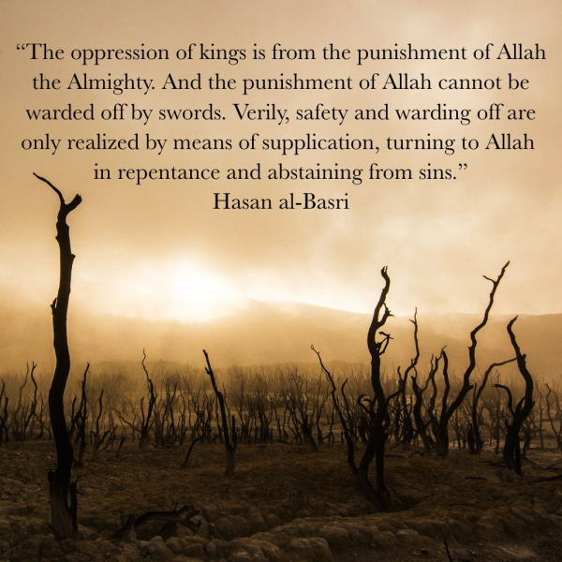
Hasan al basri

Slide 32
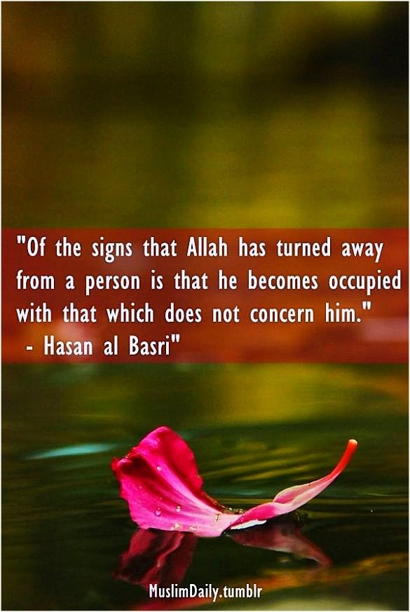
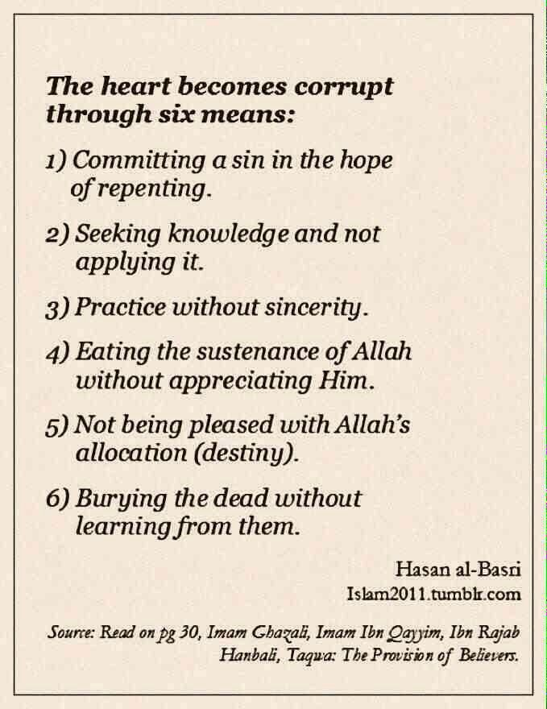
Hasan al basri

Slide 33
Asceticism and sufism
The oldest Sufis were ascetics and hermits, but they were also something more. They brought out the spiritual and mystical element in Islam, or brought it in, if they did not find it there already. "Sufiism," says Suhraward " is neither poverty nor asceticism but a term which comprehends the ideas of both, together with something besides. Without these additional qualities a man is not a Sufi though he may be an ascetic or a fakir. It is said that, notwithstanding the excellence of poverty, the end thereof is only the beginning of Sufiism."

Slide 34
Asceticism and sufism
A little further on he explains the difference thus:
" The fakir holds fast to his poverty and is profoundly convinced of its superior merit. He prefers it to riches because he longs for the Divine recompense of which his faith assures him . And whenever he contemplates the everlasting reward, he abstains from the fleeting joys of this world and embraces poverty and indigence and fears that if he should cease to be poor he will lose both the merit and the prize. Now this is absolutely unsound according to the doctrine of the Sufis, because he hopes for recompense and renounces the world on that account, whereas the Sufi does not renounce it for the sake of promised rewards but, on the contrary, for the sake of present states, for he is the ' son of his time.' The theory that ' poverty ' is the foundation of Sufiism signifies that the diverse stages of Sufiism are reached by the road of poverty. It does not imply that the Sufi is essentially a fakir.“
The keynote of Sufiism is disinterested, selfless devotion, in a word, Love. Sufism considers divine love to be of utmost importance in transforming the self. As we pursue a path of divine love in our lives, God begins to reach out and draw us in toward the divine presence. If we are willing to surrender to God, we will awaken and be taken in by Him.Followers of Sufism believe they can become closer to Allah through inner purification and introspection. They do this by meditating and receiving guidance from their spiritual leader(Sheikh), or Murshid(guide).

Slide 35
Sufi saint Ibrahim ibnu Adham
Ibrahim belonged to the royal family of Balkh. He renounced all worldly pleasures and lived for nine years in a cave near Naisabur where he spent his time in meditation. His customary prayer was, " O God, uplift me from the shame of disobedience to the glory of submission to you.” "O God !" he said, "Thou knowest that the Eight Paradises are little beside the honour which Thou hast done unto me, and beside your love, and beside your giving me intimacy with the praise of your name, and beside the peace of mind which you have given me when I meditate on your majesty."
He said : " You will not attain to righteousness until you cross six passes. The first is that you shut the door of pleasure and open the door of hardship. The second is that you shut the door of eminence and open the door of abasement. The third is that you shut the door of ease and open the door of affliction, The fourth is that you shut the door of sleep and open the door of wakefulness. The fifth is that you shut the door of riches and open the door of poverty. And the sixth is that you shut the door of expctation and open the door of making yourself ready for death."
End of Unit I

Slide 36
Unit iI
Notes:
Consider talking about:
The exemplar of classical literature
Islamic scholarship

Slide 37
abbasid period
Social & Political conditions
Developments in Poetry
Important Poets
Important Prose writers
Imam Ghazali
Notes:
Consider talking about:
Poetry
Novels
Plays

Slide 38
Social and political conditions during abbasid period
The city of Baghdad
When the 'Abbasids founded the city of Bagdad, on the right bank of the Tigris, they seem to have sought for a site which would be a compromise between the Arab creators of the Caliphs' Empire and the Persian authors of the revolution which had placed the sons of 'Abbas on the throne. The very name of the city is Persian, and means ‘given by God’. In 762 C.E. the walls of the new city began to rise. Caliph Mansur laid the first brick with his own hands, and the work was pushed forward with astonishing rapidity under his personal direction by masons, architects, and surveyors, whom he gathered out of diflferent countries, so that ‘the Round City,' as he planned it, was actually finished within the short space of four years.To the right of the Tigris lies Mesopotamia, a Semitic country from times immemorial, and overrun, since the fall of the ancient empires, by the nomad Arabs. To the left, Iranian territory begins at once.
The Bagdad of the Caliphs now lies in ruins only a very small number of the buildings remain ; modern Baghdad, which stands on the left bank of the Tigris, is still inhabited by many Persians.

Slide 40
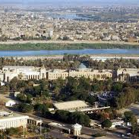
MODERN BAGHDAD

Slide 41
Persian influence
From the very outset of the eighth century, Persian influence was so strong in political matters that Mansur did not hesitate to rid himself, by the assassin's hand, of Abu Muslim, the leader who had overthrown the Umayyad dynasty, just as Harun al-Rashid, at a later date, rid himself of the Persian Barmakides who had supplied him with two powerful ministers.
In literature, this Persian influence is immense. It pervades everything poetry, theology, jurisprudence : the Arabs had ceased to write; all posts, administrative, court and legal, were held by men who were not Arabs, and the same applies to all the literature of the time. From this period onward, Arabic became the language, and the sole language, of the huge Empire of the Caliphs. But it was Arabic spoken and written by men who were Arabs by education, not by blood. All races, Persians, Syrians, Berbers from Maghrib, were melted and amalgamated.

Slide 42
Developments IN SCIENCE & LITERATURE DURING THE ABBASID PERIOD
The Sciences that developed during the period are:
I. The Native Sciences
1. Quranic explaination((علم التفسير
2. Criticism
3. The Science of Apostolic Tradition (علم الحديث)
4. Jurisprudence (الفقه)
5. Scholastic Theology
6. Grammar (نهو)
7. Lexicography
8. Rhetoric ( البلاغة )
9. Literature (الأدب )
II. The Foreign Sciences
1. Philosophy (فلسفة )
2. Geometry (هندسة)
3. Astronomy (الفلك )
4. Music
5. Medicine ( طب)
6. Magic and Alchemy (األكيميا سحرو )

Slide 43
Developments in abbasid poetry
Poetry now began to alter. The lengthy qasidas of the desert, held up as models for students by the theorists, found no more original exponents. A new kind of poetry appeared in Baghdad, where the imperial splendour was attracting the most brilliant talents. Ibn Qutayba, who died towards the end of the ninth century C.E., was the first critic of importance to declare that ancients and moderns should be judged on their merits without regard to their age. Ibn Rashi'q (1070 A.C.), whose “Umda” on the Art of Poetry is described by Ibn Khaldun as an epoch-making work, thought that the superiority of the moderns would be acknowledged if they discarded the obsolete conventions of the Ode.

Slide 44
Abu nuwas
Hasan b. Hani' gained the familiar title of Abu Nuwas(Father of the lock of hair) from two locks which hung down on his shoulders. He was born of humble parents, about the middle of the eighth century, in Ahwaz, the capital of Khuzistan. That he was not a pure Arab the name of his mother, Jallaban, clearly indicates, while the following verse affords sufficient proof that he was not ashamed of his Persian blood :
" Who are Tamim and Qays and all their kin ?
The Arabs in God's sight are nobody."
He received his education at Basra, of which city he calls himself a native. At Kufa, he studied poetry and philology under the learned Khalaf al-Ahmar., he made his way to Baghdad and soon eclipsed every competitor at the court of Caliph Harun Al Rashid. A man of the most abandoned character, which he took no pains to conceal, Abu Nuwas, by his flagrant immorality, drunkenness, and blasphemy, induced the Caliph’s anger to such a pitch that he was often threatened with death, and was actually imprisoned on several occasions. But these fits of severity were brief. The poet survived both Harun and his son, Amin, who succeeded him as Caliph.

Slide 45
Abu nuwas
However age brought him repentance as he said: “The Devil was sick, the Devil a monk would be.“
The Diwan of Abu Nuwas contains poems in many different styles like panegyric, satire, songs elegies and religious poems. But love and wine were the two motives by which his genius was most brilliantly inspired. His wine songs(khamriyyat) are generally acknowledged to be incomparable. Abu Nuwas felt that pleasure was the supreme business of his life, and that religious scruples could not be permitted to stand in the way. He even urges others not to shrink from any excess, in as much as the Divine mercy is greater than all the sins of which a man is capable.

Slide 46
Abul athahiya
Abul Athahiya was an Arab poet. He was from Kufa and gained his livelihood as a youngman by selling earthenware. His poetical talent encouraged him to set out to present himself before the Caliph Mahdi, whorichly rewarded him. Later, Harun al-Rashid bestowed on him a yearly pension of 50,000 dirhems in addition to numerous extraordinary gifts. At Baghdad he fell in love with 'Utba, a slave-girl belonging to Mahdi, but she did not return his passion or take any notice of the poems in which he celebrated her charms and cried about the sufferings that she made him endure. This desperation caused him to assume the woollen garb of ascetics. And from then on, instead of writing vain verses, he devoted his powers exclusively to those joyless meditations on mortality which have struck a deep chord in the hearts of his countrymen. Like Abul Ala al-Ma'arri and others who neglected the positive precepts of Islam in favour of a moral philosophy based on experience and reflection, Abul Athahiya was accused of being a freethinker(Zindiq).
Abul Athahiya believed in One God who formed the universe out of two opposite elements which He created from nothing and held, further, that everything would be reduced to these same elements before the final destruction of all phenomena. Knowledge, he thought, was acquired naturally (without Divine revelation) by means of reflection, deduction, and research.

Slide 47
Abul athahiya
His poetry breathes a spirit of proround melancholy and hopeless pessimism. Death and what comes after death, the frailty and misery of man, the vanity of worldly pleasures and the duty of renouncing them these are the subjects on which he dwells with monotonous reiteration, exhorting his readers to live the ascetic life and fear God and lay up a store of good works against the Day of Reckoning. The simplicity, ease and naturalness of his style are justly admired. Religious poetry, as he himself confesses, was not read at court or by scholars who demanded rare and obscure expressions, but only by pious, traditionists and divines, who like best what they can understand.
Abu 'l-'Atahiya wrote for 'the man in the street.' Discarding conventional themes tricked out with threadbare artifices, he appealed to common feelings and matters of universal experience. He showed for the first and perhaps for the last time in the history of Arabic literature that it was possible to use perfectly plain and ordinary language without ceasing be a poet. Although the bulk of his poetry is philosophical in character, there remains much specifically Islamic in doctrine, in particular as regards to Resurrection and Life after death.

Slide 48
Al mutanabbi
Abu '1-Tayyib Ahmad b. Husayn, known to fame as al-Mutanabbi, was born and bred at Kufa, where his father is said to have been a water-carrier. Following (915-965 A.D.). the admirable custom by which young men of promise were sent abroad to complete their education, he studied at Damascus and visited other towns in Syria, but also passed much of his time among the Bedouins, to whom he owed the singular knowledge and mastery of Arabic displayed in his poems. Here he pretended to be a Prophet and induced a large number of people to believe in him. But before long he was captured by Lulu the governor of Hims(Emessa), and thrown into prison. After his release he wandered to and fro chanting the praises of all and sundry, until fortune guided him to the court of Sayfu '1-Dawla at Aleppo. For nine years (948-957 a.d.) he stood high in the favour of that cultured prince, whose virtues he celebrated in a series of splendid eulogies, and with whom he lived as an intimate friend. Mutanabbi was sincerely attached to his generous master, and this feeling inspired a purer and loftier strain than we find in the fulsome panegyrics which he afterwards addressed to the black ruler Malik Kafur. Disappointed in his new patron, a negro who had formerly been a slave, the poet set off for Baghdad, and afterwards visited the court of the Buwayhid 'Adudu '1-Dawla at Shiraz. While travelling through Babylonia he was attacked and slain by brigands in 965 C.E. The popularity of Mutanabbi is shown by the numerous commentaries 3 and critical treatises on his Diwan. By his countrymen he is generally regarded as one of the greatest of Arabian poets.

Slide 49
Abul ala al ma’arri (973-1057)
The sceptical and pessimistic tendencies of an age of social decay and political anarchy are unmistakably revealed in the writings of the poet, philosopher, and man of letters Abul Ala Al Ma’arri. He was born at Ma'arratu '1-Nu'mdn, a Syrian town situated about twenty miles south of Aleppo on thecaravan road to Damascus. While yet a child he had an attack of small-pox, resulting in partial and eventually in complete blindness, but this calami ty,^ fatal as it might seem to literary ambition, was repaired if not entirely made good by his stupendous powers of memory. After being educated at home under the eye of his father, a man of some culture and a meritorious poet, he proceeded to Aleppo, which was still a flourishing centre of the humanities, though it could no longer boast such a brilliant array of poets and scholars as were attracted thither in the palmy days of Sayfu '1-Dawla.
Probably Abul Ala Al Ma’arri did not enter upon the career of a professional encomiast(a person who publicly praises or flatters someone else), He declares in the preface to his Saqtul-Zand that he never eulogised any one with the hope of gaining a reward. but only for the sake of practising his skill. He later returned in 993 C.E. to Ma'arra, where he spent the next fifteen years of his life, with no income beyond a small pension of thirty dinars (which he shared with a servant), lecturing on Arabic poetry, antiquities, and philology, the subjects to which his studies had been chiefly devoted. During this period his reputation was steadily increasing. Now he thought of trying his fortune in Baghdad, the great field of genius and exertion, where talents of every kind had the fullest scope. His stay in Baghddd, though it lasted only a year and a half (1009-1010 a.d.), decided the whole
bent of his mind for the future.
and the highest encouragement."

Slide 50
Abul ala al ma’arri’s thoughts on religion
Religion, then, is "a fable invented by the ancients,“ worthless except to those unscrupulous persons who prey upon human folly and superstition. Islam is neither better nor worse than any other creed. Not only does the poet emphatically reject the proud claim of Islam to possess a monopoly of truth, but he attcks most of its dogmas in detail. As to the Quran, Abu 'l-'Ala could not altogether refrain from doubting if it was really the Word of God, but he thought so well of the style that he produced a rival work ‘al-Fusul wa- l-Ghayat’ which appears to have been a somewhat frivolous parody of the sacred volume, though in the author's judgment its inferiority was simply due to the fact that it was not yet polished by the tongues of four centuries or readers.
In Risalatul Gufran (Epistle of Forgiveness), he has included numerous anecdotes of Zindiqs(free thinkers). In the Luzumiyyath however, he often unmasks. Thus he describes as idolatrous relics the two Pillars of the Ka'ba and the Black Stone, venerated by every Moslem, and calls the Pilgrimage itself a heathen's journey (rihlatu jahiiiyy). The following sentiments do him honour, but they would have been ranked heresy at Mecca :
" Praise God and pray.
Walk seventy times, not seven, the Temple round
And impious remain !
Devout is he alone who, when he may Feast his desires, is found
With courage to abstain."

Slide 51
Abul ala al ma’arri’s Thoughts on religion
His creed is that of a philosopher and ascetic. Slay no living creature, he says ; better spare a flea than give alms. Yet he prefers active piety, active humanity, to fasting and prayer. " The gist of his moral teaching is to inculcate as the highest and holiest duty a conscientious fulfilment of one's obligations with equal warmth and affection towards
all living beings. Abu 'l-'Ala died in 1057 a.d., at the age of eighty-four. About ten years before this time, the Persian poet and traveller, Nasir-i Khusraw, passed through Ma'arra on his way to Egypt. He describes Abu 'PAla as the chief man in the town, very rich, revered by the inhabitants,and surrounded by more than two hundred students who came from all parts to attend his lectures on literature and poetry. His poems leave no aspect of his times untouched, and present a vivid pictureof degeneracy and corruption, in which tyrannous rulers, corrupt judges, hypocritical and unscrupulous Ulemas, swindling astrologers, roving swarms of Sufis and Shias occupy a prominent place.

Slide 52
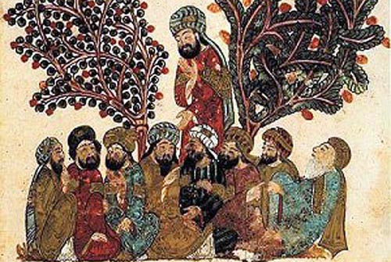
Badiuzzaman al hamdani
The credit of inventing a new and remarkable form of composition called Maqama(Place of Standing) belongs to al-Hamadhdni (1007 C.E.) known by the title conferred on him بديع زمان, which means ‘Wonder of his Age.' Born in Hamadan, he left his native town as a young man and travelled through the greater part of Persia.
In his Maqama, Hamadhdnl imagined as his hero a witty, unscrupulous vagabond journeying from place to place and supporting himself by the presents which his impromptu displays of rhetoric, poetry, and learning drew from an admiring audience. The second character is the Rawi or narrator who should be continually meeting the Hero, should relate the Hero’s adventures, and repeat his excellent compositions.
The Maqdmat of Hamadhani became the model for this kind of writing, and the types which he created survive unaltered in the more elaborate work of his successors. Each maqama forms an independent whole, so that the complete series may be regarded as a novel consisting of detached episodes in the hero's life, a medley of prose and verse in which the story is nothing, the style everything.

Slide 53
Maqamat of al hariri
Less original than Badiuzaman, but far beyond him in variety of learning and copiousness of language, Muhammad al-Qasim al-Hariri of Basra produced his Maqdmat, a masterpiece which for eight centuries has been esteemed as, next only to the Quran, in eloquence. In the Preface to his work he says that the composition of Maqdmatwas suggested to him by " one whose suggestion is a command and whom it is a pleasure to obey." This was the distinguished Persian statesman, Aniishirwan b. Khalid, At that time Hariri was living in retirement at Basra and devoting himself to literary studies. Hariri begged to be excused on the score that his abilities were unequal to the task, " for the lame steed cannot run like the strong courser."Finally, however, he yielded to the request of Aniishirwan, and, to quote his own words;
" I composed, in spite of hindrances that I suffered
From dullness of capacity and dimness of intellect,
And dryness of imagination and distressing anxieties,
Fifty Maqdmat, which contain serious language and lightsome,

Slide 54
Maqamat of hariri
And combine refinement with dignity of style,
And brilliancies with jewels of eloquence,
And beauties of literature with its rarities.
Beside verses of the Koran wherewith I adorned them,
And choice metaphors, and Arab proverbs that I interspersed,
And literary elegancies and grammatical riddles.
And decisions based on the (double) meaning of words,
And original discourses and highly-wrought orations,
And affecting exhortations as well as entertaining jests
The whole of which I have indicated through the Hero Abu Zayd of Saruj,
The part of narrator being assigned to Harith son of Hammam of Basra."

Slide 55
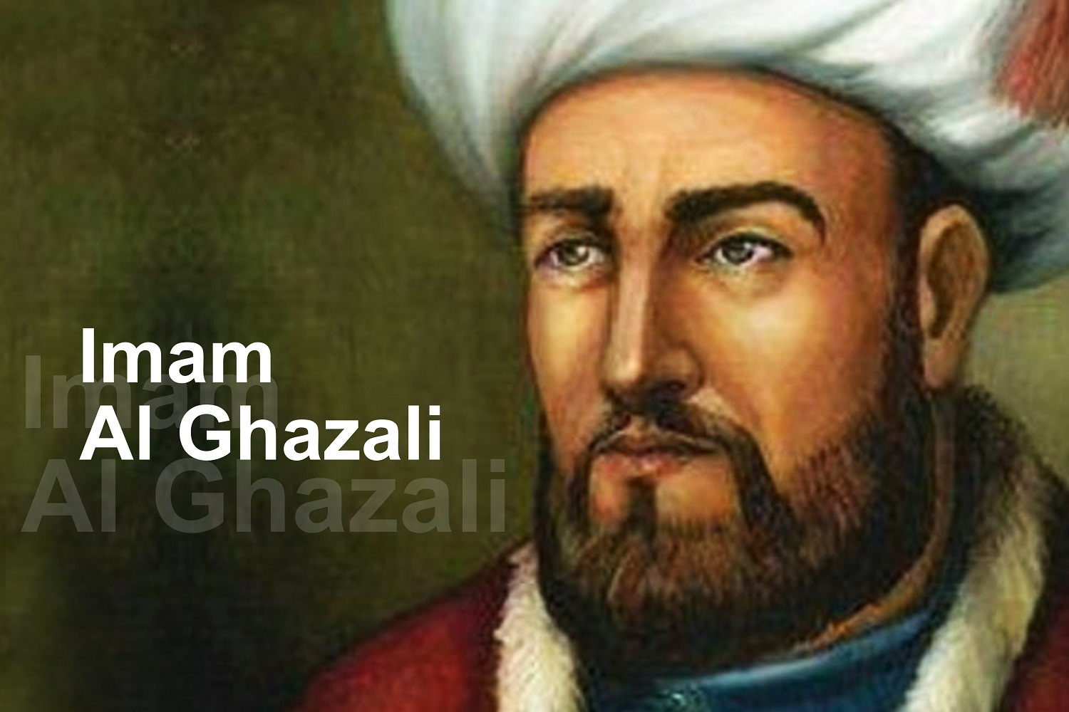
Imam Al ghazali
Al Ghazālī was born at Ṭūs (near Mashhad in eastern Iran) and was educated there, then in Jorjān, and finally at Nishapur (Neyshābūr), where his teacher was al-Juwaynī, who earned the title of imām al-ḥaramayn (the imam of the two sacred cities of Mecca and Medina). After the latter’s death in 1085, al-Ghazālī was invited to go to the court of Niẓām al-Mulk, the powerful vizier of the Seljuq sultans. The vizier was so impressed by al-Ghazālī’s scholarship that in 1091 he appointed him chief professor in the Niẓāmiyyah college in Baghdad. While lecturing to more than 300 students, al-Ghazālī was also mastering and criticizing the Neoplatonist philosophies of al-Fārābī and Avicenna (Ibn Sīnā). He passed through a spiritual crisis that rendered him physically incapable of lecturing for a time. In November 1095 he abandoned his career and left Baghdad on the pretext of going on pilgrimage to Mecca. Making arrangements for his family, he disposed of his wealth and adopted the life of a poor Sufi, or mystic. After some time in Damascus and Jerusalem, with a visit to Mecca in November 1096, al-Ghazālī settled in Ṭūs, where Sufi disciples joined him in a virtually monastic communal life. In 1106 he was persuaded to return to teaching at the Niẓāmiyyah college at Nishapur. A consideration in this decision was that a “renewer” (mujaddid) of the life of Islam was expected at the beginning of each century, and his friends argued that he was the “renewer” for the century beginning in September 1106. He continued lecturing in Nishapur at least until 1110, when he returned to Ṭūs, where he died the following year.

Slide 56
Works of imam Al ghazali
Al-Ghazālī’s greatest work is Iḥya Uloom al-Deen. In 40 “books” he explained the doctrines and practices of Islam and showed how these can be made the basis of a profound devotional life, leading to the higher stages of Sufism, or mysticism.
The relation of mystical experience to other forms of cognition is discussed in Mishkāt al-anwār (The Niche for Lights). Al-Ghazālī’s abandonment of his career and adoption of a mystical, monastic life is defended in the autobiographical work al-Munqidh min al-ḍalāl (The Deliverer from Error).
His philosophical studies began with treatises on logic and culminated in the Tahāfut al-falāsifah (The Inconsistency—or Incoherence—of the Philosophers), in which he defended Islam against such philosophers as Avicenna who sought to demonstrate certain speculative views contrary to accepted Islamic teaching
In preparation for this major treatise, he published an objective account of Maqāṣid al-falāsifah (The Aims of the Philosophers; i.e., their teachings). This book was influential in Europe and was one of the first to be translated from Arabic to Latin (12th century).

Slide 57
Works of imam Al ghazali
Most of his activity was in the field of jurisprudence and theology. Toward the end of his life he completed a work on general legal principles, al-Mustaṣfā (Choice Part, or Essentials). His compendium of standard theological doctrine (translated into Spanish), al-Iqtiṣād fī al-iʿtiqād (The Just Mean in Belief ), was probably written before he became a mystic, but there is nothing in the authentic writings to show that he rejected these doctrines, even though he came to hold that theology—the rational, systematic presentation of religious truths—was inferior to mystical experience. From a similar standpoint he wrote a polemical work against the militant sect of the Assassins (Nizārī Ismāʿīliyyah). He also wrote a book of Counsel for Kings (Naṣīḥat al-mulūk) in which he idealized the relationship between Religious theory and Practical statesmanship.

