Slide 1
DEPARTMENT OF BBA
L.SARAVANAPRIYA
SUBJECT :MANAGEMENT INFORMNATION SYSTEM
CLASS : III BBA

Slide 2
What is MIS?
MIS is the use of information technology, people, and business processes to record, store and process data to produce information that decision makers can use to make day to day decisions.

Slide 3
Components of MIS
The major components of a typical management information system are;
People – people who use the information system
Data – the data that the information system records
Business Procedures – procedures put in place on how to record, store and analyze data
Hardware – these include servers, workstations, networking equipment, printers, etc.
Software – these are programs used to handle the data. These include programs such as spreadsheet programs, database software, etc.

Slide 4
Types of Information Systems
The type of information system that a user uses depends on their level in an organization. The following diagram shows the three major levels of users in an organization and the type of information system that they use.

Slide 5
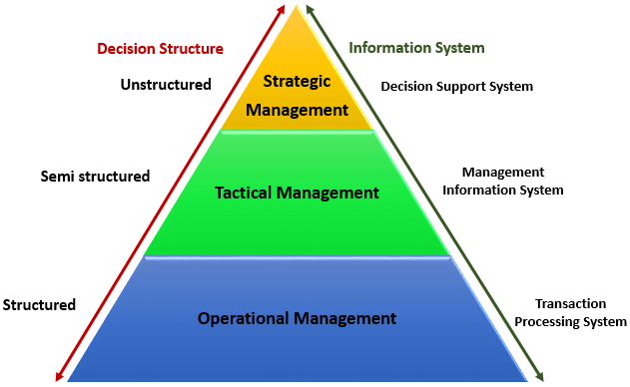

Slide 6
Strategic Management
Strategic management is the continuous planning, monitoring, analysis and assessment of all that is necessary for an organization to meet its goals and objectives.

Slide 7
Three Levels of Strategy
Corporate Strategy
The first level of strategy in the business world is corporate strategy, which sits at the ‘top of the heap’. Before you dive into deeper, more specific strategy, you need to outline a general strategy that is going to oversee everything else that you do. At a most basic level, corporate strategy will outline exactly what businesses you are going to engage in, and how you plan to enter and win in those markets.

Slide 9
Business Strategy
It is best to think of this level of strategy as a ‘step down’ from the corporate strategy level. In other words, the strategies that you outline at this level are slightly more specific and they usually relate to the smaller businesses within the larger organization.
Carrying over our previous example, you would be outlining separate strategies for selling cookies and selling cookie-making equipment at this level. You may be going after convenience stores and grocery stores to sell your cookies, while you may be looking at department stores and the internet to sell your equipment. Those are dramatically different strategies, so they will be broken out at this level.

Slide 11
Functional Strategy
This is the day-to-day strategy that is going to keep your organization moving in the right direction. Just as some businesses fail to plan from a top-level perspective, other businesses fail to plan at this bottom-level. This level of strategy is perhaps the most important of all, as without a daily plan you are going to be stuck in neutral while your competition continues to drive forward. As you work on putting together your functional strategies, remember to keep in mind your higher level goals so that everything is coordinated and working toward the same end.

Slide 13
DECISION MAKING

Slide 15
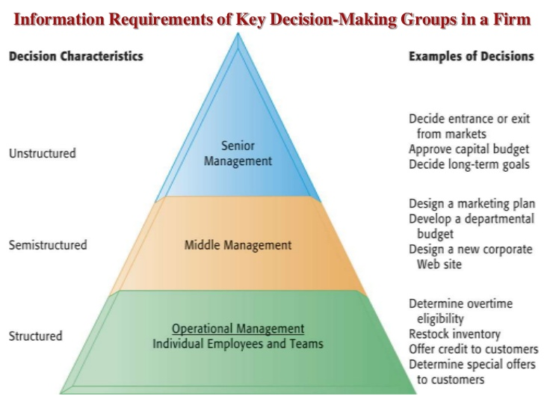

Slide 19
RATIONAL DECISION- MAKING

