Slide 1
AIR POLLUTION
By
A.M.RASHIDA BANU
ASSISTANT PROFESSOR
DEPARTMENT OF BOTANY
HAJEE KARUTHA ROWHER HOWDIA COLLEGE, UTHAMAPALAYAM

Slide 2
AIR POLLUTION
Air pollution refers to the undesirable change occurring in air causing adverse effects on man and domesticated species

Slide 5
Cause of Air pollution
Agriculture – Hydrocarbons released by plants, pollen grains, insecticides
Dust – Dust in the air is increased by dust storms, wind, volcanoes and automobiles.
Industries – Combustion of fossil fuels like coal, petroleum in industries is the main source of air pollution.

Slide 6
Automobiles- The combustion of petrol and diesel in automobiles releases harmful gases into the air. They also produce dust. Ionizing Radiation- Ionizing radiations include alpha particles, beta particles and gamma rays. Also, release from testing atomic weapons and atomic explosions.

Slide 7
Freons- Use of freons and other chloro-flouro-carbons as refrigerants, coolants and as filling agents in aerosol packages cause pollution. Aerosols – Aerosols are small particles of solid or liquid substances suspended in the air. Blocks stomata of plants and prevent the gaseous exchange between plants and atmosphere. Also change the climate of an area.

Slide 8
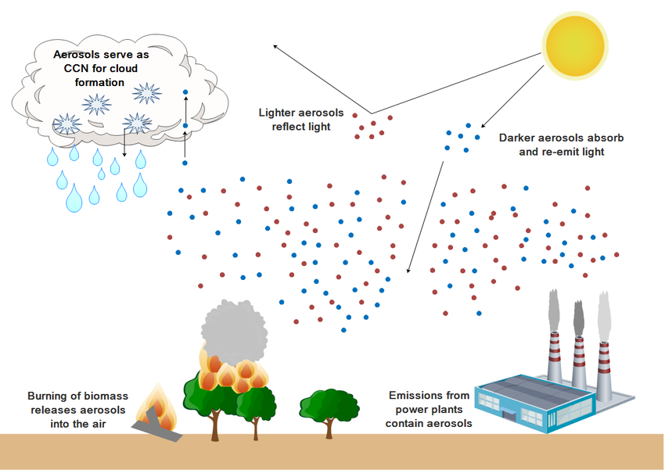

Slide 9
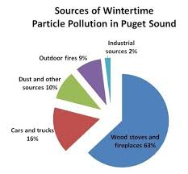

Slide 10
Effects of air pollution
Death -When air is polluted with poisonous gases, death comes as a result immediately. Bhopal episode is a good example.
Bhopal Episode: On 2nd December 1984 about 3000 human beings died, about 5000 paralyzed and thousands of cattle, birds, dogs and cats died in one night at Bhopal.
Due to the leakage of methylisocyanate (toxic gas) into the air from an insecticide plant managed by Union Carbide.

Slide 11
Chlorosis- The disappearance of chlorophyll is called chlorosis. It caused by SO2 and fluorides present in the air.
Necrosis-The breakdown of cell is called necrosis. It is caused SO2, nitrogen di-oxide, ozone and fluorides

Slide 13
Green House Effect –CO2 content of the air is increasing at the rate of 0.4% per annum. Results in an appreciable warming up of the Earth. This is called green house effect. Cause the melting of polar ice caps resulting in a rise of nearly 60 feet on the sea level. Coastal regions and low lying areas all over the world will be going under water.

Slide 14
Crop losses- Heavy loss of crop plants is caused by smog. Smog denotes a combination of smoke and fog. The important components of smog are ozone and PAN (Peroxy Acetyl Nitrate). Damages leafy vegetables, cereals, textile crops, ornamental plants, fruits and forest trees

Slide 15
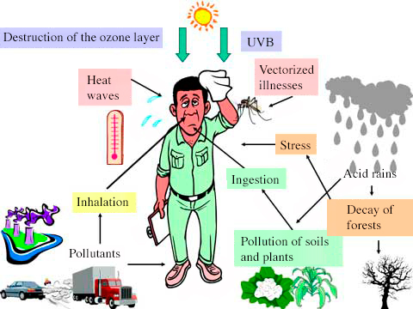

Slide 16
Respiratory Disorders - Excessive ethylene accelerates respiration causing immature senescence (old age) and abscission (accumulation of yellow fluid (pus) in the body). Aldehydes irritate nasal and respiratory tracts. Chlorine and phosgenes (carbonyl chloride) cause pulmonary oedema. H2S smells like rotten eggs and causes nausea

Slide 17
Vomiting- So2 causes vomiting. Jaundice- Arsines induce RBC breakdown and jaundice. Oxygen Carrying capacity- CO reduces 02 carrying capacity of RBC by its permanent combination with haemoglobin. Coughing- Sling is induced by phosgenes (carbonyl chloride).

Slide 18
Headache- SO2 causes headache Cancer -air pollutants like ash, soot, smoke on chromium, nickel and radioactive elements. Mutation - Radioactive elements produce mutation. Ozone produces chromosomal aberrations. Cardiac Diseases- Cadmium causes high blood pressure and heart diseases

Slide 19
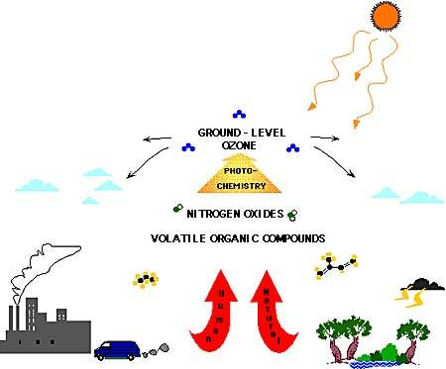
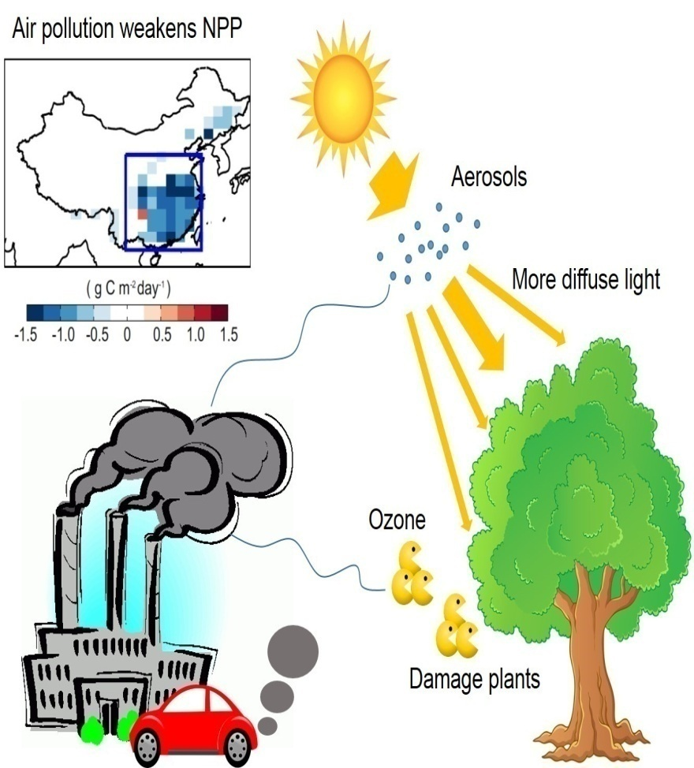

Slide 20
Acid Rains- The rain water having pH as low as 5.6 is called acid rain. This lowering of pH is due to the dissolution of acids in the rain water. Precipitation of oxides of sulphur and nitrogen with rain is term as acid rain. The rain water falls as acid rain.

Slide 21
Acid rain affects both materials and organisms. It attacks building materials mainly sandstone, limestone, marble, steel and nickel. In plants, it leads to chlorosis. Acid rain increases the acidity of lakes and rivers. Vast tracts of forests and lakes in Europe and North America ho been destroyed by acid rain. Acidity kills fish, bacteria and also and the aquatic ecosystem collapses into sterility leaving a crystal clear but ultimately a dead lake

Slide 23
Control of Air Pollution The emission of exhaust from automobiles can reduced by devices such as positive crankcase ventilation valve and catalytic converter. Electrostatic precipitators can reduce smoke and dust from industries. Gaseous pollutants arising from industries can be removed by differential solubility of gases in water.

Slide 24
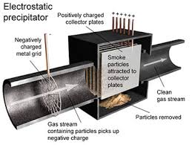
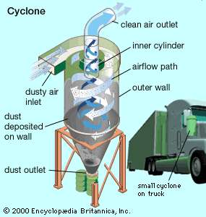

Slide 25
A fine spray of water in the device called scrubber car separate many gases like NH3, SO2, etc. from the emitted exhaust. |
Certain gases can be removed by filtration or absorption through activated carbon.
Certain gases can be made chemically inert by chemical convertion.
At the Government level pollution can be controlled framing legislations

Slide 26
Reference Books
Environmental Studies by V Arumugam and N Kumeresan
Plant Ecology and Phytogeography by Annie Ragland
Ecology by R C Dubey
Ecology and Environment by P D Sharma
Fundamentals of Ecology – S K Agarwal

