Slide 1
CITRUS CANKER
Dr. A. MAAJITHA BEGAM
ASSISTANT PROFESSOR OF BOTANY
HAJEE KARUTHA ROWTHER HOWDIA COLLEGE
UTHAMAPALAYAM-625533

Slide 2
CITRUS CANKER
Citrus canker is a bacterial disease caused by the bacterium xanthomonas citri.
It produces lesions and cankers on citrus plants.
Infection causes lesions on the leaves, stems, and fruit of citrus trees, including lime, oranges, and grapefruit.

Slide 3
First reported in Japan in 1904
Reported in India, China, Japan and Java
In 1915, Hasse established the bacterial nature of the disease and described the organism as Pseudomonas citri
Cankers are open wounds or dead tissue surrounded by living tissues.

Slide 4
SYMPTOMS
This disease affects the leaves, Twigs and fruits of Citrus plants.
A small yellow spot appears on young leaves. These yellow spots are called lesions.
The lesions becomes raised and turn brown in colour.
It is the advanced stages of infection, the lesions rupture in the centre, giving a rough corky and crater-like appearance.

Slide 5
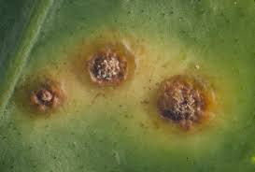
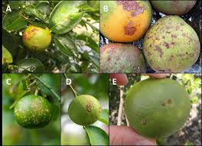
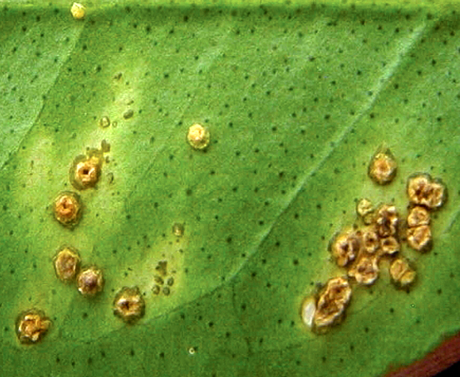
Infected leaves and Fruits
Lesions appearance

Slide 6
Yellow spots are formed on the older twigs they are prominent and irregular in shape.
The spots increase in size and coalesce to form elongated lesions.
The bacterium produces yellow spots in fruits. The canker on the fruit is only a lesion of the rind(skin). It doesnot penetrate into the flesh of the fruit.

Slide 7
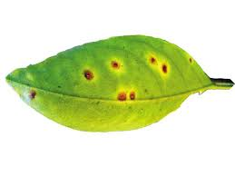
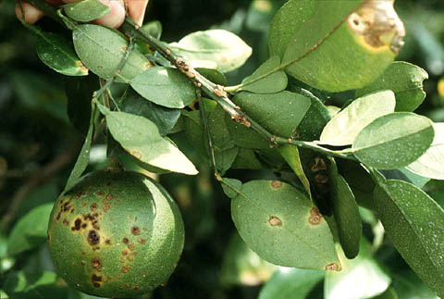
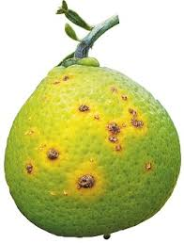

Slide 8
Causative organism
Class- schizomycetes
Order- pseudomonadales
Family- pseudomonadaceae
Genus- Xanthomonas citri
Syn.Xanthomonas campestris
Gram-negative, aerobic bacteria
Single polar flagellum
Capsulated bacillus
Non-spore forming bacterium
Colonies are yellow in colour
Common infections on Grape fruit, Key lime, Lemon, Kaffir Lime (Highly susceptible)

Slide 9
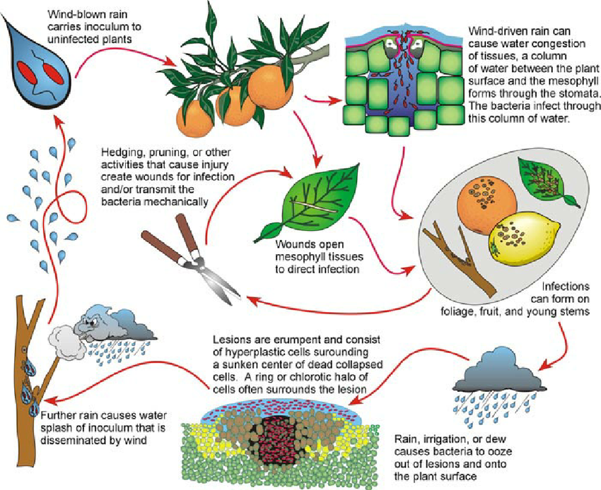

Slide 10
ETIOLOGY AND DISSEMINATION
Bacterium enters the host plant either through natural openings- stomata or through wounds.
The diseased twigs and leaves are the main sources of the inoculum.
Bacteria multiplies in the intercellular spaces.
Dissolves the middle lamella and establishes in the cortex and forms cankerous outgrowths.
The exudate released from these outgrowths contains numerous bacteria.

Slide 11
Desseminated by wind, rain and insects especially leaf-mites.
Nursery stock.
Mild temperature and wet weather favours the disease.
Temperature 20-35oC.
Pathogens survive upto 6 months in the infected leaves.

Slide 12
CONTROL
Spraying the plant with 1% bordeaux mixture or copper oxychloride 0.25% before planting.
Antibiotics like streptomycin(500-1000ppm) or phytomycin(2500ppm) at 15 days intervals
Quarantine regulations, prohibiting movement of diseased stock to disease free areas.
Infected trees must be removed and burnt.
Pruning of diseased twigs and leaves during dry season is practised.
Disease free nursery stock should be planted.
Disease resistant varieties should be cultivated.
Spraying of neem cake at the rate of 7 kg per acre.

