Slide 1
Human Resource Planning
Human Resource Planning is a systematic process of forecasting both the prospective demand for and supply of manpower, and employment of skills with the objectives of the organization. It can also be termed as the method of reviewing the manpower necessities to ensure that right kind of skills is made available to the organization.
The main purpose of HRP is to set the goals and objectives of the company. In other words, it is to have the precise number of employees, with their skills matching the requirements of the organization, so that the organization can move towards its goals.

Slide 2
Chief objectives of Human Resource Planning are as follows:
Guarantee ample supply of resources, whenever there is a need for it.
Make sure that the current manpower in the company is being used properly.
To foreseen the potential requirements of manpower at various skill levels.
Evaluate excess or scarcity of resources that are available at a given point of time.
Predict the impact of technological changes on the resources as well as on the kind of jobs they do.
Manage the resources that are already employed in the organization.
Ensure that there is a lead time available to pick and train any supplementary human resource.

Slide 3
Need for Human Resource Planning
The need of HRP may arise because of the following reasons:
In India, unemployment is a grave concern. Scarcity of manpower and that too with the required skill sets and competence, has given rise for need of Human Resource Planning.
It comes handy for smooth and continuous supply of workers when a huge number of employees is retiring, or leaving the company or maybe they are incapable of working due to psychological or physical ailments.
There is a need for Human Resource Planning when there is an increase in employee turnover, which is obvious. Some examples of this turnover are promotions, marriages, end of contract, etc.

Slide 4
Need for Human Resource Planning
Technological changes lead to a chain of changes in the organization, right from skill sets product methods and administration techniques. These changes lead to an overall change in the number of employees required and with entirely different skill set. It is here that the Human Resource Planning helps the organization deal with the necessary changes.
Human Resource Planning is required to meet the requirements of diversification and growth of a company.
There is a need for Human Resource Planning in downsizing the resources when there is a shortage of manpower. Similarly, in case of excess resources, it helps in redeploying them in other projects of the company.

Slide 5
Importance of Human Resource Planning
After the need for HRP, it is apt to discuss the importance of it. A few are mentioned below.
It gives the company the right kind of workforce at the right time frame and in right figures.
In striking a balance between demands-for and supply-of resources, HRP helps in the optimum usage of resources and also in reducing the labour cost.
Cautiously forecasting the future helps to supervise manpower in a better way, thus pitfalls can be avoided.

Slide 6
Importance of Human Resource Planning
It helps the organization to develop a succession plan for all its employees. In this way, it creates a way for internal promotions.
It compels the organization to evaluate the weaknesses and strengths of personnel thereby making the management to take remedial measures.
The organization as a whole is benefited when it comes to increase in productivity, profit, skills, etc., thus giving an edge over its competitors.

Slide 7
In any Human Resource Planning model there are three key elements which the management should adhere to: Forecasting recruitment needs:
There are a number of ways in forecasting your business needs, to know the exact number of employees required to run the business. Factors to be considered are the economical situation of any given country, internal and external factors of an organization and the demand for the products.

Slide 8
Evaluate Supply:
In estimating this, there are two aspects, one is the evaluation of the internal resources and the other is the prospective or external resources. Among the two, external factors require extra care; these include education, unemployment rate and law that is in existence. Evaluating these factors very closely will help the organization in filling the right resources at the right time with the right skill set.

Slide 9
Supply and demand balance:
This element of Human Resource Planning is very important, as striking a balance between these two forces will help the organization in understanding if there is shortage or excess of employees available in a particular group. It also helps in understanding as to the need of full time or part time needs of the organization.

Slide 10
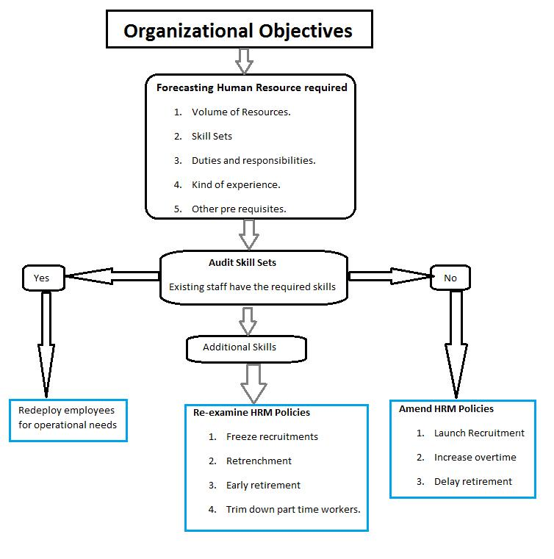
Human Resource Planning Process

