Slide 1
Chlorophyll – Structure and Workfunction
Dr. K. SHAHUL HAMEED

Slide 2
Structure of Chlorophyll
Chlorophyll is found in the chloroplasts of green plants
The basic structure of a chlorophyll molecule is a porphyrin ring, coordinated to a central atom Magnesium
chlorophyll was a mixture of two compounds, chlorophyll-a and chlorophyll-b
both giving a green solution in organic solutions
In natural chlorophyll there is a ratio of 3 to 1 (of a to b) of the two components

Slide 3
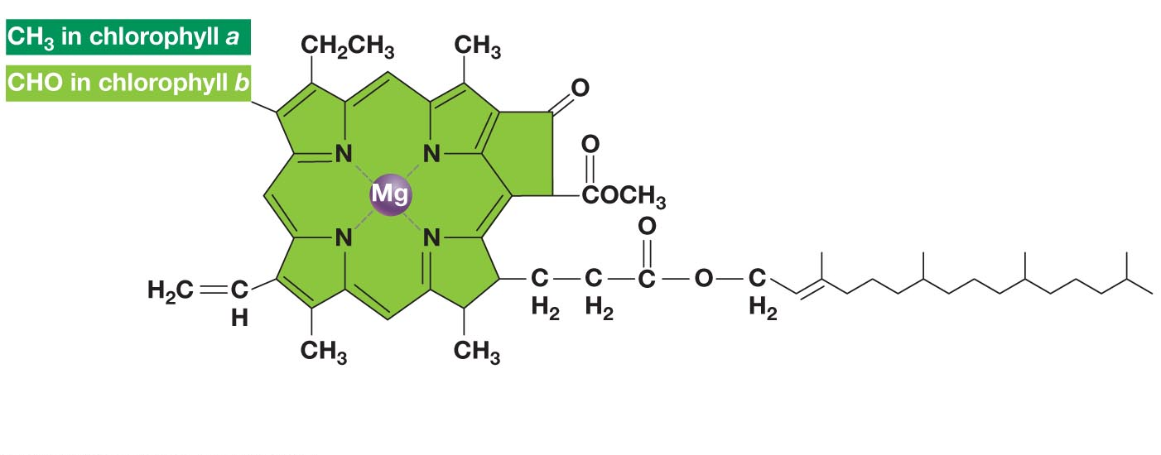
Tail
Ring structure in “head”
(absorbs light)

Slide 5
Work function of chlorophyll (Photosystems I and II)
There are two types of photosystems in the chloroplast of the plant leaves
Photosystem II (PS II) functions by absorbing a wavelength of 680 nm
The reaction-center chlorophyll a of PS II is called as P680
Photosystem I (PS I) functions by absorbing a wavelength of 700 nm
The reaction-center chlorophyll a of PS I is called as P700

Slide 6
Photosynthetic process involves both photosystems and produces ATP and NADPH (Nicotinamide adenine dinucleotide phosphate) using light energy
A photon hits a pigment and its energy is passed among pigment molecules until it excites P680
An excited electron from P680 is transferred to the primary electron acceptor
Now P680 becomes P680⁺
P680⁺ is a very strong oxidizing agent
H₂O enters into the system, is split by enzyme(PII),
H₂O 2H⁺ + O₂ + 2e⁻
the electrons are transferred to P680⁺, thus reducing it to P680
O₂ is released as a by-product of this reaction

Slide 7
Each electron “falls” down an electron transport chain from the primary electron acceptor of PS II to PS I
Energy released by the fall synthesize ATP
In PS I (like PS II), transferred light energy excites P700, which loses an electron to an electron acceptor
P700⁺, accepts an electron passed down from PS II via the electron transport chain
Each electron “falls” down an electron transport chain from the primary electron acceptor of PS I to the protein ferredoxin (Fd)
The electrons are then transferred to NADP⁺ and reduce it to NADPH
The electrons of NADPH are available for the reactions of the Calvin cycle (dark reaction)
In the Calvin cycle CO₂ is converted into carbohydrates

Slide 8
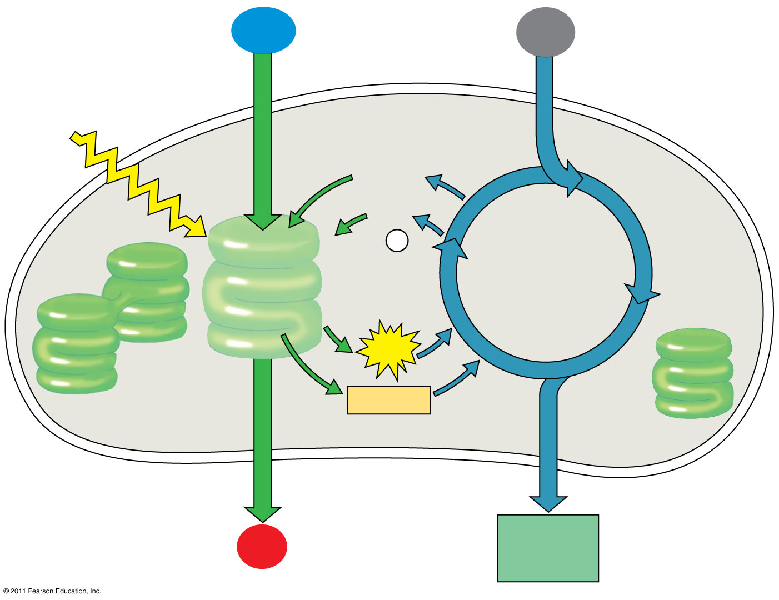
H₂O
CO₂
Light
NADP⁺
ADP
+ P _{i}
Calvin Cycle
Light Reactions
ATP
NADPH
Chloroplast
O₂
[CH₂O] (sugar)

Slide 9
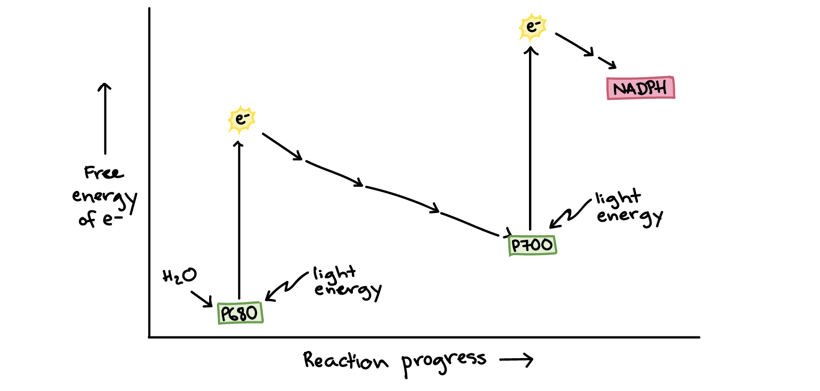
Primary acceptor
Primary acceptor
electron transport chain

