Slide 1
Raoult’s law and Ideal solutions
Dr. K. SHAHUL HAMEED

Slide 2
Raoult’s law
The partial pressure of any volatile component of a solution at any temperature is equal to the vapour pressure of the pure component multiplied by the mole fraction of that component in the solution.

Slide 3
Suppose a binary solution is made up of n_{A} moles of volatile liquid A and n_{B} moles of volatile liquid B.
If p_{A} and p_{B} are the partial pressures of the two liquid components, then according to Raoult’s law

Slide 4
Where x_{A} is the mole fraction of A and x_{B} is the mole fraction of B and are the vapour pressures of pure components A and B respectively.
According to Dalton’s law of partial pressures, the total vapour pressure P is given by
In general Raoult’s law may be expressed as

Slide 5
Ideal solution
An ideal solution may be defined as the solution which obeys Raoult’s law over the entire range of concentration and temperature and during the formation of which no change in enthalpy and no change in volume takes place.

Slide 6
So for ideal solutions the conditions are,
(i) It should obey Raoult’s law, i.e.
(ii) ΔH_{mixing} = 0
(iii) ΔV_{mixing} = 0

Slide 7
Ideal solutions
For example, solutions of following pairs almost behave as ideal solutions
n-Heptane and n-hexane;
Chlorobenzene and bromobenzene;
Benzene and toluene;
Ethyl bromide and ethyl iodide;
Ethylene bromide and ethylene chloride;
Carbon tetrachloride and silicon tetrachloride.

Slide 8
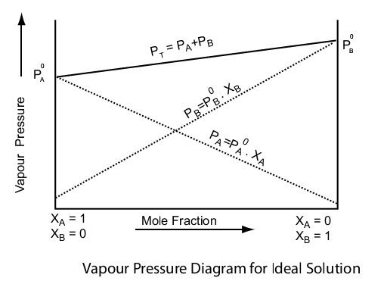
The vapour pressure – composition curve for ideal solution

Slide 9
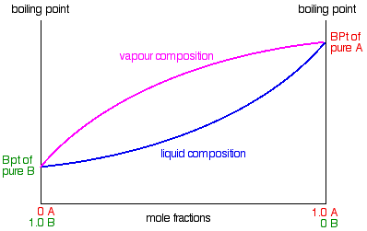
The boiling point – composition curve for ideal solution

