Slide 1
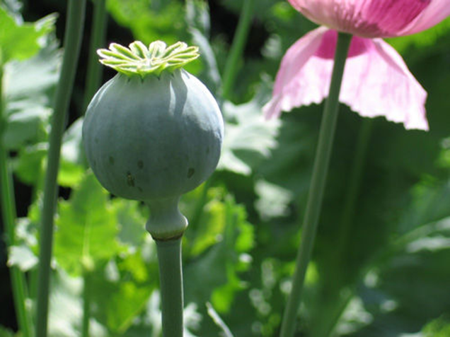
ALKALOIDS AND ANTIBIOTICS
Presented by
Dr. M.P. KESAVAN M.Sc., Ph.D.,
Assistant Professor
Department of Chemistry
HKRH College
Uthamapalayam.

Slide 2
ALKALOIDS
Definition
A class of nitrogenous organic compounds of plant origin which have pronounced physiological actions on humans. They include many drugs (morphine, quinine) and poisons (atropine, coniine).

Slide 3
CLASSIFICATION OF ALKALOIDS
True (Typical) alkaloids
The alkaloids that are derived from amino acids and have nitrogen in a heterocyclic ring.
Example
Atropine
Proto alkaloids
The alkaloids that are derived from amino acids and do not have nitrogen in a heterocyclic ring.
Example
Ephedrine

Slide 4
CLASSIFICATION OF ALKALOIDS
Pseudo alkaloids
The alkaloids that are not derived from amino acids but have nitrogen in a heterocyclic ring.
Example
Caffeine
False alkaloids
The alkaloids that are non alkaloids give false positive reaction with alkaloidal reagents.

Slide 5
General Methods of Extraction and Isolation of Alkaloids
The general methods of extraction of alkaloids from the plant sources followed five steps namely,
Sample preparation
Liberation of free alkaloidal base
Extraction of alkaloidal base with organic solvent
Purification of crude alkaloidal extract
Fractionation of crude alkaloids

Slide 6
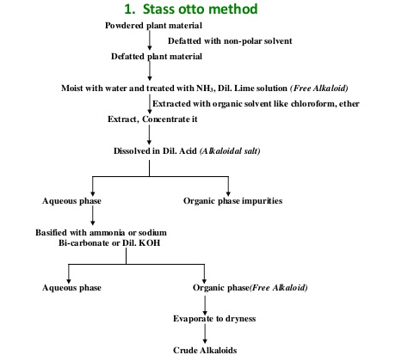
General Methods of Extraction and Isolation of Alkaloids

Slide 7
General Properties of Alkaloids
Alkaloids are colourless, crystalline, non-volatile, solids; a few such as coniine and nicotine are liquids and a few even coloured, viz. berberine is yellow.
The free bases (i.e. alkaloids themselves) are insoluble in water but soluble in most of the organic solvents. Most of the alkaloids are laevorotatory (optically active), although a few are dextrorotatory (e.g. coniine), while a few are even optically inactive, viz. papaverine.
Generally, the alkaloids are bitter in taste and have pronounced physiological activity.

Slide 8
General Properties of Alkaloids
Although many of the alkaloids possess curative properties and are of great value in medicine, they are powerful poisons.
Chemically, the alkaloids are generally basic in nature and precipitated out by the common alkaloid reagents.

Slide 9
ANTIBIOTICS
Definition
Antibiotics are specific chemical substances derived from (or) produced by living organisms that are capable of inhibiting the growth of other microorganisms like bacteria and fungi.

Slide 10
CLASSIFICATION OF ANTIBIOTICS
I. On the basis of mechanism of action
Protein Synthesis inhibitor Eg: Tetracyclines
Cell wall Synthesis inhibitor Eg: Pencillins
DNA Synthesis inhibitor Eg: Fluoroquinolones
RNA Synthesis inhibitor Eg: Rifampin
Folic acid inhibitor Eg. Sulfonamides
Mycolic acid Synthesis inhibitor Eg. Isoniazid

Slide 11
CLASSIFICATION OF ANTIBIOTICS
II. On the basis of spectrum of activity
Broad spectrum antibiotics
The broad spectrum antibiotics refers to an antibiotics that are act against a wide range of disease - causing microorganisms.
Examples
Tetracycline
Chlorampenicol
Amoxicillin
Erythromycin

Slide 12
CLASSIFICATION OF ANTIBIOTICS
II. On the basis of spectrum of activity (cont)
Narrow spectrum antibiotics
The narrow spectrum antibiotics refers to an antibiotics that are act against a narrow range of disease - causing microorganisms.
Examples
Pencillin-G
Cloxacillin
Vancomycin
Fluxacillin

Slide 13
CLASSIFICATION OF ANTIBIOTICS
III. On the basis of mode of action
Bacteriostatic antibiotics
А bacteriostatic agent is a biological (or) chemical agent that stops bacteria from reproducing, while not necessarily killing them otherwise.
Examples
Tetracyclin
Chlorampenicol
Erythromycin
Lincomycin

Slide 14
CLASSIFICATION OF ANTIBIOTICS
III. On the basis of mode of action
Bactericidal antibiotics
А bactericidal agent is a biological (or) chemical agent that kills the bacteria.
Examples
Pencillin
Erythromycin
Aminoglycosides
Cephalosporin

Slide 15
References
K.W. Bently, Alkaloids, Vol I & II, Intersicence, 1957.
I. L. FInar, Organic chemistry, Vol. II. ELBS, 1975.

