Slide 1
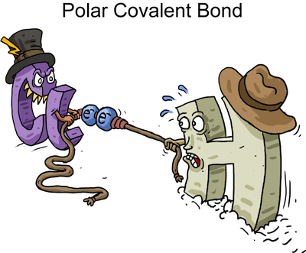
COVALENT BOND
Presented by
Dr. M.P. KESAVAN M.Sc., Ph.D.,
Assistant Professor
Department of Chemistry
HKRH College
Uthamapalayam.

Slide 2
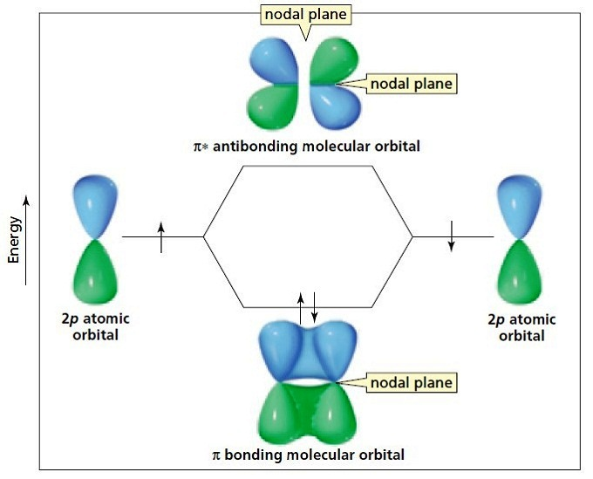
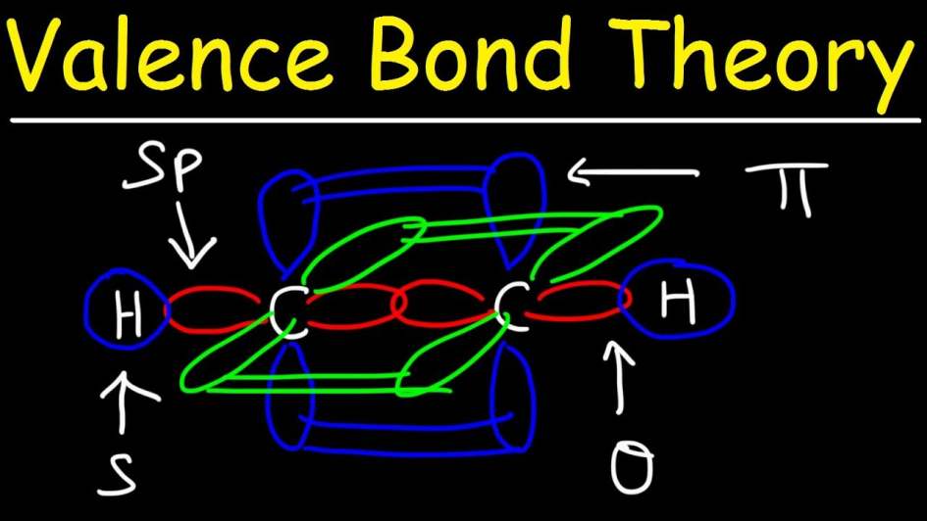
Theories of Covalent bond formation
Valence Bond (VB) Theory
Molecular Orbital (MO) Theory

Slide 3
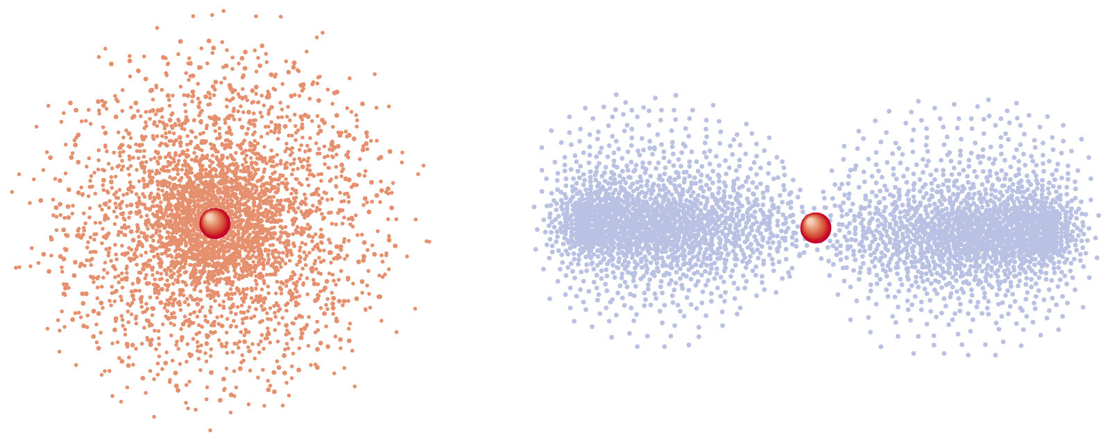
SHAPES OF ATOMIC ORBITALS
Orbitals (or) atomic orbitals
An orbital is the region of space around the nucleus within which the probability of finding an electron of given energy is maximum (90–95%).
The shape of this region (electron cloud) gives the shape of the orbital.
It is basically determined by the azimuthal quantum number l, while the orientation of orbital depends on the magnetic quantum number (m).

Slide 4
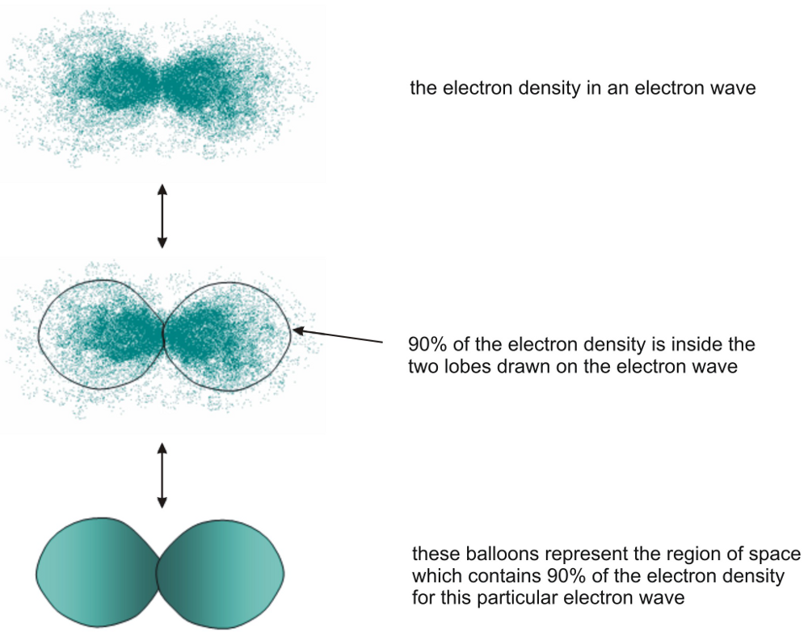
ATOMIC ORBITALS
Orbitals (or) atomic orbitals (cont.)

Slide 5
VALANCE BOND (VB) THEORY
The Valence Bond (VB) Theory was developed in order to explain chemical bonding using the method of quantum mechanics.
This theory primarily focuses on the formation of individual covalent bonds from the atomic orbitals of the participating atoms during the formation of a molecule.
This theory focuses on the concepts of electronic configuration, atomic orbitals (and their overlapping) and the hybridization of these atomic orbitals.
Covalent bonds are formed from the overlapping of atomic orbitals wherein the electrons are localized in the corresponding bond region.

Slide 6
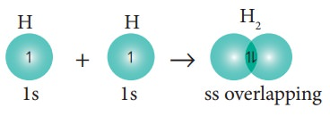
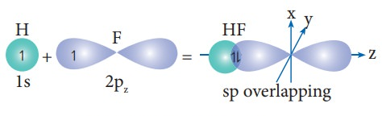
VALANCE BOND (VB) THEORY
Postulates
1. Covalent bonds are formed when two valence orbitals (half-filled) belonging to two different atoms overlap on each other. The electron density in the area between the two bonding atoms increases as a result of this overlapping, thereby increasing the stability of the resulting molecule.

Slide 7
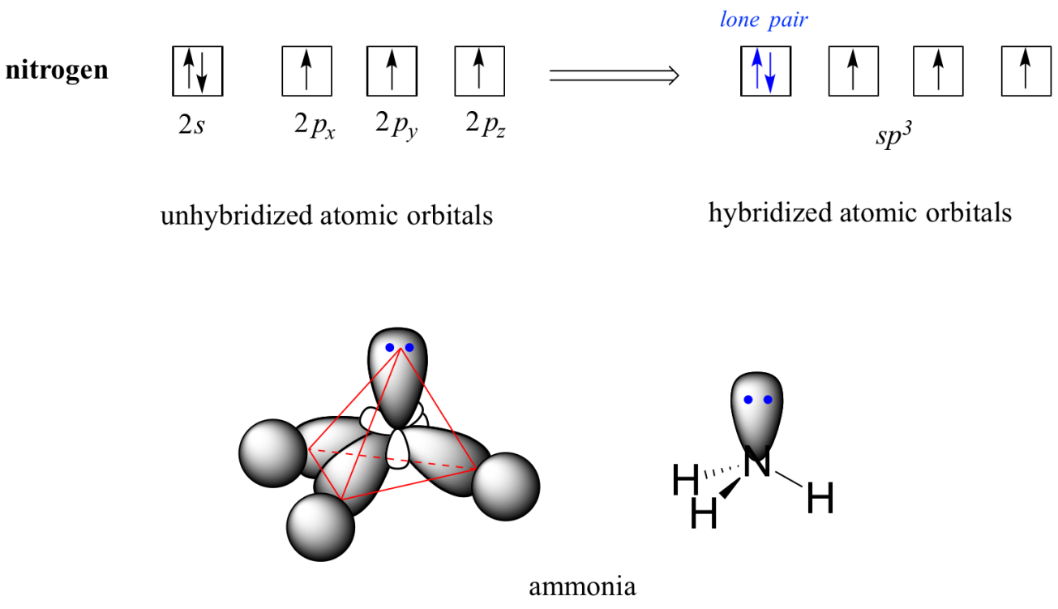
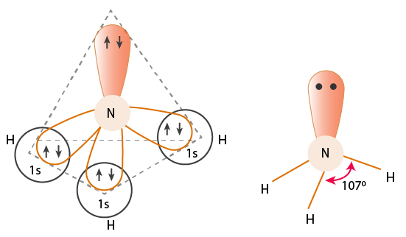
VALANCE BOND (VB) THEORY
Postulates (cont.)
2. The presence of many unpaired electrons in the valence shell of an atom enables it to form multiple bonds with other atoms. The paired electrons present in the valence shell do not take participate in the formation of chemical bonds as per the valence bond theory.

Slide 8
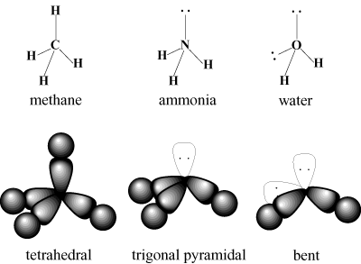
VALANCE BOND (VB) THEORY
Postulates (cont.)
3. Covalent chemical bonds are directional and are also parallel to the region corresponding to the atomic orbitals that are overlapping.

Slide 9
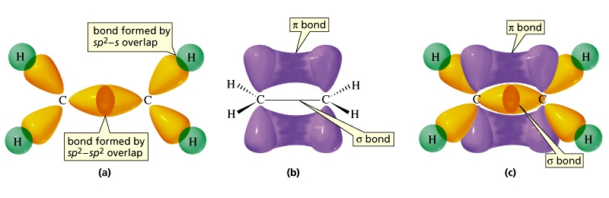
VALANCE BOND (VB) THEORY
Postulates (cont.)
4. Sigma (σ) bonds and pi (π) bonds differ in the pattern that the atomic orbitals overlap, i.e. π bonds are formed from sidewise overlapping whereas the overlapping along the axis containing the nuclei of the two atoms leads to the formation of σ bonds.

Slide 10
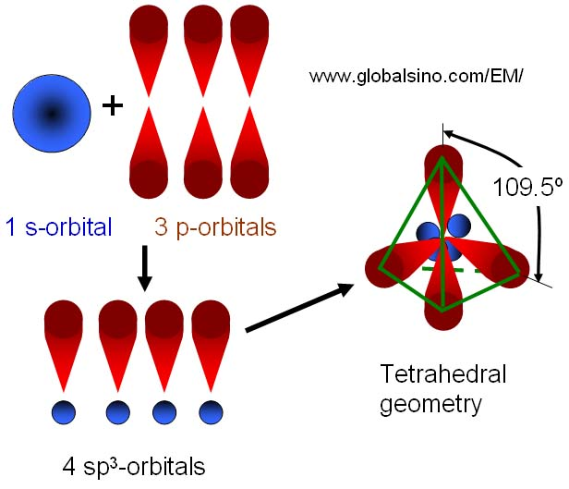
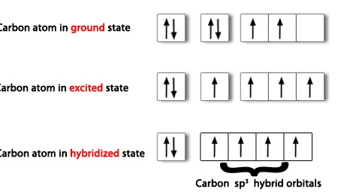
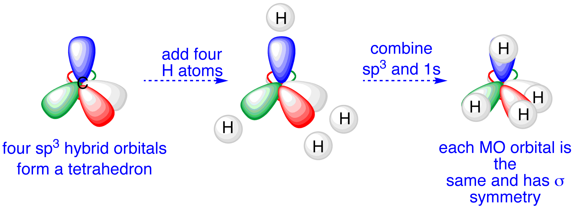
VALANCE BOND (VB) THEORY
Hybridization
According to VB theory, the atomic orbitals are mixed together (hybridize) to yield a set of new equivalent orbitals of definite geometry suitable for the pairing of electrons to form chemical bonds.

Slide 11
VALANCE BOND (VB) THEORY
Hybridization (cont.)
Type of hybridization | Shape
sp | linear
sp² | trigonal planar
sp³ | tetrahedral
dsp² | square planar
sp³d | trigonal bipyramidal
sp³d² | octahedral
Limitations
The VB theory failed to adequately explain how certain molecules contain two or more equivalent bonds whose bond orders lie between that of a single bond and that of a double bond, such as the bonds in resonance-stabilized molecules.

Slide 12
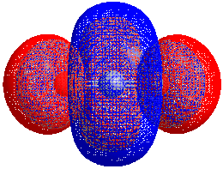
MOLECULAR ORBITAL (MO) THEORY
The Molecular Orbital (MO) Theory (often abbreviated to MOT) is a theory on chemical bonding describes the structure and properties of different molecules.
With this theory, the molecular orbitals are basically considered as linear combinations of atomic orbitals.
The approximations are further done using the Hartree–Fock (HF) or the density functional theory (DFT) models to the Schrödinger equation.

Slide 13
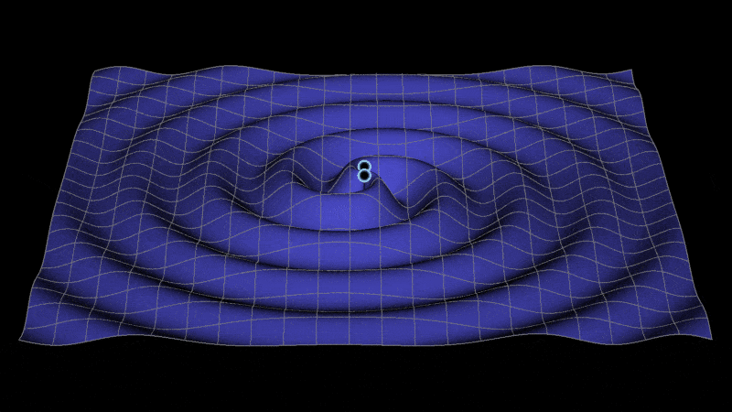
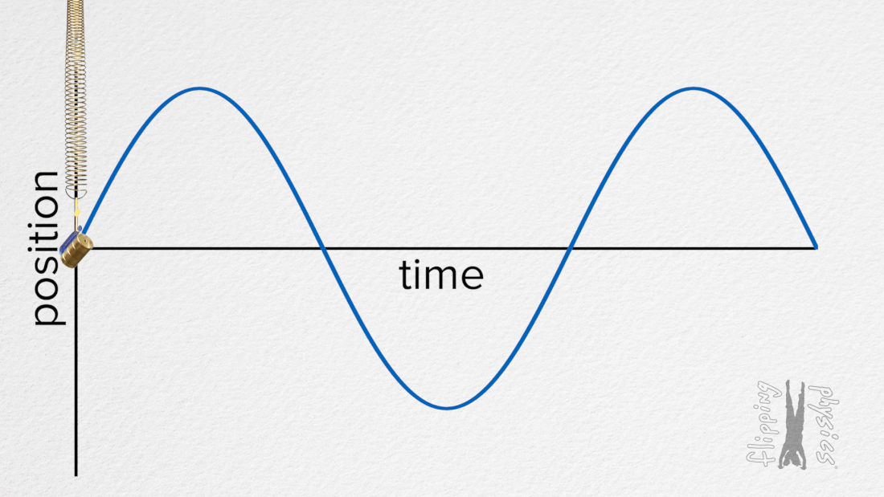
MOLECULAR ORBITAL (MO) THEORY
Postulates
Atomic orbitals of comparable energy and proper symmetry combine together to form molecular orbitals. Each atomic orbital should have a wave function (ψ - psi).

Slide 14
MOLECULAR ORBITAL (MO) THEORY
Postulates (cont.)
2. The movement of electrons in a molecular orbital is influenced by all the nuclei of combining atoms (Molecular orbital is poly centric in nature).
3. The number of molecular orbitals formed is equal to the number of combining atomic orbitals. When two atomic orbitals (AO's) combine together two molecular orbitals (MO's) are formed. One molecular orbital possess higher energy than corresponding atomic orbitals and is called anti-bonding molecular orbital (ABMO) and the other has lower energy and is called bonding molecular orbitals (BMO).

Slide 15
MOLECULAR ORBITAL (MO) THEORY
Postulates (cont.)
4. In molecules, electrons are present in molecular orbitals. The electron filling is in accordance with Pauli's exclusion principle, Aufbau principle and Hund's rule.

Slide 16
MOLECULAR ORBITAL (MO) THEORY
Combination of atomic orbitals
Electrons may be considered either of particle or of wave nature. Therefore, an electron in an atom may be described as occupying an atomic orbital, or by a wave function ψ, which are solution to the Schrodinger wave equation. Electrons in a molecule are said to occupy molecular orbitals.
The wave function of a molecular orbital may be obtained by one of two method:
1. Linear Combination of Atomic Orbitals (LCAO).
2. United Atom Method.

Slide 17
MOLECULAR ORBITAL (MO) THEORY
Linear Combination of Atomic Orbitals (LCAO)
Consider two atoms A and B which have atomic orbitals described by the wave functions ψA and ψB.
If electron cloud of these two atoms overlap, then the wave function for the molecule can be obtained by a linear combination of the atomic orbitals ψA and ψB i.e. by subtraction or addition of wave functions of atomic orbitals
ψ_{MO} = ψ_{A} ± ψ_{B}

Slide 18
MOLECULAR ORBITAL (MO) THEORY
Linear Combination of Atomic Orbitals (LCAO) (cont.)
The above equation forms two molecular orbitals,
1. Bonding molecular orbitals (BMO’s)
When addition (+) of wave function takes place, the type of molecular orbitals formed are called Bonding Molecular orbitals and is represented by
ψ_{MO} = ψ_{A} + ψ_{B}

Slide 19
MOLECULAR ORBITAL (MO) THEORY
Linear Combination of Atomic Orbitals (LCAO) (cont.)
1. Bonding molecular orbitals (BMO’s) (cont.)
They have lower energy than atomic orbitals involved. It is similar to constructive interference occurring in phase because of which electron probability density increases resulting in formation of bonding orbital.
Molecular orbital formed by addition of overlapping of two s orbitals gives one bonding σs molecular orbital.

Slide 20
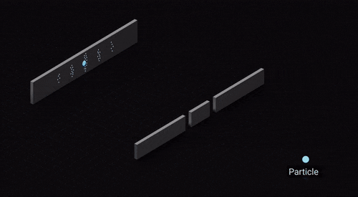
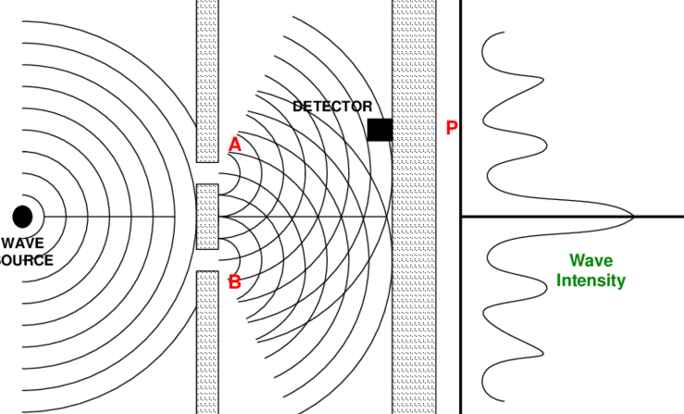
MOLECULAR ORBITAL (MO) THEORY
Linear Combination of Atomic Orbitals (LCAO) (cont.)
1. Bonding molecular orbitals (BMO’s) (cont.)

Slide 21
MOLECULAR ORBITAL (MO) THEORY
Linear Combination of Atomic Orbitals (LCAO) (cont.)
2. Anti-Bonding molecular orbitals (ABMO’s)
When molecular orbital is formed by subtraction (-) of wave function, the type of molecular orbitals formed are called Antibonding Molecular Orbitals and is represented by
ψ_{MO} = ψ_{A} − ψ_{B}

Slide 22
MOLECULAR ORBITAL (MO) THEORY
Linear Combination of Atomic Orbitals (LCAO) (cont.)
2. Anti-Bonding molecular orbitals (ABMO’s) (Cont.)
They have higher energy than atomic orbitals. It is similar to destructive interference occurring out of phase resulting in formation of anti-bonding orbitals.
Molecular Orbital formed by subtraction of overlapping of two s orbitals gives one anti-bonding σ*s molecular orbital.

Slide 23
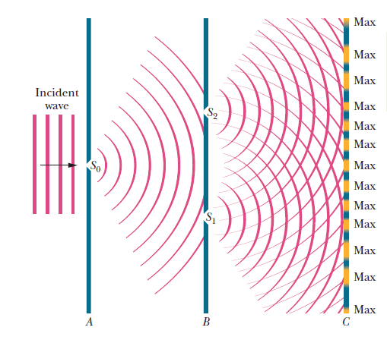
MOLECULAR ORBITAL (MO) THEORY
Linear Combination of Atomic Orbitals (LCAO) (cont.)
2. Anti-Bonding molecular orbitals (ABMO’s) (Cont.)

Slide 24
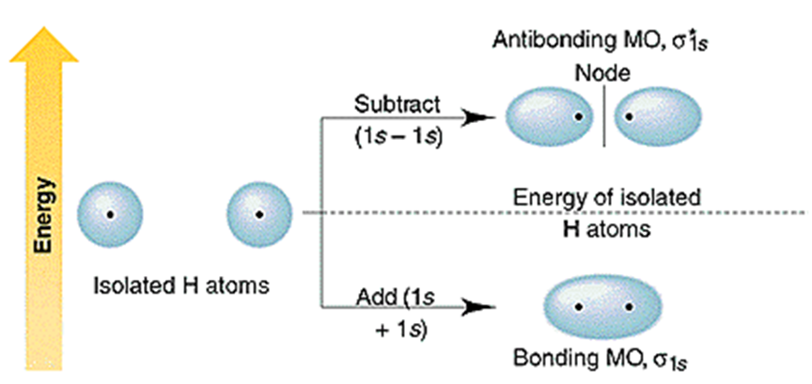
MOLECULAR ORBITAL (MO) THEORY
Linear Combination of Atomic Orbitals (LCAO) (cont.)

Slide 25
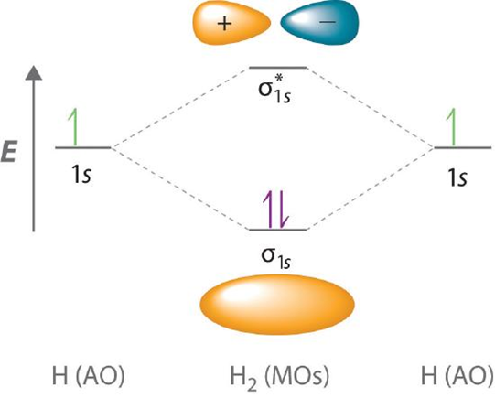
MOLECULAR ORBITAL (MO) THEORY
Molecular Orbital (MO) Diagram
A molecular orbital diagram, or MO diagram, is a qualitative descriptive tool explaining chemical bonding in molecules in terms of molecular orbital theory in general and the linear combination of atomic orbitals (LCAO) method in particular.

Slide 26
MOLECULAR ORBITAL (MO) THEORY
Filling Electrons in MO Diagrams
In constructing an MO diagram is filling the newly formed molecular orbitals with electrons. Three general rules apply:
• The Aufbau principle states that orbitals are filled starting with the lowest energy.
• The Pauli exclusion principle states that the maximum number of electrons occupying an orbital is two, with opposite spins.
• Hund’s rule states that when there are several MOs with equal energy, and the electrons occupy the MOs one at a time before two occupy the same MO.

Slide 27
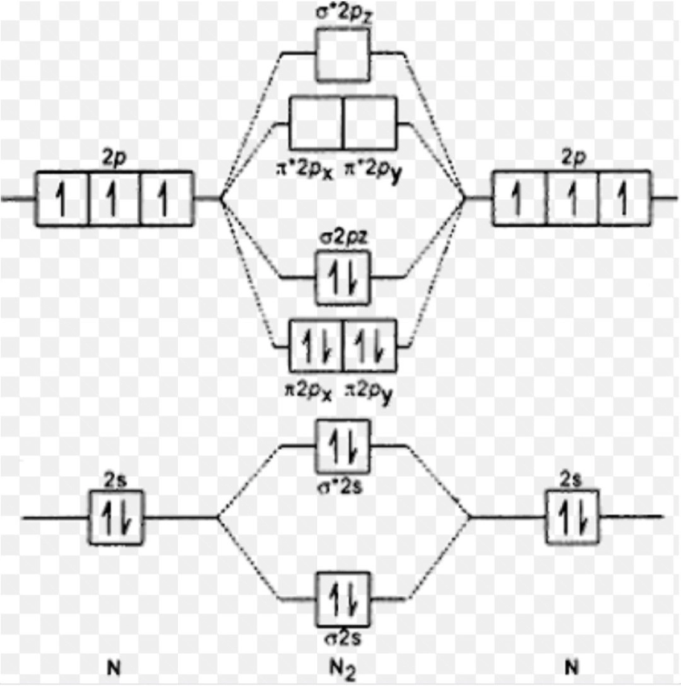
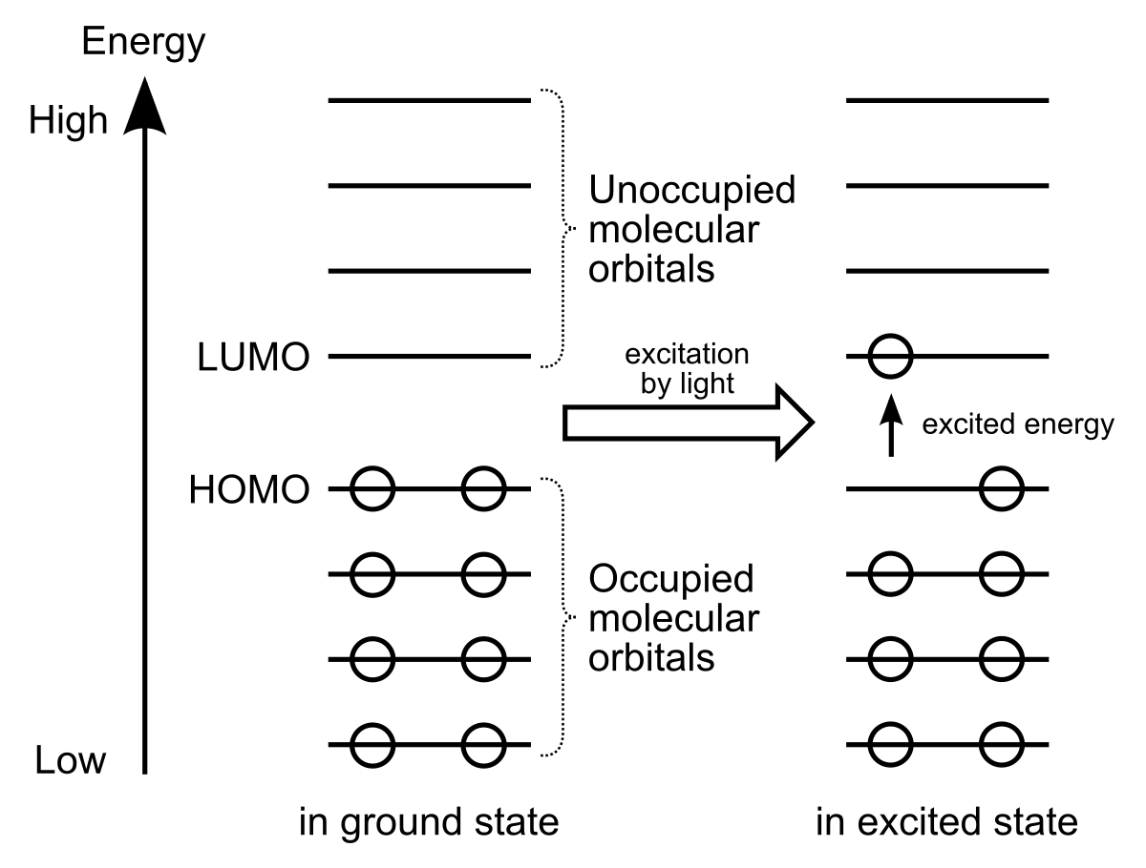
MOLECULAR ORBITAL (MO) THEORY
Filling Electrons in MO Diagrams (cont.)
The filled MO that is highest in energy is called the Highest Occupied Molecular Orbital, or HOMO; the empty MO just above it is the Lowest Unoccupied Molecular Orbital, or LUMO.
LUMO
HOMO

Slide 28
MOLECULAR ORBITAL (MO) THEORY
Filling Electrons in MO Diagrams (cont.)
The electrons in the bonding MOs are called bonding electrons, and any electrons in the antibonding orbital are called antibonding electrons.
The reduction these electrons energy is the driving force for chemical bond formation.
Whenever symmetry or energy make mixing an atomic orbital impossible, a non-bonding MO is created; often quite similar to and with energy levels equal or close to its constituent AO, the non-bonding MO creates an unfavorable energy event.
The resulting electron configuration can be described as follows,
σ1s², σ∗1s², σ2s², σ∗2s², π2p_{x}², π2p_{y}², ​σ2p_{z}² ​………

Slide 29
MOLECULAR ORBITAL (MO) THEORY
Bond Order
Bond order is the number of chemical bonds between a pair of atoms. Bond order is defined as half the difference between the number of bonding and anti-bonding electrons. Bond order is also an index of bond strength.
$$Bond order= \frac{\left(No. of electrons in BMO^{′}s−No. of electrons in ABMO^{′}s\right)}{2}$$
Magnetic Properties of Molecules
All electrons paired in MO’S- repelled by magnetic field – DIAMAGNETIC
One or more unpaired electrons in MO’s - attracted into magnetic field – PARAMAGNETIC

Slide 30
References
F. A. Cotton and G. Wilkinson, "Advanced Inorganic Chemistry", 5th Edition, John Wiley&Sons, Singapore, 1998.
K.M. Mackay and R. A. Mackay, Introduction to Modern Inorganic chemistry, 4th Edn. Prentice Hall, New Jersy, 1989.
James E. Hugheey, Ellen A. Keitler and Richard L. Keitler, Inorganic Chemistry, 4th Edn, Harper COllinsCOllege Publishes, New York, 1993.

Slide 31
