Slide 1
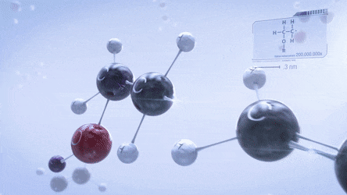
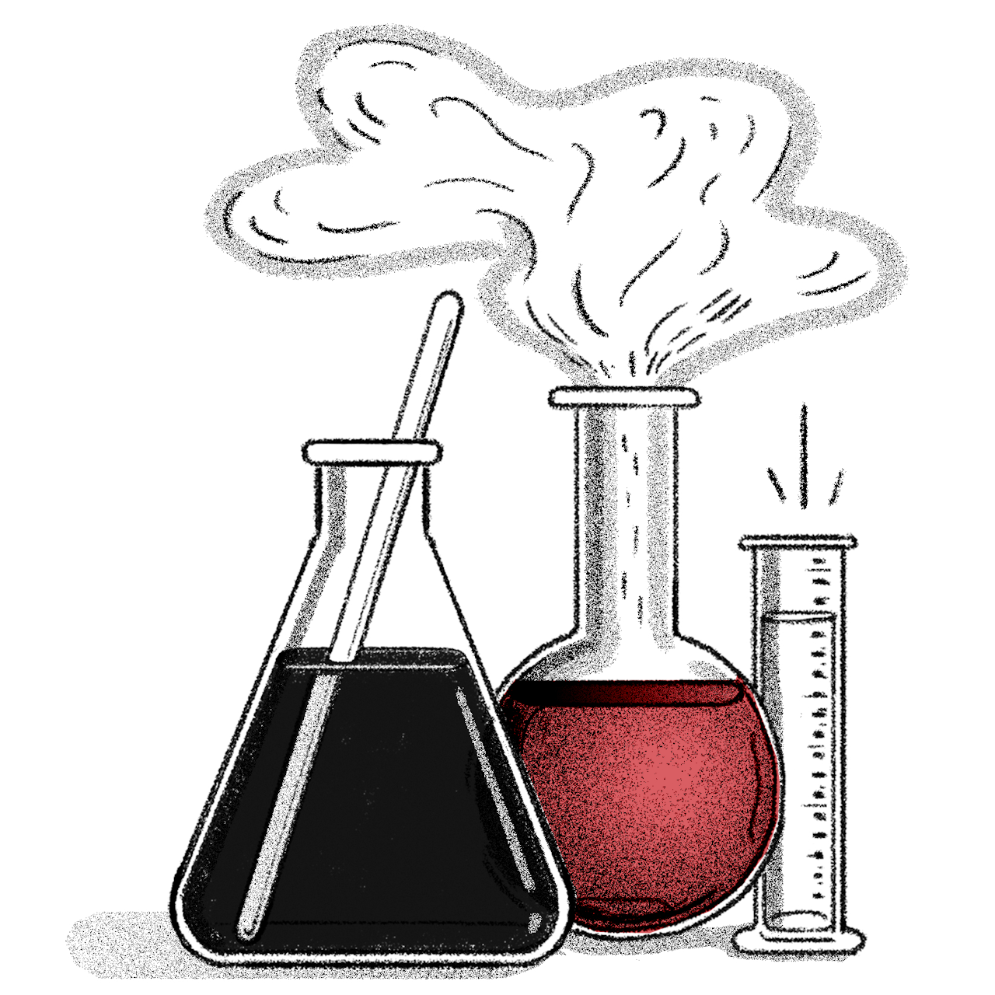
POLYMERS
Presented by
Dr. M.P. KESAVAN M.Sc., Ph.D.,
Assistant Professor
Department of Chemistry
HKRH College
Uthamapalayam.

Slide 2
Polymers ???

Slide 3
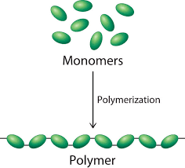
POLYMERS
Definition
Polymers are long chain, very large molecules or macromolecules, composed of many repeating subunits (small molecules) called monomers.
Polymers may be naturally found in plants and animals (natural polymers) or may be man-made (synthetic polymers).

Slide 4
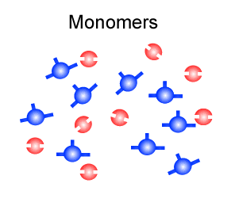
POLYMERIZATION

Slide 5
POLYMERS
Examples
Natural polymers
Synthetic polymers
Latex (rubber)
Starch
Cellulose
Silk
Wool
DNA
Proteins
Low-density polyethylene (LDPE)
High-density polyethylene (HDPE)
Polypropylene (PP)
Polyvinyl chloride (PVC)
Polystyrene (PS)
Nylon 6,6.
Teflon (Polytetrafluoroethylene)
Thermoplastic polyurethanes (TPU)

Slide 6
CLASSIFICATION OF POLYMERS
I. Classification based on the Source of Availability
There are three types of classification under this category, namely, Natural, Synthetic, and Semi-synthetic Polymers.
Natural Polymers
Semi-synthetic Polymers
Synthetic Polymers
They occur naturally and are found in plants and animals.
They are derived from naturally occurring polymers and undergo further chemical modification.
These are man-made polymers. Plastic is the most common and widely used synthetic polymer. It is used in industries and various dairy products.
Example
Example
Proteins,starch, cellulose and rubber.
Cellulose nitrate and cellulose acetate.
Example
Nylon 6,6, polyvinyl chloride (PVC) and Teflon.

Slide 7
CLASSIFICATION OF POLYMERS
II. Classification based on the Structure of the Monomer Chain
There are three types of classification under this category, namely, Linear, Branched-chain, and Cross-linked Polymers.
Linear Polymers
Branched-chain Polymers
Cross-linked Polymers
The structure of polymers containing long and straight chains fall into this category.
When linear chains of a polymer form branches, then, such polymers are categorized as branched chain polymers.
They are composed of bi-functional and tri-functional monomers. They have a stronger covalent bond in comparison to other linear polymers.
Example
Example
Polyvinyl chloride (PVC)
Low-density polyethylene (LDPE)
Example
Bakelite and melamine.

Slide 8
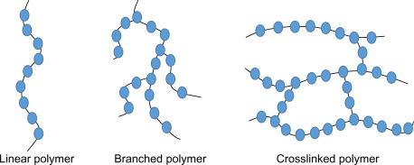
CLASSIFICATION OF POLYMERS
II. Classification based on the Structure of the Monomer Chain

Slide 9
CLASSIFICATION OF POLYMERS
III. Classification based on Polymerization
There are two types of classification under this category, namely, Addition and Condensation Polymers.
Addition Polymers
Condensation Polymers
An addition polymer is a polymer that forms by simple linking of monomers without the elimination of any small molecules.
Condensation polymers are formed by the reaction of bi- or polyfunctional molecules, with the elimination of some small molecules (such as water) as a by-product.
Example
Example
Teflon and
polyvinyl chloride (PVC)
Nylon -6, 6 and polyesters.

Slide 10
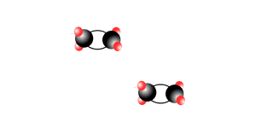
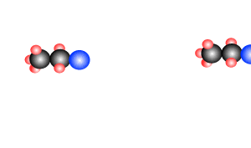
CLASSIFICATION OF POLYMERS
III. Classification based on Polymerization
Addition Polymers
Condensation Polymers

Slide 11
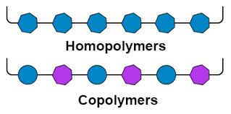
CLASSIFICATION OF POLYMERS
IV. Classification Based on Monomers
There are two types of classification under this category, namely, Homo and Hetero Polymers.
Homopolymer
Heteropolymer or co-polymer
In this type, a single type of monomer unit is present.
It consists of different type of monomer units.
Example
Example
Polyethylene
Nylon -6, 6

Slide 12
CLASSIFICATION OF POLYMERS
V. Classification Based on Molecular Forces
There are four types of classification under this category, namely, Addition and Condensation Polymers.
Elastomers
Fibres
These are rubber-like solids weak interaction forces are present.
Strong, tough, high tensile strength and strong forces of interaction are present.
Example
Example
Rubber
Nylon 6,6

Slide 13
POLYMERIZATION
Definition
Polymerization is a process through which a large number of monomer molecules react together to form a polymer.
The macromolecules produced from a polymerization may have a linear or a branched structure.
They can also assume the shape of a complex, three-dimensional network.

Slide 14
TYPES OF POLYMERIZATION
There exist several different categories of polymerization reactions, the most notable of which being,
POLYMERIZATION
Addition polymerization
Condensation polymerization

Slide 15
TYPES OF POLYMERIZATION
Addition polymerization
The addition polymerization reaction is a process through which a large number of monomer molecules react together to form a polymer without the elimination of any small molecules.
Addition polymerization is also called as chain growth polymerization.
In chain-growth, the molecules of the monomers are added together to form a large chain. The monomers adding maybe the same type or different.
Generally, alkenes, alkadienes and their derivatives are used. Alkenes are treated with small amounts of initiators.
The chain grows by adding the reactive end of growing chain to double bond of monomer.

Slide 16
TYPES OF POLYMERIZATION
Addition polymerization

Slide 17
TYPES OF POLYMERIZATION
Examples_Addition polymerization
1. Synthesis of Polyethylene (polythene)
Polymerisation of ethylene (monomer) to form polyethylene (polymer).
2. Synthesis of Teflon
Polymerisation of tetrafluoroethylene (monomer) to form teflon (polymer).

Slide 18
TYPES OF POLYMERIZATION
Condensation polymerization
The condensation polymerization reaction is a process through which a large number of monomer molecules react together to form a polymer with the elimination of small molecules as by product.
The byproduct may be water or hydrogen chloride.
Addition polymerization is also called as step growth polymerization.
In step-growth, each step may consist of a combination of two polymers having a different or same length to form a longer length molecule.
The reaction is a lengthy process and the molecular mass is increased at a very slow rate.

Slide 19
TYPES OF POLYMERIZATION
Condensation polymerization

Slide 20
TYPES OF POLYMERIZATION
Examples_Condensation polymerization
1. Synthesis of Nylon 66
Nylon 66 polymer is prepared under the condition of high pressure and temperature by the condensation polymerization of hexamethylenediamine with adipic acid.

Slide 21
TYPES OF POLYMERIZATION
Examples_Condensation polymerization
2. Synthesis of Dacron
Dacron (Terylene) polymer is prepared under the condition of high pressure and temperature by the condensation polymerization of ethylene glycol with terephthalic acid.

Slide 22
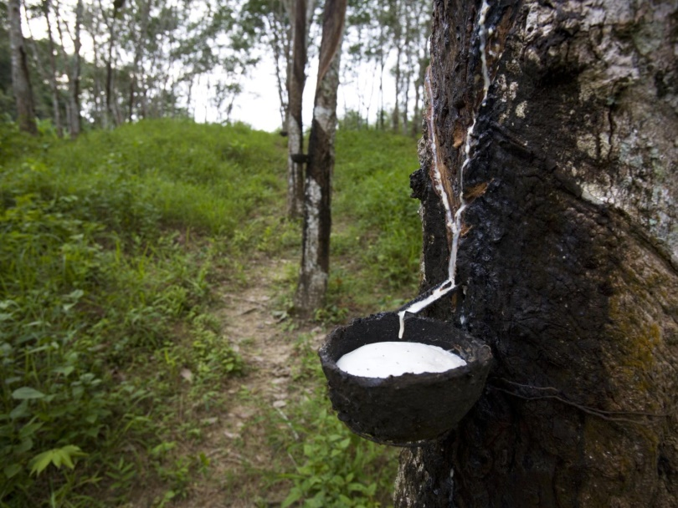
NATURAL RUBBER
These are the elastomers which are obtained naturally.
Natural rubber is made up of solid particles suspended in a milky white liquid (called latex) that drips from the bark of certain tropical and subtropical trees.
This latex rubber is mainly found in countries like Brazil, India, Indonesia, Malaysia, and Sri Lanka.
It is made by the polymerization of isoprene (2 methyl-1, 3-butadiene) which has a chemical formula (C5H8)n.

Slide 23
NATURAL RUBBER
In simple words, natural rubbers are made by loosely joining the monomers of isoprene (C5H8) in the form of a long tangled chain.
Thus, natural rubber (latex) is the polymer cis-1,4-polyisoprene with a molecular weight of 100,000 to 1,000,000 daltons.
Typically, a small percentage (up to 5% of dry mass) of other materials, such as proteins, fatty acids, resins, and inorganic materials (salts) are found in natural rubber.
23

Slide 24
NATURAL RUBBER
In the natural rubber, there is no polar substituent. The only intermolecular forces are van der Waals’ type.
The cis-configuration gives the polymeric chain of natural rubber a coiled structure. As a result, it can be stretched by the application of a force. When the force is removed, the chain returns back to its original coiled shape.
Natural rubber is soft and sticky. It can be used only in the temperature range 10°C-50°C.
At higher temperature, it becomes soft and at low temperature, it becomes brittle. It has high water absorption capacity. It is attacked by oxidising agents and organic solvents. As such, it cannot be used very extensively for commercial purposes.

Slide 25
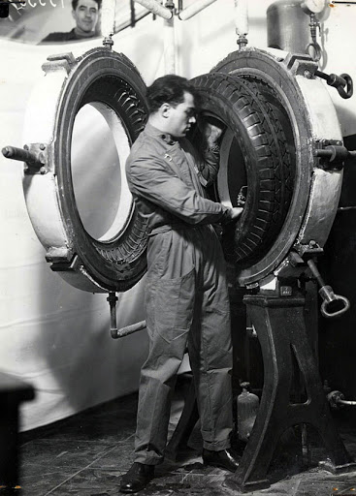
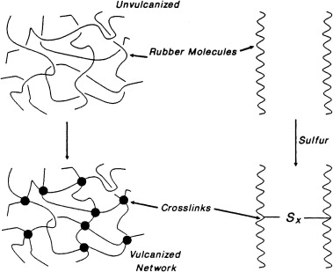
VULCANIZATION OF RUBBER
Vulcanization of rubber is a process of improvement of the rubber elasticity and strength by heating it in the presence of sulfur, which results in three-dimensional cross-linking of the chain rubber molecules (polyisoprene) bonded to each other by sulfur atoms.
Vulcanization process was invented by Charles Goodyear in 1839.

Slide 26
VULCANIZATION OF RUBBER
In this process, introducing -S-S- crosslinks in the structure of natural rubber by heating with sulphur at 110°C.
Vulcanization is carried out by adding sulfur (3-5%) and zinc oxide to the rubber, and then heating the object at about 110 °C for about 20-30 minutes.
Zinc oxide accelerates the rate of vulcanization.
Vulcanization introduces polysulphide (-S-S-) bonds between the adjacent chains.
These crosslinks tend to limit the motion of chains relative to each other.
26

Slide 27
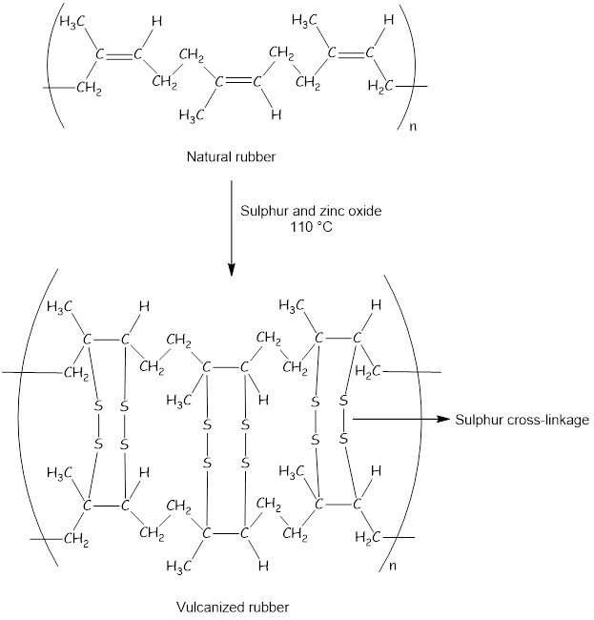
VULCANIZATION OF RUBBER

Slide 28
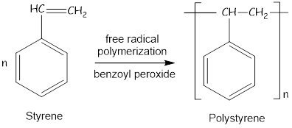
POLYSTYRENE
Preparation
Polystyrene is prepared by free radical polymerization of styrene in presence of benzoyl peroxide.

Slide 29
POLYSTYRENE
Applications
Medically it is used for sterilizing test tubes, diagnostic components, and other medical devices.
It is used to manufacture car parts which include knobs, instrument panels, sound dampening foam, etc.
Polystyrene food service packaging keeps the food fresh for a longer period of time and is less expensive than alternatives.
It is used in packaging consumer goods such as DVD cases, egg cartons, to protect against spoilage or damage.
It provides thermal insulation and is used in refrigerators, freezers, etc.
Used in housing in all IT equipment such as Television, computer, etc.
29

Slide 30
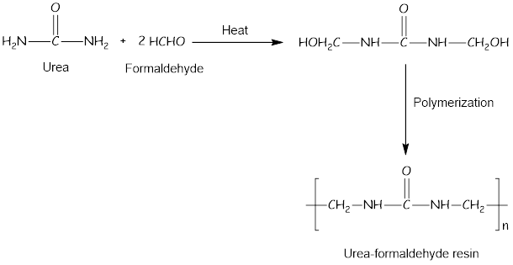
UREA – FORMALDEHYDE (UF) RESIN
Preparation
Urea – formaldehyde resin is prepared by condensation polymerization of urea with formaldehyde.

Slide 31
UREA – FORMALDEHYDE (UF) RESIN
Applications
Urea formaldehyde resin is the very common polymer and is mostly used in textiles, paper, wrinkle resistant fabrics, cotton blends, rayon, and also used to glue wood together.
Urea formaldehyde resin is mostly used when producing electrical appliances casing also desk lamps .
It is widely chosen as an adhesive because of its property of high reactivity, wonderfull performance and low price.
Urea formaldehyde resin is used in tires manufacturing from automobile industry in order to improve the bonding of rubber.
Urea formaldehyde resin is also used in agricultural field as a source of nitrogen fertilizer.
31
31

Slide 32
TEFLON
Preparation
Teflon is prepared by polymerization of tetrafluoroethylene (monomer) under pressure in stainless steel autoclaves with free radical initiators such as ammonium persulfate.
32

Slide 33
TEFLON
Applications
The nonstick property of teflon has been used in the manufacture of cookwares.
The extremely low friction of teflon makes it ideal for making machine parts, such as gears, bearings, pipe linings, joints and slide plates.
The nonstick property of teflon is also used in fabrics and carpets for improving their stain-resistant qualities.
Teflon has excellent dielectric properties, especially at high radio frequencies. This property is useful for its use as an insulator in cables and connector assemblies.
The chemical inertness of teflon makes it apt for making artificial body parts.
Teflon is used to coat specific types of hardened armor-piercing bullets.
33
33

Slide 34
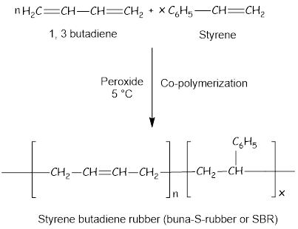
BUNA-S-RUBBER
Preparation
Buna-S-rubber is a random co-polymer formed by the emulsion polymerization of a mixture of 1:3 butadiene and styrene in the presence of peroxide catalyst at 5 °C and therefore the product is called as cold rubber. The rubber obtained is also called Styrene butadiene rubber (buna-S-rubber or SBR).

Slide 35
BUNA-S-RUBBER
Applications
A large amount of SBR is produced in latex form as a rubbery adhesive for use in applications such as carpet backing.
It is used for the manufacture of passenger car tyres and treads, motor cycle and scooter tyres, cycle tyres and tubes.
SBR is also used for the manufacture of conveyor belts, foot-wares, shoe soles, hoses and electrical insulation.
35
35
35

Slide 36
References
V. R. Gowrikar, N.V.Viswanathan : Polymer Science- Wiley Eastern Limited, New Delhi. 1986.
R.B. Seymour, Introduction to Polymer Chemistry, MC Craw Hill, New York. 1971.

