Slide 1
WELCOME

Slide 2
HYPOTHESIS

Slide 3
CONTENTS
Introduction
Characters of Hypothesis
Importance of Hypothesis
Sources of Hypothesis
Concepts of Hypothesis
Hypothesis Testing
Formulation of Hypothesis
Types of Hypothesis
Conclusion

Slide 4
INTRODUCTION
Hypothesis means a Tentative Statement about two or more relationship or Instruments. The hypothesis the new experiment and Observations of may not be prove or disprove absolutely. The meaning of hypothesis the related concepts for better understanding of the hypothesis testing techniques.

Slide 5
CHARACTERS OF HYPOTHESIS
Hypothesis should be clear and precious. The Hypothesis is not clear and precious inference the reliable.
It’s should be capable being Tested.
Hypothesis should be limited in scope and must be specific.
It’s should be consistent with most known facts.
Hypothesis should be testing of reasonable Time.
It’s must explain the facts that have rights to the need for explanation.

Slide 6
IMPORTANCE OF HYPOTHESIS
It’s pinpoints the Solutions.
It determines the kinds of data to be collected.
Indicated the types of Research.
Provide frame work for Results.
Stimulate the Future Research.

Slide 7
SOURCES OF HYPOTHESIS
Personal Experience
Imagination and Thinking
Scientific Theory
Previous Study
Cultural

Slide 8
CONCEPTS OF HYPOTHESIS
NULL HYPOTHESIS
It’s means Ho = µ = 100. The Null Hypothesis or Type I Error the decision of true decision (Ho) Accept (Ha), The Reject (Ho). It’s called Null Hypothesis.
ALTERNATIVE OF HYPOTHESIS
It’s means Ha = µ ≠ 100. It’s Type II Error the decision making or Type II Error are (Ha) False but Accepted (Ha). It’s called Alternative Hypothesis.

Slide 9
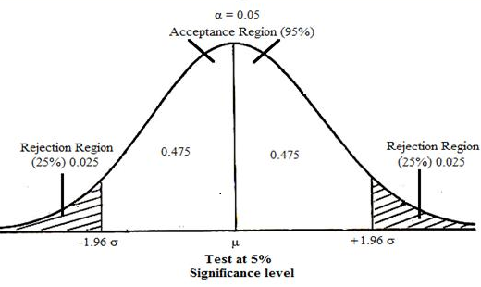
HYPOTHESIS TESTING
The Testing of Hypothesis in 5% level of Significance Confidence

Slide 10
STEPS OF SIGNIFICANCE
State Ho as well as Ha
Specify the level of significance or α Value
Decide the correct sampling distribution
Simple Random samples and workout and appropriate value from sample data
Calculate the probability that sample result would diverge as widely as it has from expectation Ho where True

Slide 11
CONTINUED
In this probability equal to are smaller than infinity value incase of 1 tailed test and Infinity 2 Tailed test
YES
Reject (Ho)
NO Accept (Ha)
There by a run the risk of committing TYPE I ERROR
There by a run the risk of committing TYPE II ERROR

Slide 12
FORMULATION OF HYPOTHESIS
Null and Alternative Hypothesis
Level of Significance
Critical Region
Decision Rules
Type I Error and Type II Error
One Tailed Test and Two Tailed Test
One Sample and Two Sample Test

Slide 13
TYPES OF HYPOTHESIS
Simple Hypothesis
Complex Hypothesis
Empirical Hypothesis
Logical Hypothesis
Statistical Hypothesis
Null Hypothesis
Alternative Hypothesis

Slide 14
CONCLUSION
A hypothesis is something more than a wild guess but less than a well-established theory. In science, a hypothesis needs to go through a lot of testing before it gets labeled a theory. In the non-scientific world, the word is used a lot more loosely. Anyone who uses the word hypothesis is making a guess.

Slide 15
THANK YOU

