Slide 1

Name:K.ATHINARAYANAN
Assistant Professor of English
Class:II M.A English
Paper Title with code: Literary Criticism-II (17PENC33)
Topic:Formalistic Approach

Slide 2
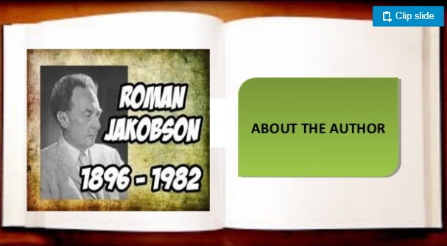

Slide 3
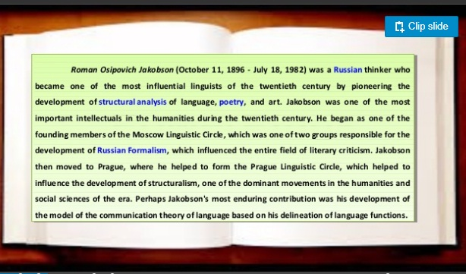

Slide 4


Slide 5


Slide 6
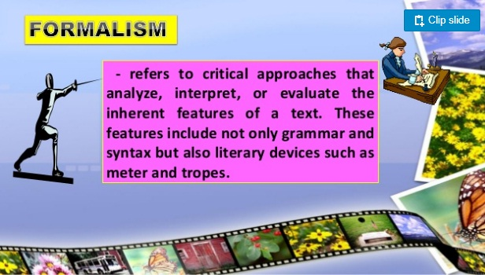

Slide 7
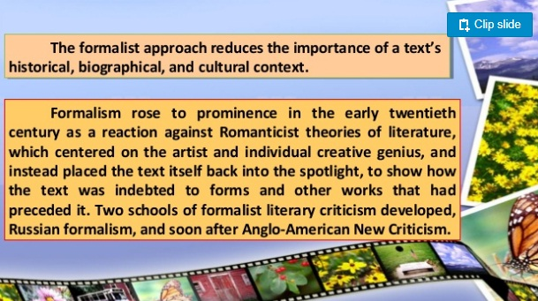

Slide 8
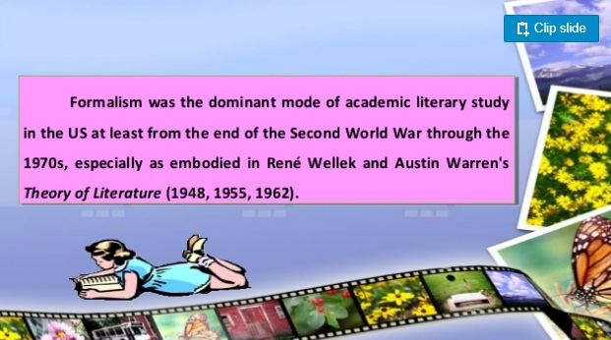

Slide 9
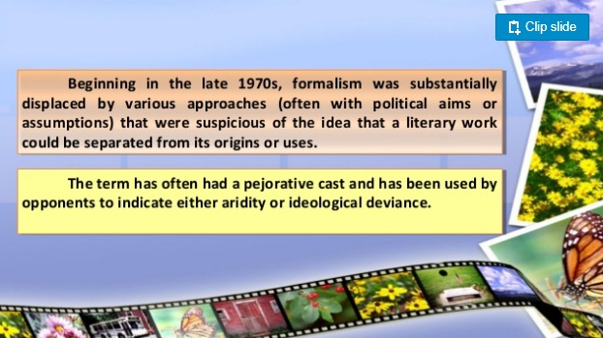

Slide 10


Slide 11
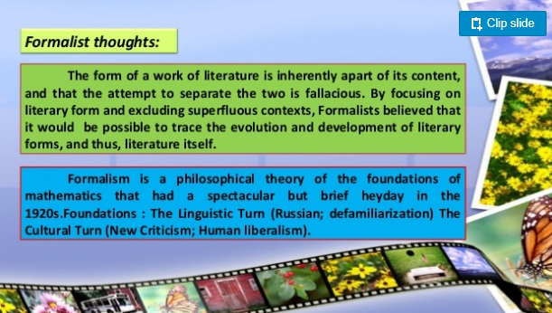

Slide 12
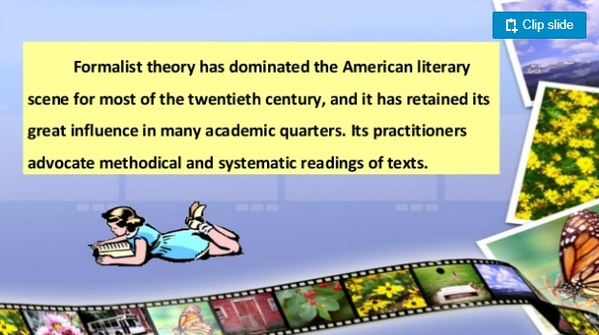

Slide 13


Slide 14
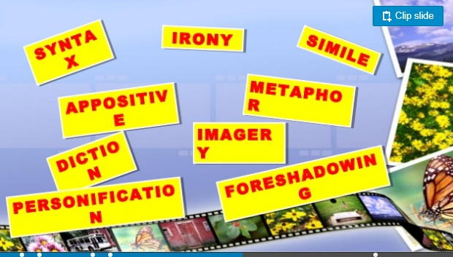

Slide 15
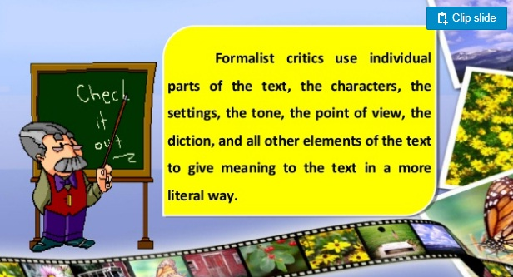

Slide 16
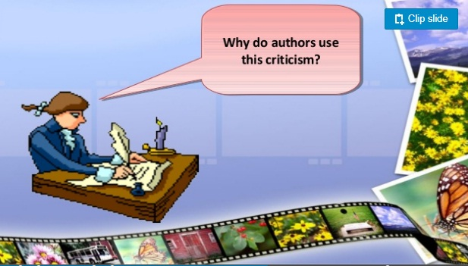

Slide 17


Slide 18
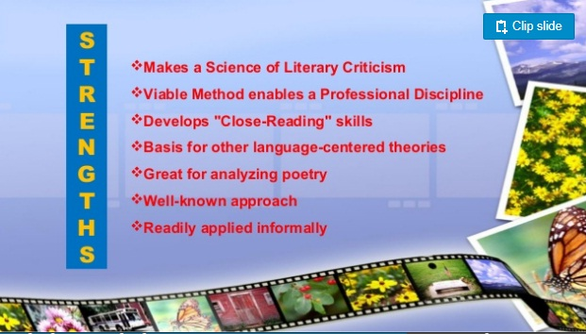

Slide 19


Slide 20
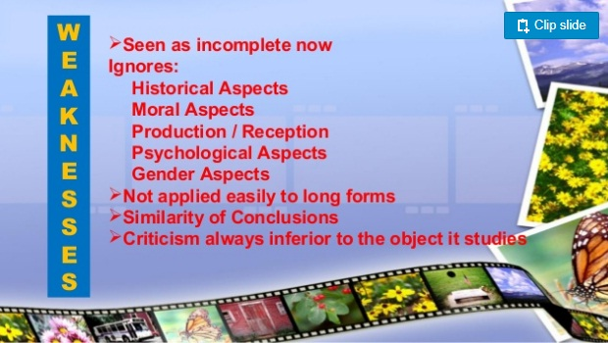

Slide 21
E-sources
www.criticaltheories.com
www.gradesaver.com
https://criticism.com

Slide 22
Thank You

