Slide 1
JAMES WATT AND STEAM ENGINE
RAIHANATH K.C
Assistant Professor History
Programme: BA HISTORY
Course Title: History of Science and Technology
Course Code: 17UHIC 43/17UHVC43

Slide 2
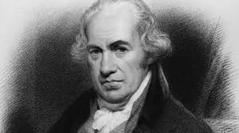
JAMES WATT (1736-1819)
Born in Greenock in Scotland
Son of a ship chandler
He was a weak child and mother taught him read and write
Father taught him mathematics and the use of wide range of tools
He worked a lot in his workshop
The inventor of Steam Engine

Slide 3
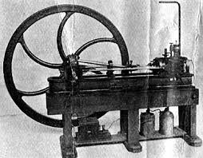
Steam Engine
The steam engine , revolutionised the Industrial Revolution
Its a device for turning heat to power
Water power initiated the Industrial Revolution and the Steam Engine hastened it.

Slide 4
Steam Engine
The continuous improvement of steam engine in two centuries reached final perfection at the hands of James Watt in 1769.
He was the inventor of the modern condensing steam engine.

Slide 5
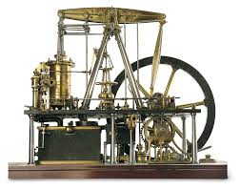

Slide 6
History of steam engine
Hero, a mathematician of Alexandria constructed an engine named “Aeolipile”
In 1629 Branca ,an Italian made impulse turbine
In 1690, Denis Papin demonstrated steam could move a piston
In 1698, Thomas Savery made practical steam pump
Thomas Newcomen established steam engine in 1712
John Smeaton applied some principles to raise the efficiency of steam engine

Slide 7
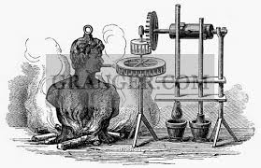
History of Steam Engine ( continue)
The first impulse turbine was constructed by an Italian named Branca in 1629.
It consisted of a wheel to the rim, to which a series of buckets or blades the wheel was made to revolve

Slide 8
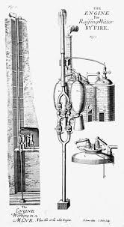
History of Steam Engine (continue)
In 1698, Thomas Savery made a practical steam pump ,that raised water through the combination of vaccum created by the condensation of steam and through steam pressure itself

Slide 9
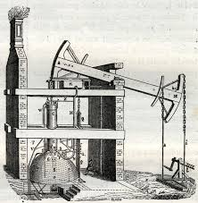
History of Steam Engine continuous;
The major progress in the steam engine was made in the beginning of the eighteenth century in 1712, Thomas Newcomen (1663-1729)established the steam engine as a practical and reliable machine.

Slide 10
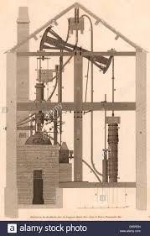
History of Steam Engine (continue)
John Smeaton at the Carron iron works in scotland applied engineering principles to raise the efficiency of the Steam Engine

Slide 11
JAMES WATT AND STEAM ENGINE
Watt took out patent of his new engine in 1769
In 1765,he was assigned the task of repairing the Newcomen’s engine
He connected a separate condenser to a cylinder by a valve
It could be cool while a cylinder was hot
In 1774,Watt entered into the partnership of Mathew Boulton to manufacture his engine
In 1775,British Parliament granted patent for 25 years

Slide 12
Socio-economic impact
The life of the people changed
T provided fast and easy transportation for the people
Hundreds of factories sprang up
Production increased with less human energy
Introduced Factory system
Transformed the agrarian society into modern industrial society
National markets emerged

Slide 13
Interesting Fact
While working at the University of Glasgow as an Instrument maker, Watt was asked to repair model of Thomas Newcomen’s steam Engine
When James Watt went to work fixing that repair work in 1764, he had no how much that job would influence the Industrial Revolution.

Slide 14
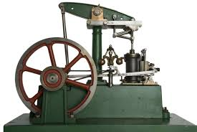
Steam engine
Watt introduced a design enhancement, the separate condenser, which avoided this waste of energy and radically improved the power, efficiency, and cost-effectiveness of steam engine. Eventually he adapted his engine to produce rotary motion, greatly broadening its use beyond pumping water.

Slide 15
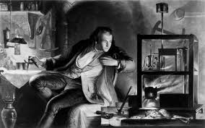
James Watt and Steam Engine
Watt attempted to commercialise his invention, but experienced great financial difficulties until he entered a partnership with Mathew Boulton in 1775.the new firm of Boulton and Watt was eventually highly successful and watt became a wealthy man. In his retirement, Watt c0ntinued to develop new inventions though none was a significant as his Steam engine works. He died in 1819

