Slide 1
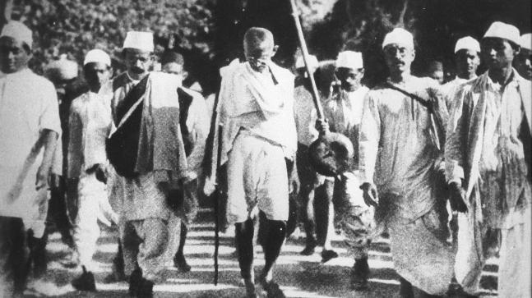
HISTORY OF INDIA, 1885-1947 A.D.
Topic: Civil Disobedience Movement
T. ANAS BABU
Assistant Professor of History
HKRH College
Uthamapalayam

Slide 2
Civil Disobedience Movement
Introduction
The Civil Disobedience Movement was a significant movement started by Mahatma Gandhi in the course of India’s freedom struggle
It aims to disobey the British Government
It was a active and strong refusal Movement to Disobey certain laws, demands or commands of British government
It was a mass nonviolent resistance

Slide 3
Causes for Civil Disobedience Movement
The Simon Commission (1927)
- In 1927 British Government appointed a committee known as Simon Commission, headed by John Simon to look the working of Government of India Act, 1919 and bring new constitutional reforms.
-Indians opposed the commission because no Indian as a member of it.
2. Protest against the arrest of Revolutionaries
- In 1929, Hindustan Socialist Republican Army (HSRA) leaders Baghat Singh, Rajkuru and Sukhdev threw bombs in the Legislative Assembly of Lahore and they were arrested
3. Demand for ‘Poorna Swaraj’
- 1929, Lahore Session of the I.N.C. set its goal as Poorna Swaraj

Slide 4
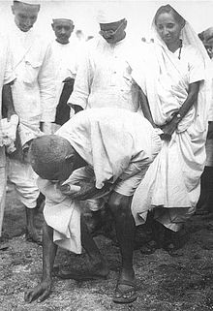
Dandi March or Salt Satyagraha (1930)
Gandhi submitted Eleven point ultimatum
to the British, but after no response he launched
Civil Disobedience Movement.
The Civil Disobedience Movement was started
with the Dandi March also called as Salt
Satyagraha.
Gandhi started from Sabarmati Ashram,
Ahmedabad, on March 12, 1930 along with
78 followers and reached a small coastal
village at Dandi after walking 390 k.m.
in 24 days
Arriving on 6th April, Gandhi picked up
a piece of salty sand and violated the salt law
of the British

Slide 5
With this Gandhi inaugurated Civil Disobedience Movement.
Earlier, the British monopolized the production of salt by laws
Then Gandhi encouraged people to boycott salt tax and make salt by their own
Salt was a symbol of the unwillingness of the people to live under the British
Gandhi was arrested on May

Slide 6
Spread of the Movement
Soon after Gandhi’s Salt Satyagraha, the Civil Disobedience Movement spread all over the country
The people started
-boycotting foreign goods
- Organizing rally’s and meetings
- Producing salt etc.

Slide 7
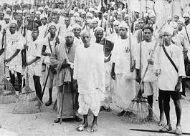
Vedaranniyam Satyagraha
In Tamil Nadu, Rajaji (C.Rajagopalachari) led a similar Salt Satyagraha called Vedaranniyam Satyagraha
He started from Trichy on April-13, along with 150 volunteers and reached at coastal Vedaranniyam in Tanjavur district (presently at Nagapattinam) after traveling 240 k.m.
Then he produced salt by violating British salt laws

Slide 8
In Assam Satyagarahis walked to Bengal for making salt
At North-West frontier, the movement was led by Khan Adul Gaffar Khan, popularly known as frontier Gandhi.
He organised Red Shirts (Kudai Khidmadgars)
At Kerala, the movement was led by K. Kelappan
The protest was strong all over India
Huge demonstrations was held in Calcutta, Madras, Bombay, North West Frontier etc.
Along with Salt Satyagraha the people also carried non-payment of land and other taxes
Women, students, workers, merchants, soldiers etc. were actively participated in the movement
The movement spread all over India.

Slide 9
Response of the Government
At the beginning government did not paid any methods to stop the movement
But, with the fast spreading of the movement, they started to arrest the people
British arrested many national leaders and people, who violated the Salt laws and participated in the movement
90,000 people were arrested including many Congress leaders
Gandhi was arrested in May
British followed Lathi charges and firings was carried against the unarmed people

Slide 10
The British soon realized to end the movement
They invited Congress for the First Round Table Conference in 1930.
But Congress was not accepted
Gandhi- Irwin Pact (1931)
Gandhi was released from Jail in Jan-1931
To end the Civil Disobedience Movement, British Viceroy, Lord Irwin initated talk with Gandhi
On Feb-1931, Viceroy and Gandhi held a meeting at Delhi called Gandhi-Irwin Pact

Slide 11
In the meeting, British and Gandhi agreed on:
1. Release all political prisoners except Baghat Singh, Rajguru and Sukdev
2. Right to make salt in coastal villages for personal consumption (not for sale)
3. Right to peaceful protest
Gandhi, on behalf of the Congress agreed to the suspension of the Civil Disobedience Movement
Mahatma Gandhi finally suspended the Civil Disobedience Movement in 1933 and asked the people for Individual Satyagraha.

Slide 12
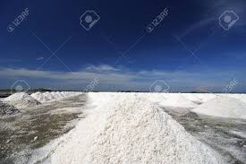
THANK YOU

