Slide 1
NATURE, SCOPE AND FEATURES OF ISLAMIC ARCHITECTURE
T.ANAS BABU
Assistant Professor
Programme: BA HISTORY
Course:ISLAMIC ARCHITECTURE
Course Code:17UHIS61/17UHVS61

Slide 2
With the coming of Muslims in India, a new type of architecture is developed in India
This new form of architecture is called ‘Indo-Islamic architecture’ or ‘Indo-Saracenic architecture’
So, the Indo-Islamic architecture is the architecture produced in India during the time of Muslim rulers
It was the synthesis (fusion, amalgam) of both Indian and Islamic style
This new style of architecture was evolved in 12th C and developed under the Muslim rulers of Delhi Sultanate, Mughals, Deccan Sultans and Muslim regional kingdoms

Slide 3
This style of architecture was brought by Muslims from Central Asia and Persia
This architectural tradition was quite different from the earliest Hindu buildings
The major features of Indo-Islamic Architecture were the use of arch, dome, vault, usage of Arabic Calligraphy, inlay decorations, use of coloured marbles etc.
This style of Islamic architecture called as arcuate architecture
Before Muslims the style of architecture was the use of pillars, Beam (lintels), pyramidal towers etc. This style is called trabeate
The Muslims brought many scientific methods in architecture
In the beginning, the Muslims mostly followed Hindu style with less influence of Islamic style

Slide 4
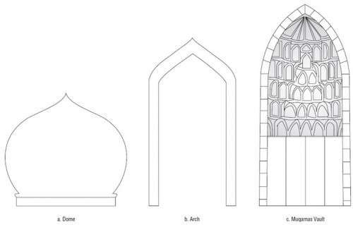
Dome
Arch
Vault

Slide 5
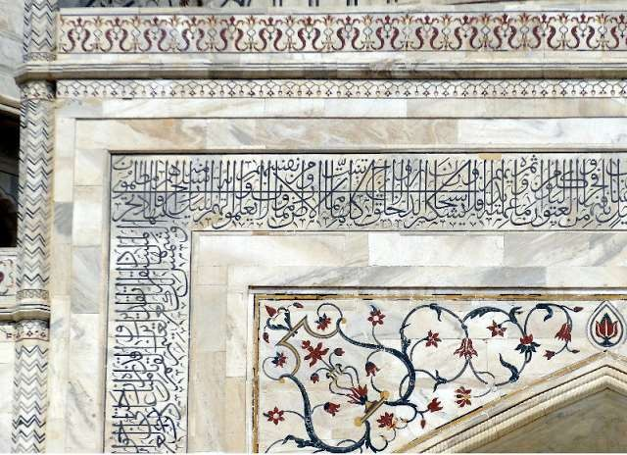
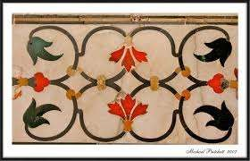
ARABIC CALLIGRAPHY
INLAY WORKS

Slide 6
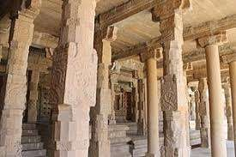
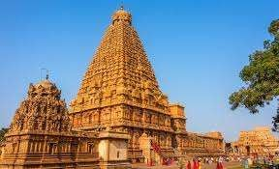
Pyramidal Tower
Pillars and Lintels

Slide 7
Before establishing India, the Islamic Architecture were already passed through the countries of Iran, Iraq and Egypt
The difference was in India the buildings were constructed with typical mortar-masonry

Slide 8
Nature and Features of Islamic Architecture in India
The Islamic Architecture in India mainly categorized into two
Religious Arctre . Example: Mosques and Tombs
Secular Arctre. Palaces, Forts
1. Religious Architecture
The religious architecture mainly includes Mosques and Tombs (Dargha)

Slide 9
Mosques (Masjids)
A mosque or Masjid is a place of worship for Muslims
The Mosques represent simple form of Islamic artistic style
The mosques having an open courtyard, surrounded by pillared verandah crowned with a dome.
The Mihrab indicates the direction of ‘qibla’ for prayer
In the right of the mihrab stands the mimber or pulpit
where Imam preside over the proceedings
Large masjids which have Friday prayers called Jama Masjid

Slide 10
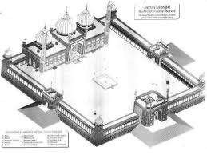
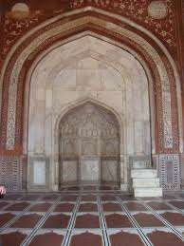
Topography of Delhi Jama Masjid
Mihrab and Mimber

Slide 11
Tombs or Maqbara
Tomb is a monument constructed for the memory of dead person
Unlike the simplicity of mosques, the tombs always a impressive structure with huge beautification eg: Taj Mahal
The tomb consists the tomb chamber, whose center is the cenotaph
The mortuary locates in the underground
This entire building covered with a dome (Gumbad)
The tomb of a Muslim saint is called dargah
In all Islamic buildings, Qur'anic verses inscribed in arches, walls, pillars, domes etc (calligraphy)

Slide 12
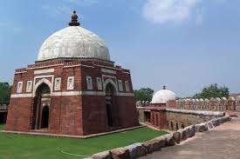
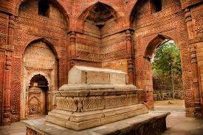
Tomb of Giyazuddin Tughlaq
Grave inside the Tomb

Slide 13
2. Secular Architecture
The secular Architecture built out of the interest and need of a ruler for his comfort and show his power by displaying palaces, gardens, forts, etc
It include wide range of buildings
Akbar built his palace at Fatehpur Sikri and Shahjahan (Red Fort) at Shahjahanabad in New delhi.
Like them many sultanate, Mughals and other Muslim rulers built their secular buildings in different part of Indian subcontinent,

Slide 14
THANK YOU

