Slide 1
ANDREAS VESALIUS
Dr.S.VARGHESE JEYARAJ
ASSOCIATE PROFESSOR
Programme: BA HISTORY
Semester: VI
Course Title: History of Science and Technology
Course Code : 17UHIC43/17UHVC43

Slide 2
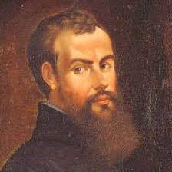
ANDREAS VESALIUS 1514-1564

Slide 3
ANDREAS VESALIUS
Life :
Born : January 1514in Brussels where his father worked as an apothecary to a family know as the Hapsburgs.
He first began his studies in the fields of language and science at the Catholic University located in Lowen and later transferred that later year switched to medicine.
He studied galenal medicine and in 1536 he performed his first public operation in lowen.

Slide 4
ANDREAS VESALIUS
Life continued:
At the age of 23 he became a proffessor for surgery in Padua.
Five years later he produced his infamous work “De Humani Corporis Fabrica ( “On the Fabric of Human Body”)
In 1544 he too became a personal Physician to the Hapsburg
He died on October 10, 1564 on a trip to jerusalem

Slide 5
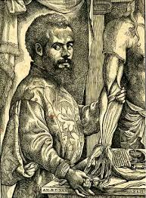
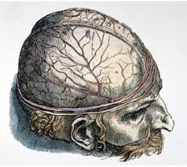
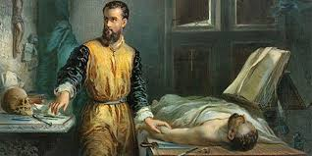
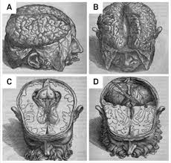
EXPERIMENTS
He used human cadavers to make his outlines of the body instead of animals like many other scientists of the time did.

Slide 6
ACCOMPLISHMENT
In addition to his book hr worked as Physician to Emperor Charles V and to Philip the II of Spain

Slide 7
IMPORTANT WORKS PUBLISHED
The Anatomy of the Human Body
Muscle dissections and observations of Human Body
The Fabrica
The Book is arranged in seven parts

Slide 8
The Fabrica – Seven Parts
Bones And Cartillages
Ligaments and muscles
Veins and Arteries
Nerves
Internal Organs of Digestion and Reproduction
Heart and Lungs
Brain and Sense Organs

Slide 9
ANDREAS VESALIUS
Father of modern Anatomy
Founder of modern Biological Research
The father of Modern Biology
The father of University Science

