Slide 1
NICHOLAUS COPERNICUS
DR.S VARGHESE JEYERAJ
ASSOCIATE PROFESSOR
Programme: BA
Course Title: History of Science and Technology
Course Code: 17UHIC 43/17UHVC43

Slide 2
Nicholaus Copernicus
Polish astronomer
Birth: February 19,1473
Death: May 24, 1543
Place of birth: Tarun, Poland

Slide 3
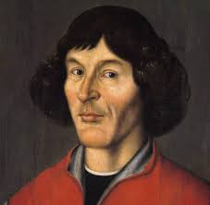
Nicholaus Copernicus

Slide 4
Known for;
Proposing a Heliocentric (sun-centered)model(1500s)for the solar system, in which the sun is stationaryat the center, and Earth and the other planets orbit around it.
Copernican System
Theory of Planet movements;
The theory of Nicholaus Copernicus regarding the mechanics of solar system, which postulates that the Earth and the other planetsrevolve around the sun
This theory challenged the Ptolemaic system of astronomy that had prevailedsince the second century.

Slide 5
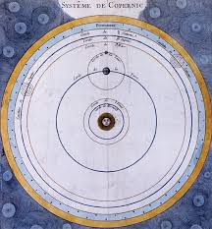
Copernican System:

Slide 6
Heliocentric Plan
Heliocentric plan of Solar System in the first edition of copernicus ‘de revolutionibus
1. Sun m
2. Mercury
3. Venus
4. Earth
5. Mars
6. Jupiter
7. Saturn
8. Celestal Sphere

Slide 7
Career;
1491-1494: Studied mathematics at krakow Academy (now JMagiellonian University)
1496: Went to Italy to study Astronomy and law the university of Balogna
1497:Began observation of the Sun, Moon, and palnets
1514Wrote Commentariolus, an outline of his astronomical ideas, but did not circulate it widely
1543: Published De Revolutionibus orbium coelestium (on the revolutions of the celestial spheres ) which held that earth and the other planets orbit a centrally located sun.

Slide 8
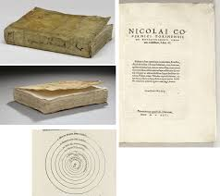
First edition of De Revolutionibus

Slide 9
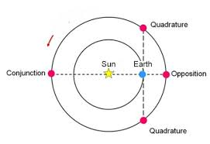
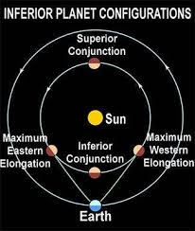
Planetary Configurations
Configurations of an superior planet
Configurations of an inferior planet

