Slide 1
Theory of equations
H. HABEEB RANI
Assistant professor of Mathematics
Department of mathematics
Hajee Karutha Rowther Howdia College

Slide 2
Theory of equation : Any value of x for which the polynomial f(x) vanish is called a root of the equation .i.e,f(x)= 0.
Corallery: If f(a)=0, the polynomial f(x) has the factor
(x-a) ie) Let (a,b) be the root of the equation. F(x)=0. Then (x-a) is a factor of polynomial.

Slide 3
NOTES:
If f(a)& f(b) are of different signs then atleast one root of the equation f(x)=0 must lie between a & b.
If f(a) &f(b) have likes signs then even number of roots of f(x) =0 ,lie between a&b or else there is no root between a,b.
If f(a)&f(b) have unlike signs odd number of roots lie between a&b.

Slide 4
If f(x)=0is an equation of odd degree. It has atleast one real root whose signs is opposite to that of the last term.
If f(x) =0 is of even degree and absolute terms is negative then equation has atleast one positive root and atleast one negative root.
Every equation f(x)=0 of the n^{th} degree has atmost n roots.

Slide 5
In an equation with real Co-efficient Imaginary roots occurs in pairs. In an Equation With Rational CO- EFFICIENT IRRATIONAL ROOTS OCCURS IN PAIRS.

Slide 6
IN AN EQUATION WITH REAL CO-EFFICIENT IMAGINARY ROOTS OCCUR IN PAIRS.
Let the equation be f(x)=0 &
Let α+iβ be one root of an equation f(x)=0,where α and β are real coefficient
then f(α+iβ) =0
we get α-iβ be an another root.

Slide 7
Iin an equation with rational co-efficients irrational roots occurs in pairs .
let the equation be f(x)=0 &
a+√b is a root of the equation . Where a&b are rational.
f(a+√b )=0.
we get a-√b is an another root of the equation .

Slide 8
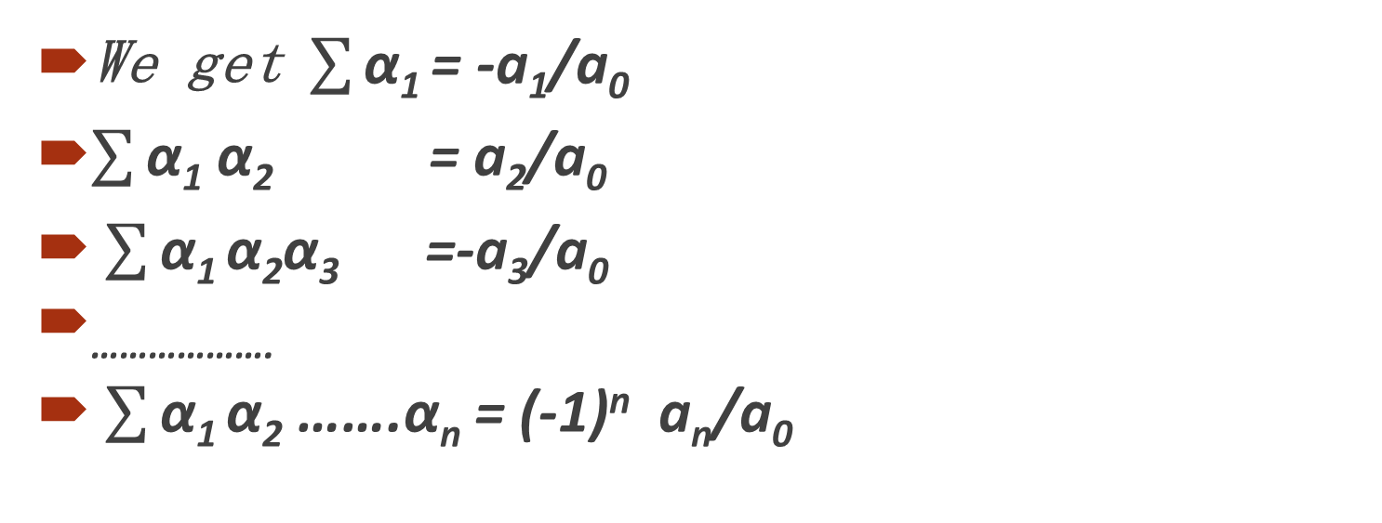
Relation between roots and co- efficient of equation ..
We get $\sum{\text{α}\text{1}}$ = -a₁/a₀
$\sum{\text{α}\text{1}}$ α₂ = a₂/a₀
$\sum{\text{α}\text{1}}$α₂α₃ =-a₃/a₀
……………….
$\sum{\text{α}\text{1}}$α₂ …….α_{n} = (-1)^{n} a_{n}/a₀

Slide 9
The symmetric function of the root.
Let α₁,α₂,α₃,……….α be the root of the equation .
f(x)= x⁴ +p₁ x ^{n-1} +p₂ x ^{n-2} +…….. +p_{n} =0.
we have larn that S₁ =£α₁ =-P₁
S₂ =£α1α2=P2
S₃=£α1α2α₃=-P₃………….
……………… etc…

Slide 10
THANK YOU…….

