Slide 1
GRAPH THEORY Dr.P.ANITHA Assistant Professor Department of Mathematics III-B.Sc Mathematics

Slide 2
Definition: A graph G is said to tree if it is connected and acyclic
GRAPH THEORY
Graph theory
Trees, planar and matchins

Slide 3
Theorem: Let G be a graph with n nodes and e edges
The following are equivalent:
1. G is a tree (connected, acyclic)
2. Every two nodes of G are joined by a unique path
3. G is connected and n = e + 1
4. G is acyclic and n = e + 1
5. G is acyclic and if any two non-adjacent points are joined by a line, the resulting graph has exactly one cycle

Slide 4
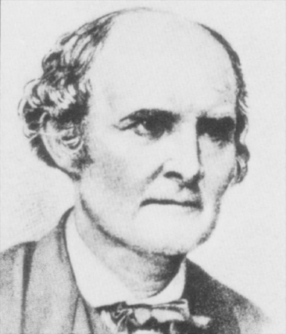
Cayley’s Formula
The number of labeled trees on n nodes is n^{n-2}

Slide 5
A graph is planar if
it can be drawn in the plane without crossing edges

Slide 6
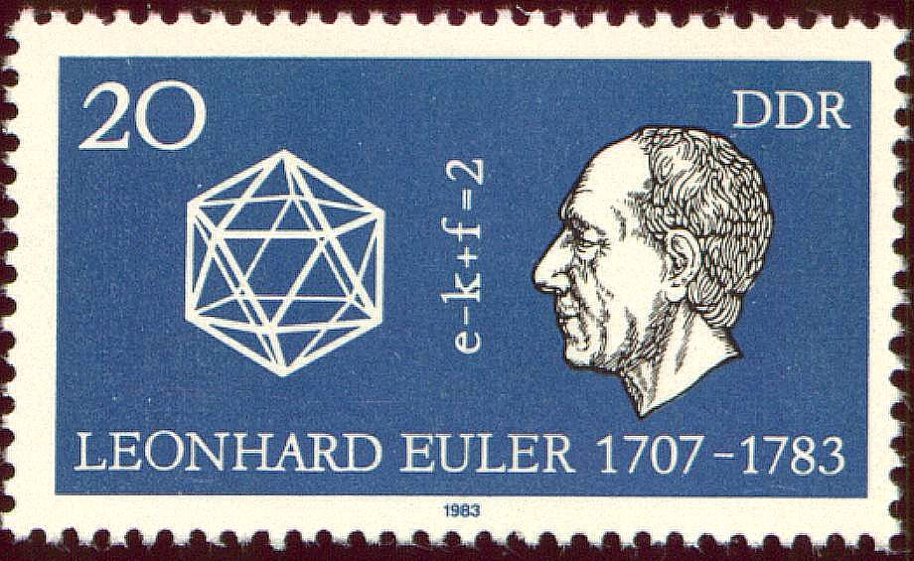
Euler’s Formula
If G is a connected planar graph with n vertices, e edges and f faces, then n – e + f = 2

Slide 7
Graph Coloring
A coloring of a graph is an assignment of a color to each vertex such that no neighboring vertices have the same color

Slide 8
Spanning Trees
A spanning tree of a graph G is a tree that touches every node of G and uses only edges from G
Every connected graph has a spanning tree

Slide 9
Finding Optimal Trees
Trees have many nice properties (uniqueness of paths, no cycles, etc.)
We may want to compute the “best” tree approximation to a graph
If all we care about is communication, then a tree may be enough. We want a tree with smallest communication link costs

Slide 10
Finding Optimal Trees
Problem: Find a minimum spanning tree, that is, a tree that has a node for every node in the graph, such that the sum of the edge weights is minimum

Slide 11
Tree Approximations
7
8
4
5
9
7
6
8
9
11

Slide 12
Finding an MST: Kruskal’s Algorithm
Create a forest where each node is a separate tree
Make a sorted list of edges S
While S is non-empty:
Remove an edge with minimal weight
If it connects two different trees, add the edge. Otherwise discard it.

Slide 13
Applying the Algorithm
7
4
1
5
9
8
9
10
7
3

Slide 14
Analyzing the Algorithm
The algorithm outputs a spanning tree T.
Suppose that it’s not minimal. (For simplicity, assume all edge weights in graph are distinct)
Let M be a minimum spanning tree.
Let e be the first edge chosen by the algorithm that is not in M.
If we add e to M, it creates a cycle. Since this cycle isn’t fully contained in T, it has an edge f not in T.
N = M+e-f is another spanning tree.

Slide 15
Analyzing the Algorithm
N = M+e-f is another spanning tree.
Claim: e < f, and therefore N < M
Suppose not: e > f
Then f would have been visited before e by the algorithm, but not added, because adding it would have formed a cycle.
But all of these cycle edges are also edges of M, since e was the first edge not in M. This contradicts the assumption M is a tree.

Slide 16
Greed is Good (In this case…)
The greedy algorithm, by adding the least costly edges in each stage, succeeds in finding an MST
But — in math and life — if pushed too far, the greedy approach can lead to bad results.

Slide 17
TSP: Traveling Salesman Problem
Given a number of cities and the costs of traveling from any city to any other city, what is the cheapest round-trip route that visits each city exactly once and then returns to the starting city?

Slide 18
TSP from Trees
We can use an MST to derive a TSP tour that is no more expensive than twice the optimal tour.
Idea: walk “around” the MST and take shortcuts if a node has already been visited.
We assume that all pairs of nodes are connected, and edge weights satisfy the triangle inequality d(x,y) ≤ d(x,z) + d(z,y)

Slide 19
Tours from Trees
Shortcuts only decrease the cost, so
Cost(Greedy Tour) ≤ 2 Cost(MST)
≤ 2 Cost(Optimal Tour)
This is a 2-competitive algorithm

Slide 20
Bipartite Graph
A graph is bipartite if the nodes can be partitioned into two sets V₁ and V₂ such that all edges go only between V₁ and V₂ (no edges go from V₁ to V₁ or from V₂ to V₂)

Slide 21
Dancing Partners
A group of 100 boys and girls attend a dance. Every boy knows 5 girls, and every girl knows 5 boys. Can they be matched into dance partners so that each pair knows each other?

Slide 22
Dancing Partners

Slide 23
Perfect Matchings
Theorem: If every node in a bipartite graph has the same degree d ≥ 1, then the graph has a perfect matching.
Note: if degrees are the same then |A| = |B|, where A is the set of nodes “on the left” and B is the set of nodes “on the right”

Slide 24
A Matter of Degree
Claim: If degrees are the same then |A| = |B|
Proof:
If there are m boys, there are md edges
If there are n girls, there are nd edges

Slide 25
The Marriage Theorem
Theorem: A bipartite graph has a perfect matching if and only if |A| = |B| = n and for all k ∈ [1,n]: for any subset of k nodes of A there are at least k nodes of B that are connected to at least one of them.

Slide 26
The Marriage Theorem
For any subset of (say) k nodes of A there are at least k nodes of B that are connected to at least one of them
The condition fails for this graph

Slide 27
The Feeling is Mutual
At least k
k
At most n-k
n-k
The condition of the theorem still holds if we swap the roles of A and B: If we pick any k nodes in B, they are connected to at least k nodes in A

Slide 28
Proof of Marriage Theorem
Call a bipartite graph “matchable” if it has the same number of nodes on left and right, and any k nodes on the left are connected to at least k on the right
Strategy: Break up the graph into two matchable parts, and recursively partition each of these into two matchable parts, etc., until each part has only two nodes

Slide 29
Proof of Marriage Theorem
Select two nodes a ∈ A and b ∈ B connected by an edge
Idea: Take G₁ = (a,b) and G₂ = everything else
Problem: G₂ need not be matchable. There could be a set of k nodes that has only k-1 neighbors.

Slide 30
Proof of Marriage Theorem
The only way this could fail is if one of the missing nodes is b
a
b
k-1
k
Add this in to form G₁, and take G₂ to be everything else.
This is a matchable partition!

Slide 31
Generalized Marriage: Hall’s Theorem
Let S = {S₁, S₂, …} be a set of finite subsets that satisfies: For any subset T = {T_{i}} of S, | UT_{i} | ≥ |T|. Thus, any k subsets contain at least k elements
Then we can choose an element x_{i} ∈ S_{i} from each S_{i} so that {x₁, x₂, …} are all distinct

Slide 32
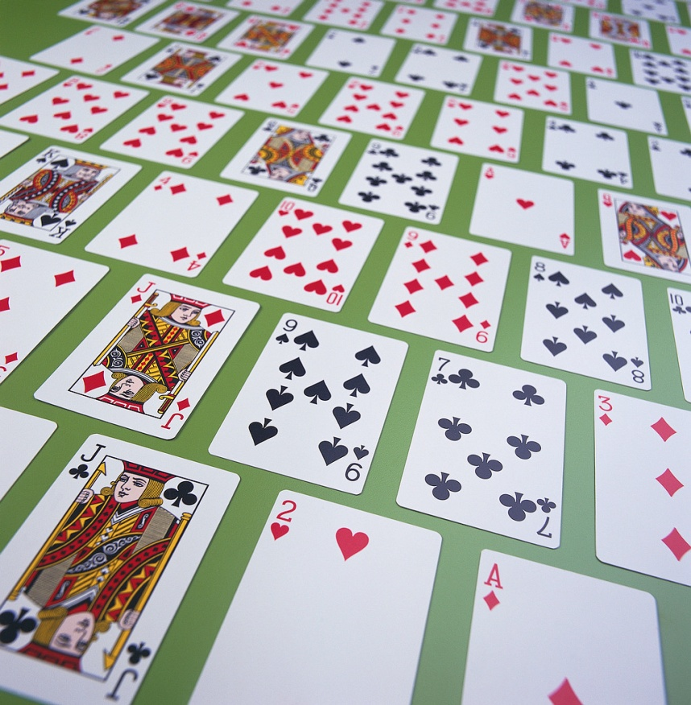
Example
Suppose that a standard deck of cards is dealt into 13 piles of 4 cards each
Then it is possible to select a card from each pile so that the 13 chosen cards contain exactly one card of each rank

Slide 33
Minimum Spanning Tree
- Definition
Kruskal’s Algorithm
- Definition
- Proof of Correctness
Traveling Salesman Problem
- Definition
- Using MST to get an
approximate solution
The Marriage Theorem
Here’s What You Need to Know…

Slide 34
Text book: GRAPH THEORY -S.Arumugam &S.Ravichandran
Reference book:Graph theory—S.Kumaravelu and Susheela Kumaravelu

