Slide 1
Insulin Production
Unit IV
Under topic: Production of Insulin
Subject Name: Recombinant DNA Technology
Subject Code: 17UMBC61
Semester : III
Programme : B. Sc. Microbiology
Dr. A Sajith Ahamed
Assistant Professor
Department of Microbiology
H.K.R.H. College

Slide 2
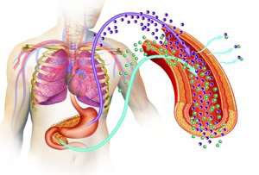
Functions of Insulin
Is a polypeptide hormone produced by the β cells of the islets of Langerhans in the pancreas
Its main function is enabling the cells to take up glucose ( providing it with energy it needs).
It is required for normal glucose homeostasis.

Slide 3
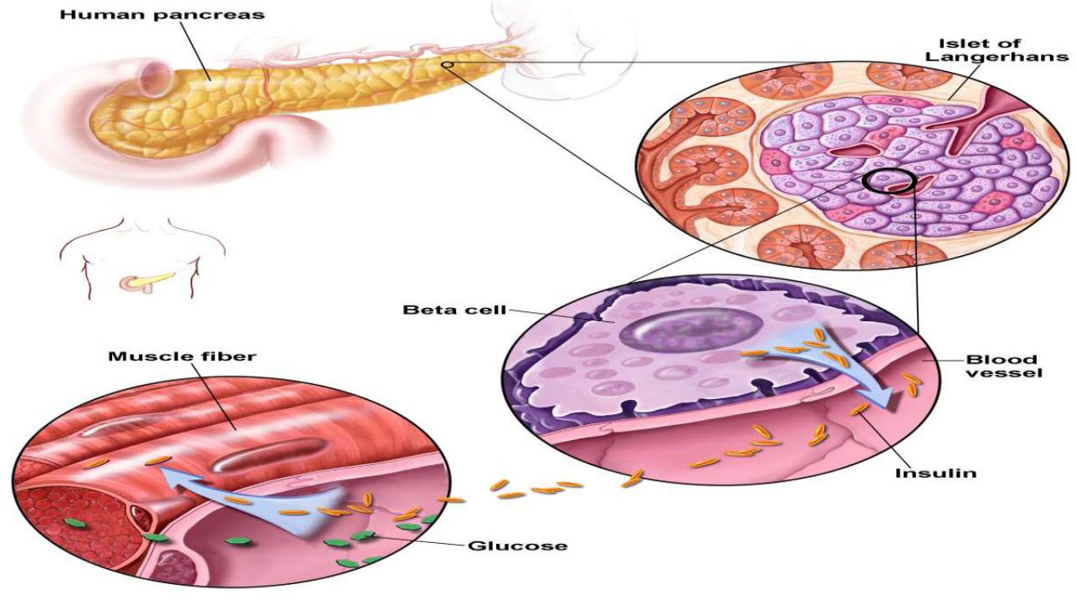
Functions of Insulin

Slide 4
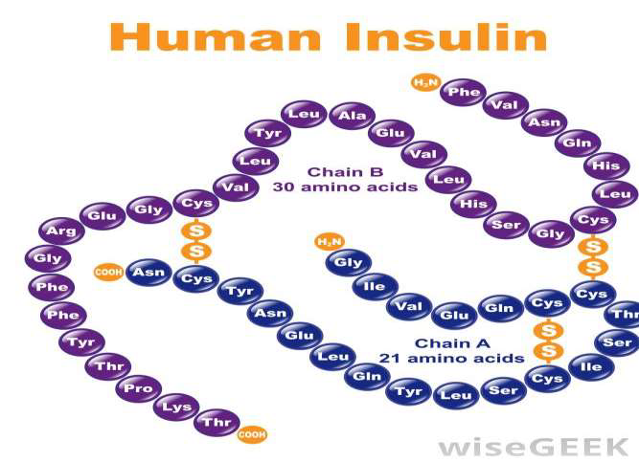
The Structure Of Insulin
Insulin is composed of two peptide chains referred to as the α chain and β chain.
α and βchains are linked together by two disulfide bonds, and an additional disulfide is formed within the α chain.
α chain consists of 21 amino acids and the β chain of 30 amino acids.

Slide 6
Fermentative insulin production

Slide 7
Fermentative insulin production

Slide 8
Pro-insulin method

Slide 9
Conversion of porcine insulin into H- insulin

