Slide 1
EXCRETIVE SYSTEM Subject Name: GENERAL BIOLOGY Subject Code: 17UMBA31 SHOBIYA BANU.A Assistant Professor Department of Microbiology H.K.R.H. CoLLEGE

Slide 2
EXCRETIVE SYSTEM
Excretion may be defined as the separation and elimination of nitrogenous metabolic waste from the body.
The wastes eliminated are called excretory products.
They have three types
1. Kidney of man
2. Nephron
3. Formation of urine

Slide 4
KIDNEY OF MAN
Man has two kidney, they are located at the abdomen one on either side of the verteble column.
Two kidneys not located at same level,
Right kidney is slightly lower than the left one,
It is bean shaped structure,
Kidney is the peripheral portion appears dark reddish brown and central portion appears light red.
Each kidney contains 10 to 15 pyramids,
Each pyramid has thousands of tubules called uriniferous tubules.

Slide 5
Nephron
Nephron consists of a twisted tubules closed at one end, open at the other end.
Each kidney of man is formed of about one million Nephron.
Each nephron is a coiled tube length of 3cm, total length of nephroi about 65cm.
One end of the Nephron is formed of Bowman’s capsule.
Henley's loop has three regions
Descending limb
Thin segment
Ascending limb

Slide 6
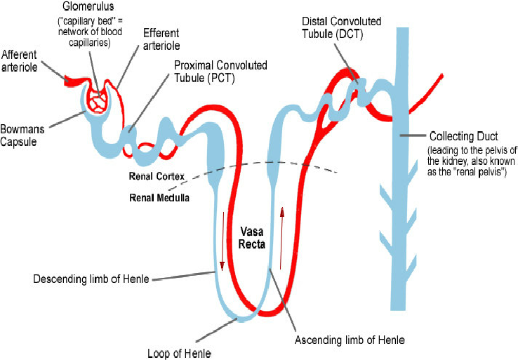

Slide 7
FORMATION OF URINE
Urine is the excretory fluids by the kidney
Involves three steps
1.Ultrafiltration
2. Reabsorption
3.Secretion
Ultrafiltration
The staining of blood by the molpighian corpuscles, blood and capillary space of the bowman’s capsule.
Bowman capsules + glomerular Malpighian corpuscle
Blood in 24 hours 180 liters of glomerular filtrate is formed.

Slide 8
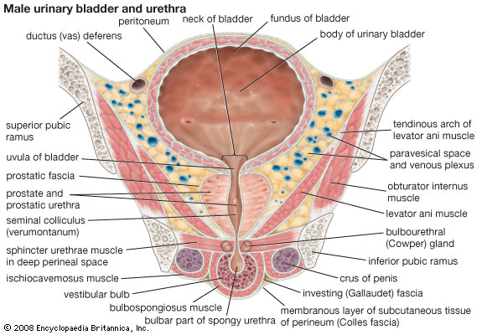

Slide 9
REABSORPTION
Every day about 180 liters glomerular filtrate are formed. Normal man excretes only 1 to 2.5 liters of urine.
Blood by the capillary network enveloping the uriniferous tubules.
180 liters of glomerular filtrate about 178 or 179 liter are reabsorption.

Slide 10
SECRETION
Secretion is the release of unwanted materials from the blood into the nephron.
Urine secretes the urinary tubules,
K+ &H+ irons secreted by convoluted tubules,
Creatinine and phosphate are other substance secreted.

Slide 11
THANKING YOU

