Slide 1
RIBOSOMES
Subject Name: CELLBIOLOGY Subject Code: 17UMBA41 SHOBIYA BANU.A Assistant Professor Department of Microbiology H.K.R.H. CoLLEGE

Slide 2
RIBOSOMES
Ribosome is protein synthesis there are ribonucleo-protein
Ribosomes were observed by claude in the year of 1941 and he was named in microsomes. The palade was observed in 1955 was named in ribosomes.
STRUCTURE OF RIBOSOMES
Ribosomes are spherical in shape of prokaryotes are smaller in size of 150A^{O} and eukaryotes are large in size of 250A^{O} diameter.

Slide 3
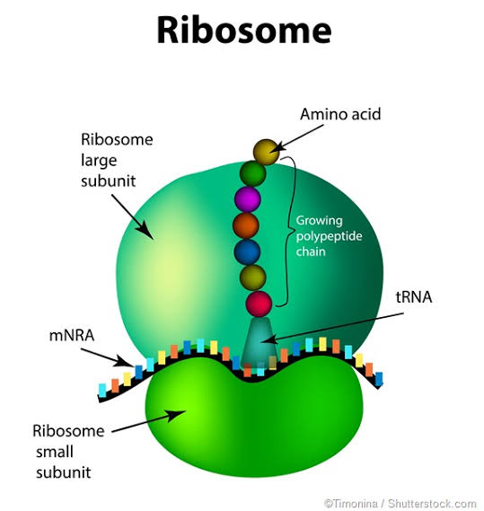

Slide 4
TWO SUB-UNITS
Large sub-unit
Small sub-unit
LARGE SUB-UNIT
Spherical structure, the 3 convex is side and concave is bottom.
The body of subunit is base and large protuberance is one side of the rim in lower surface on either side of the protuberance is depression.
The large subunit constitutes exit domain of ribosomes binds with cell membrane.
mRNA binding domain in cancave upper surface of small subunit
The peptidyl transferase in large subunit connecting the A site and P site.

Slide 5
SMALL SUB-UNIT
Asymmetrical structure, lower surface is convex into head and base, the upper surface is cancave into cleft.
Sub-unit separately in cytoplasm, ribosomes line is join an mRNA chain.
Ribosomes is string of polyribosome (or) polysome.
Small sub-unit holds the mRNA during protein synthesis.

Slide 6
Ribosomes has 3 binding sites
A site tRNA containing activated amino acid
P site tRNA containing polypeptide chain
E site tRNA released into the cytosol.
Eukaryote has two sites A site, P site and E site is being absent.

Slide 7
TWO TYPES OF RIBOSMES
70s ribosomes
80s ribosomes
70s RIBOSOMES
It is prokaryotic cell and smaller in size, ribosomes molecular weight 3x 10⁶ daltons.
Ribosomes are composed of rRNA and proteins.
70s ribosomes is two sub-unit, large 50s and small 30s ribosomes
50s sub-unit composed – 23s rRNA, 5s rRNA and 30 different proteins
30s sub-unit composed – 16s rRNA and 20 different proteins.

Slide 8
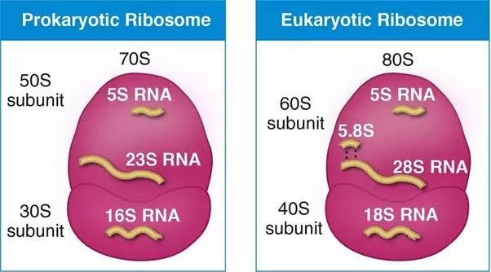

Slide 9
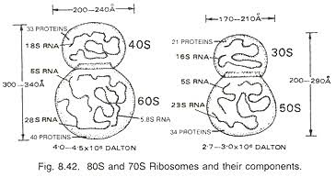

Slide 10
80s RIBOSOMES
It is eukaryotes cell and large in size, ribosomes, molecular weight 5x 10⁶ daltons.
80s ribosomes is two sub-unit, large 60s and small 40s ribosomes.
60s sub-unit composed – 5s rRNA, 5.8s rRNA, 28s rRNA and 50 different proteins.
30s sub-unit composed – 18s rRNA and 30 different proteins.

Slide 11
FUNCTION OF RIBOSOMES
Ribosomes are 8 functions
Protein synthesis
Decoding of mRNA
Acceptance of correct Amino Acyl tRNA
Peptide bond formation
Translocation of peptidyl tRNA
Translocation of deacylated tRNA
Exit of deacylated tRNA
Protection

Slide 12
PROTEIN SYNTHESIS
Two subunit join together mRNA, ribosomes attached mRNA to form polyribosome contain binding sites for the attachment of tRNA activated amino acid,
tRNA contain peptide chain, the ribosomes move to mRNA.
mRNA translated and peptide chain by the addition of correct amino acids one by one.
DECODING OF mRNA
Ribosomes and translates the code present in the mRNA assembles the amino acid, the sequence of nucleotide in the mRNA. The 30s subunit involved in decoding.

Slide 13
ACCEPTANCE OF CORRECT AMINO ACYL tRNA
Dioxin protein synthesis to allow the ribosomes.
Amino acyl tRNA attached to the A site.
PEPTIDE BOND FORMATION
Protein synthesis, ribosomes links the amino acid by peptide bonds.
50s subunit helps in peptide bond formation.

Slide 14
TRANSLOCATION OD PEPTIDYL tRNA
30s and 50s subunits are involved in translocation.
Peptidyl tRNA shifted from A site to P site.
TRANSLOCATION OF DEACYLATED tRNA
30s and 50s subunits are involved in translocation.
Deacylated tRNA shifted from P site to E site.

Slide 15
EXIT OF DEACYLATED tRNA
Deacylated tRNA is removed from E site.
PROTECTION
mRNA passing through the ribosomes protected from nuclease similar newly synthesized polypeptide chains are protected from proteases.

Slide 16
THANKING YOU

