Slide 1
ENTITY RELATIONSHIP MODEL
BY
A.PEERMOHAMED MCA.,SET
ASST. PROF OF INFORMATION TECHNOLOGY
HAJEE KARUTHA ROWTHER HOWDIA COLLEGE UTHAMAPALAYAM.

Slide 2
CONTENT
E-R model
Example
Components:
Entity
Attribute
Relationship

Slide 3
E-R MODEL
Entity relationship model also called e-r model and it is a high level model.
This model is used to define the data elements and relationship for a specified system.
It develops a conceptual design for the database. It also develops a very simple and easy to design view of data.
In ER modeling, the database structure is portrayed as a diagram called an entity-relationship diagram.

Slide 4
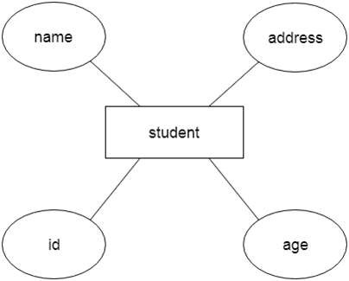
EXAMPLE -

Slide 5
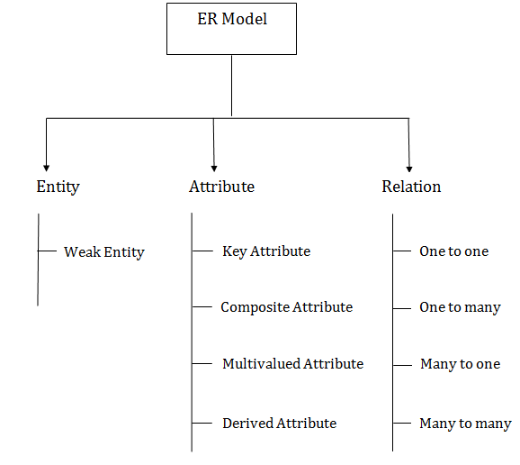
Component of ER- Diagram

Slide 6
Entity -
An entity may be any object, class, person or place.
In the ER diagram, an entity can be represented as rectangles.

Slide 7
Weak Entity
An entity that depends on another entity called a weak entity.
The weak entity doesn't contain any key attribute of its own.
The weak entity is represented by a double rectangle.

Slide 8
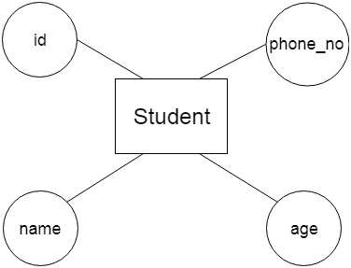
Attribute -
The attribute is used to describe the property of an entity.
For example - id, age, contact number, name, etc. can be attributes of a student.

Slide 9
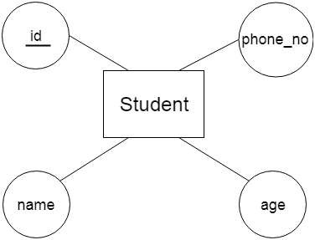
Key Attribute
The key attribute is used to represent the main characteristics of an entity.
It represents a primary key.
The key attribute is represented by an oval shape with the text underlined.

Slide 10
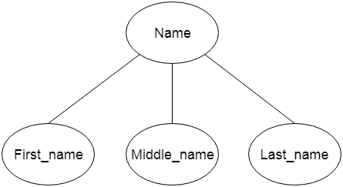
Composite Attribute
An attribute that composed of many other attributes is known as a composite attribute.

Slide 11
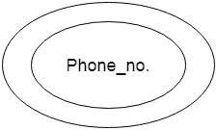
Multivalued Attribute
An attribute can have more than one value.
These attributes are known as a multivalued attribute.
The double oval is used to represent multivalued attribute.

Slide 12
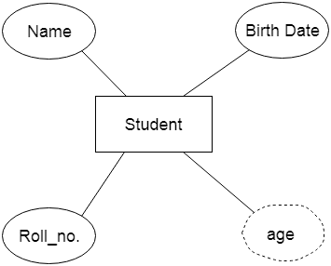
Derived Attribute
An attribute that can be derived from other attribute is known as a derived attribute.
It can be represented by a dashed oval.

Slide 13
Relationship -
A relationship is used to describe the relation between entities.
Diamond shape is used to represent the relationship.
There are two types one is strong relation and second is weak relation.
Strong relationship represented by a single diamond where weak relationship represented by double diamond

Slide 14
Types of relationship
1.One-to-One Relationship
When only one instance of an entity is associated with the relationship, then it is known as one to one relationship.
For example, A female can marry to one male, and a male can marry to one female.

Slide 15
2.One-to-many relationship
When only one instance of the entity on the left, and more than one instance of an entity on the right associates with the relationship then this is known as a one-to-many relationship.
For example, Scientist can invent many inventions, but the invention is done by the only specific scientist.

Slide 16
3.Many-to-one relationship
When more than one instance of the entity on the left, and only one instance of an entity on the right associates with the relationship then it is known as a many-to-one relationship.
For example, Student enrolls for only one course, but a course can have many students.

Slide 17
4.Many-to-many relationship
When more than one instance of the entity on the left, and more than one instance of an entity on the right associates with the relationship then it is known as a many- to-many relationship.
For example, Employee can assign by many projects and project can have many employees.

