Slide 1
INTRODUCTION TO DBMS
BY
A.PEERMOHAMED MCA.,SET
ASST PROF. OF INFORMATION TECHNOLOGY
HAJEE KARUTHA ROWTHER HOWDIA COLLEGE
UTHAMAPALAYAM.

Slide 2
CONTENTS
DEFINITION
DBMS ENVIRONMENT
ADVANTAGES OF DBMS
LIMITATIONS OF DBMS
CHARACTERISTICS OF DATA IN DATABASE
TYPES OF DBMS

Slide 3
DEFINITION
A collection of self-describing and integrated data files
System catalog
Meta data
Data dictionary
Overhead data
Data abstraction

Slide 4
DBMS Environment
Hardware
Client-server architecture
Software
dbms, os, network, application
Data
Schema, subschema, table, attribute
People
Data administrator & database administrator
Database designer: logical & physical
Application programmer
End-user: naive & sophisticated
Procedure
Start, stop, log on, log off, back up, recovery

Slide 5
Advantages of DBMS
Control redundancy
Consistency
Integrity
Security
Concurrency control
Backup & recovery
Data standard
More information
Data sharing & conflict control
Productivity & accessibility
Economy of scale
Maintenance

Slide 6
Limitations of DBMS
Complexity
Size
Cost
Software
Hardware
Conversion
Performance
Vulnerability

Slide 7
CHARACTERISTICS OF DATA IN DATABASE
The data in the database possess several characteristics data in the database are consistent,
integral,
non redundant,
secured,
centrally managed and shared among multiple applications. There are sever advantages of using database approach, such as the following:

Slide 8
Contd..
There are sever advantages of using database approach, such as the following:
Single repository of data is maintained
All users access the data from the same resource
Quick retrieval of data
Reduce application development time
Flexibility in change of database structure
Enforce standardization
Up-to-date information availability
Authorized access security of data
Enforce integrity constraints and business rules
Provide backup and recovery procedure

Slide 9
Types of Database Management Systems
Hierarchical databases
Network databases
Relational databases
Object-oriented databases

Slide 10
Hierarchical databases
In a hierarchical database management system (hierarchical DBMSs) model, data is stored in a parent-children relationship node.
In a hierarchical database, besides actual data, records also contain information about their groups of parent/child relationships.
In a hierarchical database model, data is organized into a tree-like structure.
The data is stored in the form of a collection of fields where each field contains only one value.
The records are linked to each other via links into a parent-children relationship.
In a hierarchical database model, each child record has only one parent.
A parent can have multiple children.
To retrieve a field’s data, we need to traverse through each tree until the record is found.

Slide 11
Contd..

Slide 12
Advantage
A hierarchical database can be accessed and updated rapidly.
As shown in the figure above, its model structure is like a tree and the relationships between records are defined in advance.
This feature is a double-edged sword.

Slide 13
Disadvantage
This type of database structure is that each child in the tree may have only one parent. Relationships or linkages between children are not permitted, even if they make sense from a logical standpoint.
Hierarchical databases are like this in their design.
Adding a new field or record requires that the entire database be redefined.

Slide 14
Network Database
Network database management systems (Network DBMSs) use a network structure to create a relationship between entities.
Network databases are mainly used on large digital computers.
Network databases are hierarchical databases, but unlike hierarchical databases where one node can have a single parent only, a network node can have a relationship with multiple entities.
A network database looks more like a cobweb or interconnected network of records.
In network databases, children are called members and parents are called occupiers

Slide 15
Advantages
Conceptual simplicity
Capability to handle more relationship types.
Ease of data access
Data integrity
Data independence

Slide 16
Disadvantages
System Complexity
Absence of structural independence.

Slide 17
Relational Databases
In a relational database management system (RDBMS), the relationship between data is relational and data is stored in tabular form of columns and rows.
Each column of a table represents an attribute and each row in a table represents a record.
Each field in a table represents a data value.
Structured Query Language (SQL) is the language used to query RDBMS, including inserting, updating, deleting, and searching records.
Relational databases work on each table that has a key field that uniquely indicates each row.
These key fields can be used to connect one table of data to another.

Slide 18
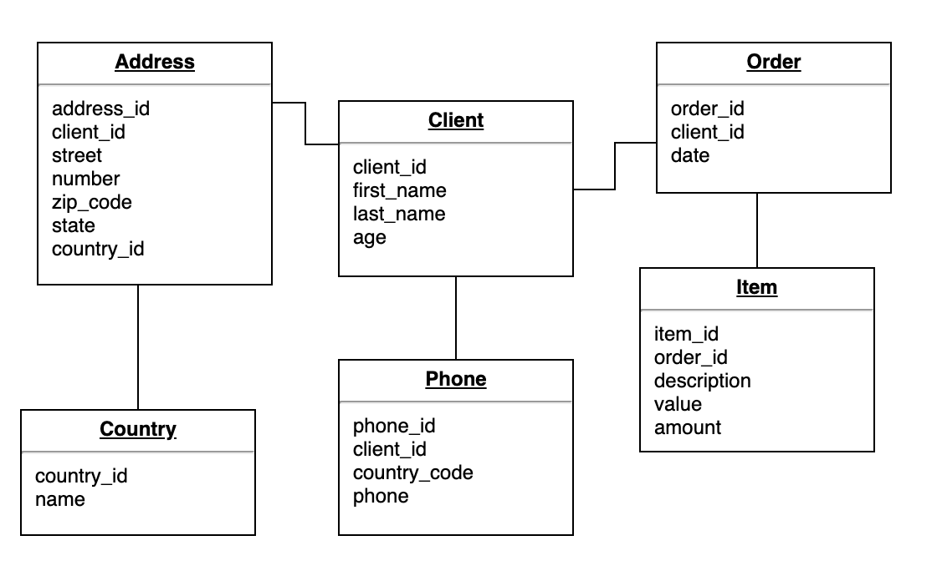
Contd..

Slide 19
Advantages
Relational databases can be used with little or no training.
Database entries can be modified without specifying the entire body

Slide 20
Disadvantages
Hardware overheads.
Ease of design can lead to bad design.
‘Information Island’ phenomenon.

Slide 21
Object-Oriented Model
In this Model, we have to discuss the functionality of object-oriented Programming.
It takes more than the storage of programming language objects.
Object DBMS's increase in the semantics of C++ and Java.
It provides full-featured database programming capabilities while containing native language compatibility.
It adds the database functionality to object programming languages.
This approach is analogical of the application and database development into a constant data model and language environment.
Applications require less code, use more natural data modeling, and code bases are easier to maintain. Object developers can write complete database applications with a decent amount of additional effort.

Slide 22
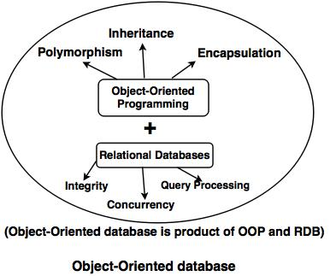
Contd..

Slide 23
Advantages
Capability to handle large numbers of different data types.
Marriage of object oriented and database technology.
Object oriented improves productivity-inheritance.
Data Acess

Slide 24
Disadvantages
Difficult to Maintain
Not suited for all applications.

Slide 25
THANK YOU

