Slide 1
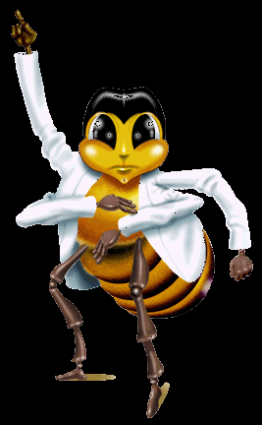
Part – II Behaviour of honey bees
Dr.M.Mohamed Meeran
HOD of Zoology

Slide 2
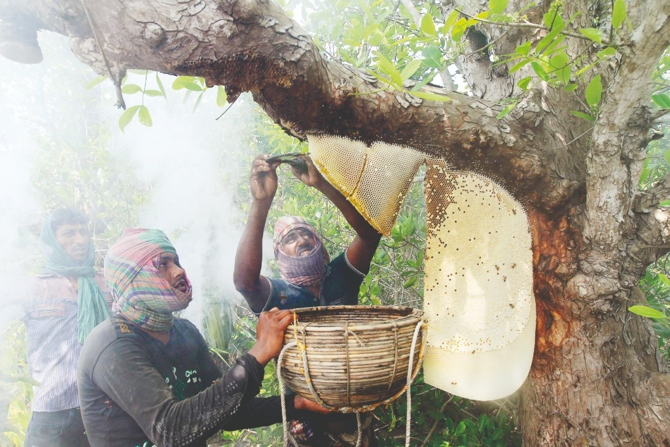
What is Bonphool?
It is the wild honey collected from Sunderbans forest of West Bengal in the month of June every year. The honey collectors are called Maulis and risk their life in front of Sunderbans tigers……

Slide 3
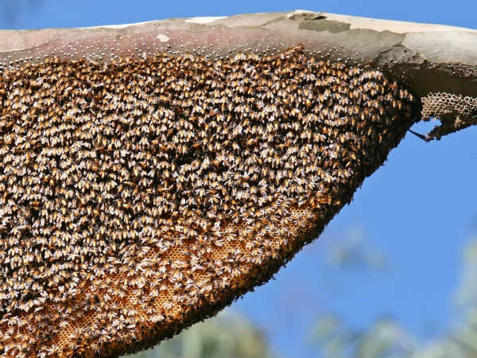
Structure of bee hive

Slide 4
Division of labour among the Workers…..
Worker bees are the smallest in the hive but majority in number.
Live up to 60 days and work in the hive for 21 days after emerging from the eggs
Their functions are to collect honey, look after young-ones, to clean comb, to defend the hive, and to maintain the temperature of the hive.
Depending on the work they do, they are also known as Nursery bees, Builders, Repairers, Foragers, Scout, Cleaners and Fanners.

Slide 5
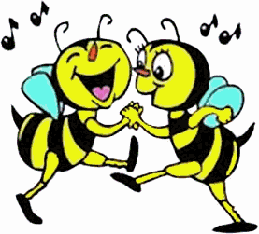
Bee dance
In 1973, the Austrian scientist Karl von Frisch was awarded the Nobel Prize for his research on the honey bee waggle dance
He recognized how this unique form of communication allowed bees to share information on the location of food sources with nest-mates.
The dance, performed by a honey bee upon returning to the colony having successfully located a food source,
offers information on the presence, odor,
quality,
direction,
and distance of said food source, enabling nest-mates to exploit it.

Slide 6
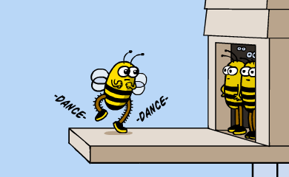
Quality of bee dance
The recruitment of foragers from a hive begins when a scout bee returns to the hive with nectar from a newly found nectar source.
If the nectar source is of excellent quality, nearly all foragers will dance enthusiastically and at length each time they return from foraging.
Food sources of lower quality will produce fewer, shorter, and less vigorous dances; recruiting fewer new foragers.
Types – Round and Waggle dance

Slide 7
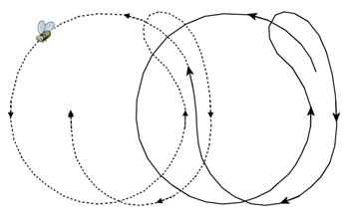
The Round Dance
The round dance is used for food sources 25-100 meters away from the hive or closer.
The round dance does not give directional information.
Bees watching the dance detect fragrance of the flower left on the dancing bee.
Additionally, the scout bee leaves odor from its scent gland on the flower that helps guide the recruits.

Slide 8
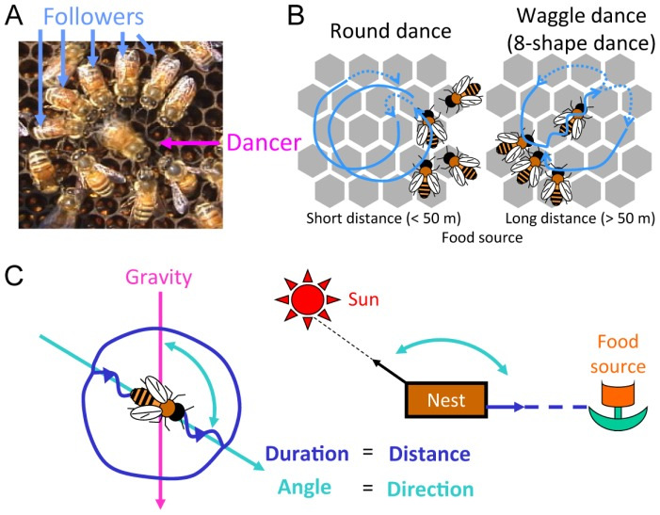
The Waggle Dance
As the food source becomes more distant the round dance is replaced by the waggle dance.
The waggle dance includes information about the direction and energy required to fly to the goal.
Energy expenditure (or distance) is indicated by the length of time it takes to make one circuit.

Slide 9
Nuptial flight
Nuptial flight is an important phase in the reproduction of most ant, termite, and some bee species.
During the flight, virgin queens mate with males and then land to start a new colony, or, in the case of honey bees, continue the succession of an existing hived colony.

Slide 10
The queen then releases pheromones to attract males. However, the queens often try to escape the drones, allowing only the fastest and the fittest males to mate.
A male drone will mount the queen and insert his endophallus (structure playing a major role in copulation).
All the sperms are stored in queens body in spermatheca and lay eggs (fertilized as well as unfertilized) throughout her lifetime.

Slide 11
Swarming
“Honey Bee Swarms are Common but Not Dangerous”
- Donald Lewis
Swarming is a natural process in the life of a honey bee colony.
Swarming occurs when a large group of honey bees leaves an established colony and flies off to establish a new colony, essentially creating two from one.
Swarming is a natural method of propagation that occurs in response to crowding within the colony.
Swarming usually occurs in late spring and early summer and begins in the warmer hours of the day.

Slide 12
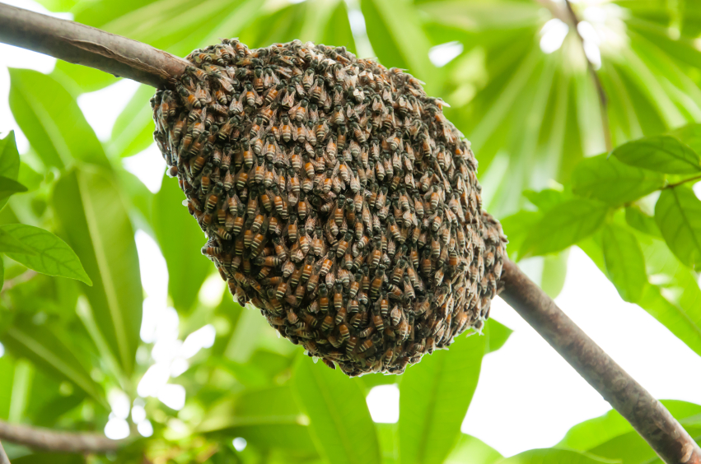
Honey bee swarms may contain several hundred to several thousand worker bees, a few drones and one queen. Swarming bees fly around briefly and then cluster on a tree limb, shrub or other object.
Clusters usually remain stationary for an hour to a few days, depending on weather and the time needed to find a new nest site by scouting bees.
When a suitable location for the new colony, such as a hollow tree, is found the cluster breaks up and flies to it.

Slide 13
Swarm control
Swarming can be prevented by clipping off special queen brood cells as they are constructed, since a colony does not send out a swarm unless a new queen is ready to take the place of the reigning queen.
There are a few other methods of swarm control
(a) Primary swarm is allowed to take place but trapped in a swarm trap and hived as a separate colony. The after-swarms are prevented by destroying the remaining queen brood cells

Slide 14
(b) One or two brood combs in the strong colonies which are inclined to issue swarms are removed and given to weak colonies.
Detecting of Swarming
During early winter, the queen increases drone production by laying unfertilized eggs. This is in preparation of colony swarming.
Workers are also likely to prepare to rear a new queen. A few early stage larvae are fed a special food called royal jelly and their cells are enlarged to accommodate the larger queen.

Slide 15
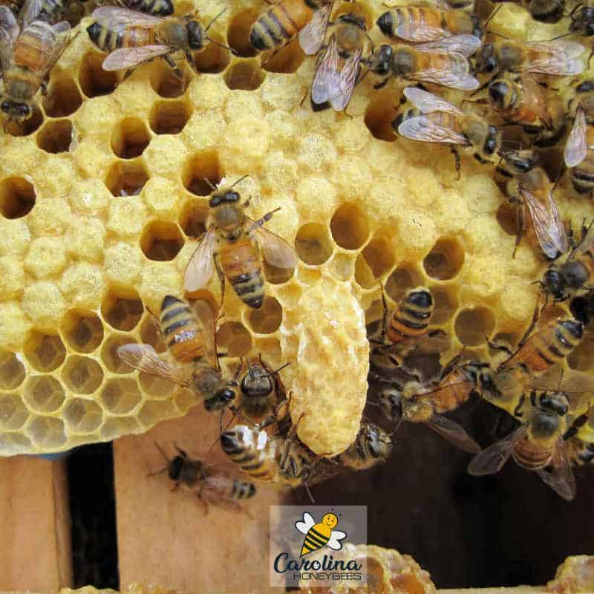
Supersedure
Supersedure is the term used by beekeepers to describe the replacement of an old queen by her daughter.
Natural supersedure usually occurs at the end of the summer or early autumn
The new queen that emerges from the cell will take over from, or supersede, the old queen.

Slide 16
Thank you

