Slide 1
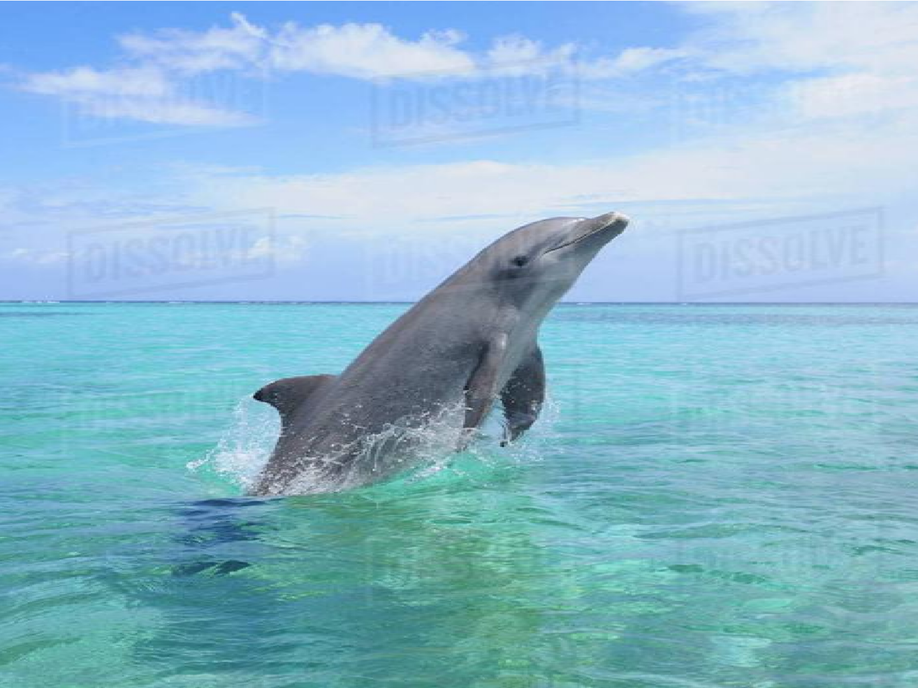




Aquatic mammals & their adaptations
Dr. M. ASHIQ UR RAHMAN
Assistant Professor of Zoology
Hajee Karutha Rowther Howdia College
Uthamapalayam – 625 533 (Theni Dist.)
Email: ashique.md@gmail.com

Slide 2







Aquatic Mammals
Mammals are primarily terrestrial animals, but some of them have wonderfully adapted their secondary aquatic life.
So based on the relation to water and the aquatic adaptations, mammals are classified in to two group:
  Entirely/Completely aquatic mammals
  Semi-aquatic or amphibious mammals
They either live in fresh water or salt water.

Slide 3

Entirely/Completely aquatic mammals: Aquatic mammals include species that live their entire live in the water and depend on it for survival, such as whales, dolphins or manatees etc. They never come to land and are completely reside in water.
Semi-aquatic or amphibious mammals:
  There are some mammals reside their live in both terrestrial and aquatic environments called semi- auqatic animals/Amphibious mammals, like seals, otters, and hippopotamuses etc.
  The semi-aqatic mammals spend the majority of their time in the water (for food and shelter), but need to return to the land for important activities such as mating, breeding and molting.

Slide 4


Adaptation and Modification in aquatic mammals
Completely aquatic mammals
Group | Example
Cetacea | Whales , dolphins , porpoises
Sirenia | Dugongs , manatees
Note# A great disadvantage of all aquatic mammals is retention of the lung breathing habit

Slide 5


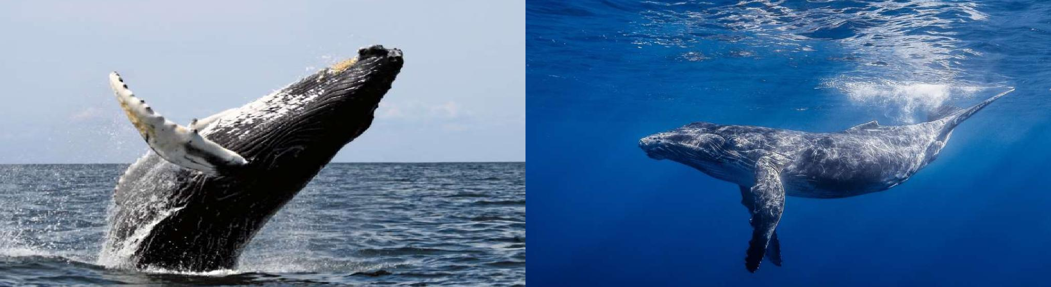

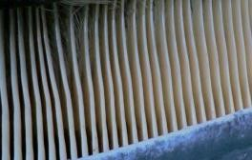
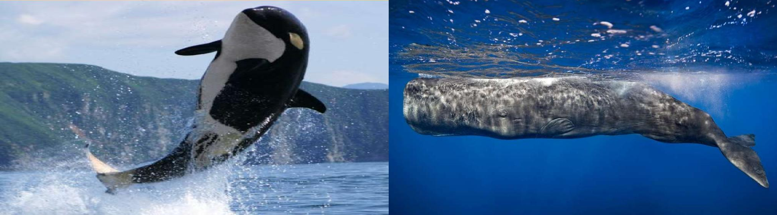
Cetacea (Whale like mammals)
Baleen whale
Blue whale
Baleen Sieve
Killer whale
Sperm whale

Slide 6

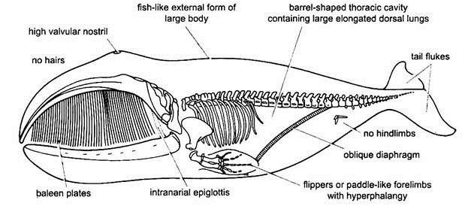
Fig. Body outline structure of the Whale.

Slide 7

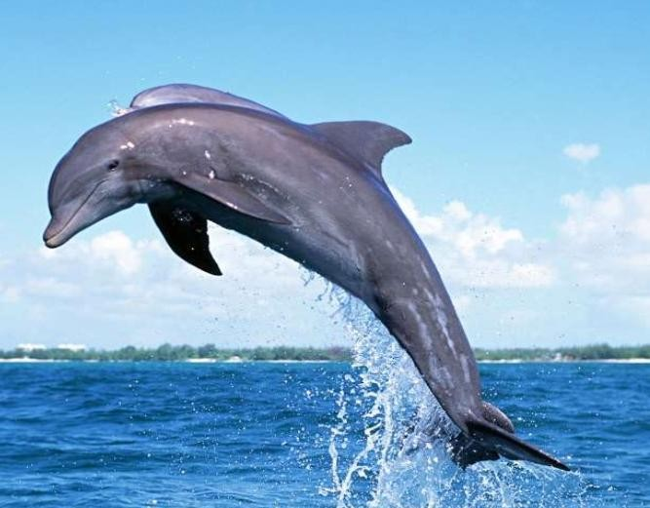
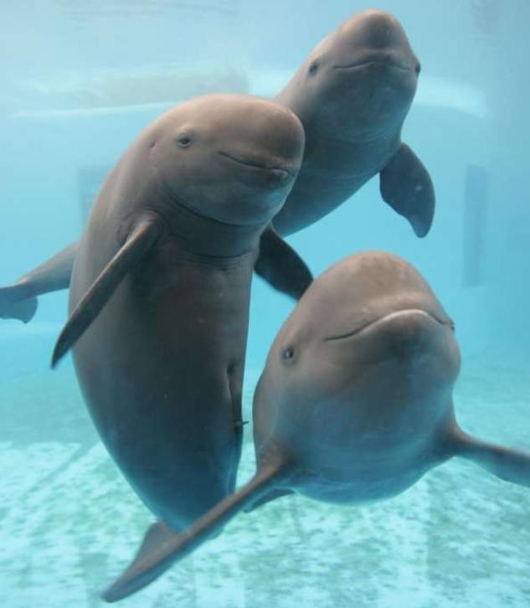
Dolphins
Porpoises

Slide 8
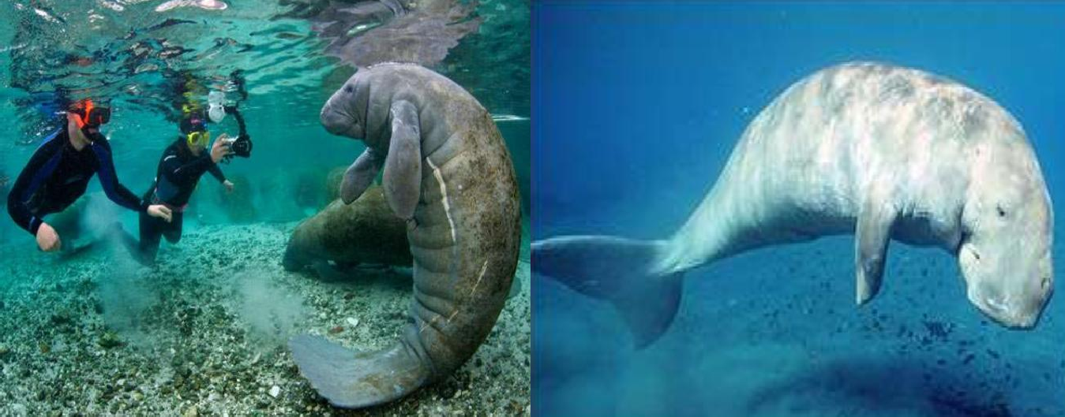
Sirenia(aquatic herbivorous mammals)
Manatees
Dugongs (sea cows)

Slide 9

Semi-aquatic or amphibious mammals
Group | Example
Monotremata | Ornithorhynchus (Platypus)
Marsupialia | Chironectes
Artiodactyla | Hippopotamus
Pinnipidia | Walruses ,otters, seals , sea lions
Rodentia | Beavers , Musk rats

Slide 10

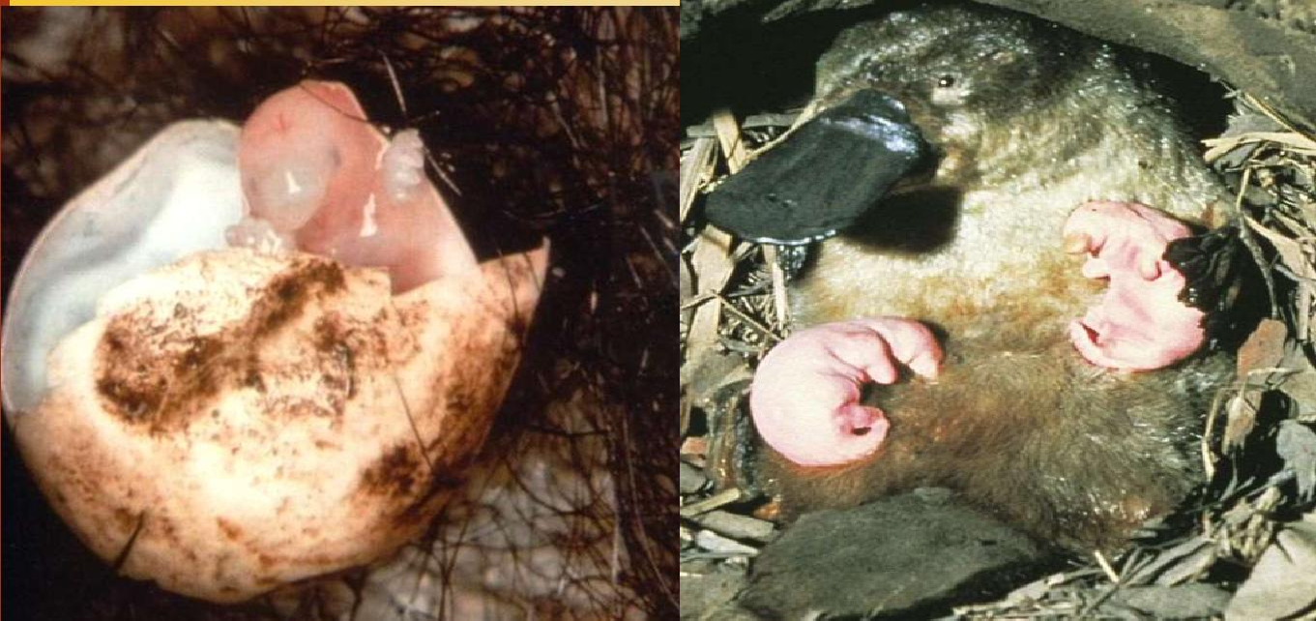
Monotremata (Egg laying mammals Ornithorhynchus): , They also referred as duck- billed platypus, important features are pectoral girdles made of five bones, splayed legs and rudimentary ribs on the neck vertebrae. Both male and female platypuses are born with ankle spurs, only the male's spurs deliver venom.

Slide 11

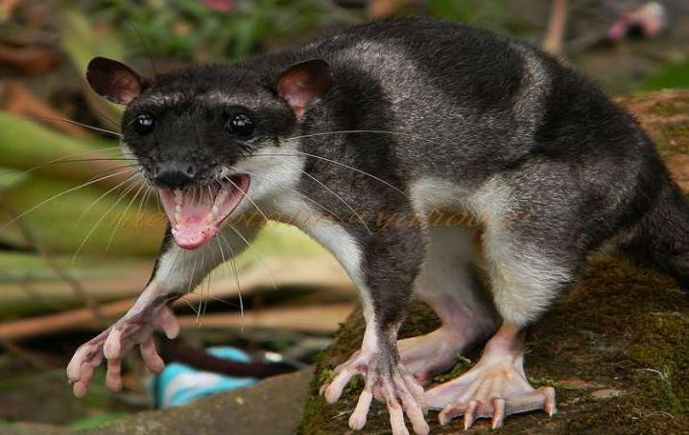
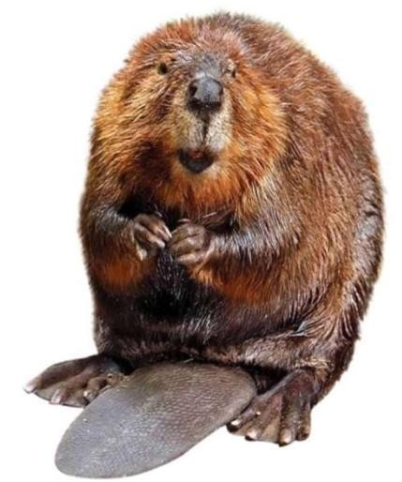
Chironectes (Marsupialia): It is the only living member of its genus.
Beavers (Rodentia): Long incisors that grow continuously.

Slide 12



Important Aquatic adaptations
Modification in Original structure | Characteristics
Body shape | Elongated skull, tapering and stream lined body help in swimming, reduced projecting structure like hind limb, pinnae, scrotum etc.
Integumentory modification | Mainly loss of hair, skin glands & the formation of blubber (fatty layer of adipose tissue, beneath the epidermis –thick coat ), that maintained constant temperature and prevent heat loss. Hair around the mouth (except white whales)
Locomotor adaptation | Origin of flipper (swimming paddles ), Forelimbs are modified into skin covered un jointed flipper , Formation of dorsal fin, tail flukes in cetaceans Hyperdactyly and hyperphalangy (development of extra fingers & extra phalanges )
Respiratory modifications | The nose opening is move to the dorsal side of the head that help animal to inhale atmospheric air ,without raising head, Nostrils are valvular (closed during under water stay), Epiglottis has become tubular, elongated .
Cont^{n}..

Slide 13

Mammary gland | In lactation the mammary duct dilates and acts as storage of milk which is pumped directly into the mouth of the young.
Skeleton Modification | Endoskeleton is lighter by the presence of oil inside bones, Modification of skull bone, Cervical vertebrae are fused (neck region reduced).
Large lungs | Highly elastic & non lobular with high storage capacity, this allow the animal to stay under water for a longer period, High concentration of myoglobin in muscles that help to store oxygen.
Teeth | Teeth are simple, dentition is homodont and monophyodont, In baleen whales teeth are present only embryo.
Digestive System | Mastication is absent in aquatic animal oral cavity, Salivary glands are very much reduced, stomach having chambered & specialized for crushing and digesting the food.

Slide 14




Important points
All kind of skin gland including (Lacrimal) are absent and skin is devoid of muscle and nerve
Thy have foam like substance made up of fat mucus and gas in the middle ear which improve their hearing under water.
Melon: It is a receptor organ present in front of nostril which detect pressure change in water.
Baleen: In some whale the upper jaw develop rows of numerous triangular horny plate called baleen, serve as effective sieve to capture plankton.
Harderian gland – This gland secrete a fatty substance which protect the eye under water.
Nictitating membrane of eye is absent.

Slide 15

References:
Jordan, E.L. and Verma , P.S., Chordate Zoology, S. Chand and Company
Ltd, 1998.
http://www.notesonzoology.com/mammals/aquatic-mammals-and- adaptations-chordata-zoology/8523.

Slide 16



